Slide 1
Telecommunication
By Adhish JS (EC23B1003)

Slide 2
Internship Objectives
Introduction
VSAT Communication
GSM
Radio Communication
Exchange
Network
Scada
Conclusion

Slide 3
Introduction
The internship at ONGC, Cauvery Asset provided practical exposure to communication technologies such as VSAT, GSM, and SCADA systems. This experience bridged the gap between theoretical knowledge and real-world applications in the oil and gas industry, enhancing skills in monitoring and control technologies essential for industrial processes.

Slide 4
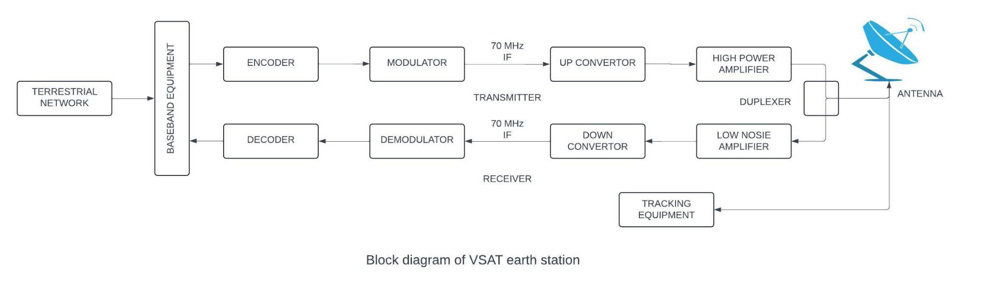
VSAT (Very Small Aperture Terminal)
In 1980,Pradman Kaul, president of Hughes, created the two-way Ku-band VSAT.
VSAT communication used to transmit/receive data, voice and video signals over a satellite communication network.
VSAT systems can operate using various industry frequencies such as C-Band, Ku-Band, KaBand and X-Band. ONGC uses C-Band with 4 GHz for downlink and 6 GHz for uplink.

Slide 5
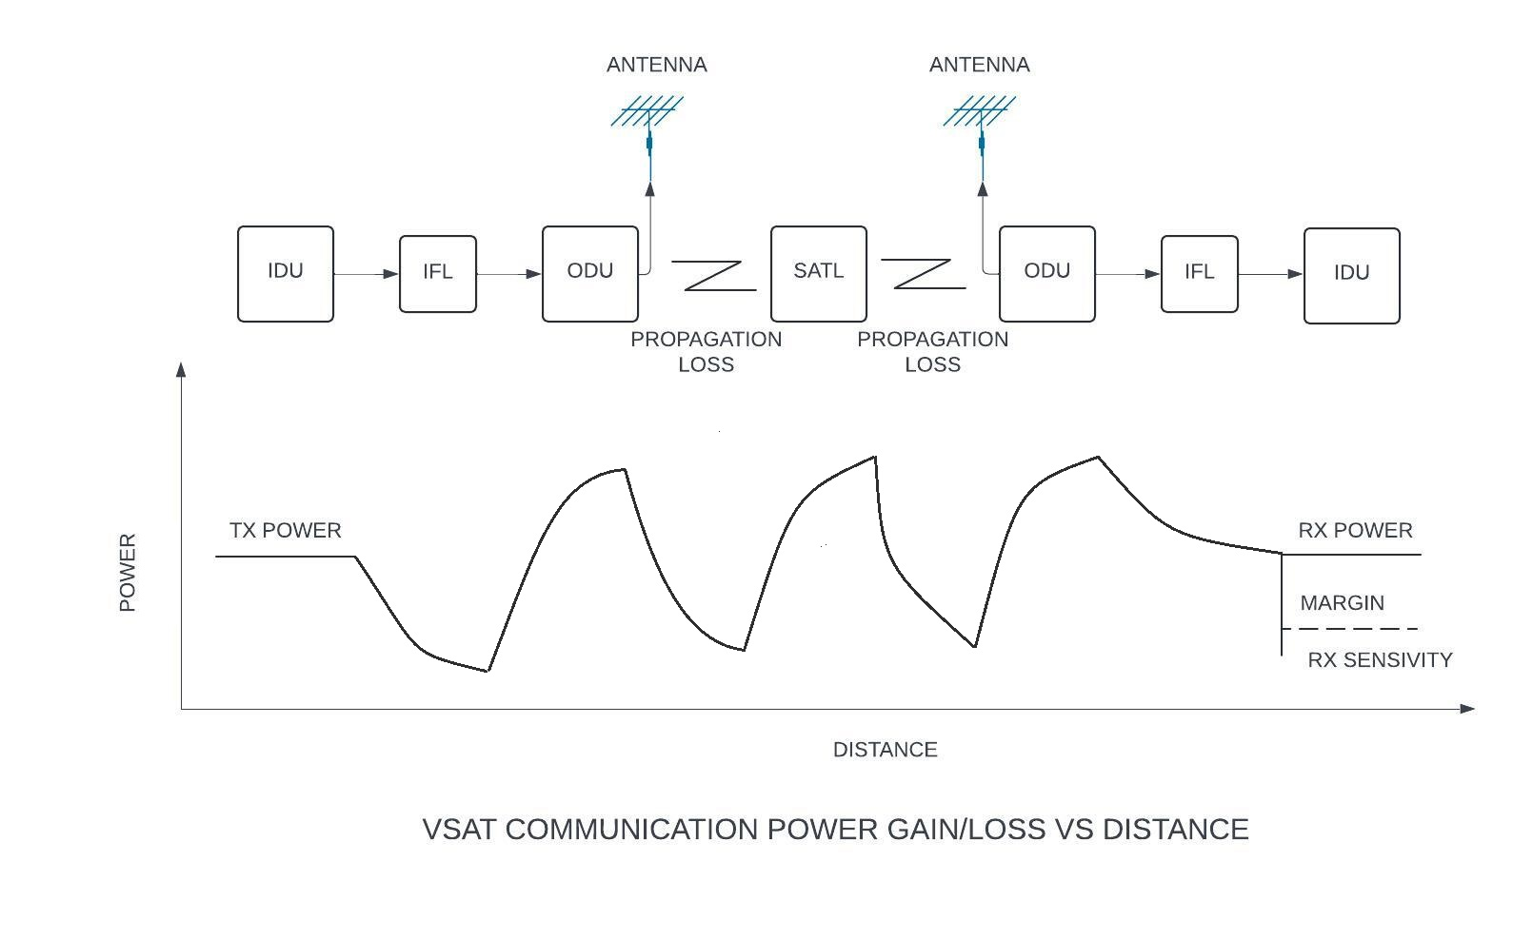
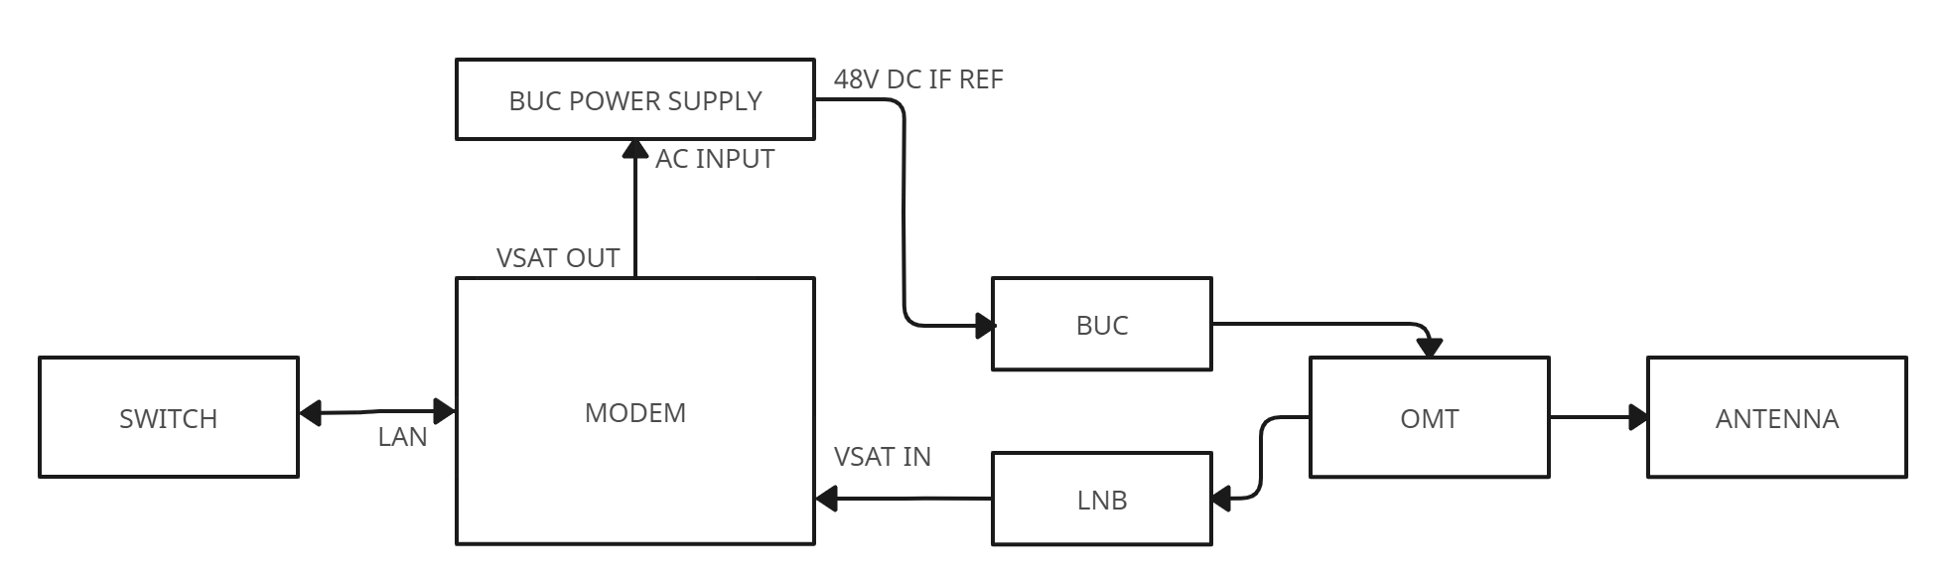
Signal attenuation of RF signal:
Due to humidity in the atmosphere.
Dust particles in the atmosphere.
Due to rain.
Line of sight.

Slide 6
GSM COMMUNICATION (Global System for Mobile)
GSM is an open and digital cellular technology used for mobile communication, which is between two mobile via SIM (Subscriber Identity Module).
It is developed by the European Telecommunications Standards Institute (ETSI) to describe the protocols for second-generation (2G) digital cellular networks used by mobile devices such as mobile phones and tablets.
It was first implemented by Germany in 1992.
GSM uses 2G and 3G technology to transfer voice and data.
The Architecture of GSM:
The mobile station (MS)
The base station system (BSS)
The network switching system (NSS)
The operations and support system (OSS)

Slide 7
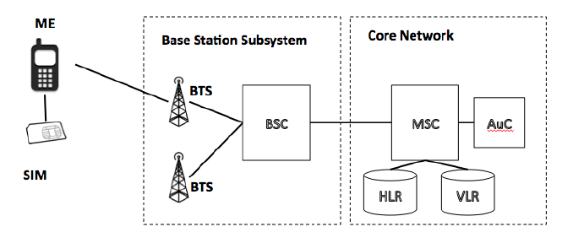
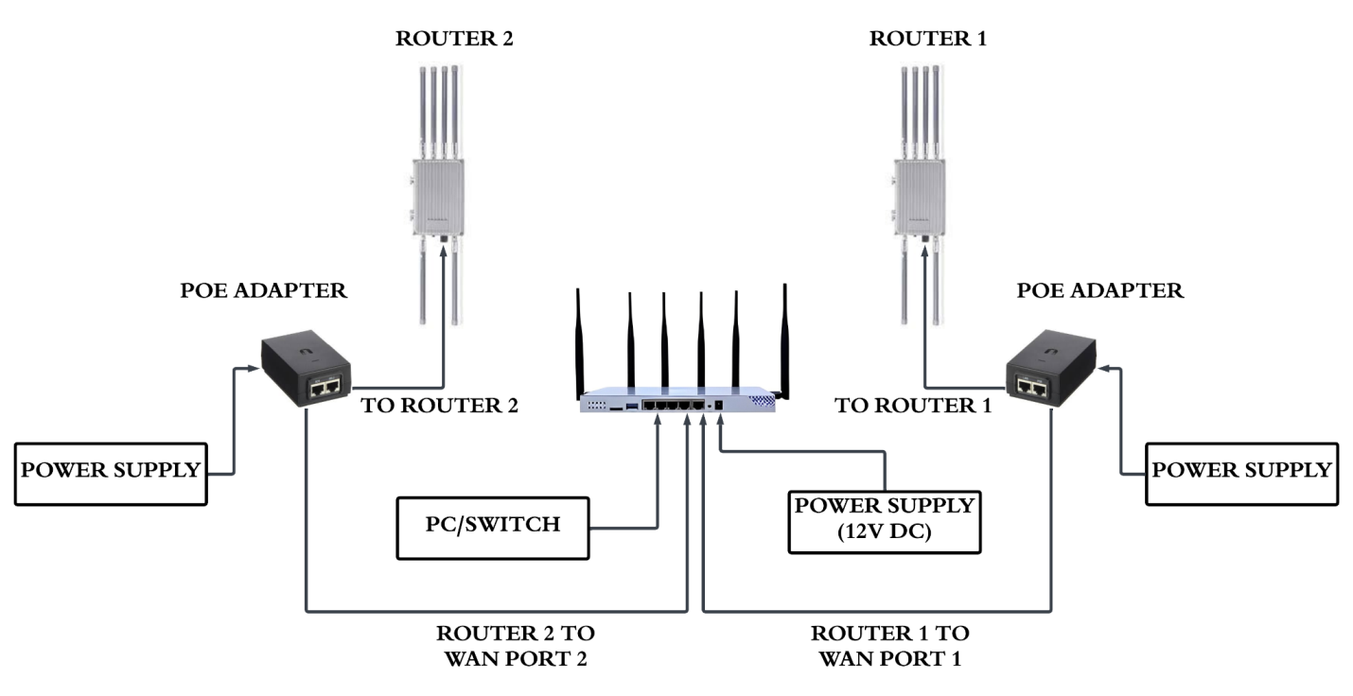

Slide 8
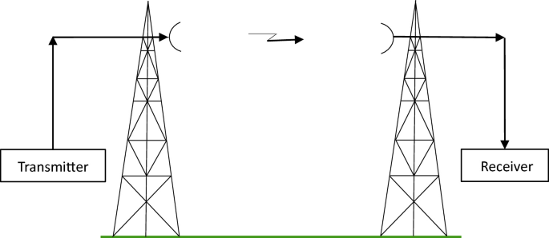
RADIO COMMUNICATION
In radio communication systems, information is carried across space using radio waves, where Radio waves are electromagnetic waves of frequency between 3 hertz (Hz) and 300 gigahertz (GHz)

Slide 9
Radio communication is point to point.
Radio is a very useful method to communicate data from one device to another, especially over long distances, or where physical wiring is not feasible.
Network Architecture:
Access Point (AP): These are the primary base stations in a radio communication network. They transmit data to multiple subscriber modules.
Radio Transmission: In radio transmission, a radiating antenna is used to convert a time-varying electric current into an electromagnetic wave or field, which freely propagates through a non-conducting medium such as air or space.
Subscriber Modules (SMs): These are the end-user devices that receive data from the access points. They can be fixed or mobile, and are typically installed at the customer’s premises

Slide 10
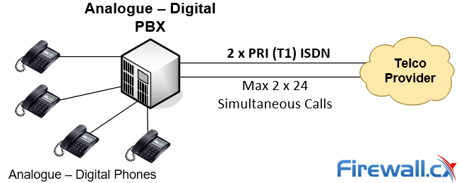
EXCHANGE
A telephone exchange, also known as a telephone switch or central office.
It facilitates the interconnection of telephone subscriber lines or digital system virtual circuits, enabling telephone calls between subscribers.
The main functions of an Exchange are Switching, Signalling, and Controlling.

Slide 11
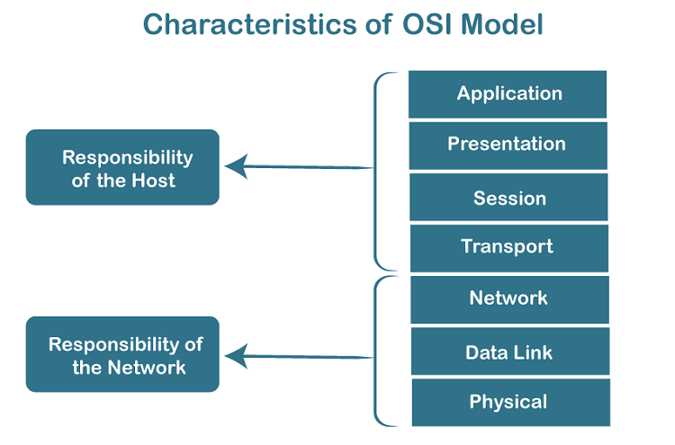
NETWORK
A computer network is a system that connects two or more computing devices for transmitting and sharing information. These devices are connected using physical wires such as fiber optics, but they can also be wireless.
Types of Computer Networks
Personal Area Network (PAN)
Local Area Network (LAN)
Metropolitan Area Network (MAN)
Wide Area Network (WAN)
Virtual Private Network (VPN)

Slide 12
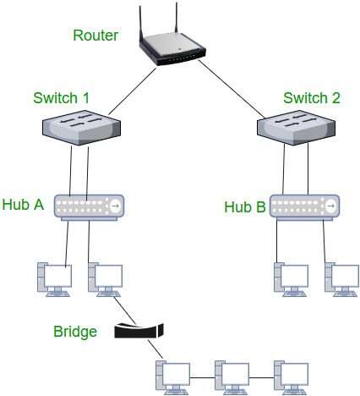
INTERNET PROTOCOL ADDRESS:
The address through which any computer communicates with other computer is simply called an Internet Protocol Address or IP address.
For example, If we want to load a web page or we want to download something, we require the address for delivery of that particular file or webpage. That address is called an IP Address.
Types of IP Addresses
IPv6 (Internet Protocol Version 6)
IPv4 (Internet Protocol Version 4)
NETWORK DEVICES:

Slide 13
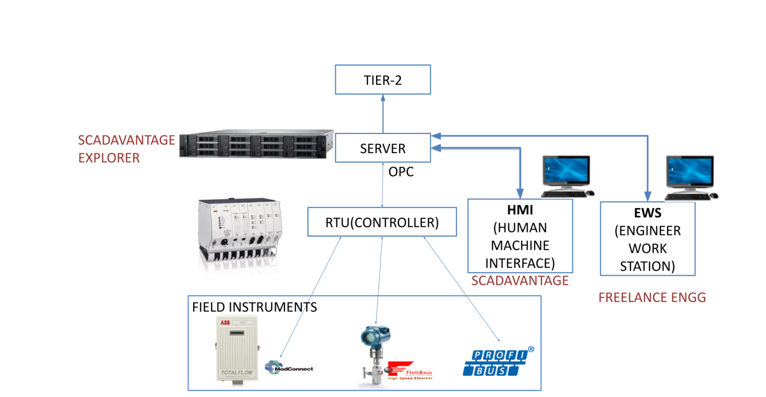
SCADA (Supervisory Control and Data Acquisition)
SCADA systems monitor real-time data, control processes, and store information for analysis.
They manage the flow of data, and in general, data is collected by sensors and passed to PLCs. SCADA can handle simple control commands, such as opening and closing valves, sounding alarms, and similar types of controls

Slide 14
CONCLUSION
My internship at ONGC, Cauvery Asset, provided valuable hands-on experience in communication technologies like VSAT, GSM, and SCADA systems. I gained practical insights into how these technologies support the oil and gas industry, bridging the gap between theory and real-world applications. This experience has enhanced my technical skills and prepared me for future career opportunities in the field of electronics and communication.

