Slide 1
AnalogEdge
PLL Behavioral Modeling and Verification
Lock-time analysis, jitter sensitivity and integration guidelines
10 MHz to 100 MHz
reference in, divide-by-10 PLL
Persevex VLSI Course | Project 1
Notes:
This project builds and studies a charge-pump PLL that turns a 10 MHz reference into a 100 MHz clock. I modeled each block, simulated lock behavior, swept bandwidth and damping, studied jitter, and wrote integration guidelines.

Slide 2
What the project covers
1
Block modeling
2
Dynamic simulation
PFD, charge pump, loop filter, VCO and divider. Target 100 MHz, lock rule defined.
Lock time, frequency settling and phase error under a reference step and a disturbance.
3
Noise and jitter
4
Integration guidelines
Sweeps of loop bandwidth and damping; jitter and stability trade-offs.
Clocking recommendations, model limitations and assumptions.
Notes:
The brief has four phases. Phases 1 and 2 are the model and the lock simulation. Phase 3 is the sweeps and jitter. Phase 4 is the written guidelines and limitations.

Slide 3
How the PLL works
Reference 10 MHz
Output 100 MHz
PFD
Which edge is early?
Charge pump
Turns error into current
Loop filter
R + C smooth it to a voltage
VCO
Voltage sets the frequency
Divide by N = 10
100 MHz back to 10 MHz
Locked = phase error below 0.3 ns for 30 reference cycles, so the output is steady at 100 MHz.
Notes:
The PFD compares the reference with the divided VCO clock. The charge pump converts the timing error into current, the loop filter turns it into a control voltage, and the VCO changes frequency. The divider brings 100 MHz back to 10 MHz for the comparison. I define lock as phase error under 0.3 ns for 30 consecutive cycles.

Slide 4
Baseline design values
Parameter | Value
Reference frequency | 10 MHz
Divider N | 10
Charge pump current | 100 µA
VCO gain | 50 MHz/V
Loop filter C | 100 pF
Loop filter R | 6.26 kΩ
VCO start frequency | 90 MHz
356 kHz
0.7
natural frequency
damping factor
65°
549 kHz
phase margin
unity-gain crossover
The VCO starts 10% too slow so the simulation shows a full lock.
Notes:
Natural frequency follows from Icp, Kvco, N and C. R is chosen for a damping of 0.7. These values give 356 kHz natural frequency and 65 degrees of phase margin. Starting the VCO at 90 MHz shows the full lock acquisition.

Slide 5
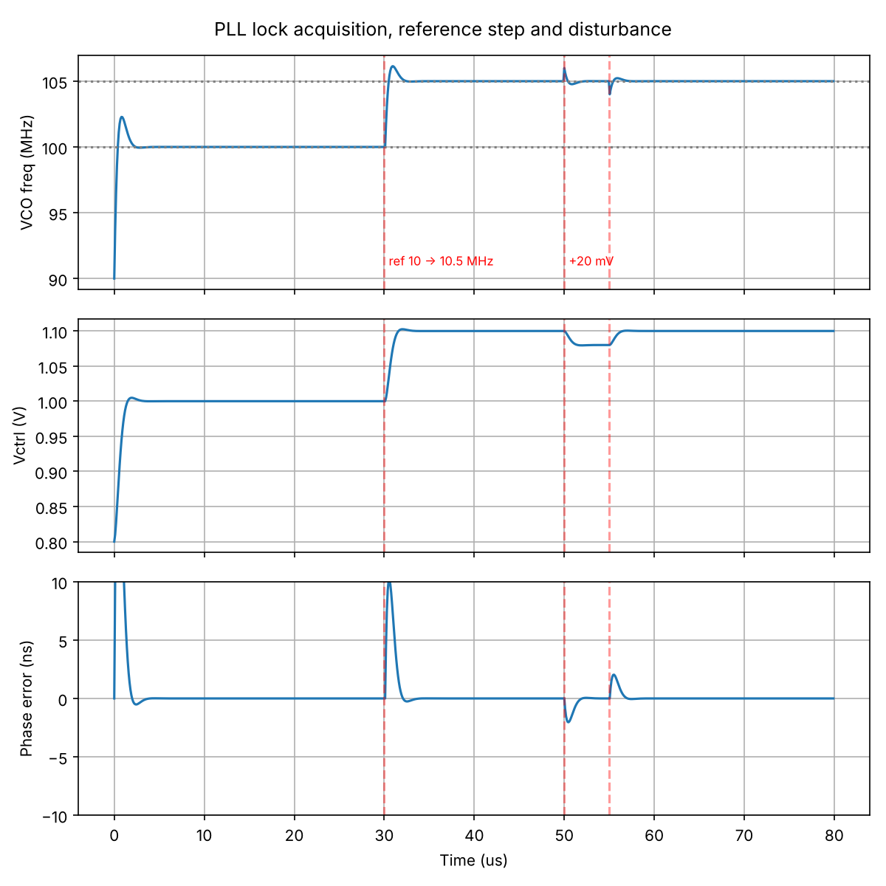
The PLL locks in a few microseconds
3.0 µs
lock from 90 MHz to 100 MHz
2.0 µs
re-lock after 10 to 10.5 MHz reference step
1.5 µs
recovery from a 20 mV disturbance (1 MHz kick)
Frequency overshoot 22.8% in simulation vs 21% from the linear model: the two models agree.
Notes:
Top plot is VCO frequency, middle is control voltage, bottom is phase error. At 30 microseconds the reference steps to 10.5 MHz and the PLL re-locks in about 2 microseconds. At 50 microseconds a 20 mV disturbance moves the output by 1 MHz and the loop recovers in about 1.5 microseconds. Lock time depends on the definition, which is why the report states it.

Slide 6
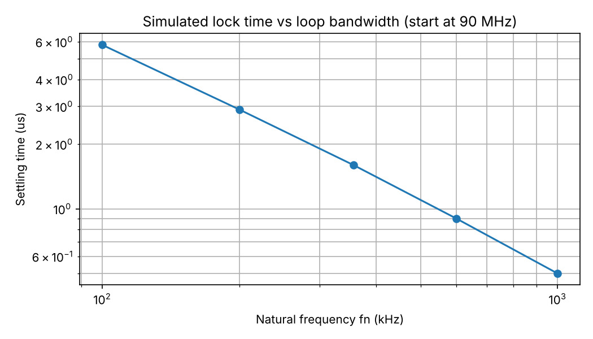
Wider loop bandwidth locks faster
Natural frequency | Settle to 1 MHz
100 kHz | 5.8 µs
200 kHz | 2.9 µs
356 kHz | 1.6 µs
600 kHz | 0.9 µs
1 MHz | 0.5 µs
Lock time is proportional to 1 / bandwidth: doubling the bandwidth halves it. The cost is more noise passed from the reference (next slides).
Notes:
This is from the time-domain simulation, starting at 90 MHz. Lock time scales inversely with bandwidth. Overshoot and phase margin stay the same because damping is fixed.

Slide 7
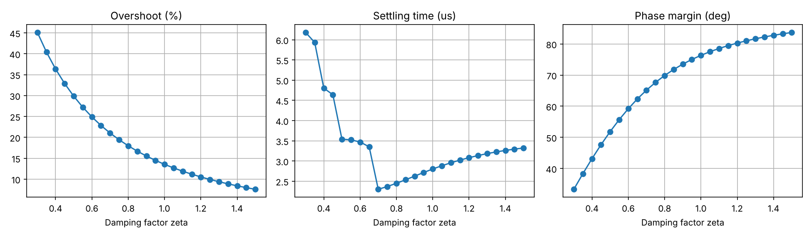
Damping: speed against stability
Damping 0.3
45% overshoot, 33° margin
Rings, low margin
Damping 0.7
2.3 µs settling, 65° margin
Fastest, good margin
Damping 1.0 to 1.5
13% to 8% overshoot, 76° to 84°
Safe but slower
Notes:
Left plot is overshoot, middle is settling time, right is phase margin, all against damping factor at the baseline bandwidth. A damping of 0.7 gives the fastest settling. Values from 0.7 to 1.0 balance speed and margin.

Slide 8
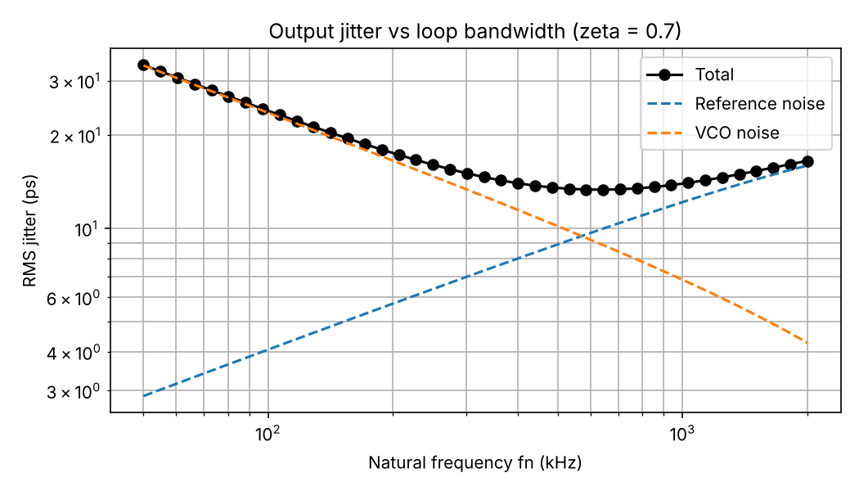
Jitter has a sweet spot in bandwidth
13.35 ps
minimum RMS jitter, near 640 kHz (about fref / 15)
Too narrow: VCO noise dominates (24 ps at 100 kHz)
Too wide: reference noise, multiplied by N squared, dominates
Above fref / 10 crossover the model is optimistic
Assumed noise: reference -130 dBc/Hz white, VCO -110 dBc/Hz at 1 MHz offset. The trend and the optimum matter, not the absolute picoseconds.
Notes:
The jitter has two parts. VCO noise is suppressed by a wide loop. Reference noise is passed by a wide loop and is multiplied by N squared. The total has a minimum near 640 kHz. The noise levels are assumed values, so the absolute picoseconds are illustrative.

Slide 9
Integration guidelines
Loop bandwidth
Damping
Reference clock
Natural frequency fref/30 to fref/15; crossover below fref/10
Use 0.7 to 1.0 for 65 to 76 degrees of margin
Low-jitter source; keep N small
Control line Vc
Supply isolation
Lock monitor
Short, shielded, guard ring: 20 mV moves output 1 MHz
Dedicated filtered supply and clean analog ground for VCO
Hold downstream logic in reset until lock, allow 5 µs
Notes:
These recommendations come directly from the sweeps: the bandwidth range from the jitter minimum and the validity of the model, the damping range from overshoot and margin, and the layout advice from the fact that 20 mV on the control line moves the output by 1 MHz.

Slide 10
Conclusion and limitations
What we found
Limitations
Baseline PLL locks in about 3 µs and recovers from disturbances in about 1.5 µs
Lock time scales as 1 / bandwidth
Damping 0.7 to 1.0 balances speed and stability
Jitter is lowest near 640 kHz
Ideal charge pump: no leakage or mismatch
Linear behavioral VCO, integer-N only
Second-order loop; no ripple filter
Assumed noise levels; no process corners
Notes:
The PLL meets the lock-time targets and the sweeps give a clear design window. Before using this design in a product, charge-pump non-idealities, a second filter pole and process, voltage and temperature corners must be added.

