Slide 1
SheIsSafeSim.
OBJECT ORIENTED PROGRAMMING USING PYTHON. 23ELC205.
REVIEW - 1

Slide 2
Team Member(s):
Adhithya R - (CB.EN.U4ELC24028)

Slide 3
ABOUT THIS PROJECT:
What this actually is?
SheIsSafeSim is a Python Based Object Oriented Simulator that models the working of an emergency alert system for women’s safety. The project focuses on showcasing OOP principles in Python, while also demonstrating how these safety-systems could function in the real world.
Source of Motivation:
Safety is a concern, be it a child or a woman, or those who are old or disabled. These emergency systems are essential for providing quick responses in unsafe situations. While the actual concept relies in the usage of IoT based devices, GPS, and mobile networks, this mini-project provides a simulation of the same workflow, in an understandable, structured and educational way.

Slide 4
ABOUT THIS PROJECT:
Key Features:
User Simulation : Represents a user who can trigger or cancel alerts.
Emergency Contacts : Trusted Contacts or the Law Enforcement are notified when an alert is triggered.
Multiple Alert Modes : SMS, Call, and App Notification alerts are simulated using OOP concepts such as inheritance and polymorphism.
Location Sharing : Each alert carries the user’s (mock for this project) location coordinates.
Event Logging : Every alert is stored with details. (time, user, notified contacts, etc.)
Cancellation Feature : The user can cancel and notify that they are safe.

Slide 5
Conceptual Overview
Core Concept: SheSafeSim acts as a virtual alert network where a user can:
Login/Register in the system.
Add and manage emergency contacts.
Update location manually.
Trigger a Panic Alert, which sends simulated messages to all contacts via three channels.
Channels Simulated:
📩 SMSAlert
📞 CallAlert
🔔 AppNotification

Slide 6
Concepts Applied
Concept | Where Used | Purpose
Encapsulation | Private vars like __name, __contacts | Protect user and contact data
Abstraction | BaseAlert abstract class | Defines a unified interface for all alert types
Inheritance | SMSAlert, CallAlert, AppNotification subclasses | Extend functionality of BaseAlert
Polymorphism | send_alert() overridden in each subclass | Different alert behaviors through common interface
Composition | User class contains Contact objects | Real-world relation: a user has contacts
Static Method | receive_alert() in Contact | Shared alert behavior independent of instance

Slide 7
System Architecture
Layers of the System:
Frontend Layer (GUI) – Tkinter for user interaction
Backend Layer (Logic) – OOP classes for user, contacts, and alerts
Persistence Layer – CSV storage for saved contact lists
Event Layer – Emergency event triggering and handling
Modules Used:
tkinter → GUI design
csv → file handling
abc → abstract base class implementation
datetime → time-stamping alerts
random → generating unique alert IDs
webbrowser → opening Google Maps

Slide 8
Workflow
Step-by-Step Process:
User Login/Register → Authentication verified
Dashboard Opens → User adds/view contacts
User Updates Location → Stored in user profile
Panic Alert Triggered → Loop through all contacts
Alert Channels Activated:
SMS
Call
App Notification
Confirmation Message Shown → "Alert Sent Successfully"

Slide 9
GUI Design Overview
Interface Components:
Login Page: Username, ID, Password fields
Register Page: New user creation
Dashboard:
Add/View Contacts
Update Location
Send Panic Alert
Open Map
GUI Framework: Tkinter
Buttons, Labels, Entry widgets, and Toplevel popups used.
MessageBox for success/error alerts.

Slide 10
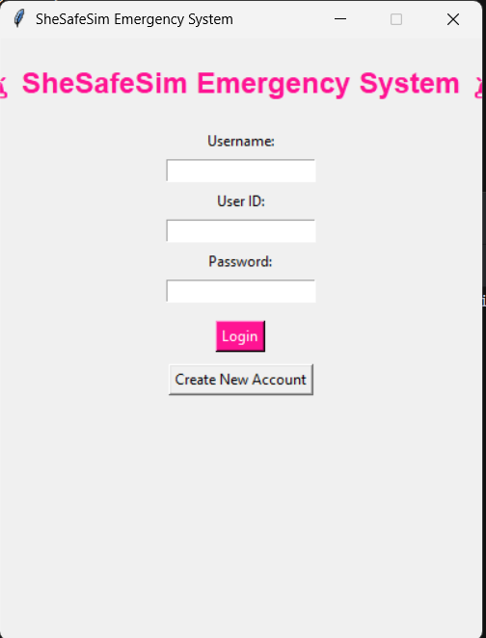
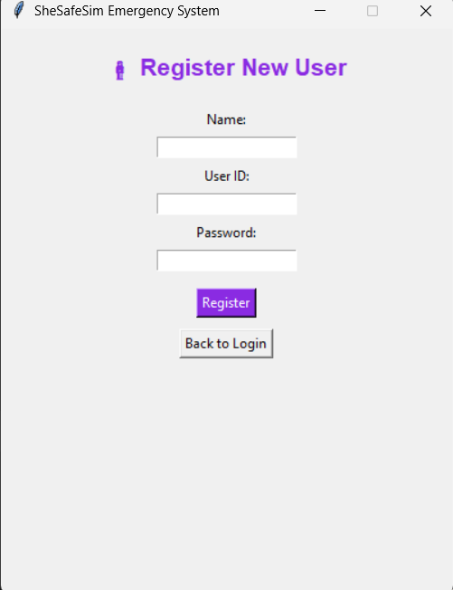
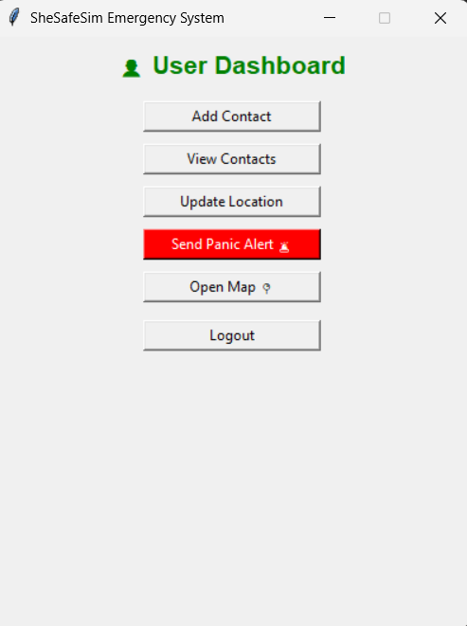

Slide 11
Emergency Simulation Process
Trigger Function: User.quick_panic_alert()
Execution Flow:
Checks if contacts exist.
Creates instances of all three alert classes.
Calls their send_alert(message) methods.
Displays confirmation messages for each.
Logs event via console print with timestamps.

Slide 12
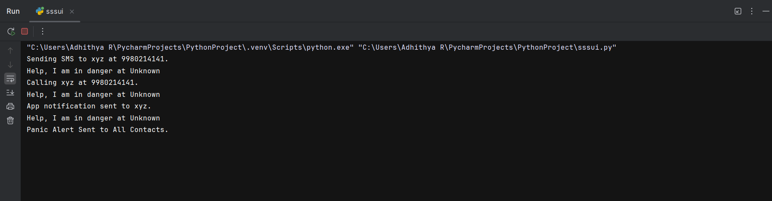

Slide 13
Technical Enhancements Outside OOPs and Future Scope
Enhancements:
🛰️ Integrate GPS Module or Google Maps API for live location.
📲 Link with Blynk/IoT Cloud for real alert notification.
📈 Add alert history logs and export feature.
🔒 Implement encryption for user credentials.
🤖 Optional AI voice assistant trigger (“Hey SheSafe, emergency!”).

Slide 14
Methodology Summary as Different Phases
Phase 0 – Backend Planning and Infrastructure
Phase 1 – Design and GUI Planning
Phase 2 – Linking Backend with GUI
Phase 3 – Testing and Debugging
Phase 4 – Verification and Sampling of Outputs.

Slide 15
Software Used:
Category | Technology
Programming Language | Python 3.13
GUI Framework | Tkinter
File Handling | CSV
Libraries Used | abc, datetime, random, webbrowser
Design Pattern | OOP (Abstraction, Inheritance, Polymorphism)
IDE | PyCharm

Slide 16
Results
Achieved:
User registration and authentication
Dynamic contact management
Location update and persistence
Panic alert simulation across three channels
Interactive GUI-based control panel

Slide 17
Conclusion
Combines software design, human safety, and IoT-inspired alert logic.
Acts as a base prototype for future real-world IoT emergency systems.
This project successfully demonstrates the application of OOP principles in solving a real world safety issue.

Slide 18
References
Tkinter Crash Course on YouTube : https://youtu.be/ibf5cx221hk?si=iNBkJJiNKu3iYTR_
CSV Modules
Google Maps API
Usage of Web Browser : https://youtu.be/6CYNFVBS2sw?si=YkQvXra7Vq8Uclmp

