Slide 1
FY26 Financial Forecast & Scenario Analysis
Britannia Industries
FP&A Project

Slide 2
Objective of the Analysis
Understand historical performance (FY23–FY25)
Identify key business drivers
Build FY26 forecast
Assess margin risk under different scenarios

Slide 3
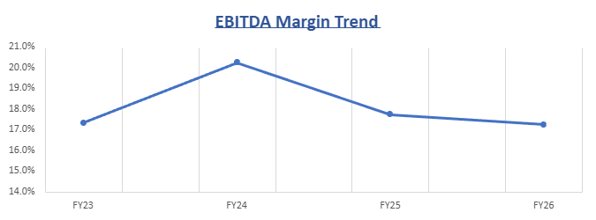
Historical Performance Overview
Revenue growth accelerated in FY25 (~7%)
EBITDA margin peaked in FY24 (~19%)
Margin pressure in FY25 due to higher raw material costs
Raw material cost ~60% of revenue

Slide 4
Key Financial Drivers Identified
Revenue Drivers
Cost Drivers
Volume growth
Pricing power
Raw material inflation (primary risk)
Advertising as discretionary lever
Stable employee cost structure

Slide 5
FY26 Base Case Outlook
Revenue Growth Assumption: 7%
Raw Material %: 59.1%
EBITDA Margin: ~17%
Margins remain sensitive to commodity price movements.

Slide 6
Scenario Analysis – Margin Sensitivity
Scenario | EBITDA Margin
Base | 17%
Upside | 19.5%
Downside | 14.5%

