Slide 1

SmartSelect
A Unified AI Answer Comparison Tool
“Ask once. Compare answers from multiple AIs.”
Presented by : Adi Vinay Bodapati

Slide 2
Introduction to SmartSelect:
What is SmartSelect?
SmartSelect is a unified AI platform that allows users to type one question and get answers from multiple AI systems — like ChatGPT, Gemini, Copilot, and Grok — all on a single screen.
Why was it created?
Different AI platforms give different answers. SmartSelect helps users quickly compare and select the best response without switching between apps or tabs.

Slide 3
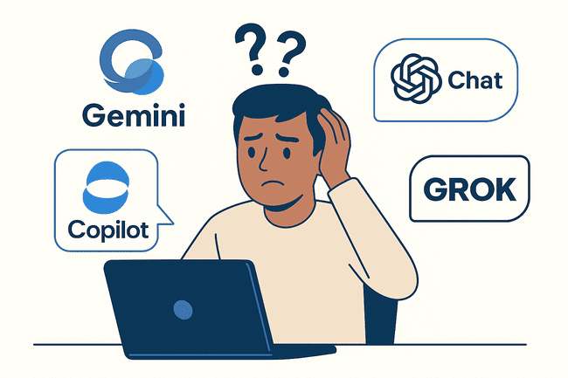
Problem Statement
Users often rely on multiple AI platforms to get answers.
Switching between tools like ChatGPT , Gemini , Copilot , and Grok is time –consuming.
No single place to compare responses side by side
Lack of clarity on which AI gives the best or most relevant answer for a given query.

Slide 4
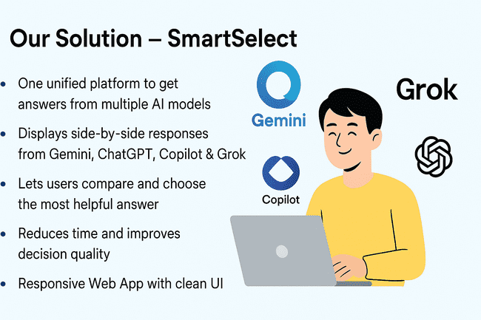

Slide 5
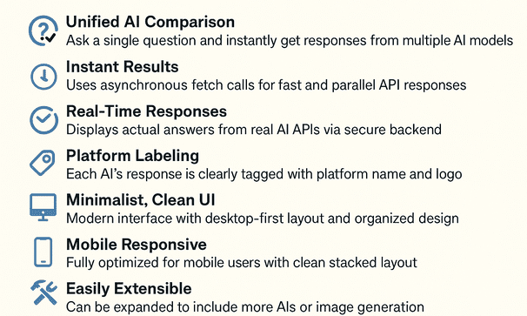
Project Objectives / Key Features

Slide 6
How SmartSelect Works?
Users input questions
Select AI platforms(Gemini/chatGPT/copilot/grok)
Receive Responses from platforms
User picks the best answer from a platforms

Slide 7
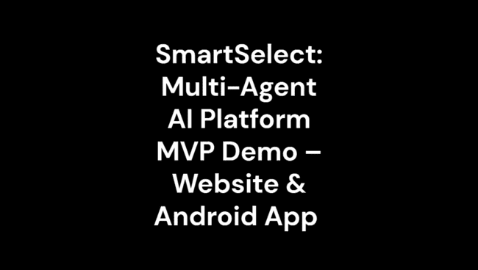
Working Demo:

Slide 8
Technical Stack
Backend
Node.js (Proxy Server)
Express.js
API integration with platforms like OpenRouter, TogetherAI, Groq
Frontend
HTML5
CSS3
JavaScript (Vanilla JS)
APIs / Platforms Used
Google Gemini
ChatGPT (via TogetherAI)
Copilot (via Mistral)
Grok (via Groq)
Storage / Hosting
GitHub Pages (for static hosting)
WordPress (optional integration)
Vercel (backend proxy deployment)

Slide 9
Design Decisions:
Minimalist UI design
Reusable Backend Proxy
Split Layout
Platform Selector Dropdown
Real time Response Display
Modular Code Structure

Slide 10

Challenges Faced:
API Access Limitations
Mobile Optimization
Real-Time Fetching
Integrating Multiple Platforms
UI Complexity

Slide 11
Future Enhancements:
Image-Based Question Support
SmartSelect API Key System
Voice Input & Response
Answer Analytics Dashboard
Multilingual Support
AI Answer Ranking Engine

Slide 12
Conclusion:
✅ SmartSelect simplifies AI-powered decision-making by offering multiple platform responses in one view.
✅ It bridges the gap between AI models like Gemini, ChatGPT, Copilot, and Grok in a single interface.
✅ Both website and app prototypes are developed and functional.
✅ The system enhances user control, comparison, and trust in AI-generated answers.
✅ SmartSelect is ready for scaling with future features like voice input, image generation, and API integration.

Slide 13


