Slide 1

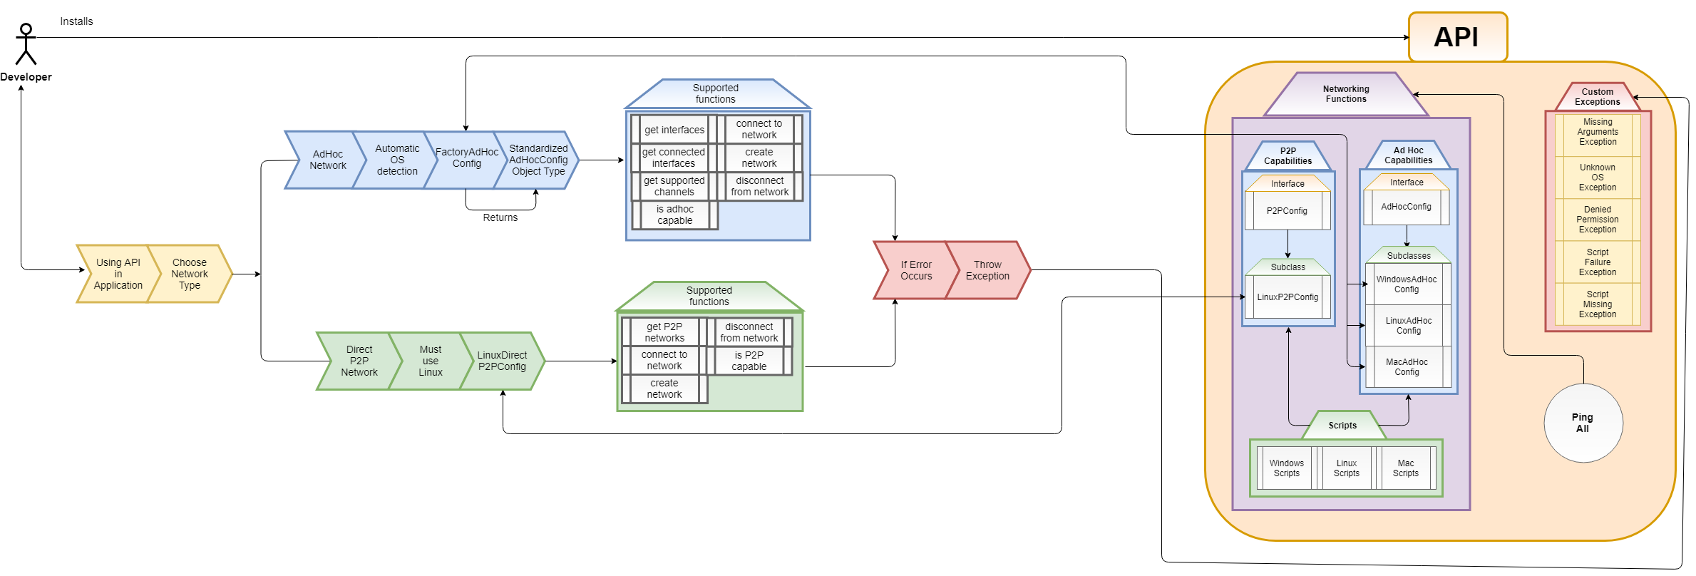

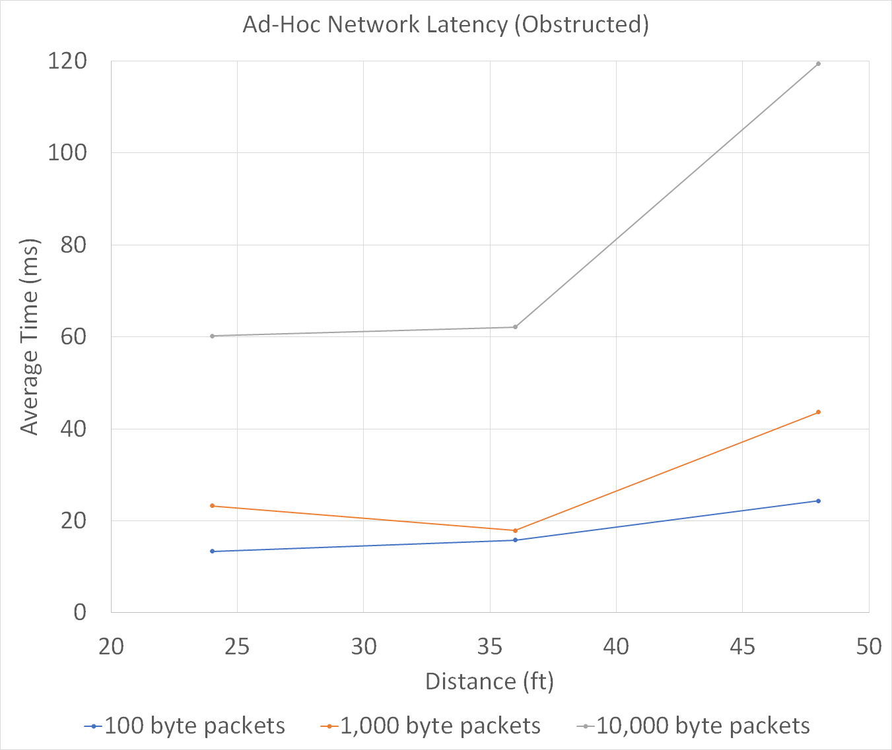
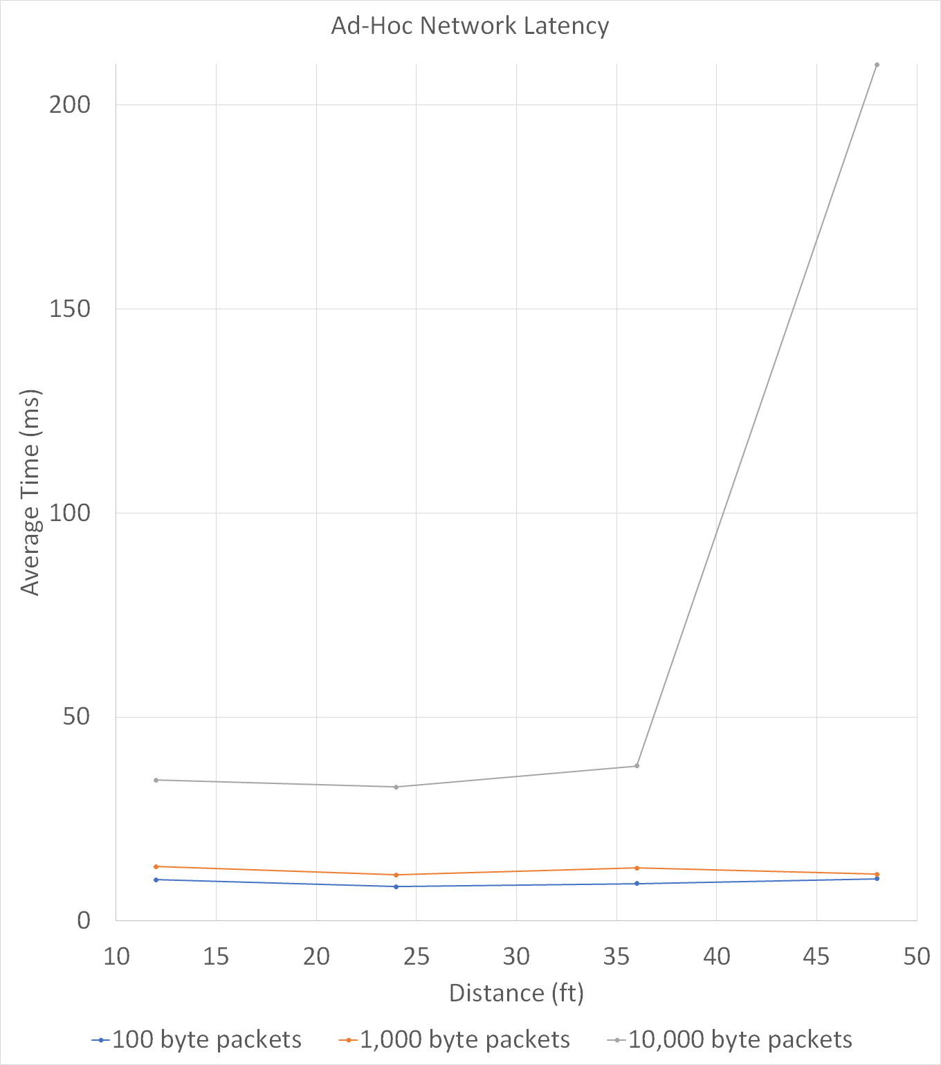
A Java API for unifying ad-hoc Wifi networking
Peter Banis, Klaus Çipi, Michael Kolar, Robert Olsen
Faculty Advisor: Dr. Marius C. Silaghi, Dept. of CES, Florida Institute of Technology
Project Goal
The goal of the project was to provide an API to assist in cross-platform compatible networking applications; the API can use Ad-Hoc networking capabilities from Windows, Mac, and Linux operating systems. The team sought to employ a similar toolset for Wifi Direct connections on Linux and Android. This API will standardize networking applications and make cross-platform communication more practical.
Challenges
Each operating system has a different API for networking
No prior experience with Android development
Quick identification of every device on a network
Architecture
Ad-Hoc Configuration Interface
Wifi Direct Configuration Interface
OS-level subclasses and scripts
API-wide IP discovery
Every Ad-Hoc device can be a client or server
No centralized device in Ad-Hoc network
System Design Diagram
Features
Automatic OS Detection
Runtime support for Event Logging
Ad-Hoc Networks
Wifi Direct Networks
Example Uses
File transfer
Share internet access
Form a distributed network
Form an intranet
Results
The Ad-Hoc API supports three operating system groups (Windows, Mac, Linux), and each network can handle up to 255 devices connected at the same time. A reliable network connection can be maintained for up to maximum range of 230 feet. Bandwidth between two devices on an Ad-Hoc network will fall within a range from 1.04 to 1.33 megabits per second (Hardware-dependent).

