Slide 1



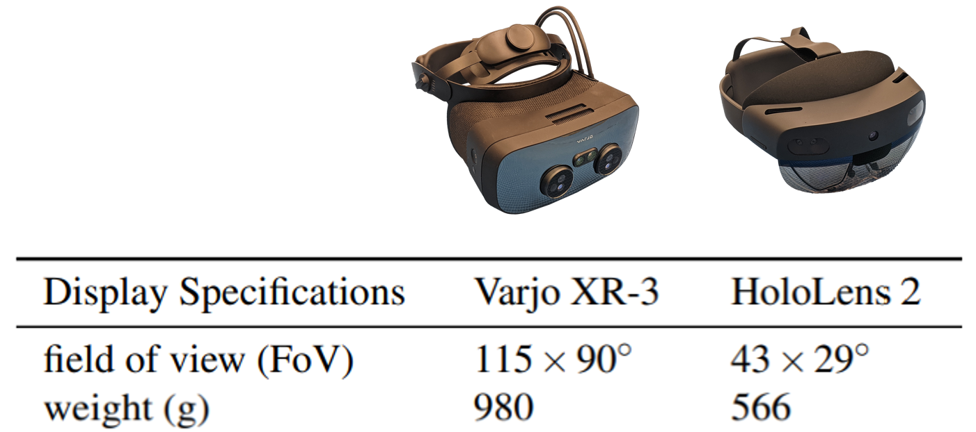
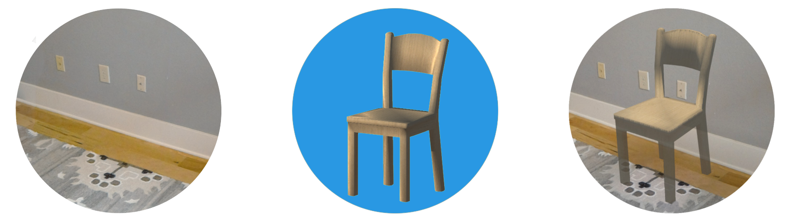
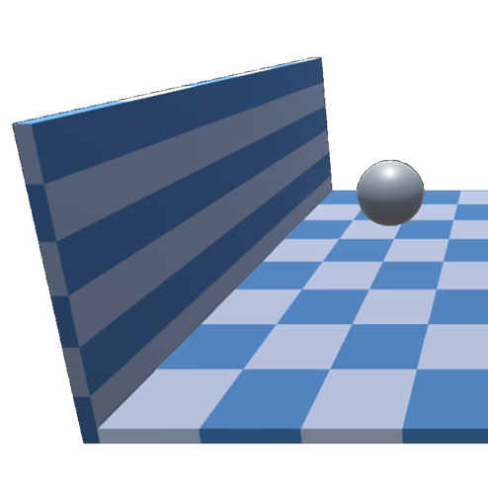
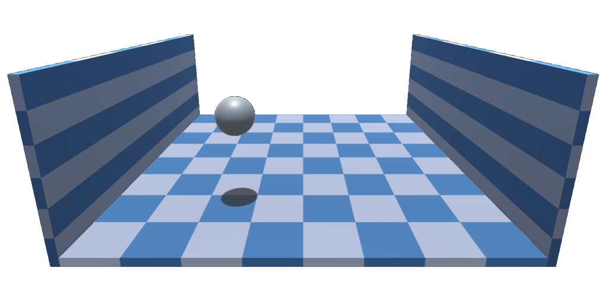

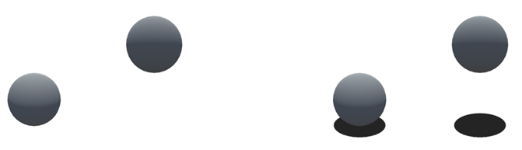
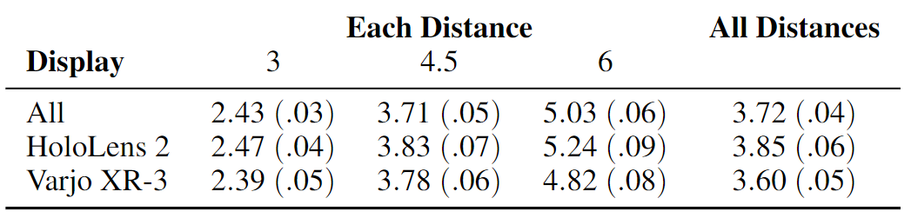
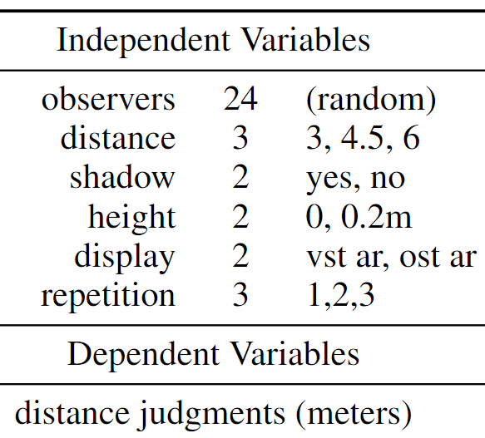
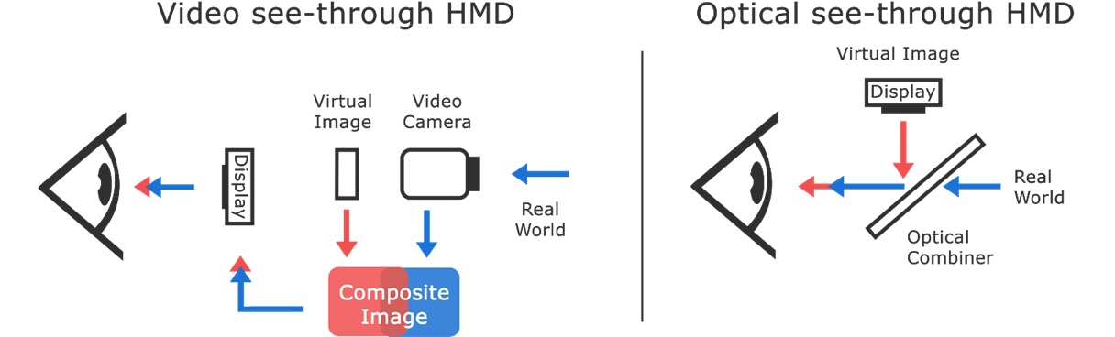
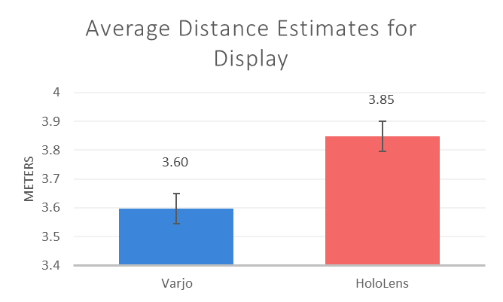
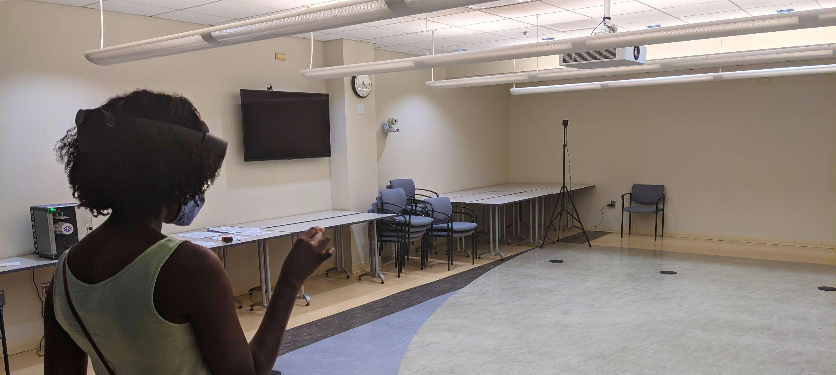
Judging Distances to Virtual Objects Generated by Optical and Video See-Through
Augmented Reality
Bobby Bodenheimer¹, Haley Adams¹, Jeanine Stefanucci², Sarah Creem-Regehr²
¹Department of Computer Science, Vanderbilt University
²Department of Psychology, University of Utah
Varjo XR-3 vs. HoloLens 2
Specifically, we study perception in the Varjo XR-3, a VST AR display, and the Microsoft HoloLens 2, an OST AR display. Both are considered state-of-the-art for their respective display categories. Their optical properties differ as do their field of view (FoV) and weight.
In the Varjo XR-3, a person’s view of the real world is restricted, but virtual objects can be rendered anywhere on its screen.
In the HoloLens 2, a person’s view of the real world is unrestricted, but virtual objects can only be rendered onto a small area of the plastic shield. The device is lightweight.
AR distorts depth perception
Depth perception in augmented reality (AR) is distorted [1], but we have yet to isolate the properties of AR that affect people’s ability to correctly perceive the position of virtual objects in space. It is possible that AR display properties and poor integration of virtual objects into real scenes contribute.
Shadows and object height influenced judgments
Finally, we found that the vertical height of a virtual object and the presence of a cast shadow influenced distance judgments
Participants distance judgments were more accurate when shadows were present. And they judged targets to be farther away when they were floating.
We had predicted an interaction between shadow and object height, but this was not found in our study.
Table 1: Specifications for the VST and OST HMDs
Grounded vs. floating targets
Surface contact cues, like cast shadows, are often missing when virtual objects are rendered in real world scenes for AR.
This missing information may cause people to misjudge the positions of objects in space when it is unclear if an object is on the ground or if it is floating above it [2].
Accordingly, we are interested in how the presence of a shadow affects people’s ability to determine the position of both grounded and floating targets.
Figure 1: In AR displays virtual stimuli are integrated into reality
Distortions may differ across head-mounted displays (HMDs)
Direct comparisons between different AR head-mounted displays (HMDs) may help us understand how the technical tradeoffs between these AR displays influence perception. Yet few of these comparisons have been conducted. In this research, we compare depth perception in two of the most common types of AR displays:
Discussion
Our results showed that distance judgments across both displays were underestimated. This result reinforces a growing body of literature in AR HMDs that has found distance estimates in action space to be
underestimated [1].
We also found that participants were more accurate at estimating distances in the HoloLens 2 than in the Varjo XR-3. It is possible that this difference was influenced by weight and FoV differences between the 2 HMDs [3]—but this theory will need more research to confirm.
Although we found effects of both shadow and height as perceptual theory and previous work would predict [2,4], we did not find the predicted interaction between object height and the presence of cast shadow, which is a fruitful topic for future investigation.
Figure 3: Cast shadows can disambiguate object position
Figure 4: Targets were on or above the ground, with or without cast shadow
Experiment
We evaluated verbal reports of egocentric distance judgments in both OST and VST AR displays to virtual targets at 3, 4.5, and 6 meters.
For each display, participants reported distance judgments to both grounded and floating targets that were rendered either with or without a cast shadow.
The order that the AR displays were experienced was counterbalanced.
Distances were underestimated
We found significant underestimation of distance in both HMDs
But they were underestimated less in OST AR
Distances were underestimated by 15.1% in the HoloLens 2 and by 20.2% in the Varjo XR-3.
Video See-through (VST) — Virtual overlays are rendered using a display panel and images of the real world are captured through stereoscopic video cameras
Optical See-through (OST) — Virtual overlays are projected onto a plastic shield in front of the viewer’s eyes. As a result, viewers have an unaltered view of the real world but the screen is much smaller
Table 3: Average distance judgments in meters
References
[1] Rosales, C. S., Pointon, G., Adams, H., Stefanucci, J., Creem-Regehr, S., Thompson, W. B., & Bodenheimer, B. Distance judgments to on-and off-ground objects in augmented reality. IEEE VR 2019.
[2] Ni, R., Braunstein, M. L., & Andersen, G. J. Perception of scene layout from optical contact, shadows, and motion. Perception 2004.
[3] Pfeil, K., Masnadi, S., Belga, J., Sera-Josef, J. V. T., & LaViola.Distance perception with a video see-through head-mounted display. CHI 2021.
[4] Adams, H., Stefanucci, J., Creem-Regehr, S. H., Pointon, G., Thompson, W. B., & Bodenheimer, B. Shedding Light on Cast Shadows: An Investigation of Perceived Ground Contact in AR and VR. TVCG 2021.
Figure 2: VST and OST displays integrate virtual stimuli differently
Figure 5: A participant wearing the HoloLens 2
Table 2: Variables for our experiment
Figure 6: Average distance judgements for the Varjo XR-3 and HoloLens 2
This material is based upon work supported by the Office of Naval Research under grant N00014-21-1-2583

