Slide 1
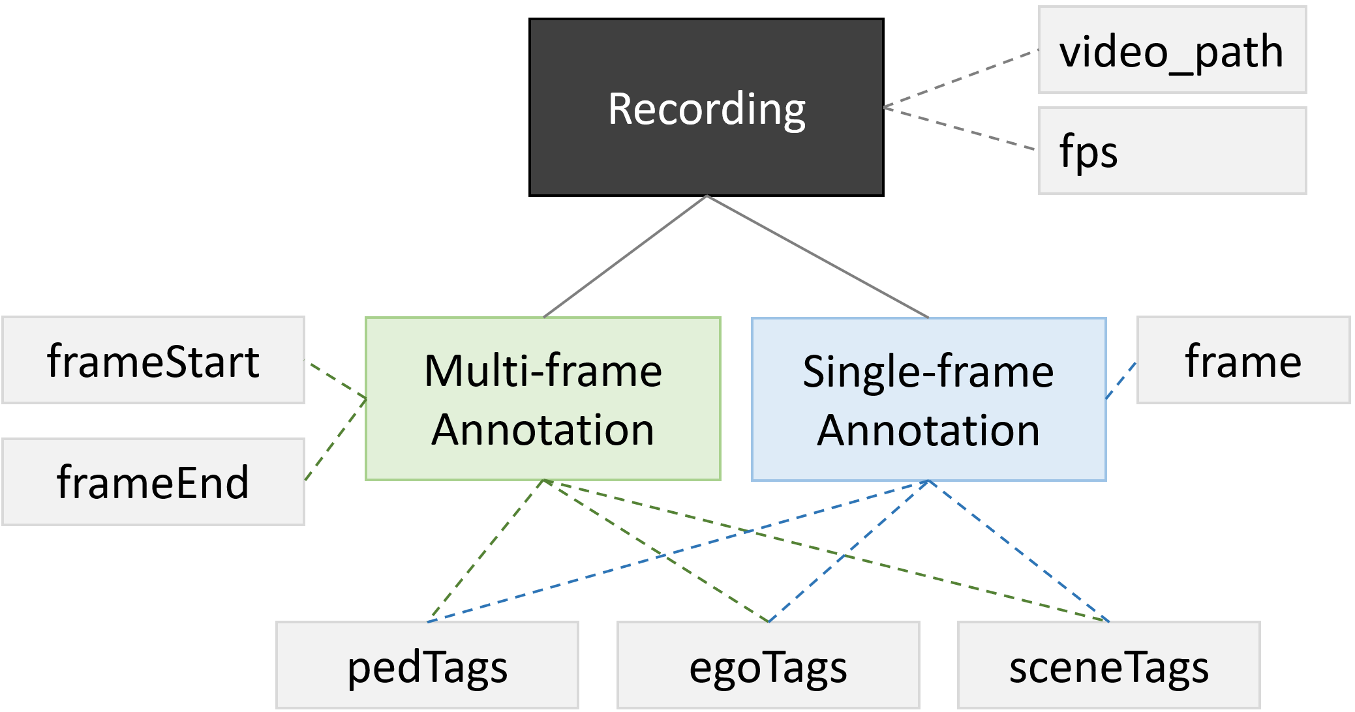
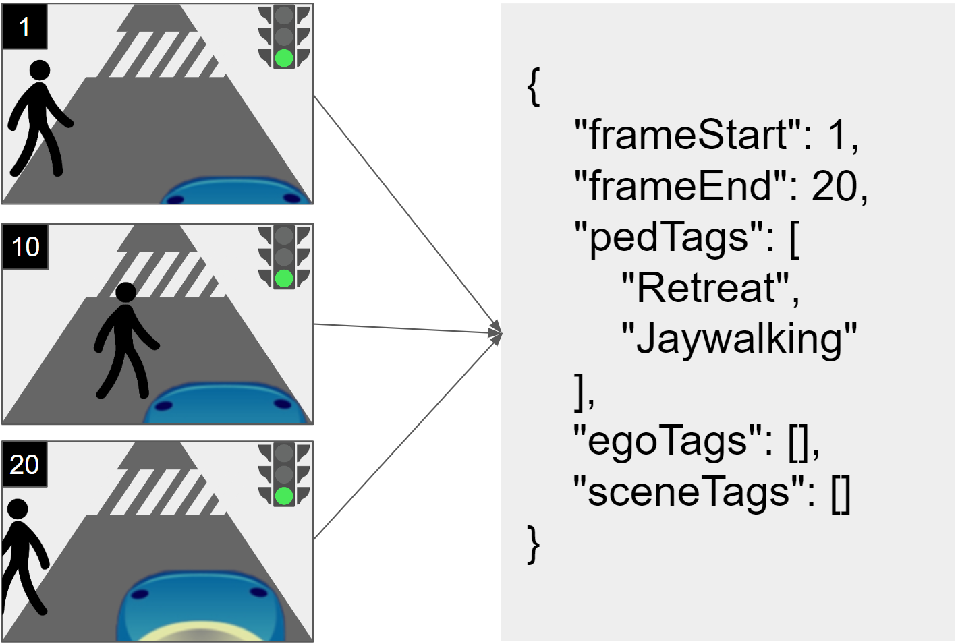
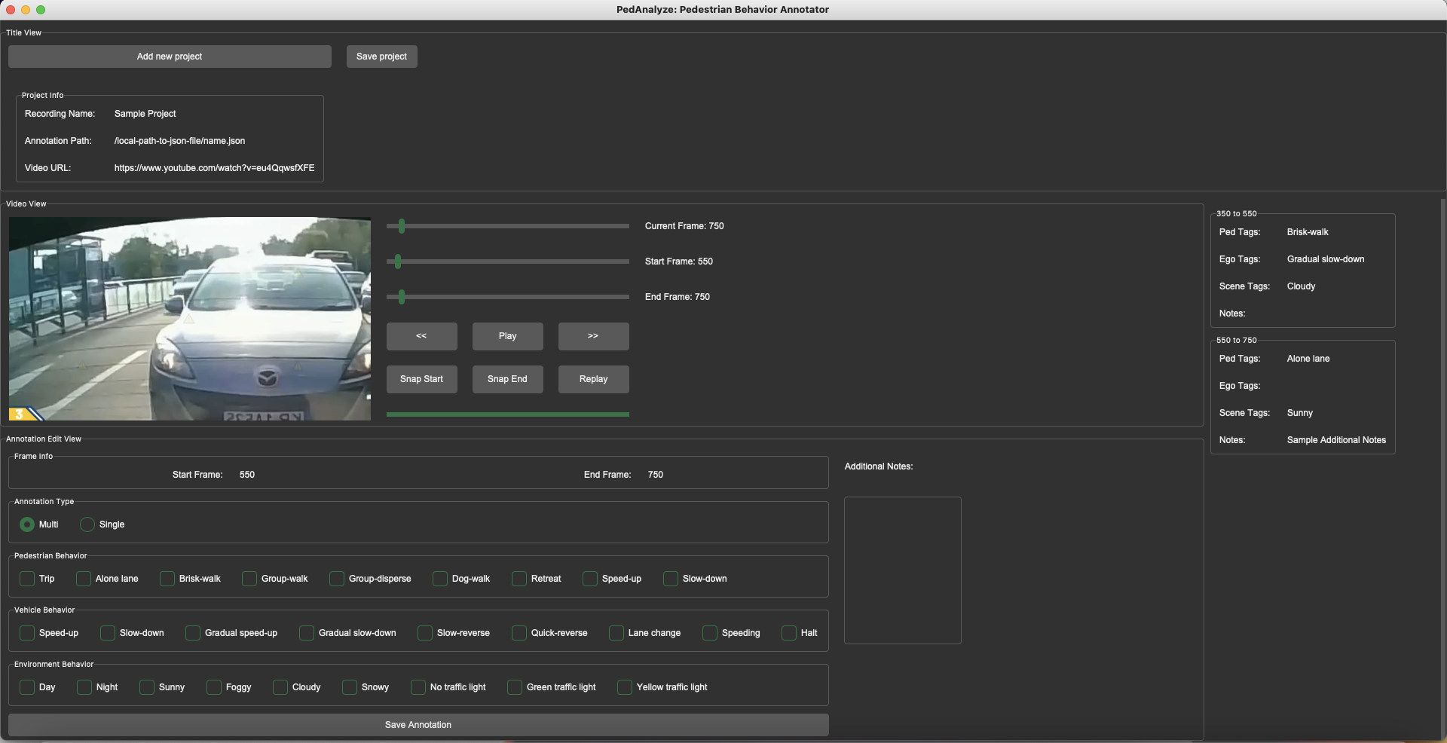
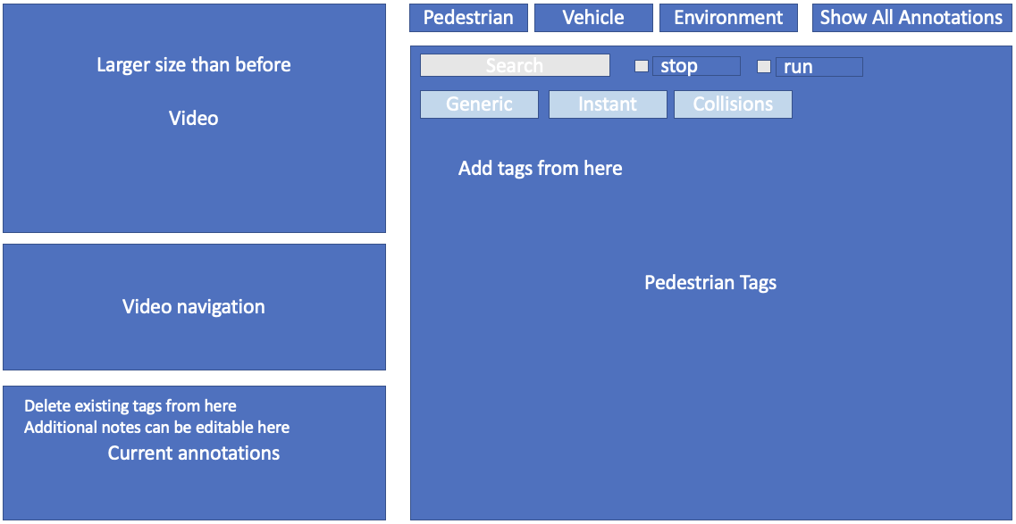



PedAnalyze - Pedestrian Behavior Annotator and Ontology
Taorui Huang, Golam Md Muktadir, Srishti Sripada, Rishi Saravanan, Amelia Yuan, Jim Whitehead
Department of Computer Science and Engineering, University of California, Santa Cruz
Introduction & Motivation
Most analysis focus on factors that influence pedestrian behavior
Emphasis on behavior diversity instead
Existing datasets lack consistent annotations
Text-based explanations vary too much across annotators
Per-frame annotations cause redundancy & obscure temporal relationships
Existing datasets don’t contain rare, edge-case scenarios in social media dash-cam videos
Pedestrian behavior-driven research (e.g., behavior prediction)
https://github.com/adhocmaster/ped-behavior-annotator
Methodology & Results
Data Model of an Annotation
Pedestrian Behaviors
Vehicle Behaviors
Environment Conditions
Pedestrian Demographics
Additional Information
Purpose
Tag Subsets
Future Works & Conclusions
Improving Annotation Accuracy + Consistency
Establishing a comprehensive set of ontology with more behavior coverage
Option for users to configure and add their own tags as appropriate
Dataset Development
Release initial datasets with dash-cam videos from YouTube and Instagram
More advanced dataset: recent work has shown the benefit of a defined ego-vehicle relative coordinate system; supporting this in PedAnalyze removes the need for absolute positioning. When combined with behavior tags, this will allow for the re-creation of these scenarios in AV simulators.
Collaboration + Integration
Capability for team members to collaborate and merge annotations — beneficial for locating and resolving inter-rater disagreements
Integration with Instagram, Facebook, and other platforms
UI Rearrangement (ongoing)
Pedestrian and vehicle behavior tags emphasize interactions and maneuvers
Environment condition and pedestrian demographic tags expose context
Together, these tag categorizations jointly produce the desired description language.
Contributions
Single-frame + Multi-frame Annotations:
Single-frame — identification and categorization of objects
Multi-frame — captures behaviors from start to end
Structured Datasets:
Tags prevent wording differences between human annotators
Controlled vocabulary with explicit definitions enables tag querying
Set of Pedestrian/Vehicle Behavior Tags:
Standardizes a collection of possible behaviors that can be exhibited
Annotation Tool for Social Media Dash-cam Videos
We characterized behaviors and conditions into subsets to make the tag searching process more intuitive and fast.
PedAnalyze User Interface
Subsets | Pedestrian Behavior Tags
Generic | Trip, Along lane, Brisk-walk, Group-walk, Group-disperse, Dog-walk, Retreat, Speed-up, Slow-down, Wander, Pause-start, Jaywalking, Cross-on-red
Instant Reaction | Swerve, Break, Flinch out, Flinch in, Frozen
Collision | Collision, Near-miss, Run into traffic, Thrown back
Interaction | Make stop, Make go, Aggression, Assault, Observing
Mental State | Looking, Glancing, Not looking/glancing Distracted, Agitated, Cautious, Indecisive
Intention | Cross, Not-cross, Not-sure-cross
Subsets | Vehicle Behavior Tags
Generic | Aggressive acceleration, Aggressive brake, Gradual acceleration, Gradual brake, Slow-reverse, Quick-reverse, Lane change Speeding, Halt
Collision | Induced collision, Run-stop, Swerve
Interaction | Make go (allowing the pedestrian to go)
Irregular | Sidewalk (drives onto sidewalk)
Subsets | Environment Condition Tags
Time & weather | day, night, sunny, foggy, cloudy, snowy
Traffic lights | none, green, yellow, blinking yellow, red
Road signs | stop sign
Location | crosswalk, no crosswalk
Traffic | light, moderate, heavy, one-way, two-way
Visibility | occluded pedestrian, glare on windshield
Subsets | Demographic Tags
Age | child, adult, elderly
Gender | man, woman
Culture | Swedish, Chinese, Indian, German, etc.
SIAM Workshop 2024

