Slide 1
Research Pipeline in Carla

Slide 2
Requirements
Driver Modeling
Specific test scenarios with other vehicles and pedestrians
Metrics to evaluate performance
Access to sensors
Pedestrian Modeling
An ego model
Specific test scenarios with other vehicles and pedestrians
Metrics to evaluate ego’s performance.

Slide 3
Pedestrian Modeling
Pretrained
Ego
Train against new pedestrian model
Test against old pedestrian model
Comparison

Slide 4
Driver Modeling
Basline Ego
Evaluation against a set of scenarios
Comparison
New
Ego

Slide 5
Roundabout Driver Evaluation
Train on RoundD
Ego
Evaluation against a RoundD
Comparison
Train on our Scenario Generator

Slide 6
Driver Modeling
Two different approaches:
A new architecture
A new/novel training approach for an existing architecture for existing scenarios.
A set of new scenarios (or a method to generate such scenarios). – we need to evaluate the importance of testing against these scenarios.

Slide 7
Tasks
A search for pedestrian spawn points wrt the direction and position of the ego vehicle. - Mahi
Integration – Muktadir
Roundabout Map Creation – Zarif
Pedestrian-based scenario Generation – Ryan & Muktadir
Non-ego vehicle based scenario Generation – Jawad
Pedestrian behaviors – Muktadir
Human driver - Jawad

Slide 8
Roundabout Driver Modeling
Maps – Zarif
Spawn Pedestrians – Mahi
Integration – Muktadir & Jawad
Add Pedestrian Behavior – Muktadir
Add NPC/human drivers – Jawad
Setup baseline ego – Mahi + Zarif
First set of scenarios - Ryan

Slide 9
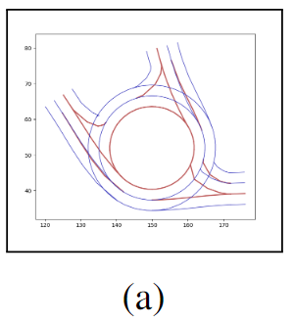
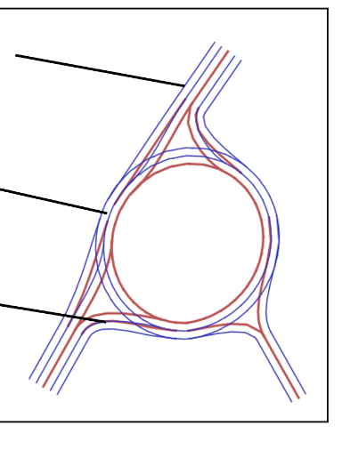
First set of scenarios

Slide 10
2 week plan (28th July – 11th August)
Integration goals:
Integrate the pedestrian nav point generator so that we can generate pedestrians any time in any scenario.
Integrate Carla srunner and leaderboard. (partially done, but need new repository)
First set of scenarios
Functional description only – Ryan
3 roundabouts from junction art – Zarif
Fix spawn-point generator and make a python package – Mahi
Collecting data through Roach. – Zarif and Mahi
Setup Roach with roundabouts

Slide 11
Next
Converting RoundD to Carla Scenarios

