Slide 1
Cloud Native Streaming Data Analytics and ML Pipeline for resource management and traffic engineering
Each component deployed as PODs managed as K8S CRDs / Operators, deployable anywhere with K8S
Indra G Harijono

Slide 2
Cloud Native Resource and traffic Analytics/Policies (and ML)
Characteristics:
Constant Kubernetes based resource monitoring
Streaming data analytics from tracing, metrics, resource data from all applications running on Kubernetes
Analytics and Correlation between Kubernetes cluster resources, tracing and metrics data
Traffic policy modification (enforcement), steering and control in real time
Validation of changes on traffic policies
Data protection and privacy
ML based analytics to anticipate future (resource) needs
Command & Control
vMEC
Control + Command
Tracing
Tracing
Control + Command
Event Driven Streaming Application
(pipelines)
Tracing
Control + Command
Tracing
Tracing
Metrics etc.
Tracing, Metric, resource Data etc.
vMEC Registry
Resource Analytics Data*
vMEC
Hot path analytics
ML
Cold Storage
Tracing
Data Ingestion point
Tracing
Tracing
Tracing, Metric, resource Data etc.
Tracing
Real-Time View
Batch analytics
Tracing
Metrics etc.
Batch View

Slide 3
Cloud Native Resource and traffic Analytics/Policies (and ML): vMEC
Components of Virtualized MEC:
Kubernetes + Istio + Clovisor
Data Collector for tracing, metrics and Kubernetes resources and utilization:
Sanitize data
Correlate data
Derive data
Inject data into data analytics pipeline
Validator of traffic steering and policy
Analytics and Correlation between Kubernetes cluster resource utilization, tracing and metrics data (locally on each vMEC)
Data Analytics Ingestion point
K8s Node
vMEC (on k8s)
Data Ingestion point
(Open) Tracing
K8s
Resource
K8s
Resource
K8s
Resource
Tracing, Metric, resource Data etc.
K8s Node
Metrics (Prometheus)
Collectors
K8s
Resource
K8s
Resource
K8s
Resource
Others

Slide 4
Cloud Native Resource and traffic Analytics/Policies (and ML): Command & Control
Components of Command and Control:
Obsolete!!!
K8s Node
vMEC (on k8s)
K8s
Resource
K8s
Resource
K8s
Resource
Istio Pilot + Mixer
Command & Control
Istio Policy
Istio API
K8s Node
K8s
Resource
K8s
Resource
K8s
Resource

Slide 5
Cloud Native Resource and traffic Analytics/Policies (Demo): Disk/Memory Usage on Kubernetes
Components:
1 vMEC
Tracing data:
TBD
Metric data:
Kubernetes
TBD
Collectors
Istio API
Command & Control
Analytics
Data Ingestion Point
Scenario:
Continuously collecting tracing, metrics and other relevant data (TBD)
Sanitize and inject the tracing, metrics data for analytics
Data analytics detects resource limits (high memory usage on pods) and start new pod(s) and reroute/redistribute the incoming request/traffics via Command and Control component
Command and Control component ask Istio to steer or change traffic policies
Collectors collect the new data and validate that the traffic policy is successfully applied
K8s Node
Istio Pilot + Mixer
Command & Control
Istio Policy
Control + Command
K8s
Resource
K8s
Resource
K8s
Resource
Data Analytics
K8s Node
vMEC (on k8s)
Web
Client
(Open) Tracing
K8s
Resource
K8s
Resource
K8s
Resource
Metrics (Prometheus)
Collectors
Data Ingestion point
K8s Node
Tracing, Metric, resource Data etc.
K8s
Resource
K8s
Resource
K8s
Resource
Others

Slide 6
Cloud Native Resource and traffic Analytics/Policies (Demo): Disk/Memory/Network Usage for video files servers on Kubernetes
Components:
1 vMEC with Video files server
Tracing data:
TBD
Metric data:
Kubernetes
TBD
Collectors
Istio API
Command & Control
Analytics
Data Ingestion Point
Scenario:
Continuously collecting tracing, metrics and other relevant data (TBD)
Sanitize and inject the tracing, metrics data for analytics
Data analytics detects resource limits (high latencies, low throughput, memory and storage usage on pods) and start new pod(s) and reroute/redistribute the incoming request/traffics via Command and Control component
Command and Control component ask Istio to steer or change traffic policies
Collectors collect the new data and validate that the traffic policy is successfully applied
K8s Node
Istio Pilot + Mixer
Command & Control
Istio Policy
Control + Command
K8s
Resource
K8s
Resource
K8s
Resource
Data Analytics
K8s Node
vMEC (on k8s)
Client
(Open) Tracing
K8s
Resource
K8s
Resource
K8s
Resource
Metrics (Prometheus)
Collectors
Data Ingestion point
K8s Node
Tracing, Metric, resource Data etc.
K8s
Resource
K8s
Resource
K8s
Resource
Others

Slide 7

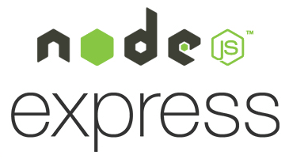
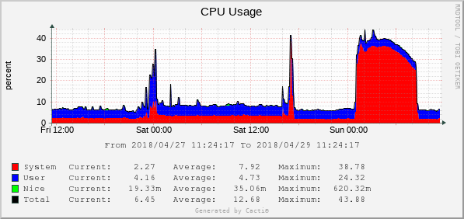
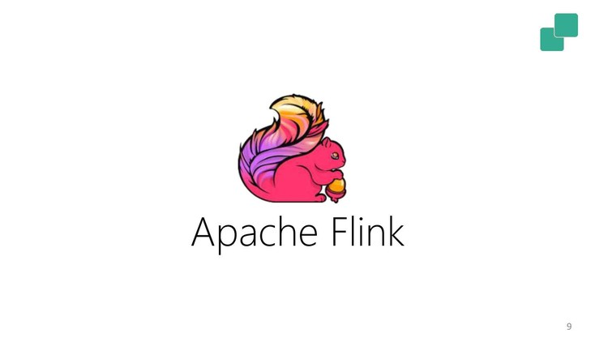
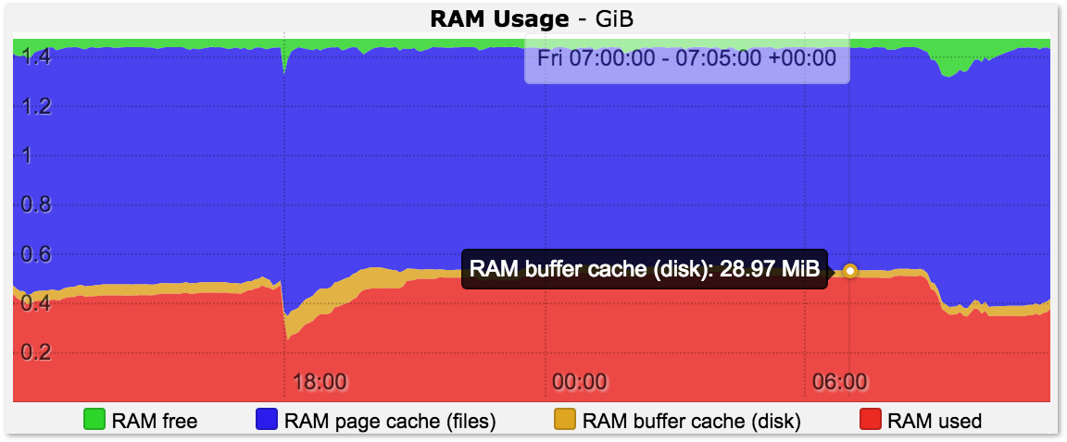

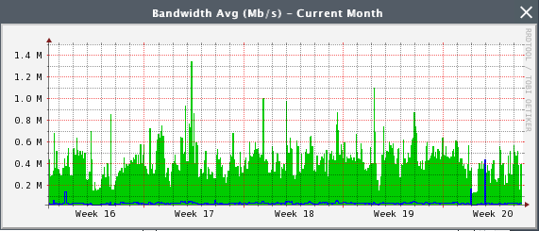
Cloud Native Resource and traffic Analytics/Policies (Demo): Istio Service View
Clients:
REST Client
GRPC Client
Backend Components:
Services on everest-app namespace:
FS
Fibo: Can generate high CPU usage
Guide: Can generate high network trafic and/or memory usage
Istio Pilot + Mixer
Monitoring
Fibo
(REST Service)
Control + Command
FS
(REST Service)
REST
REST
Client
Command & Control
REST
REST
Data Analytics
(Flink)
Istio Ingress Gateway
GRPC
Kafka
GRPC
Guide
(GRPC Service)
GRPC
Client
GRPC
Collectors
Tracing, Metric, resource Data etc.
namespace: everest-app

Slide 8
Cloud Native Resource and traffic Analytics/Policies (Demo): Version & Pod’s view
Components:
Everest App (everest-app namespace)
Everest: Kafka, registry, command and analytics (everest namespace)
Scenario:
4 types of clients: regular, cpu-, memory-, network traffic-intensive clients
Collector send streams of performance data, metric and tracing to analytics
Registry contains rules:
Category
Actions
Analytics process the stream and yield:
Critical: cpu, memory, network ???
High:
Normal:
Low:
Monitoring
(Service)
Registry
(Service)
Registry
FS
(Service)
FS-v1
Client
Command-1
Analytics
(Service)
Fibo-v1-0
Everest-sink
(job)
Fibo-v1-1
Client
Fibo
(Service)
Command-0
Fibo-v2-0
FS-v2
Everest-sink
(job)
Istio Ingress Gateway
Fibo-v2-1
Client
FS-standalone-v1
Collector-1
Kafka
(Service)
FS-standalone-v2
FS-v3
Guide-v1-0
Client
Guide
(Service)
Guide-v1-1
Collector-0
Guide-v2-0
Guide-v2-1
namespace: everest-app
namespace: everest

