Slide 1
Sends in order, receives in random
Sender
Path
Sender
Path abstracts away the receiver, and intermediate links. It can also be thought as the bottleneck of a path.
Sender

Slide 3
Simple control system
A learning sender
The bbr system has adhoc assumptions
Learn noise
Getting a large ttl does not reflect network congestion properly
Beliefs that can adapt fast. Round trip time bounds given a path.
How can we estimate the actual roundtrip time.

Slide 4
Packet level sim
Multi-node network.

Slide 5
NS3
Do the same operations on NS3

Slide 6
What does a sender know about traffic?
Source
Destination (might be our path identifier at a given period)
Date and time
Packet distribution over several factors
RTT
Neither RTProp, nor BtlBw
IP addresses, ports of source and dest, ethernet addresses of source but not always the dest (indirect communication).
Does it know about the ACK strategy?

Slide 7
What is the goal RTT (=Actual RTProp?)
The goal RTT needs to be determined by a model which adapts fast
Adaption rate at a given state
Can we only think of estimating RTProp and optimizing goal RTT?
What can RTT trend in a short time span indicate?
Traffic changes based on the time on the day, day of the week, day of the month, or year, etc. Traffic changes based on real world events. Traffic also changes due to network topology and path selection process.

Slide 8
BBR
In a time window for a connection,
Estimate RTProp
Estimate BtlBw
Estimate both only one at every ACK based on a check
Pacing delivery

Slide 9
Client 1
Issues:
How packets are sent to nodes inside the network. (always broadcasting?). Routing strategy (simple, every packet exactly knows the path it need to follow)
Addressing (standard ip or numeric id)
If sender2’s bottleneck is node 2, and client1’s bottleneck is node 1, we probably cannot replace node 2 by a random TTL value assignment. If we are only interested in the path of client1, the node simulation on its path depends on the intersection of other paths.
Data in flight is not only packets sent by clients and servers, but also the duplicate packets.
Number of outstanding packets. NO ACK strategy now.
Throughput and latency of each node
Length of each queue
Node:
queue: hold incoming data
Another queue to hold data in transmission to simulate transmission delay
Delivery rate
List of connected nodes, clients, servers
Client 2
1
Server 1
2
3
Server 2
Client 3
4

Slide 10
A path
Delay in the bluebox only.
Client 2
3
4
Server 2
2
4

Slide 11
Modeling Transmission delay between two nodes
Two nodes connected with a wire has transmission delay
Network object creates channels between nodes and sets the delays. The getDelay(fromNode, toNode) is useful in determining the delay from one node to another.

Slide 12
Path mechanism
When a node receives some data, the delivery rate, the channel, and the queue all together works. First, the data is push to the queue, then delivery rate decides packets it can process. Next, for each outgoing packet, it removes the packet from the queue, adds a delay to the packet and schedules delivery to the next node (found from the path), and puts into the channel/pipe.
Path has a client, and nodes. The last node acts as the server. Server has no running thread. When it receives packets, it immediately acknowledges the packets.
Every packet has a reference to the Path object. This is useful for a node to identify next destination node for the packet.

Slide 13
Uncontrolled Thread-based simulation
Each element in the network has its own thread
All threads start at the beginning of the simulation
Simulator collects data periodically
All threads stop at the end of the simulation

Slide 14
Uncontrolled Simulation
Each node, client, and server has their own threads and runs asynchronously.
Time resolution: ms (mili-seconds)
Everything works with the same resolution. This has some side-effects:
A client does not actually send data every ms. So, in some ms, it’s possible that it sends more data than the delivery rate, which will overflow the queue. How to resolve that? Change delivery rate to per second. Need to make sure data sent over 1 second is close to the delivery rate.
We don’t know how much each thread will block. It might be several ms. For nodes, it’s better to send all the data for missing ms.

Slide 15
Controlled Simulation
Simulation algorithm ensures all the nodes, clients and server runs based on synchronized time-steps. All the calculations for a timestep must be completed before the next timestep begins.

Slide 16
Delivery mechanism
queue
Pipe/wire
A previous node calls onIncomingPacket of the next node to deliver the packet.
When a packet arrives at a node:
It joins the queue
Packets curNode and nextNode (using the path object) is updated
Does nothing else.
On each simulation step:
Put some packets from the queue to the pipe constraint by the delivery rate of the node.
When a packet joins the pipe, its nodeLeaveAt is updated by the current timestep and delay of the transmission between currentNode and destinationNode.
Remove packets from pipe, which have nodeLeaveAt is <= timestep, and send to destination nodes
Single event queue to order the packets everywhere.

Slide 17
Model with Event Queue
Resolution parameter in Nodes and Clients are not used in Event Queue model
EventQueue with actual time will create time gaps in creating and routing packets, because of processing of events. So, instead, we create simulation timestep which increases by 1 after each step. The resolution parameter says whether it’s a ms/mcs/ns. A lot of other parameters are defined in ms/s. So, we need to adjust their calculations based on simulation timestep unit.
Heap is sometime reconstructed and events with the same time can be reordered. So, we need to serialize events by adding microseconds.

Slide 18
Transmission delay in MS
Transmission delay is the amount of time required to push one BYTE to a channel: A 20 B packet requires:
20 * transmissionDelayPerByte amount of time.
If transmissionDelayPerByte is 0.0001ms, it would take 0.002 ms or 2 micro seconds to push the packet into a channel.

Slide 19
Where there will be no queuing
Let’s say our queue size is 5 and 5 packets arrived at time 1000Here are the events that will happen:
Arrive p1
Channel p1 (because as queue was empty, p1 will be pushed to the channel at 1000)
Arrive p2
Channel p2
Arri…
Because even if we had [A1, A2, A3, A4, A5] in the event queue at time 1000. Each of the arrival event will be put before the pending arrival events. So, queue will never have more than 1 item.

Slide 20
Experimental plan
Analysis RTT change over n-RTT time
Some power calculation which considers both expected throughput and RTT
Try to stress the network and see what would be the highest throughput.
Then try to achieve the best RTT
Then try to optimize a trade-off function.

Slide 21
Visualisation
Node summary every 100ms.
All nodes like a barchart
Client summary every 100ms and put on the nodes.

Slide 22
Experimental Setups
Client 1 DeliveryR | Client 1 Outs. P | Client 2 DeliveryR | Client 2 Outs. P
3000 | 10 | 3000 | 10 | done
3000 | 100 | 3000 | 100 | done
2000 | 10 | 2000 | 10
2000 | 100 | 2000 | 100
1500 | 10 | 3000 | 10
1500 | 10 | 100 | 10
1500 | 10 | 500 | 10

Slide 23
Impact of delivery rate (node 2 at 2000/s)
id | Client 1 DeliveryR | Client 1 Outs. P | Client 2 DeliveryR | Client 2 Outs. P | Comments on queue and rtt
 | 1500 | 100 | 1500 | 100 | Outstanding packets (30, 40), rtt(60, 70), queue (110, 120)
 | 1500 | 100 | 1000 | 100 | Outstanding packets (30, 40), rtt(60, 70), queue (110, 120)
 | 1500 | 100 | 500 | 100 | Outstanding packets (1, 2), rtt(2, 2.5), queue (2, 3)
 | 1000 | 100 | 1500 | 100 | Outstanding packets (40, 50), rtt(50), queue (80)
 | 1000 | 100 | 1000 | 100 | Outstanding packets (1, 2), rtt(1.5, 2.5), queue (1, 2)
 | 1000 | 100 | 500 | 100 | Outstanding packets (1), rtt(1.3), queue (0)
 | 1000 | 100 | 1010 | 100 | Outstanding packets (1, 2), rtt(1.5, 2.5), queue (1, 2)
 | 1000 | 100 | 1100 | 100 | Outstanding packets (16, 20), rtt(16,20), queue (30)
 | 500 | 100 | 1500 | 100 | Outstanding packets (1, 3), rtt(1.5, 2.5), queue (1, 3)
 | 500 | 100 | 1000 | 100
 | 500 | 100 | 2500 | 100 | Outstanding packets (70, 80), rtt(50, 60), queue (80)
When the combined delivery rate (delay between packets) of the clients is higher than the bottleneck’s channeling rate, convergence is very slow. This is because they initially inflate the queues.

Slide 24
Impact of delivery rate (node 2 at 500/s)
id | Client 1 DeliveryR | Client 1 Outs. P | Client 2 DeliveryR | Client 2 Outs. P | Comments on queue and rtt
15-100-15-100 | 1500 | 100 | 1500 | 100 | Outstanding packets (30, 40), rtt(60, 70), queue (110, 120)
15-100-10-100 | 1500 | 100 | 1000 | 100 | Outstanding packets (30, 40), rtt(60, 70), queue (110, 120)
 | 1500 | 100 | 500 | 100 | Outstanding packets (1, 2), rtt(2, 2.5), queue (2, 3)
 | 1000 | 100 | 1500 | 100
 | 1000 | 100 | 1000 | 100
 | 1000 | 100 | 500 | 100
 | 1500 | 10 | 1000 | 10
 | 1500 | 10 | 500 | 10
 | 1500 | 10 | 300 | 10
 | 500 | 100 | 1500 | 100
 | 500 | 100 | 1000 | 100
 | 500 | 100 | 2500 | 100

Slide 25
Impact of exploration when power increases.
id | Client 1 DeliveryR | Client 1 Outs. P | Client 2 DeliveryR | Client 2 Outs. P | Comments on queue and rtt
 | 1500 | 100 | 1500 | 100
 | 1500 | 100 | 1000 | 100
 | 1500 | 100 | 500 | 100
 | 1000 | 100 | 1500 | 100 | Outstanding packets (20), rtt(20), queue (20)
 | 1000 | 100 | 1000 | 100
 | 1000 | 100 | 500 | 100
 | 1000 | 100 | 1010 | 100
 | 1000 | 100 | 1100 | 100 | Outstanding packets (1, 2), rtt(2, 2.5), queue (2, 3)
 | 500 | 100 | 1500 | 100
 | 500 | 100 | 1000 | 100
 | 500 | 100 | 2500 | 100

Slide 26
Impact of exploration when power increases. (long network)

Slide 27
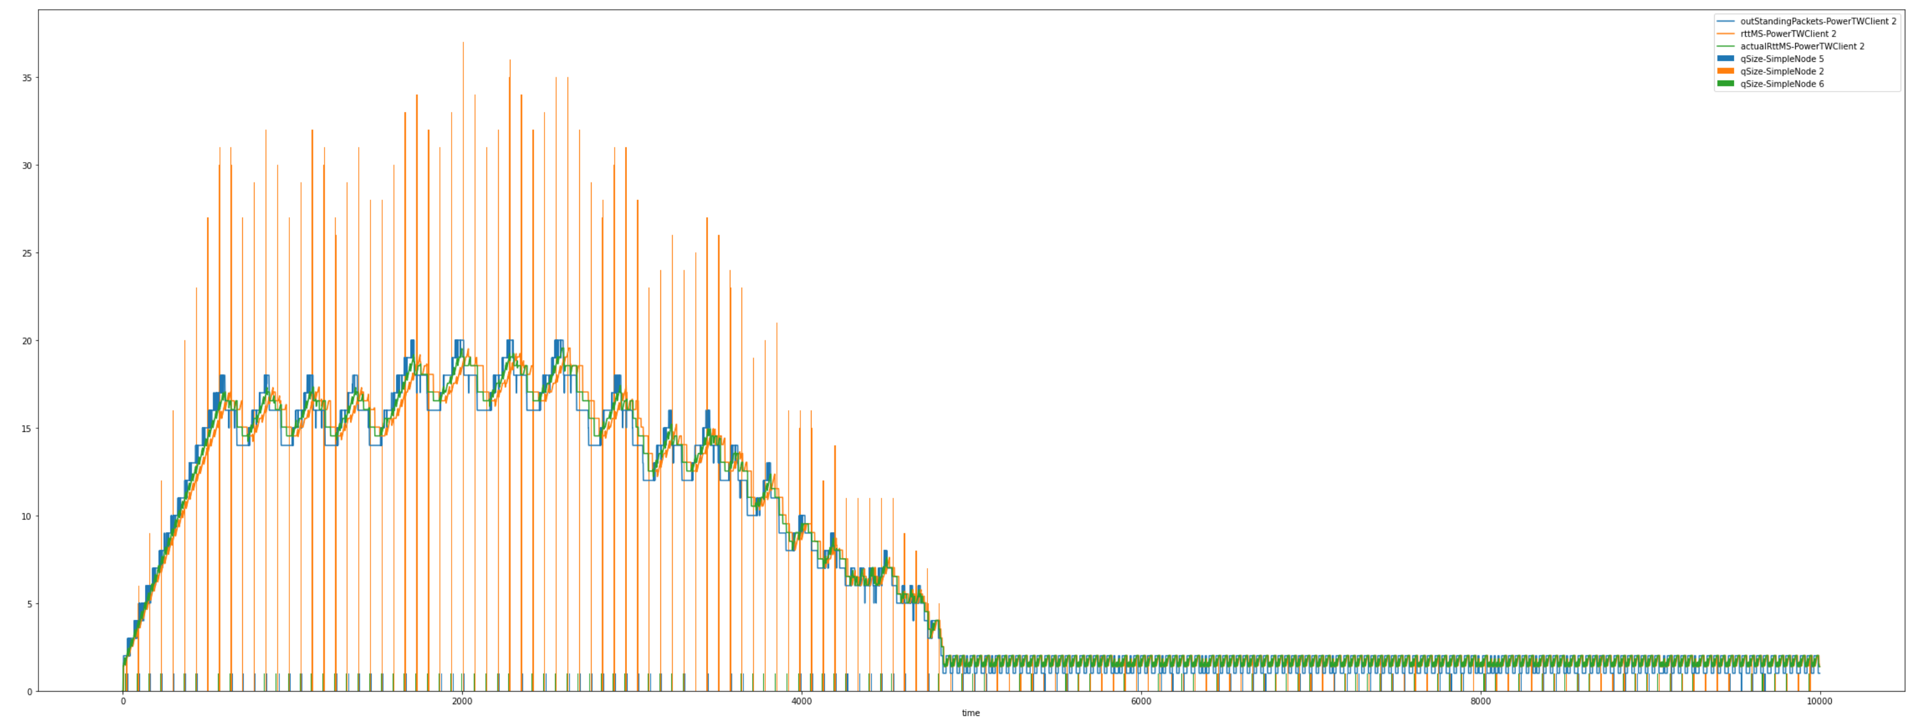
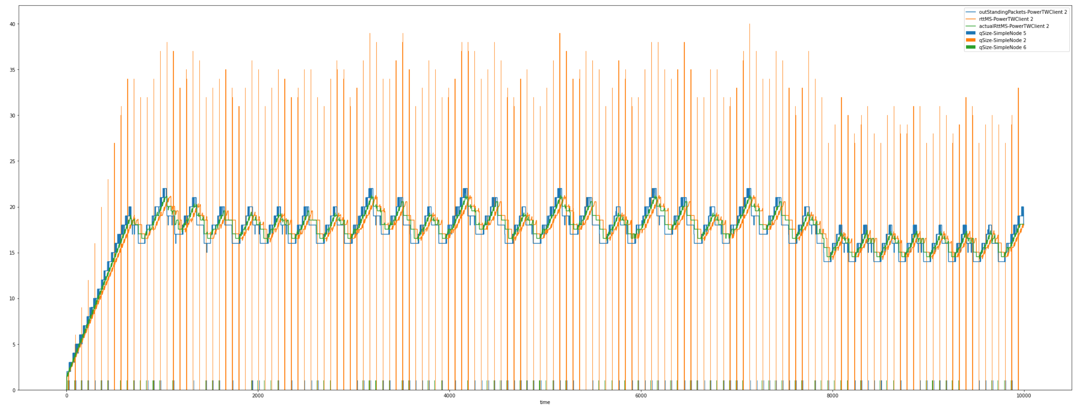
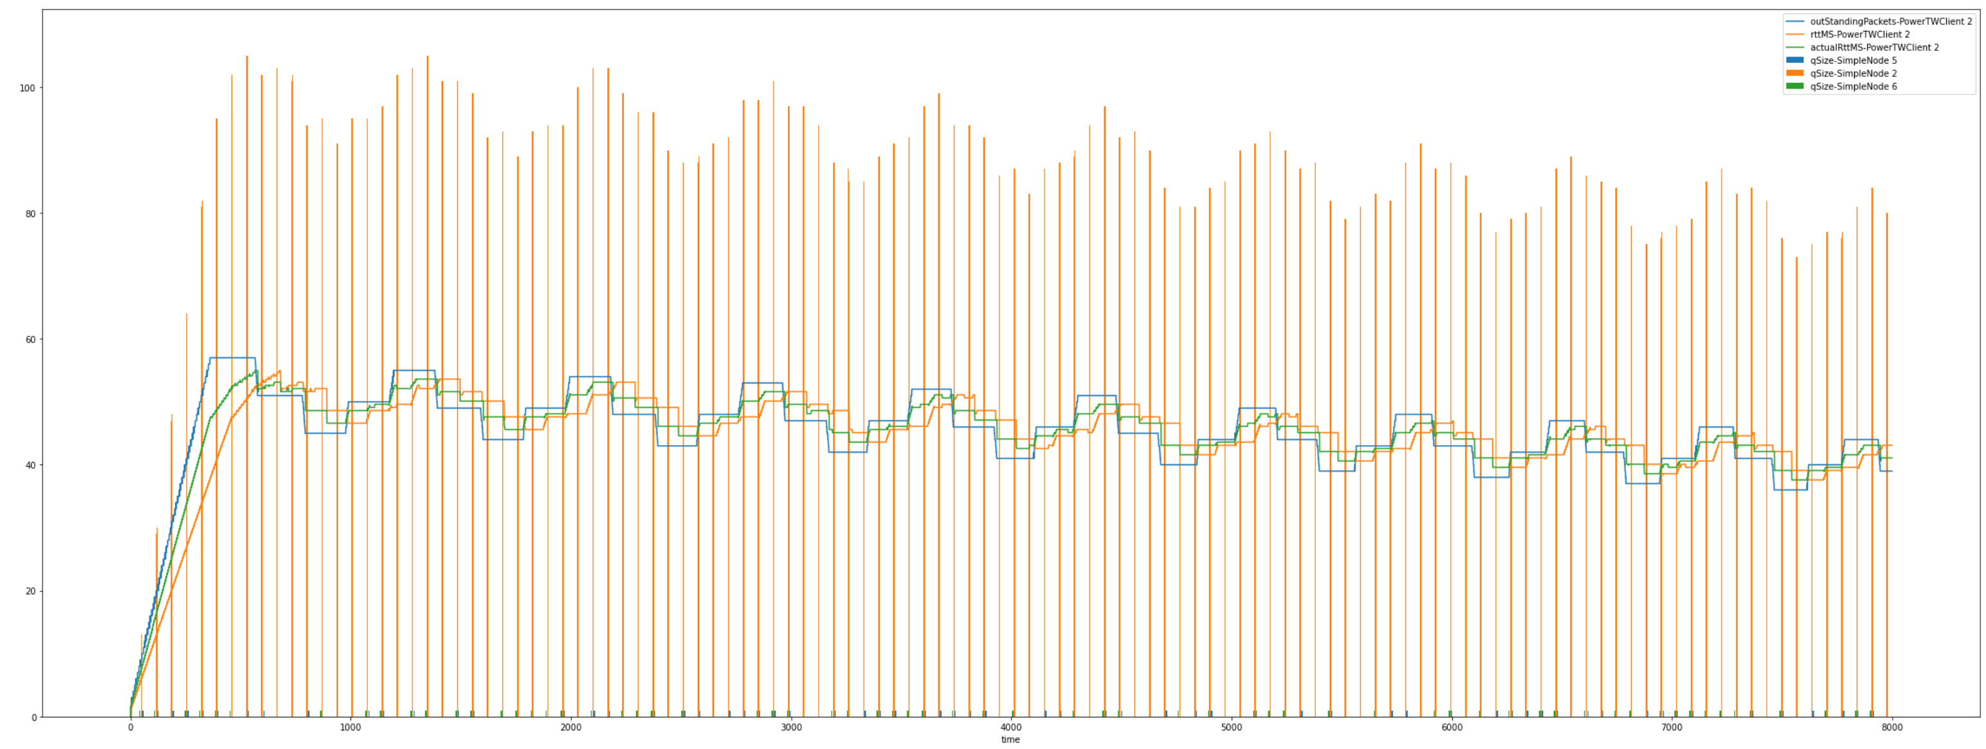
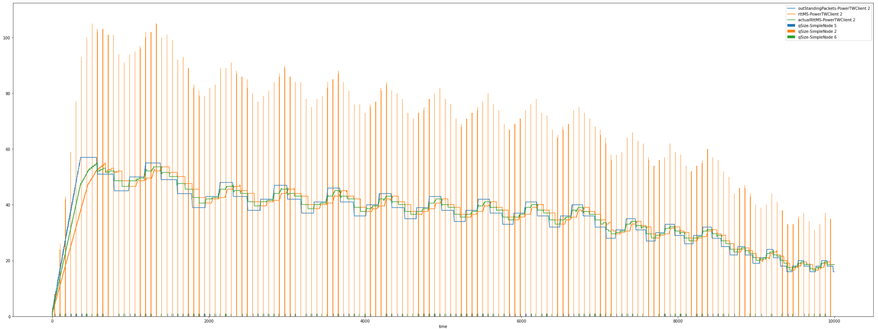
Impact of exploration when power increases.
No exploration
Exploration : 0.2

Slide 28
Impact of initial max_outstanding packets

Slide 29
RTT estimation and policy update cycles
P1 sent
Pm sent
Rtt estimation on P(m)
1 RTT
1 RTT
1 RTT
Policy update
P1 ack
Pm ack
Policy update
Whenever we update the policy, the impact on rtt can only be reliably measured after 2 currentRTT times. But there will still be impact of previous queue sizes before the policy updates.

Slide 30
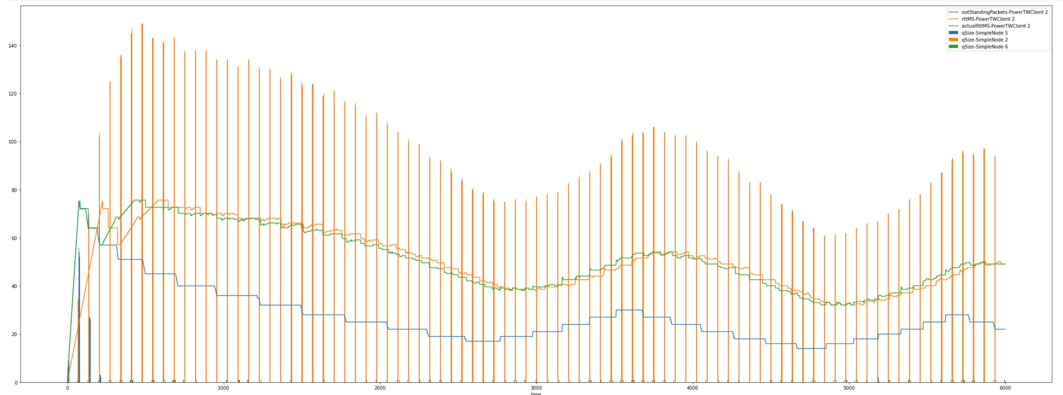
Interesting observations for 100 max outstanding packets with delivery rate 1.5k both clients
The client does not try to optimize after a lower boundary
We need to add some exploration mechanism
What to do when rtt does not change?

Slide 31
Client ideas
Find optimal rtt and throughput in the beginning. And try to find a trade off.
RL #1: state (an MDP on S = (rtt, max outstanding, curr outstanding) A = amount of increase/decrease = {+-10%, 20 %) = discrete values.
RL #2: state (S = (a short history of power, rtt, max outstanding, curr outstanding)
Q(s,a) = goal rtt – curRtt.
Exploration, e = 0.1 or a function. E can be reset.
Power trend over several rtts (right now 1 rtt).

Slide 32
Event Simulator
start
timestep <= maxTimeSteps
End
Call onTimeStepStart
of each node (reset stats)
Events = {ArriveNode, EnterChannel}
has Event in the timeStep?
notifyClients (creates packet events)
N
Y
New events = Execute Event
Call onTimeStepEnd
of each node (collect stats)
Add new events to the event queue
timeStep++

Slide 33
Algo 1. policy cycle
Estimate rtt
Update policy
Wait 2rtt time
Go back to 1

Slide 34
PowerClient - policy
Power = outstanding_packets / rtt^2
If power 2rtt before is less than current power (increase):
if exploit:
increase max_outstanding_packets by 20%
return
Decrease max_outstanding_packets by 20%
If max_outstanding_packets < minimum_threshold:
max_outstanding_packets = minimum_threshold
return

