Slide 1
DSVA Merger Content Strategy
April 2018

Slide 2
Outline
This is our strategy for merging Vets.gov and VA.gov tools and content and for setting a strong, global foundation for the future VA.gov.
1. Our content design goals
2. Our content design principles
3. Content design problems
4. Proposed global content model
5. How we will execute this strategy

Slide 3
1. Our content design goals

Slide 4
These are our content goals for 2018 and beyond
OUR CONTENT DESIGN GOALS
Get Veterans to the tools and content they want and need in just 1 or 2 clicks
Help realize the Digital Modernization Vision to have the best online experience in the federal government (July 2017)
Help realize the CTO’s top 2018 priority to make VA’s online experience match that of a typical Fortune 500 company
Future-proof our content and IA so future tools and content have a place to go
Create adaptable content that can be surfaced contextually (i.e., personalization)
Better structure content that is CMS-, SEO-, and analytics-ready, and flexible for multi-user, multi-device contexts
Clarify and streamline content ownership and management (i.e., content governance)

Slide 5
2. Our content design principles

Slide 6
These are our guiding principles for designing and structuring our content and IA on VA.gov
OUR CONTENT DESIGN PRINCIPLES
Collocate content: content items about the same topic are grouped together
Produce information scent: content labels are appropriately descriptive
Create multiple access paths: the same content can be accessed in multiple places and through different flows
Make the agency’s internal structure invisible: users care about the tools and content they want and need, not which VA administration or organization provides it
Build trust and transparency: users need single sources of truth and transparency into their journey with VA
Use plain language (as much as we can): make it easy for users to read and understand VA content

Slide 7
3. Content design problems

Slide 8
We have a lot of content models and content problems
Content design problems
A lot.

Slide 9
The benefit lifecycle is rigid and doesn’t apply to all tools and content across VA.gov
Content design problems
Explore
Apply
Track
Manage

Slide 10
There are many benefit categories
Content design problems
Health Care
Disability
Education and Training
Careers and Employment
Pension
Burials and Memorials
Housing Assistance
Life Insurance
Records

Slide 11
Three administrations own the tools and content
Content design problems
VHA
VBA
NCA

Slide 12
There are Veteran sub-groups and other non-Veteran audiences that use VA.gov
Content design problems
Veterans
News Media and the Public
Family, Dependents, and Caregivers
Medical Professionals
Veteran Service Organizations, Partners, and Small Businesses
Transitioning Servicemembers, Active Duty, Reserves
VA Employees

Slide 13
Unauthenticated vs. authenticated tools and content serve different purposes
Content design problems
Unauthenticated (not logged in)
New users and new benefit-seekers
Authenticated (logged in)
Personalized, customized user experience
Returning users and post-benefit-seekers
Single transactions (i.e., apply once, find a facility once, etc.)
Multiple, routine transactions (i.e., track and manage many times; e.g., refill a prescription)
Profile, account, and personal document management
Drives account creation

Slide 14
We lack single sources of truth for individual benefits and topics
Content design problems
VA.gov
MyHealtheVet
Explore
Vets.gov
/healthbenefits/apply/
How do I apply for health care?
/mhv-portal-web/va-health-benefits
/health-care
/health-care/apply/

Slide 15
4. Proposed global content model

Slide 16
The challenge
Proposed content model
How do we create a global content model that accounts for competing content, organizational, and audience structures and also set a strong, global foundation for the future VA.gov?

Slide 17
A hub-and-spoke content model…
Proposed content model
HUB
Spoke
Spoke
Spoke
Spoke
Spoke

Slide 18
…with the benefit category as the hub…
Proposed content model
Education

Slide 19
…and the benefit lifecycle as the spokes…
Proposed content model
Education
Explore and Apply
Track and Manage
Other Resources

Slide 20
…allowing for cross-benefit tools and content…
Proposed content model
Education
Explore and Apply
Track and Manage
Other Resources
Careers
Explore and Apply
Other Resources
Track and Manage
GI Bill
Comparison
Tool

Slide 21
…and ownership by each administration.
Proposed content model
Education
Explore and Apply
Track and Manage
Other Resources
Health Care
Explore and Apply
Other Resources
Track and Manage
Veterans Benefits Administration
Veterans Health Administration

Slide 22
What a benefit hub would look like
PROPOSED CONTENT MODEL
Disability Benefits
You may be able to get VA disability benefits if you got sick or injured, or developed a mental health condition (like PTSD) while serving in the military.
Need help?
Call us v
Explore and Apply
Determine eligibility >
Disability conditions >
Submit an appeal >
Track and Manage
Track your claims and appeals >
How to navigate the appeals process >
More Resources
VR&E benefits and services >
Adaptive housing grants >
Go to VBA page >

Slide 23
Why this global content model works
PROPOSED CONTENT MODEL
Consolidates into 1 model and aligns the 3 main existing VA global content models (by benefit category, by benefit lifecycle, and by administration)
Is Veterans-first and centered on what users want and need
Creates a single source of truth for each benefit category and its tools and content, resulting in better SEO and analytics and a better user experience
Is flexible enough to allow for other non-benefit hubs like audiences (e.g., ‘Family and Caregiver Benefits,’ ‘For Transitioning Servicemembers,’ etc.) or topics (e.g., ‘Research,’ ‘About PTSD,’ etc.)
Provides a place for global VHA, VBA, and NCA content that crosses individual benefits
Results in a streamlined content governance model for VA administrations, content managers, and other stakeholders

Slide 24
5. How we will execute this strategy

Slide 25
Executing our merger content strategy falls into 5 main work streams (in no particular order)
HOW WE WILL EXECUTE THIS STRATEGY
Build a new VA.gov homepage
Build a new VA.gov global navigation
Modify existing Vets.gov benefit hub pages and add new hubs
Deliver Vets.gov tools and content on VA.gov domain
Apply the U.S. Web Design System (USWDS) to VA.gov

Slide 26
1. Build a new VA.gov homepage
HOW WE WILL EXECUTE THIS STRATEGY
What this will include:
Single log-in box
Top Veteran tasks, tools, and resources
Access to all Veteran benefit hubs
New visual design and layout, incorporating the USWDS

Slide 27
2. Build a new VA.gov global navigation
HOW WE WILL EXECUTE THIS STRATEGY
What this will include:
New IA that prioritizes Veteran-facing tools and content
New visual design, incorporating the USWDS
Streamlining and updating all existing Vets.gov sub-navigation to align with new global IA

Slide 28
3. Modify existing benefit hub pages and add new hubs
HOW WE WILL EXECUTE THIS STRATEGY
What this will include:
Updating the content, links, and design of the existing benefit overview pages (8 in total)
Adding 1-2 additional hubs, as needed (e.g., ‘Records’)

Slide 29
4. Deliver Vets.gov tools and content on VA.gov domain
HOW WE WILL EXECUTE THIS STRATEGY
What this will include:
Updating all Vets.gov URLs to VA.gov URLs
We will need to negotiate over duplicative and redundant Vets.gov and VA.gov URLs to create single canonical URLs (e.g., va.gov/health – where does this go?)
Removing all references to ‘Vets.gov’ and replacing them with references to ‘VA.gov’ or ‘VA’
Removing all external link icons on Vets.gov links that go to VA.gov
Reviewing and adjusting (as needed) user flows for signing in

Slide 30
5. Apply the U.S. Web Design System (USWDS) to VA.gov
HOW WE WILL EXECUTE THIS STRATEGY
What this will include:
At minimum, all pages on VA.gov will get the USWDS applied to the header, global navigation, and footer
How best to apply the USWDS to page bodies will require more research into feasibility and scope

Slide 31
BONUS: What about a CMS?
HOW WE WILL EXECUTE THIS STRATEGY
This requires more time, research, and a long-term CMS plan for VA.gov
There are currently a lot of Teamsite CMS limitations, plus broken content management and publishing permissions and workflows
We will need to build some basic CMS functionality into the homepage for things like facility closings and other links

Slide 32
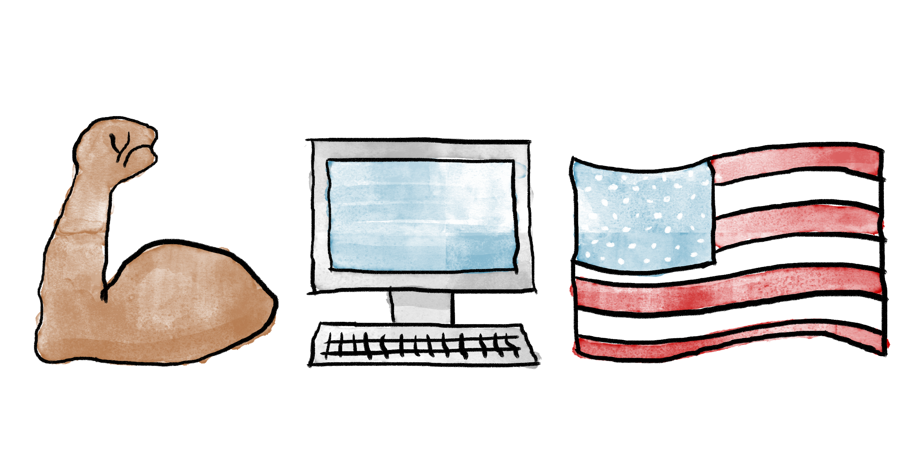
Contact Andy L., Jeff B., or Chris J. with questions
Go to the Merger repo for more info: /digitalservice/projects/Merger

