Slide 1

VSP Discovery and Logistics Workshop
VA.gov | [new team]
VSP Product Development Support Team
#vfs-platform-support
July 8, 2019

Slide 2
Welcome!

Slide 3
Agenda
VSP ONBOARDING
Discovery
Demo: Slack and Zenhub walkthroughs
Demo: Ticket creation in Zenhub
Demo: Pull request creation in Github

Slide 4
Discovery

Slide 5
Product Scope
DISCOVERY
Is this a new product, or an improvement of an existing one?
What are the goals or desired outcomes for this product?
Do you have any key performance metrics (KPMs) and if so, what are they?

Slide 6
Product Requirements
DISCOVERY
Is there a requirements document or engineering specification?
Does this product have any soft deadlines?
Does this product have any hard deadlines?
Does this product have any Congressional mandates?
Are there any promotional or marketing efforts planned?

Slide 7
Are there any work items in progress?
DISCOVERY
Are there any work items in progress?
This could include content strategy, information architecture, visual designs, or front/back-end code.

Slide 8
Work In Progress
DISCOVERY
Are there any work items in progress?
This could include content strategy, information architecture, visual designs, or front/back-end code.

Slide 9
Content Strategy
DISCOVERY
Are there any changes in strategy or copy for this product?
Are there any changes in formatting or SEO strategy?

Slide 10
Information Architecture
DISCOVERY
Are there any URL or site structure changes included in this product?
Will this product require any new URLs or homepage calls to action?
How do you expect a user to find this product or service?

Slide 11
User Research
DISCOVERY
Does your team conduct user research as part of your process?
Do you conduct quantitative, qualitative, or another type of research?
Does your team do any type of mobile or accessibility testing as part of your research?

Slide 12
Design and UX
DISCOVERY
What is your team's design process? Do you prefer to work mobile-first?
How does your team approach responsive design?

Slide 13
Front End Development
DISCOVERY
Has your team previously used the Formation design system?
How do you approach testing? Does your team prefer to write unit, e2e, or integration tests?
Does your team include tests as part of code submissions?

Slide 14
Back End Development
DISCOVERY
Does your team know of any integration points like a login routine that will be needed for your product?
Are there any APIs needed to make your product function correctly?

Slide 15
Accessibility
DISCOVERY
Are you planning to integrate with any third-party libraries or UI components like drag-and-drop or mapping interfaces?
Does your QA effort include any accessibility testing?
Can you describe the test procedures used?
Would you be interested in additional accessibility best practice training sessions?
Can you describe the type of training that would be most useful?

Slide 16
Slack walkthrough

Slide 17
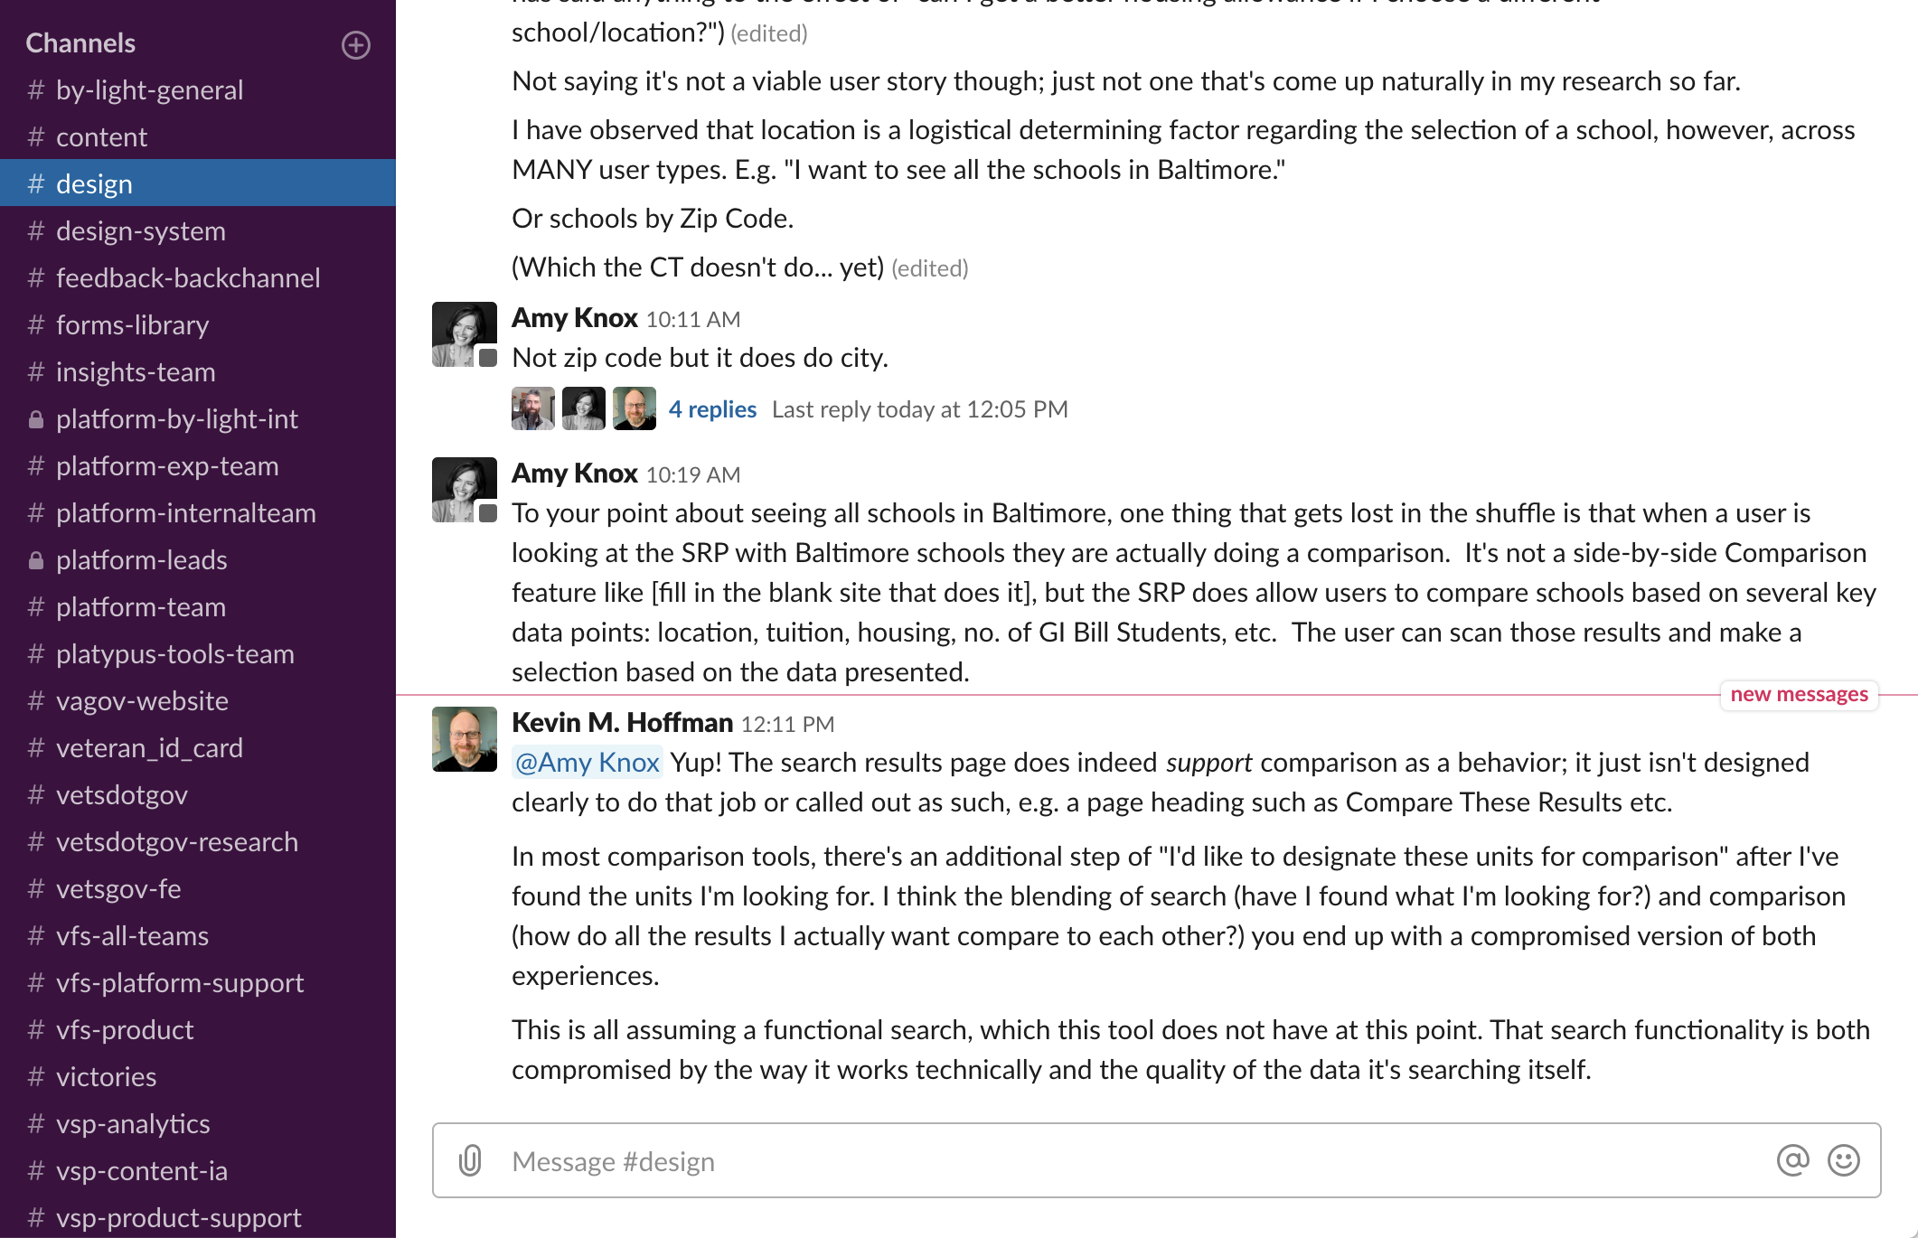
Slack
COMMUNICATION
@-messaging in Slack
Use public channels for questions and discussion

Slide 18
Zenhub walkthrough

Slide 19
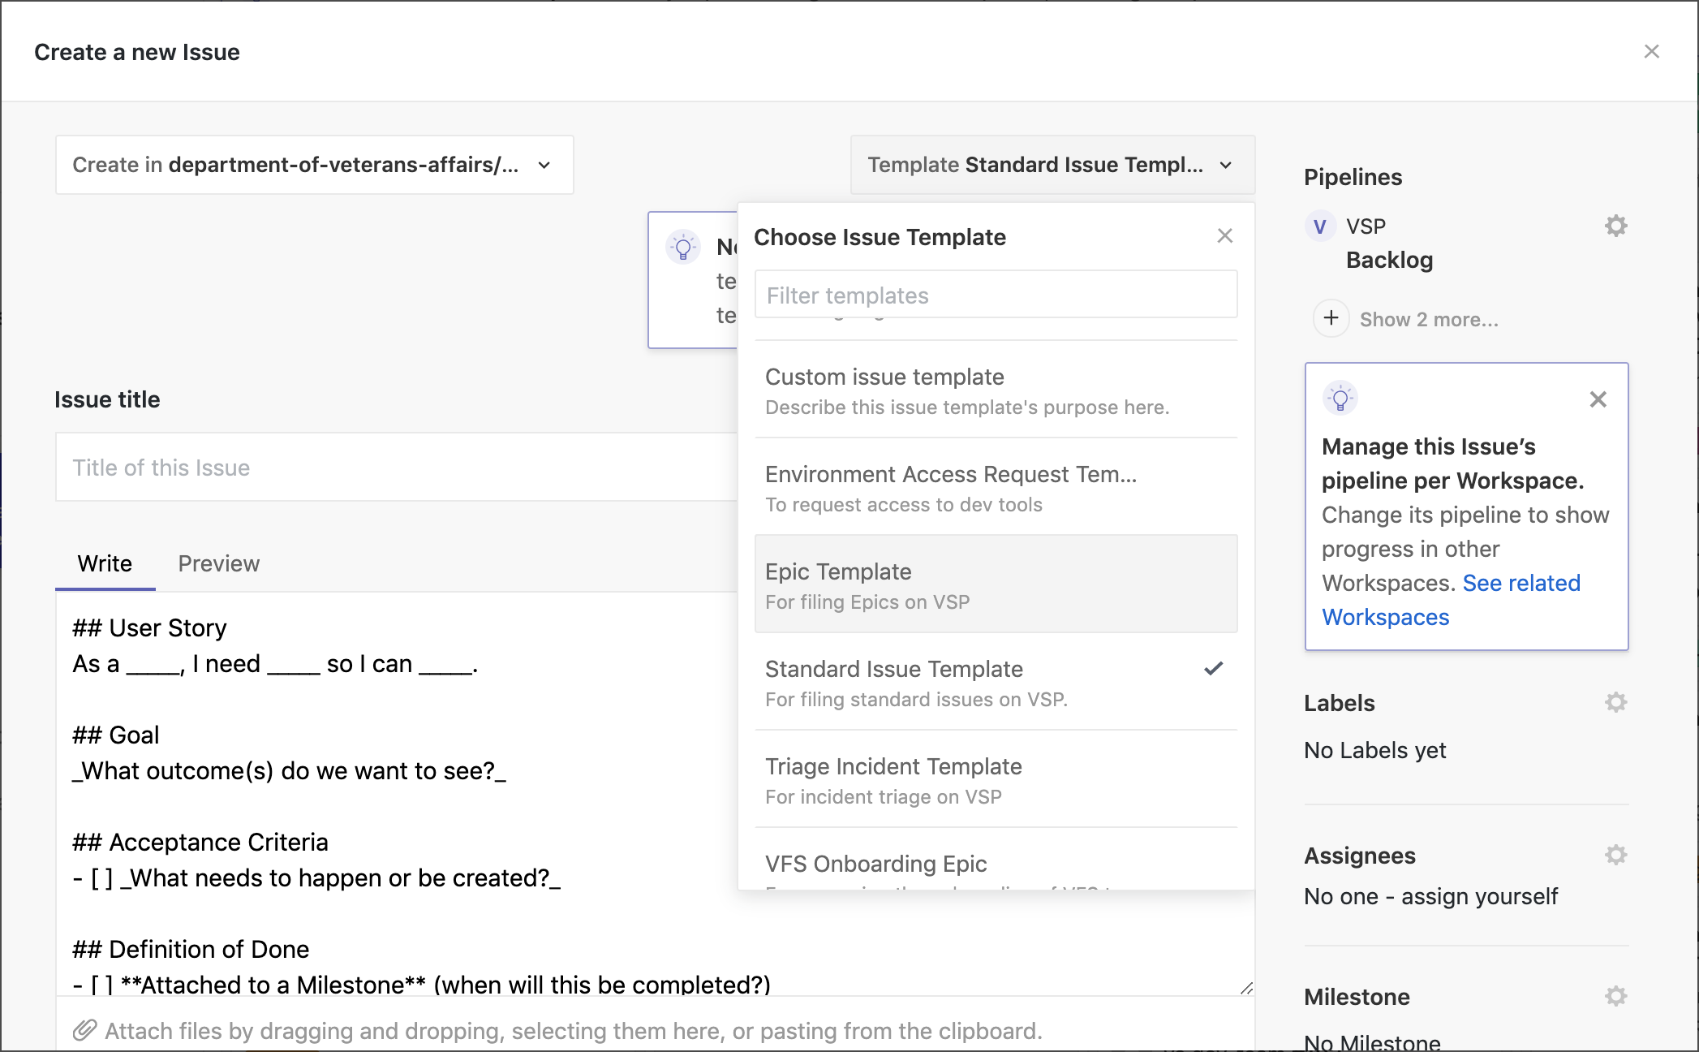
Zenhub
COMMUNICATION
Create an epic
Create an issue and associate it with the epic
Create another issue and demonstrate the blocker feature

Slide 20
Pull Request Creation

Slide 21
Pull Requests
COMMUNICATION
Discuss the pull request cadence:
Frequency
Size of code change
When to break a PR into smaller atomic changes
Show the PR template
Show how to associate the pull request with a Zenhub issue
Show how to use the draft PR feature
Show how to mark the PR ready for review
Show how to ask a reviewer for a second look (re-request)

Slide 22
Thank you!

