Slide 1

UX Onboarding
VA.gov | [new team]
Emily Waggoner, VSP Lead UX Designer
emily@adhocteam.us
Layla Soileau, VSP Senior UX Designer
layla@adhocteam.us
July 18, 2019

Slide 2
Welcome!
Notes:
Emily

Slide 3
Agenda
UX ONBOARDING
Introductions
VA.gov overview
UX practice
Research
Design
Content and Information Architecture
508 & accessibility
Feedback
Questions and discussion
Notes:
Emily

Slide 4
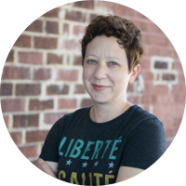




Who we are
UX ONBOARDING
Emily Waggoner
UX Design Lead, VSP
Slack: @emily
Layla Soileau
Senior UX Designer
VSP Product Support
Slack: @layla
Amy Cesal
Senior UX Designer
VSP Insights & Analytics
Slack: @Amy Cesal
Trevor Pierce
Accessibility Expert
VSP Product Support
Slack: @Trevor Pierce
Notes:
Emily/Layla

Slide 5
Who are you?
UX ONBOARDING
One minute each:
Name
Role
What are you excited about?
What are you nervous about?
Notes:
Emily facilitates
Layla takes notes

Slide 6
VA.gov’s mission
UX ONBOARDING
VA.gov enables Veterans to discover, apply for, track, and manage the benefits they've earned.
VA.gov aims to be the new home for all Veteran-facing, transactional services.
Notes:
Layla

Slide 7
Tour of VA.gov
Notes:
Emily

Slide 8
Design and Research at VA
UX ONBOARDING
Platform
Amy Cesal Ad Hoc
Mikki Northuis Ad Hoc
Layla Soileau Ad Hoc
Trevor Pierce Ad Hoc
Emily Waggoner Ad Hoc
Applications
Katelyn Caillouet Ad Hoc
Ian Hilton Oddball
Kevin Hoffman DSVA
Amy Knox Booz Allen
Carola Ponce DSVA
Samara Strauss DSVA
Alex Taylor Ad Hoc
APIs (Lighthouse)
Julia Elman Ad Hoc
Maria Vidart-Delgado Ad Hoc
Design System
Jared Cunha DSVA
Ryan Thurwell DSVA
Notes:
Emily

Slide 9

How VFS teams work
UX ONBOARDING
Agile, two-week sprints
Veteran-centered design
Discovery
Prototype
Test
Launch
Build
Notes:
Layla

Slide 10
How we’ll collaborate
UX ONBOARDING
Weekly design meeting
Design reviews
Office hours
Check-ins
One VSP design team member will attend a stand-up meeting once a week
We’re available to be research notetakers and observers
Notes:
Layla

Slide 11
Working remotely or with remote teams
UX ONBOARDING
Default to over-communicating
Take advantage of Zoom (in particular video)
Sit in on remote user research sessions
Find time to reach out and just chat with people
Notes:
Layla

Slide 12
Slack
UX ONBOARDING
UX channels:
#design
#design-system
#feedback-backchannel
#vetsdotgov-research
Use DMs when it truly needs to be private
Ask questions in public channels
Use wtf-bot to decode acronyms (/wtf ATO)
Everything in the DSVA Slack is subject to the Freedom of Information Act (FOIA)
Notes:
Emily

Slide 13
Tour of Slack
Notes:
Emily

Slide 14
GitHub
UX ONBOARDING
Most of your work (or requests to others for work) should be connected to a ZenHub issue or product folder
Decisions made in Slack conversations and meetings should be documented in GitHub
Planning, notes, documentation should be in a markdown (.md) file
Research documentation and design decisions should be stored in appropriate research folder within product folder
Cross-link any research to the research history
Notes:
Layla

Slide 15
Tour of GitHub & ZenHub
Notes:
Layla - Project structure GitHub, Project Zenhub, add a ticket with the template, add a bug

Slide 16
Email
UX ONBOARDING
Ideally only used when communicating with people outside the DSVA team, such as stakeholders
Notes:
Layla

Slide 17
Recurring meetings
UX ONBOARDING
Weekly UX team meetings
Sprint team meetings: Your team lead and product manager will send you these. Expect standups most days, and weekly backlog grooming or sprint planning.
Teamwide meetings: Bi-weekly demo and Team of Teams
Notes:
Emily

Slide 18
How we UX
Notes:
Emily

Slide 19
How we UX
UX ONBOARDING
Design, research, content, IA, and accessibility are integrated from the very beginning
Be able to both lead and be led
Bring your team along with you on your process
Always ask WHY
Validate assumptions
Always be improving
Look for the story in everything we do (for stakeholders, ourselves, and potential medium posts)
Notes:
Emily

Slide 20
Research

Slide 21
Research
UX ONBOARDING
Most designers do their own research or engage deeply in the research process. There's no magic formula for doing research but it often (sort of) looks like this:
Discovery sprint to get the lay of the land and jump start your project.
Analytics when there are existing/comparable systems
Comparative analysis
Baseline testing of any existing/comparable systems
card sorting / tree testing
Early prototype testing (can be scrappy, paper-based)
Prototype testing or testing on staging with code
and for all things, we aim to test with a variety of users -- including those with low-literacy, cognitive disabilities, visual impairments/assistive technology
Notes:
Layla

Slide 22
Remote moderated sessions
UX ONBOARDING
Remote research sessions allow VA.gov to talk to Veterans all over the country and include research in the design process more frequently.
Remote sessions may be conducted using Zoom, Webex, or GoToMeeting.
Perigean will provide login and account details. Use their accounts, not yours.
Notes:
Layla

Slide 23
In-person moderated sessions
UX ONBOARDING
Washington, D.C. only
In-person sessions must be conducted in Washington DC, and the lead researcher is responsible for identifying and securing a location, and communicating that location back to Perigean.
In past, teams have used contractors offices, public library spaces, and WeWork.
We do not recommend running sessions in coffee shops and other public restaurants if you are planning to discuss a participant's PII or PHI. While you may use DSVA space for sessions, you need to make sure that you can get participants through security. This will add time and additional to your sessions, and may make your participant feel uncomfortable.
Notes:
Layla

Slide 24
Recruiting for moderated sessions
UX ONBOARDING
Recruiting Veterans, service members, caregivers, and dependents
DSVA has a recruiting contract with Perigean Technologies, a company that helps us recruit, screen, gather consent from, and schedule research sessions with Veterans.
If you want to leverage this option, email or slack Lauren Alexanderson (or Lacey Higley during July 2019) with the link to your research plan in the appropriate GitHub product folder
For remote sessions, 1 week prior to your desired start date
For in-person sessions, 2 weeks prior to your desired start date
Notes:
Layla

Slide 25
Recruiting for card sort, tree test, etc.
UX ONBOARDING
(NO SURVEYS or QUESTIONNAIRES allowed)
If you need to recruit a wider pool of Veterans for a card sort, tree test, chalkmark, or other test, email or slack Lauren Alexanderson (or Lacey Higley during July 2019) with the link to your research plan in the appropriate GitHub product folder.
They may be able to help you tap into other options.
Notes:
Layla

Slide 26
Recruiting for VA staff, internal teams, etc.
UX ONBOARDING
DSVA does not have a contract for recruiting internal staff, VSOs, press, or other external audiences not identified above.
Work with your stakeholders and product leads to identify and recruit these audiences.
Notes:
Layla

Slide 27
Before you begin research
UX ONBOARDING
1
2
3
4
5
CREATE RESEARCH FOLDER
All project-related research & elements should live in this GitHub folder.
CREATE RESEARCH PLAN
View the research plan template
REVIEW PRE-RESEARCH CHECKLIST
View the pre-research checklist
SHARE WITH COLLEAGUES
Recruit observers and notetakers for your research sessions
RECRUIT PARTICIPANTS
Learn more about recruiting
Notes:
Layla

Slide 28
Tracking research in ZenHub
UX ONBOARDING
Label: Use "research" - should be one universal label so that we can find all research tasks
Epics: Create any research tickets in the existing epic (i.e. the "discovery" or "design" epic or the "launch" epic for a product). Link to the research template within each research issue.
Fields to use for Epics
epics have a release (PI number), not a milestone
Milestones are only for sprints
can use "future" as the release if we don't have a specific PI for it
all epics go into the "epic" pipeline
View more info and see examples
Notes:
Emily

Slide 29
Demo: Creating research tickets in GitHub
Notes:
Layla - Make fake research tickets: https://github.com/department-of-veterans-affairs/vets.gov-team/blob/master/Practice%20Areas/Research/June2019_updated_research_process.md

Slide 30
After research
UX ONBOARDING
If you have a preferred way of doing synthesis: consider how you might involve remote members of your team in that process, so they have buy-in to the outcomes.
If you do NOT have a preferred way of doing synthesis or want help: ask fellow designers to work with you to come up with a plan. Include your sprint team!
Plan to present/socialize your results: minimally, to your team and fellow designers. You may also be asked to present at biweekly sprint demos, at PI research summaries, or with stakeholders.
Update Research History document
Notes:
Layla

Slide 31
Design
Notes:
Emily

Slide 32
Design
UX ONBOARDING
Mobile-first
Use established design patterns when possible
Design for accessibility
Get continuous, frequent feedback from your team
Test your designs with Veterans early and often

Slide 33
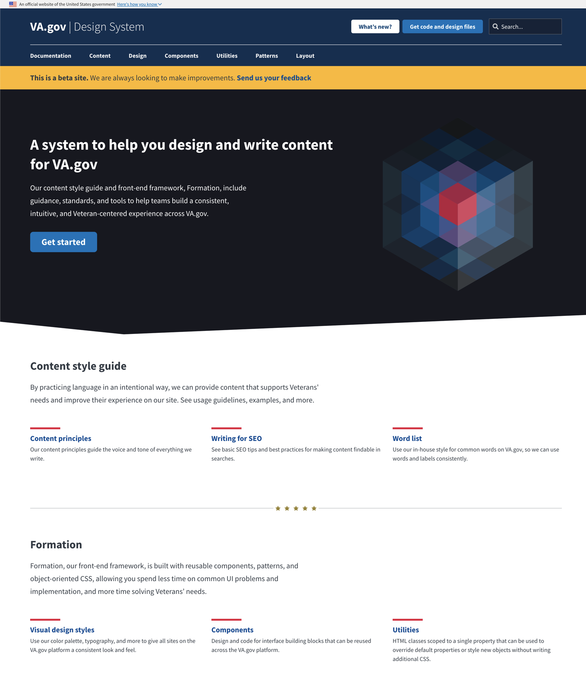
VA.gov design system
UX ONBOARDING
Go to design.va.gov
This is our “single source of truth” for design.
If you have questions about a pattern or need to add one, please bring it up in the #design-system Slack channel!

Slide 34
Tour of design.va.gov
Notes:
Emily

Slide 35
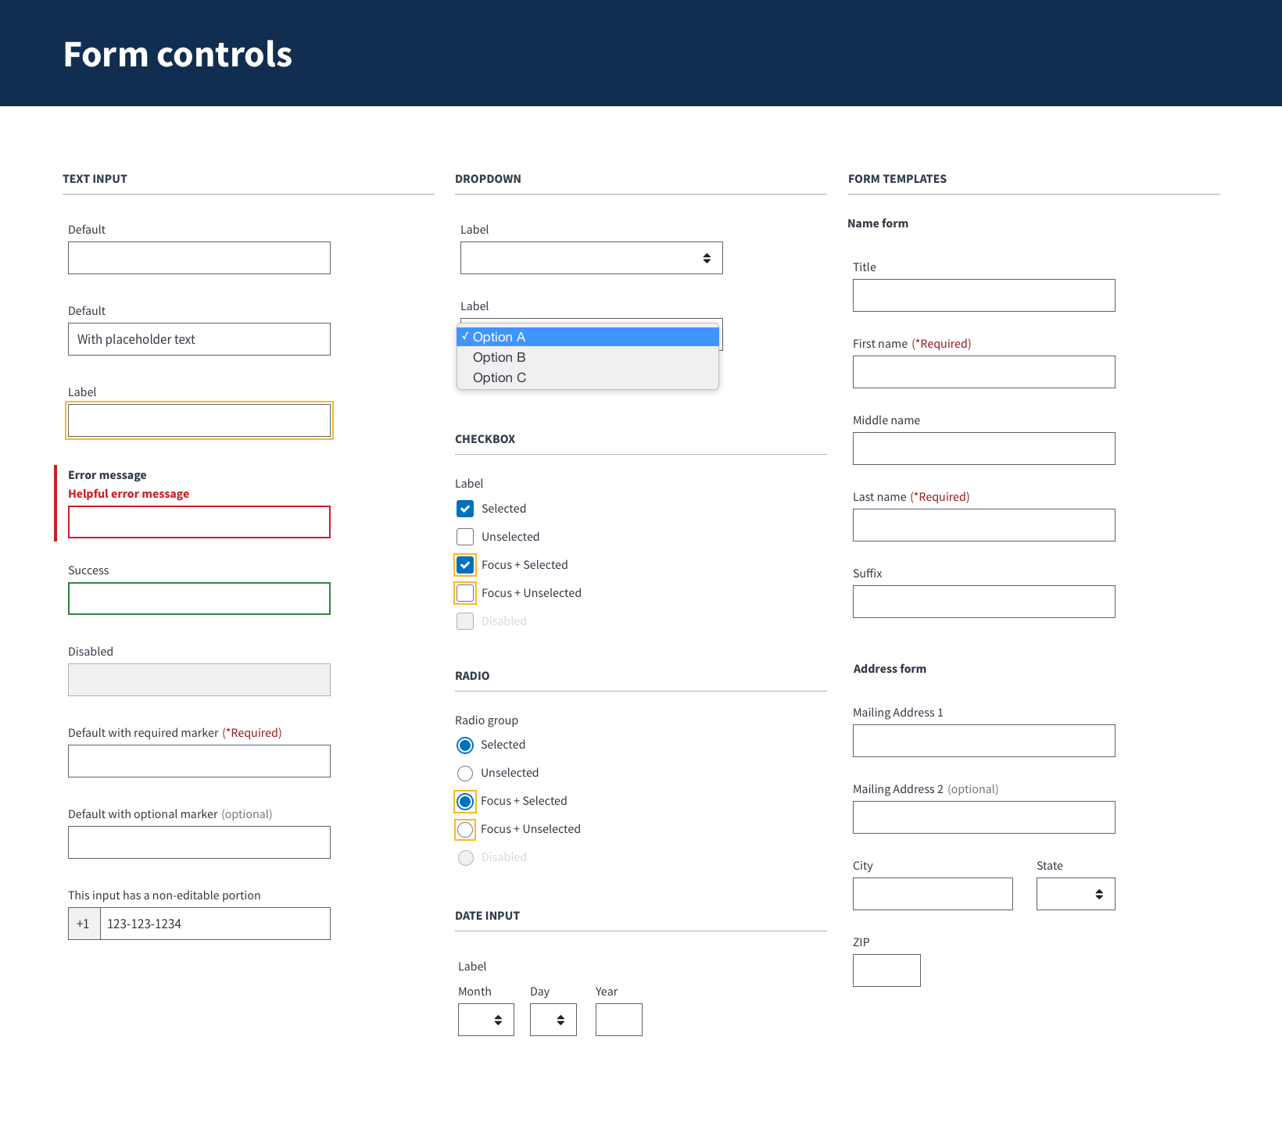
Sketch pattern library
UX ONBOARDING
A tool for designers to create hi-fidelity mockups of features on VA.gov.
It also serves as documentation of the styles and components that make up VA.gov, as well as basic guidelines for the design system.
Download the latest Sketch pattern library
Notes:
Emily

Slide 36
Tour of Sketch library
Notes:
Emily

Slide 37
Additional resources
UX ONBOARDING
List of design tools
Form design process
Official VA Graphics Resources
Notes:
Emily

Slide 38
UX review process
UX ONBOARDING
1
3
3
5
4
2
Designer prepares for the design review in advance
2
Reviewers discuss the design
Designs are reviewed by the team
The designer rejoins the conversation
View the full UX review process
Notes:
Emily

Slide 39
Content & IA

Slide 40
VA.gov content style guide
UX ONBOARDING
Go to design.va.gov/content-style-guide/
This is our house style guide for the VA.gov website.
It’s shared across VA administrations and teams, so we can speak with one voice and create a consistent, helpful experience for Veterans and non-Veteran customers.
For content questions ask Peggy Gannon, or post your question in the #content Slack channel
Notes:
Peggy or Emily

Slide 41
Content reviews
UX ONBOARDING
VSP Point of Contact: Peggy Gannon
Plan and review content early in the design process
How to prepare for content review
Talk with your team’s Content Strategist and agree on the best way to collaborate
Get final content review and approval before launching
Notes:
Peggy or Emily

Slide 42
Information Architecture
UX ONBOARDING
Define your Information Architecture
How your service will integrate into the existing Veteran-facing Services Platform?
How will your users find and get to your service?
How to prepare for an IA review
Notes:
Emily (also Emily to find IA guidelines and drop)

Slide 43
508 & accessibility
Notes:
Layla

Slide 44
Design for accessibility
UX ONBOARDING
Start with well-structured content that assistive devices can make sense of.
Use clear labeling and contextual help.
Create a clear hierarchy on each page/screen.
Don’t hide critical information in images or complicated diagrams.
Understand that many low-vision people don’t use screen readers.
Don’t rely on color or sound alone, to communicate critical information or cues.
Animation can be a helpful cue to re-enforce the impact of choices.
Design with low motor skills in mind.
Document keyboard focus targets when elements are added or removed.
View accessibility design principles in the VA Digital Service Handbook
Notes:
Layla

Slide 45
Accessibility resources
UX ONBOARDING
Accessibility and 508 Best Practices and Launch Guidelines
Resources for Designers (WebAIM)
Alternative Text (WebAIM)
What is Color Contrast? (The A11y Project)
Understanding Color Blindness (The A11y Project)
Don’t Use The Placeholder Attribute (Smashing Magazine)
Notes:
Layla

Slide 46
Accessibility tools
UX ONBOARDING
Tota11y accessibility visualization toolkit (Khan Academy)
Axe accessibility browser extension (Chrome and Firefox)
Tanaguru Contrast Finder
Colorblinding browser extension (Chrome)
ChromeLens browser extension (Chrome)
Notes:
Layla

Slide 47
What’s next?
Notes:
Emily

Slide 48
What’s next?
UX ONBOARDING
Schedule 1:1s:
Layla Soileau, UX Research & Design
Trevor Pierce, Accessibility
Peggy Gannon, Content
Mikki, Information Architecture
Your VA product owner
Notes:
Emily

Slide 49
Need help?
UX ONBOARDING
UX Design & Research
Emily
Layla
Content & IA
Peggy (content)
Mikki (IA)
Accessibility
Trevor
Notes:
Layla

Slide 50
5-minute survey
Link to survey
Notes:
Emily

Slide 51
How are you feeling?
UX ONBOARDING
Has anything changed?
What are you excited about?
What are you nervous about?
What questions do you have?
Notes:
Layla facilitates
Emily takes notes

Slide 52
Thank you!

