Slide 1
Embedded Application
User Space Drivers
Linux Kernel Drivers
Digital Hardware System

Slide 2
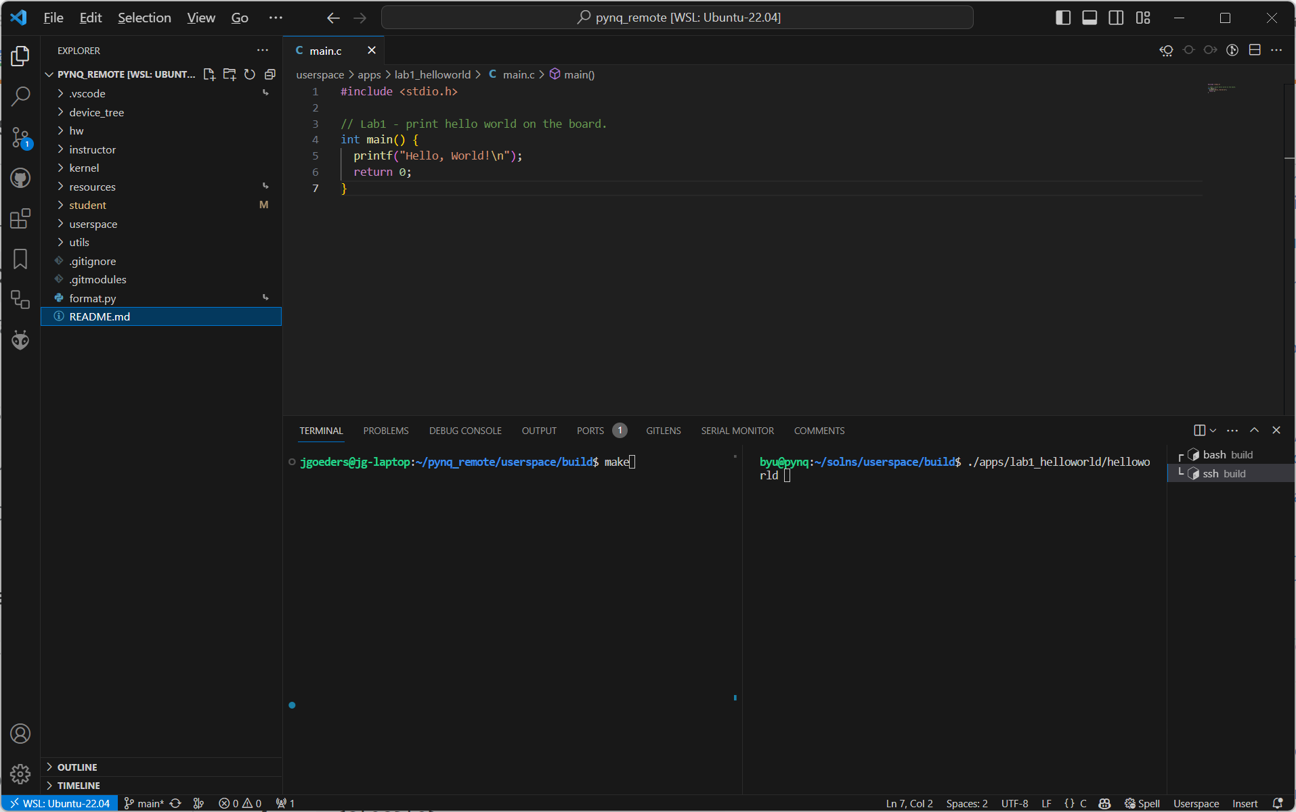
Open your mounted directory to view files here
Use one terminal to build your code locally
In another terminal, SSH into you PYNQ board and run your compiled programs

Slide 3
FIT
Processor
user_intc
UIO
irq
0x1E – interrupt input
addr bus
0x1D – interrupt input

