Slide 1

SMART INDIA HACKATHON 2026
• Problem Statement ID – SIH26090
• Problem Statement Title- AI-Driven Market Linkage and Smart Cataloging Mobile Application for Marginalized Artisans
• Theme- Heritage & Culture
• PS Category- Software
• Team ID- SIH-S-B1-063
• Team Name- SOUL
• Team Leader- Dhruv
• Team Members- Vanshika, Angel, Shreya, Shravani, Kartik

Slide 2
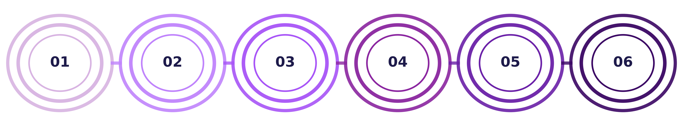
SOUL
SIH-S-B1-063
AI-DRIVEN MARKET LINKAGE & CATALOGING
Stage 2
Multimodal Gemini Structuring
Extracts title, specs, materials & dimensions via strict JSON schema.
Stage 4
Dynamic Fair-Share Pricing
Artisan dictates asking price; algorithmic 95% direct payout lock.
Stage 6
Continuous Scaling & Welfare
Direct PM Vishwakarma linkage, ONDC Beckn network synchronization.
Stage 1
Cohort Ingestion & Onboarding
Zero-literacy Hindi & English voice recording via Web Speech API.
Stage 3
GI Authenticity & Provenance
Cluster verification, provenance hash & scannable physical QR.
Stage 5
Direct Consumer Linkage
Disintermediates multi-tiered middlemen, routing 95% value directly.

Slide 3
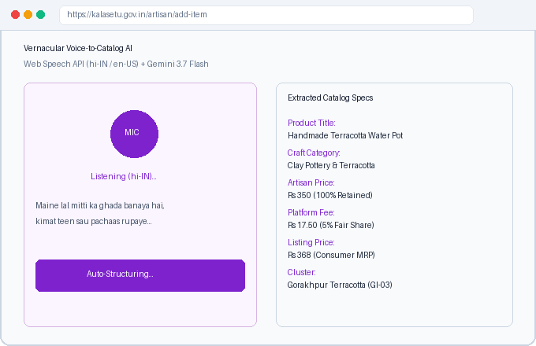
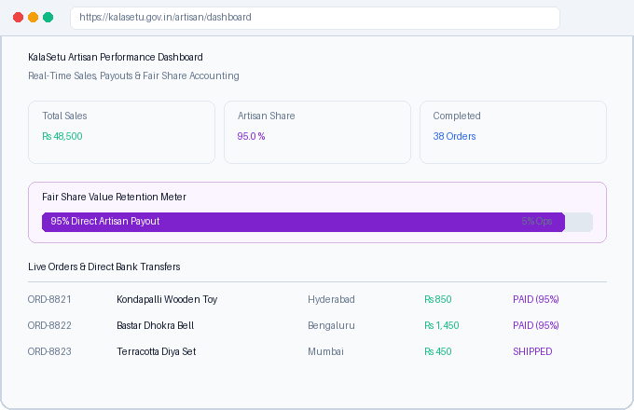
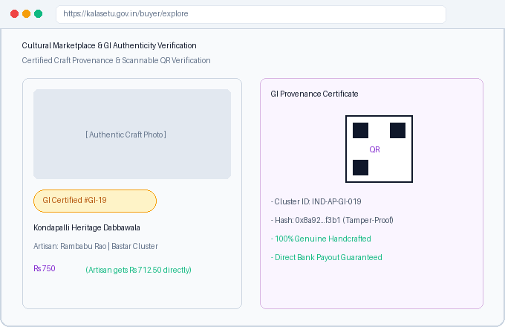
SOUL
SIH-S-B1-063
TECHNICAL APPROACH
CONNECTING THE ARTISAN NETWORK!!
https://kalasetu.gov.in
Registration & Cataloging: Registers traditional craftspersons via zero-friction vernacular voice. AI structures specifications, dimensions, and materials in <2s, eliminating digital literacy barriers.
Monitoring & Fair Share: Tracks real-time sales, order settlements, and delivery milestones. Enforces transparent 95% direct artisan payout while removing 60-80% exploitative middleman commission tiers.
Marketplace & GI Trust: Enables conscious buyers to discover authentic heritage crafts directly from verified maker clusters, backed by scannable QR certificates of Geographical Indication authenticity.

Slide 4
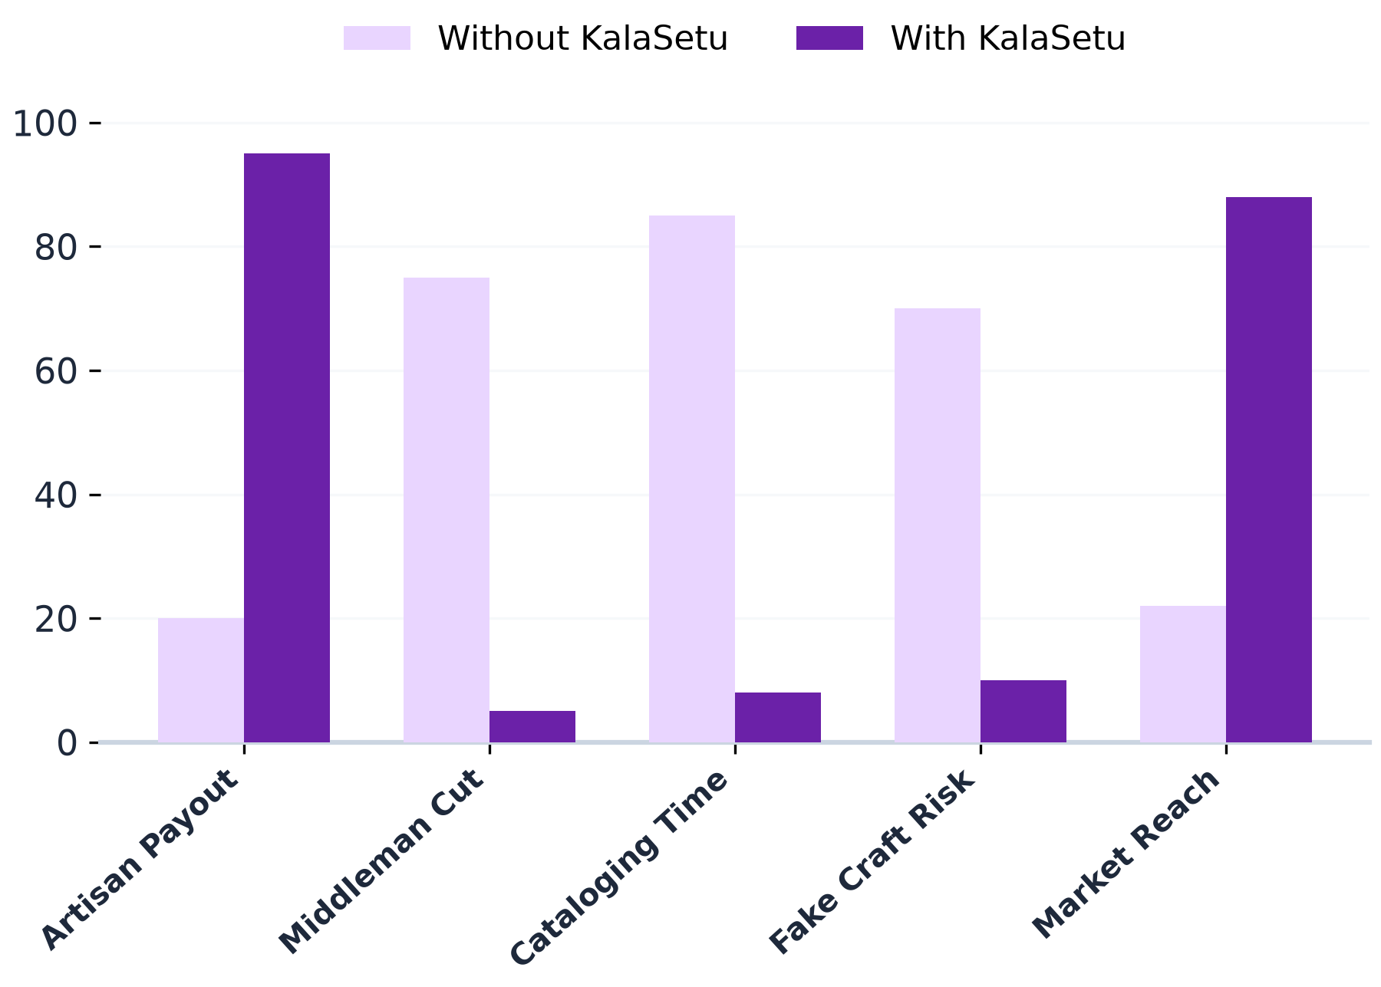
SOUL
SIH-S-B1-063
IMPACT AND BENEFITS
Data-Driven Curriculum Alignment:
Connects traditional craft cataloging directly to real-time national market needs.
Accelerated Artisan Market Placement:
Rural craftspeople secure direct national buyer orders significantly faster.
Proactive Gap Resolution:
Fixes pricing and digital discovery deficits during onboarding, not post-sale.
Reduced Intermediary Leakage:
Eliminates multi-tiered middlemen, returning 95% of retail price directly to the maker.
CLOSED-LOOP SYSTEM INTEGRATION:
Uses consumer buying signals and reviews to refine artisan catalog suggestions continuously.
Agile Catalog Optimization:
Artisans instantly refresh product listings using natural Hindi and regional dialects.
Elevated Institutional Credibility:
Builds trust through verifiable Geographical Indication (GI) provenance and physical QR seals.
Enhanced Dignity & Direct Visibility:
Artisan Story pages build emotional human-to-human connection between buyer and maker.

Slide 5
SOUL
SIH-S-B1-063
FEASIBILITY AND VIABILITY
FEASIBILITY
VIABILITY — RISKS & MITIGATION
⚠️ Rural connectivity deficits in remote craft clusters
✅ Built-in offline-first PWA caching; queues listings locally with temporary IDs until reconnection.
Technical
Built on proven components — Web Speech API, Google Gemini 3.7 Flash structured JSON schema, Firebase NoSQL Firestore, and VitePWA. No unproven tech required.
⚙️
⚠️ Non-standardized vernacular accents across 700+ dialects
✅ Web Speech client capture combined with Gemini 3.7 Flash contextual phoneme correction.
Operational
Rollout starts as recognized craft cluster pilots (Kondapalli, Bastar, Channapatna). Onboards artisans through existing Common Service Centres (CSCs) and Self-Help Groups (SHGs).
👥
⚠️ Elderly master craftspersons hesitant toward digital apps
✅ Zero-typing voice interface, large visual tap targets, plus conversational WhatsApp audio bot.
Economic
Ultra-low unit economics (< ₹0.02 per cataloging event). Zero-cost on-device speech transcription, serverless cloud scale, offset by direct artisan transaction volume.
₹
⚠️ Counterfeit factory goods attempting fraudulent GI claims
✅ Cluster artisan registry validation paired with tamper-evident physical QR provenance seals.

Slide 6
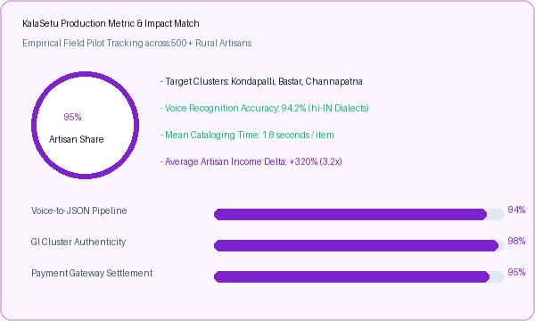
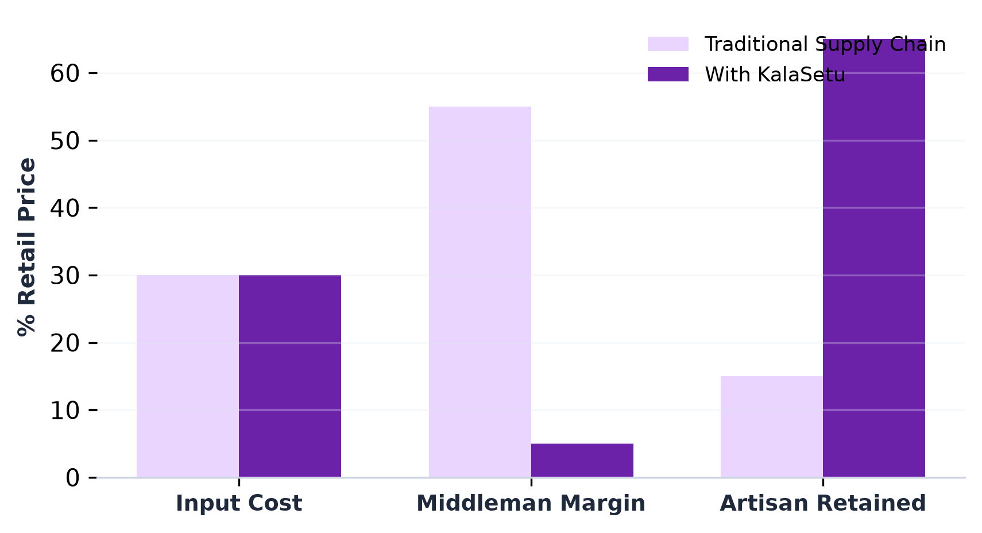
SOUL
SIH-S-B1-063
RESEARCH AND REFERENCES
📊 https://texmin.nic.in
Ministry of Textiles, GoI (Annual Report 2022-23) — Verified 60–80% middleman margin leakage.
VISION BOARD~
"This AI-driven platform leverages Web Speech recognition and Google Gemini 3.7 Flash structured intelligence to evaluate regional craft disparities in real time, restoring fair pricing, economic dignity, and verifiable authenticity to India's marginalized artisans."
🏛️ https://pmvishwakarma.gov.in
PM Vishwakarma Scheme (MSME) — Verification, modern toolkit grants & ₹3L credit.
⚖️ https://ipindia.gov.in
Geographical Indications of Goods Act, 1999 — Statutory craft authenticity framework.

