Slide 1
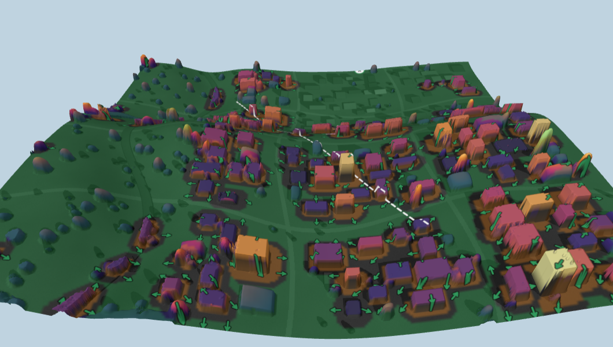
DepthWizard
One satellite image → a metric 3D surface model → an evacuation plan
Shadow-measured building heights, honest about uncertainty
Flood, landslide and earthquake escape routes
Runs offline in a browser on one office PC
Problem statement by ISRO · Working prototype
Notes:
Open with the question a district officer asks when the river rises: which buildings flood, and which way do people walk? DepthWizard answers that from one satellite image. It estimates heights, says how sure it is, and turns them into escape routes.

Slide 2
A 30 m DEM shows the hill, not the town on it
What free elevation data gives
What disaster planners need
Why existing options fall short
CartoDEM, SRTM, Copernicus GLO-30 at ~30 m
Hills and valleys are there
Individual houses, trees and streets are not
Datums differ: CartoDEM sits ~46 m off the geoid at Namchi
Which buildings sit in the flood or debris zone
Which buildings are tall enough to shelter on
Which way each street should run, and how long it takes
Where crowds will jam
LiDAR and stereo surveys are slow and costly
AI depth models output unitless numbers
Most tools stop at a 3D picture, not a decision
GIS tools need trained operators
The gap: evacuation decisions need building heights in metres, and free data stops at the terrain.
Notes:
Three columns: what we have, what planners need, and why the gap exists. The key point: the problem is not making a 3D picture, it is answering decisions that need heights in metres.

Slide 3
From image to evacuation plan in five steps
1
2
3
4
5
Read & reproject
AI relative height
Measure in metres
Model hazards
Route people
›
›
›
›
PNG, JPG or GeoTIFF; GeoTIFF reprojected to UTM so pixels are metres
Depth Anything V2 on 518 px tiles, aligned and blended without seams
Shadow length × sun angle, slope-corrected with the DEM; GCPs and datum fix
Flood (HAND), landslide susceptibility, earthquake debris reach
Walking-time field to safe zones, refuges, choke points, printable plan
Every output carries a label (absolute metres, metres above ground, or relative 0–1) and an error estimate.
Notes:
Walk the pipeline left to right. Stress step 3: this is where metres come from, and it is physics, not guesswork. Step 5 is what the user actually gets.

Slide 4
Heights you can defend: shadows first, AI second
Shadow measurement
Slope correction for hill towns
Height = shadow length × (tan sun elevation + terrain slope along the shadow). Sun angles come from GeoTIFF metadata or the acquisition time.
On a hillside, uphill shadows are shorter and downhill ones longer. Using the DEM slope cut shadow-height error from 5.5 m to 3.1 m.
Shadow-first fusion
Honest output modes
Buildings with a clean shadow keep their measured height. Others get the AI estimate, trusted only as far as it agrees with the measurements (ρ).
Absolute DSM · metres above ground · terrain only · relative 0–1. No metres are claimed without a scale source.
Notes:
This is our answer to 'it is just a wrapper'. The AI gives shape; physics gives metres. The slope correction matters most in Sikkim-type terrain. The rho value means the app measures how much to trust the AI on each image.

Slide 5
Demo-town result: 39% lower error on buildings and trees
3.1 m
RMSE of shadow-measured building heights (r = 0.91)
5.5 m
same, without the slope correction (r = 0.78)
−46 m
CartoDEM datum offset corrected automatically
Synthetic Namchi-like town with known truth (1024 × 1024 px at 0.5 m). Indian field validation is the next step.
Notes:
Be upfront that this is a synthetic scene where we know the truth exactly. Error drops from 11.5 to 7.0 m on objects. The slope correction is the single biggest gain. We do not yet claim Indian accuracy; slide 11 covers how we will get it.

Slide 6
Three hazards, each using the heights we measure
Flood
Landslide
Earthquake
Height Above Nearest Drainage: a rise of h metres floods every cell lower than h above its stream.
Susceptibility from slope, flow convergence and bare ground, plus a downslope run-out path.
Collapse debris reaches about half a building's height into the street.
Where height matters
Where height matters
Where height matters
Buildings ≥ 9 m whose roofs stay 3 m above water become vertical-evacuation refuges.
Routes avoid source and run-out zones; stable, gentle open ground becomes safe zones.
Narrow streets between tall buildings are flagged; open ground beyond reach is the assembly area.
Routing: Tobler walking speed (uphill vs downhill) × hazard penalty, one Dijkstra pass from all safe zones → a direction and walking time for every spot.
Notes:
Each hazard model is simple and explainable, which is what a district officer needs. The novelty is that the heights feed the decisions: refuges in floods and debris reach in earthquakes need building heights.

Slide 7
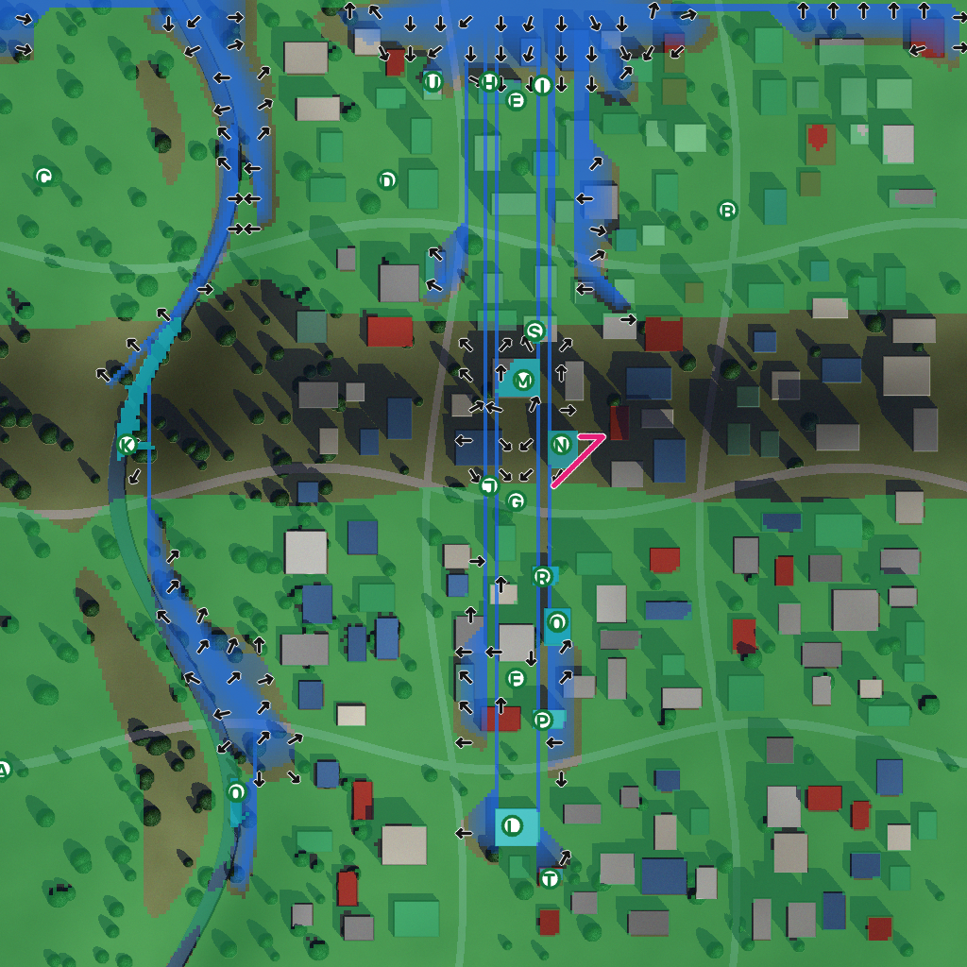
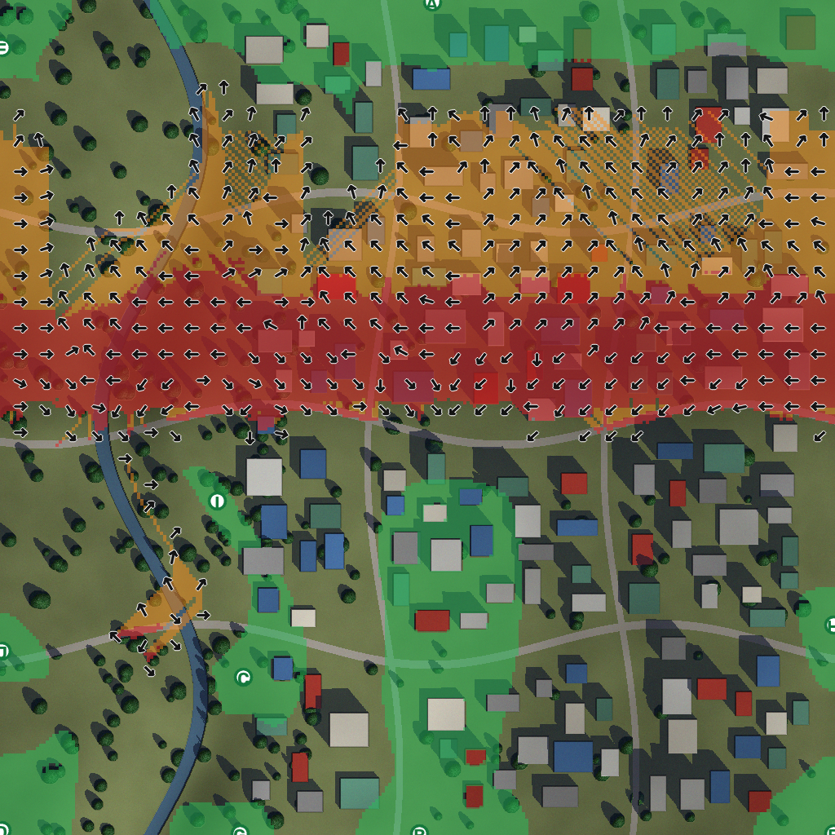
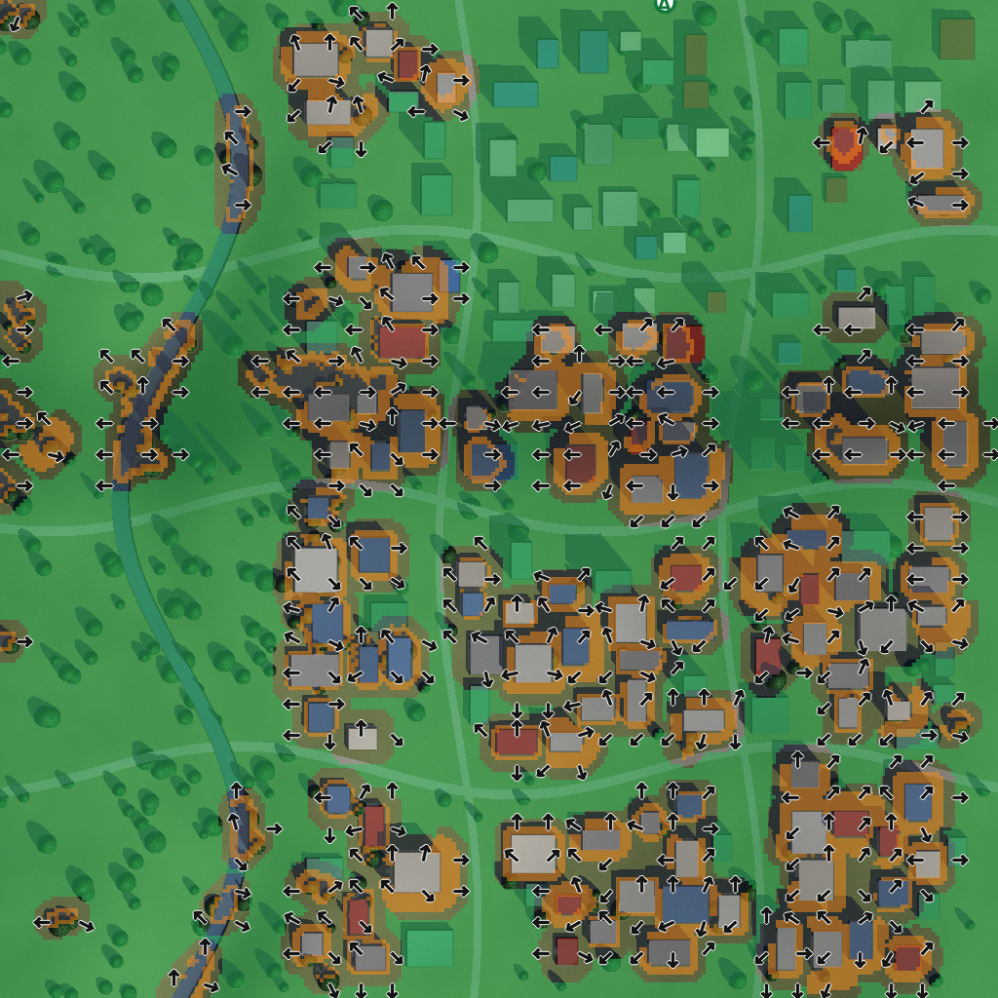
What the officer sees: arrows, safe zones, choke points
Flood, 3 m rise
Landslide
Earthquake
Arrows: the fastest way out, coloured by minutes Letters: safe zones with capacity !: choke points needing marshals
Notes:
Live demo if possible; these are real screenshots from the running app on the demo town. Tap anywhere and the app draws the walking route from that spot.

Slide 8
Plain-language plan, 3D check, one-click exports
Example summary the app writes
“117 of 123 buildings are in the danger zone (about 6,700 people, estimated). Half can walk to safety within 1.6 min. Main safe place: Zone A, open assembly area.”
1
Print one-page evacuation plan
2
KML / GeoJSON for phones and GIS
3D view: measured building heights on the terrain, with the escape arrows draped on top
3
GeoTIFF DSM, heights, uncertainty
Notes:
The summary is generated from the scenario, so a non-technical user reads sentences, not heatmaps. Exports go straight to WhatsApp, a printer or a GIS team.

Slide 9
Built for district offices, not GPU labs
0.8 GB
~8 s
1 PC
installed size, down from 4.7 GB (ONNX Runtime, no PyTorch or CUDA)
to process a 1024 px scene on a laptop CPU
serves the whole office over the LAN; others need only a browser
Guided mode: three steps
Expert mode
1
Load the image (or try the demo town)
Layers: surface, heights, confidence, drainage, error, time-to-safety
Elevation profile and point inspector
Validation against a reference DSM
Measured anchors table
2
Read the height card: what kind of heights, how reliable
3
Pick a hazard, move the slider, tap the map for a route
Notes:
This answers the feasibility and UX critique directly: small install, CPU only, browser access, and a guided mode that hides the expert tools.

Slide 10
Problem-statement requirements → features
Requirement | DepthWizard feature | Status
Relative DSM for plain images | Tiled Depth Anything V2, labelled 0–1 | Done
Absolute DSM in metres for georeferenced images | DEM + datum offset + shadow/GCP scale | Done
Building / surface heights | Shadow measurement with slope correction | Done
3D view to navigate and check | Three.js 3D, profile, point inspector | Done
Accuracy assessment | Built-in validation vs reference DSM; error layer | Done (synthetic)
Usable by non-experts | Guided mode, plain-language summary, printable plan | Done; user test pending
Disaster use | Flood, landslide, earthquake escape routing | Done
Validation on Indian terrain | ICESat-2, GEDI, field survey | Next
Notes:
The reviewer asked for an explicit requirement matrix. Point out the honest statuses on the last rows.

Slide 11
What is not done yet, and the plan
Honest limits
1
Indian validation
Accuracy shown on a synthetic town, not yet on Indian ground truth
Shadow method assumes near-nadir view and flat roofs
Routes use open ground, not yet the road network
AI fine-tuning (DEM-conditioned) not started
No pilot with a disaster agency yet
ICESat-2 and GEDI spaceborne LiDAR tracks, a 30–50 building field survey, and a Cartosat stereo pair from NRSC
2
Roads + people
OpenStreetMap road network; WorldPop population
3
Pilot
Show a district disaster office a plan for their own town; run a usability test with non-experts
Notes:
Saying this before the judges do is the strongest credibility move. All three next steps use free data or can be done by the team.

Slide 12
Where the water goes, which streets block, and which way to run
From one satellite image, on one office PC, with heights you can check.
github.com/adhuDXD/Depth-Wizard
Live demo: python -m depthwizard.server → Try demo town
Notes:
Close on the decision the tool supports, then invite questions or switch to the live demo.

