Slide 1
Rise of Coders
Team Members:
Aniket Dhuri
Sairaj Vuriti
Manisha Reddy
Chethan NT
Amruta Shintre

Slide 2
Problem Statement 5
Problem – There are many situations where people must make sense out of a large set of documents quickly.
Manually looking through documents in order to understand what's there is very time-consuming and inefficient.
How might we help a person quickly understand what content is in a large set of documents by generating high quality summaries or phrases that represent all of the content?

Slide 3
Approach 1 : Topic Modelling by Latent Dirichlet allocation
Approach
<Summarize https://www.cl.cam.ac.uk/teaching/1213/L101/clark_lectures/lect7.pdf>

Slide 4
Approach 1 : Topic Modelling by Latent Dirichlet allocation
Result
Got quality tokens but making meaningful sentences problem.
CatchPhrases from existing documents didn’t match
Non coherent tokens.

Slide 5
Approach 2: Algorithm using IBM Watson NLP API
Approach – PART 1 – Extracting relevant sentences.
For each training set xml document
Extract the sentences tag and the catchphrase tag
Generate keywords using IBM Watson API ( free tier has 1000 transactions per day)
Aggregate keywords from all documents of training set
Check for frequency of aggregate keywords in each sentence of current xml document
Return len(catchphrase tag) number of top n sentences from current xml document

Slide 6
Approach 2: Algorithm using IBM Watson NLP API
Results
Got exact sentences which had meaningful grammar formation.
Relevant text based on highlighting in a document.
The keywords from IBM Watson NLP API are very relevant
Removes stopwords
Stems the data
No single word tokenizations
Better weights compared to LDA

Slide 7
Approach 2: Algorithm using IBM Watson NLP API
Approach – PART 1 – Extracting relevant sentences.
For each document in xml
Find keywords using IBM Watson NLP API
Find similar keywords using Python difflib library to cluster the similar keywords using gestalt pattern matching and add those similar keywords in a set.
Similarity is done using a configuration called tolerance( current – 50% match )
Find similar keyword sets repeating in which files.
Create a graph in neo4j graph database using keywordset⬄filelist mapping generated to visualize the keyword sets that are common to each file and case files related to each other with keywords.

Slide 8
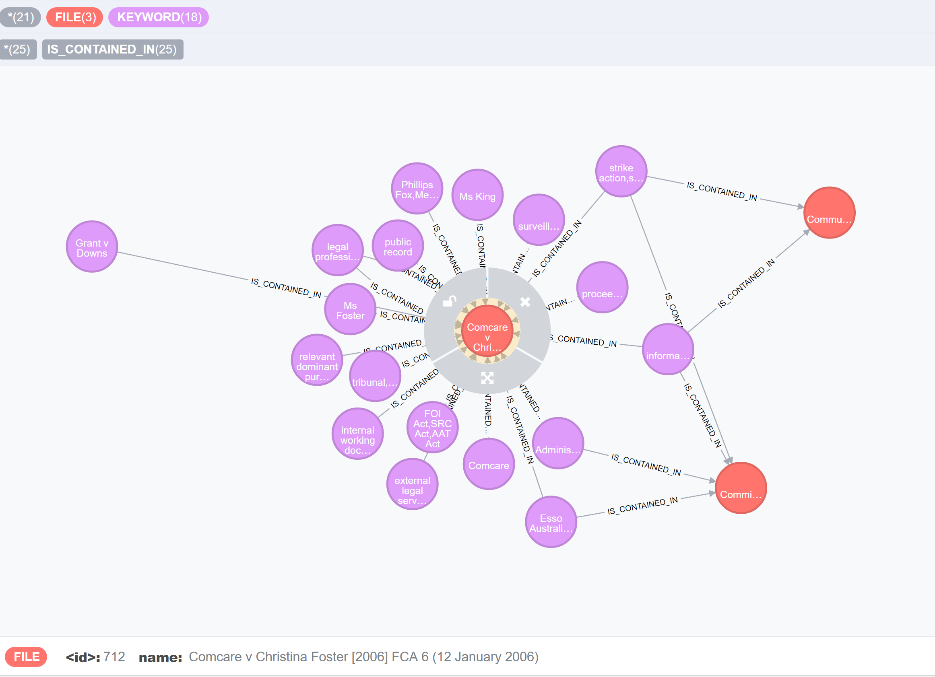
Approach 2: Algorithm using IBM Watson NLP API
Data from 3 files – Hence 3 File Nodes- See info below about one case “ Comcare ….”
Cluster Keyword nodes

Slide 9
Approach 2: Algorithm using IBM Watson NLP API
Giving own query to Match all keywords belonging to case – “Communications, Electrical, Electronic, ….”
MATCH (k:KEYWORD)-[:IS_CONTAINED_IN]->(f:FILE) where f.name=" Communications, Electrical, Electronic, Energy, Information, Postal, Plumbing amp; Allied Services Union of Australia v ACI Operations Pty Ltd [2006] FCA 7 (16 January 2006)" RETURN f,k

