Slide 1

Predicting customer buying behaviour
20/11/2022

Slide 2
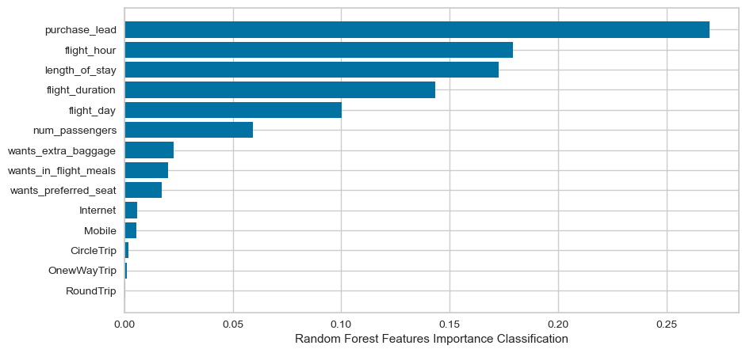
PREDICTIVE MODEL RESULTS
Accuracy
85 %
Accuracy of the model is good but AUC score is not up to the mark so we need to increase it
We have trained the data set with Random forest classifier model and received
ACCURACY: 85.09
AUC score: 0.538
purchase_lead
flight_hour
length_of_stay
flight_duration
flight_day
are the top 5 features which influence Customer buying behavior
AUC Score
0.538

