Slide 1
The proteoSE analysis pipeline
Proteomics on Bioconductor's SummarizedExperiment
Import → Filter → Impute → Test → Enrich → Explore

Slide 2
FOUNDATIONS
What is Bioconductor?
• An open-source project providing R packages for the analysis of high-throughput biological data — genomics, transcriptomics, proteomics.
• Twice-yearly coordinated releases: packages are tested together, so they interoperate rather than each inventing its own data format.
• Shared S4 data structures are the glue. Learn one container and dozens of packages become usable.
• Rich domain annotation ships as packages too — e.g. org.Hs.eg.db maps human gene symbols, UniProt accessions and GO terms.

Slide 3
FOUNDATIONS
Why it fits proteomics
• A proteomics experiment is a matrix (proteins × samples) plus metadata on both — exactly what Bioconductor containers model.
• Missing values, imputation, and linear-model testing (limma) are already solved and battle-tested here.
• proteoSE stands on the shoulders of DEP2, limma, clusterProfiler, PhosR and iSEE — it adds convenience, not a new ecosystem.
• One object carries raw data, results and annotation together, so your analysis stays reproducible and shareable.

Slide 4
THE CORE DATA STRUCTURE
The SummarizedExperiment
• The single container every proteoSE step reads from and writes to.
• It bundles four coordinated parts so rows and columns can never fall out of sync:
assay(s) the numeric matrix — protein intensities (proteins × samples). You can hold several: raw, imputed, imputation mask.
rowData one row of annotation per protein — gene symbol, UniProt ID, description, and later the test results.
colData one row per sample — condition, replicate.
metadata a free-form slot for anything else — e.g. GO-enrichment results.

Slide 5
THE CORE DATA STRUCTURE
How the pieces fit
colData() — samples (Ctrl_1 … TreatB_5)
rowData()
proteins
(gene, UniProt,
description,
test results)
assay(s)()
intensity matrix
proteins × samples
lfq_raw · imputed_perseus · imputed
Subset the object → rows & columns stay aligned automatically.
metadata() — GO enrichment, notes

Slide 6
THE CORE DATA STRUCTURE
What's actually inside
Real values from the example project (4000 proteins × 15 samples):
colData() — one row per sample
rowData() — one row per protein
condition | replicate | sample
Ctrl | 1 | Ctrl_1
Ctrl | 2 | Ctrl_2
Ctrl | 3 | Ctrl_3
name | genes | protein_groups | protein_descriptions
TSPAN14 | TSPAN14 | Q8NG11 | tetraspanin 14
PPP4C | PPP4C | A0A024R625 | protein phosphatase 4 …
BRD7 | BRD7 | A0AA34QW01 | bromodomain containing 7
GOLGA6D | GOLGA6D | A2VDJ1 | golgin A6 family member D
assay() — intensity matrix (NA = missing)
 | Ctrl_1 | Ctrl_2 | Ctrl_3 | Ctrl_4
TSPAN14 | NA | 15.75 | 15.97 | 15.54
PPP4C | NA | 14.61 | 15.61 | 14.85
BRD7 | NA | NA | NA | 14.00
GOLGA6D | 15.99 | 15.78 | 15.57 | 15.71

Slide 7
THE CORE DATA STRUCTURE
Getting your data back out
assay(se) the numeric matrix
assayNames(se) names of all assays (raw, imputed, mask)
rowData(se) per-protein annotation + results
colData(se) the sample design
metadata(se) enrichment results and extras
se[rows, cols] subset — every part stays in sync

Slide 8
THE CORE DATA STRUCTURE
The escape hatch: back to a data frame
The SE is great for the standard pipeline. For anything custom, don't fight it — export midway and use dplyr / tidyr on a plain data frame.
get_df_wide(se)
get_df_long(se)
4000 × 23 · one row per protein, one column per sample
60000 × 17 · tidy: one row per protein × sample
Long format is ready for ggplot2 and group-wise work:
get_df_long(se) |> group_by(genes, condition) |>
summarise(mean_int = mean(intensity, na.rm = TRUE))
Do the custom analysis on the data frame, then join results back into rowData() if you want them in the object.

Slide 9
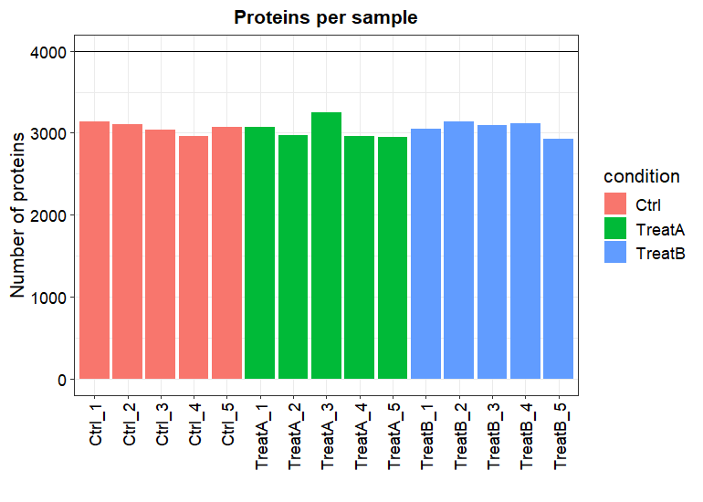
PROTEOSE PIPELINE · 1
Import
optimized_spectronaut_to_se()
Read the Spectronaut report + condition setup, clean the messy column names, build a SummarizedExperiment (4000 × 15). No candidates table needed. plot_numbers() checks each run identified enough proteins.

Slide 10
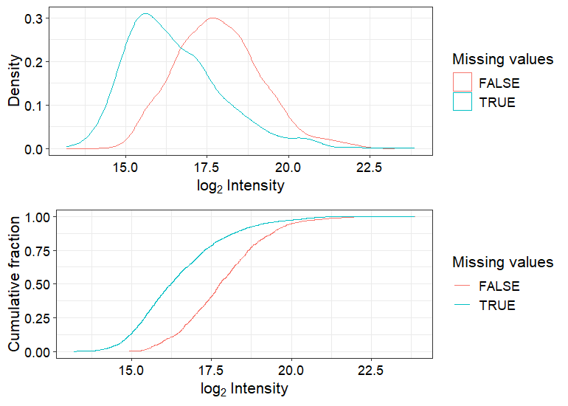
PROTEOSE PIPELINE · 2
Filter
filter_perseus()
Drop proteins with too many missing values (4000 → 2837). plot_detect() reveals the missingness is low-abundance dropout (MNAR): proteins with NAs sit at lower intensity — which tells us how to impute.

Slide 11
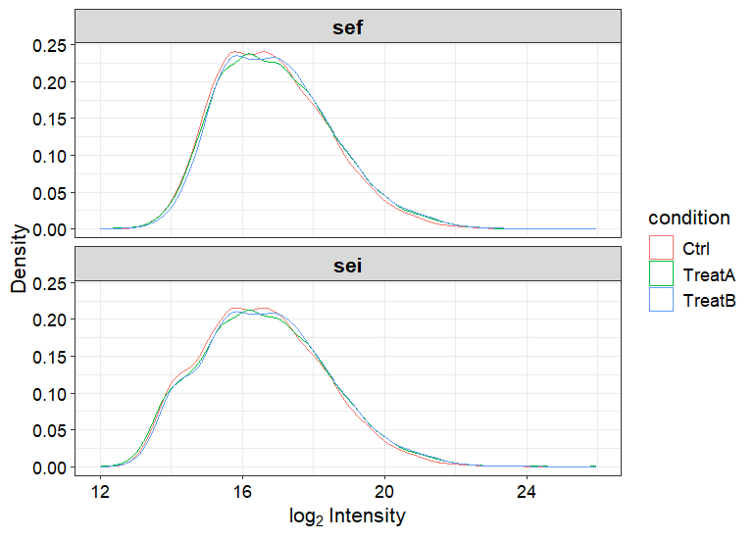
PROTEOSE PIPELINE · 3
Impute
impute_perseus() / impute_DEP()
Fill remaining NAs from a left-shifted Gaussian (Perseus style). The raw matrix and an imputation mask are kept as extra assays. plot_imputation() shows the filled-in low-intensity shoulder.

Slide 12
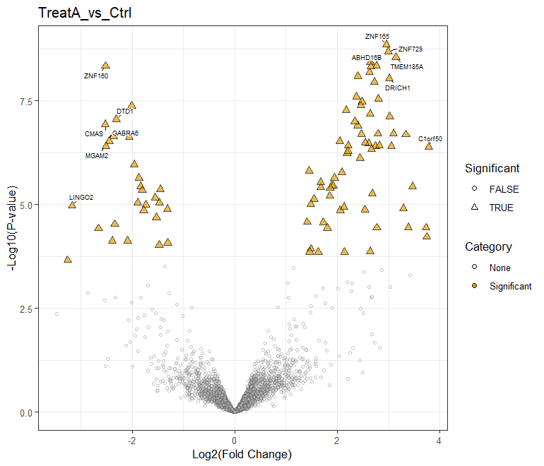
PROTEOSE PIPELINE · 4
Test
test_diff() + add_rejections()
Differential abundance via limma. type='control' tests each treatment vs Ctrl; rejections flag hits at adj. p < 0.05 and |log2FC| > 1 (92 in TreatA, 102 in TreatB). proteoSE::plot_volcano() draws the result.

Slide 13
PROTEOSE PIPELINE · 5
Enrich
enrich_go_se()
results live in metadata(se)
GO / gene-set enrichment (clusterProfiler::gseGO) on a fold-change column. Results are stored inside metadata(se) — the object stays the single source of truth.

Slide 14
PROTEOSE PIPELINE · 6
Explore
se_to_isee() + isee_mini()
interactive — no static figure
Launch an interactive iSEE app with custom panels: volcano plots, NCBI gene links, and a GO-enrichment table — all driven by the same object.

Slide 15
One object, start to finish.
Full worked example with code + output: vignettes/worked_example.md

