Slide 1
Replicating the
VisionAI Reflex Simulations
Every figure and number in the Results section, reproduced from three scripts in under ten seconds.
13 figures · 3 result files
ASDRP · paper/simulation
Notes:
Goal of this deck is that anyone on the team can regenerate every figure in the paper and get byte-identical output.

Slide 2
CONCEPT
What is actually being simulated
We do not simulate the neural detector.
ML Kit runs only on Android. Instead the app's decision layer is ported to Python line for line, keeping every shipped constant, and is fed synthetic bounding boxes generated from camera geometry.
Real app
ML Kit boxes to Kotlin rules to speech
Simulation
So the study measures whether the decision brain does the right thing given a detection, not whether the camera sees the obstacle.
Synthetic boxes to ported rules to logged decision
Identical rules. Identical constants. Synthetic eyes.
Notes:
The honesty point for reviewers. Simulation validates the decision layer, not perception.

Slide 3
STEP ONE
Setup
Two libraries and a clone. Nothing else is required.
# tested on python 3.13.5, numpy 2.1.3, matplotlib 3.10.0
pip install numpy matplotlib
git clone https://github.com/adhvayjagadeesh/GuideGlass.git
cd GuideGlass/paper/simulation
!
Run from inside
paper/simulation
Two scripts import sim_reflex, so a different working directory breaks the import.
No API keys, no Android device, and no network access are needed. The simulation is pure geometry and arithmetic.

Slide 4
STEP TWO
Run the three scripts
sim_reflex.py
2 s
1
fig1 to fig6, sim_results.json
Ported rules plus 6 figures
sim_extra.py
5 s
2
6 figures, sim_extra_results.json
Envelope, speed, sweeps, flicker, hints, cadence
sim_baselines.py
2 s
3
fig_baselines, sim_baseline_results.json
Five rule comparison for Figure 3
python3 sim_reflex.py && python3 sim_extra.py && python3 sim_baselines.py
Notes:
Order matters only in that sim_reflex must be importable. Running all three takes under ten seconds.

Slide 5
VERIFY
Every seed is fixed, so replication is exact
13 of 13
3 of 3
under 10 s
figures byte-identical
result files identical
for the full rebuild
# regenerate in a scratch copy, then compare
cp sim_*.py /tmp/repro && cd /tmp/repro
python3 sim_reflex.py && python3 sim_extra.py && python3 sim_baselines.py
cmp fig_baselines.png <original>/fig_baselines.png # silence means identical
Notes:
This is the claim that makes the study contestable. Anyone can rebuild it and get the same bits.

Slide 6
MECHANISM
What happens inside one simulated frame
Place
Project
1
2
Object height, width, distance, lateral offset. Camera height and pitch.
Pinhole geometry gives the box. Height fraction equals H over 1.155 times d.
Perturb
Decide
3
4
Ten percent noise on box size, three percent on centre position.
Ported rules. Corridor gate, width rejection, size gates, looming.
Latch
Advance
5
6
State machine. Two frames to fire, four to clear, cooldown, re-arm.
One tenth of a second. The walker closes 0.14 m. Repeat.
Notes:
Camera model is 60 degrees vertical, 46 horizontal, 10 fps, 1.4 m per second.

Slide 7
TRACEABILITY
Where the numbers come from
Every threshold in the simulation is copied from the shipped Android source, so the study cannot drift from the app.
ObstacleDetector.kt
ReflexTuning
corridor 0.32 to 0.68, near height 0.34, near area 0.12, enter 2, clear 4
ObstacleDetector.kt
companion
loom window 0.9 s, time to contact 2.0 s, growth rate 0.6 per s
VisionActivity.kt
companion
stop cooldown 3500 ms, re-arm 1200 ms, throttle 1500 ms
Change a constant in the app, rerun the three scripts, and every figure and quoted number updates together.

Slide 8
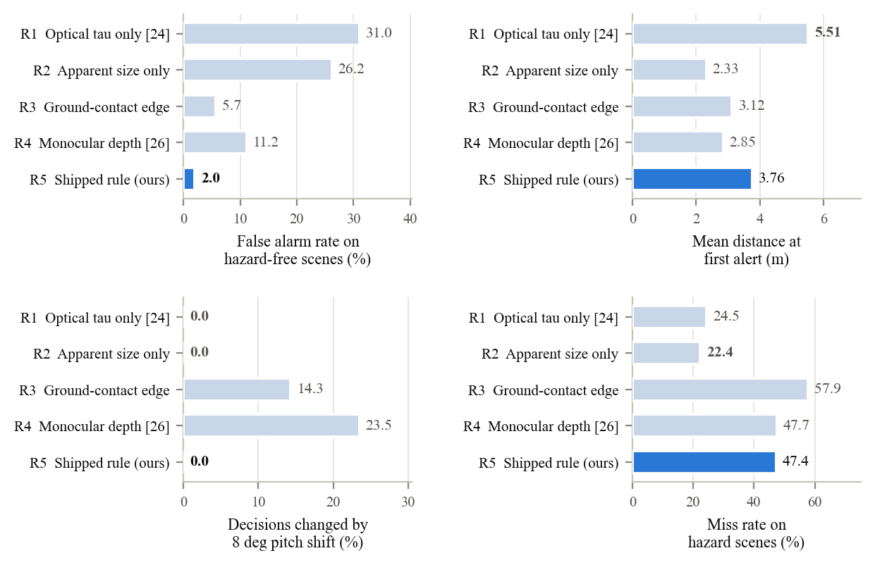
MAPPING
Which output becomes which paper figure
fig1_architecture.png
Figure 1
Two tier runtime architecture
fig3_warning.png
Figure 2
Alert distance versus obstacle height
fig_baselines.png
Figure 3
Figure 3, the new baseline comparison
Five rule comparison, replaces the old legacy figure
fig4_timeline.png
Figure 4
The remaining seven figures support the longer version of the Results section and the tuning discussion.
Double approach, two alerts versus 81

Slide 9
EXTENDING
Changing a threshold and re-running
Thresholds are module level constants, so a sweep is a loop rather than an edit.
import numpy as np, sim_extra as sx
rng = np.random.default_rng(23)
for gate in [0.26, 0.34, 0.46]:
fa, miss = sx.eval_rule(rng, near_h=gate)
print(gate, round(fa, 2), round(miss, 1))
Useful entry points
frame_danger
one frame verdict
eval_rule
error rates for a rule
RULES
add a new baseline here
Adding a comparator means appending one function and one row to RULES in sim_baselines.py. The scoring harness picks it up automatically.

Slide 10
STATE THIS WHEN PRESENTING
What replication does and does not prove
Does prove
Does not prove
The decision layer behaves as designed
Results are exactly reproducible
Comparisons are contestable by anyone
That the detector boxes the obstacle at all
Behaviour under real light, blur, and hardware
Anything about safety for a real traveller
Camera geometry, frame rate, and walking speed are stated assumptions, not measurements. The field tests exist to check them.
github.com/adhvayjagadeesh/GuideGlass · paper/simulation
Notes:
Close on the limits. Owning them is what makes the reproducibility claim credible.

