Slide 1
Do Reading Assistants Peek Ahead?
Reader-faithfulness: detecting and fixing look-ahead leaks from the pipeline and from model memory (EchoTales)
Adhyan Jain (24BCI0111) Atharva Sheerh Pandey (24BCI0069) Aryan Gahlot (24BCI0033)
BCSE306L Artificial Intelligence | Slot C1 + TC1 | VIT | 16 October 2026
Notes:
Say: our project asks one question. When a language model helps a reader who is only partway through a book, does it quietly use what it remembers about the rest of the book? We measure it, test why it happens, and audit our own knowledge-graph system for the same fault. About ten minutes: problem, method, three results, demo, honest limits, plan.

Slide 2
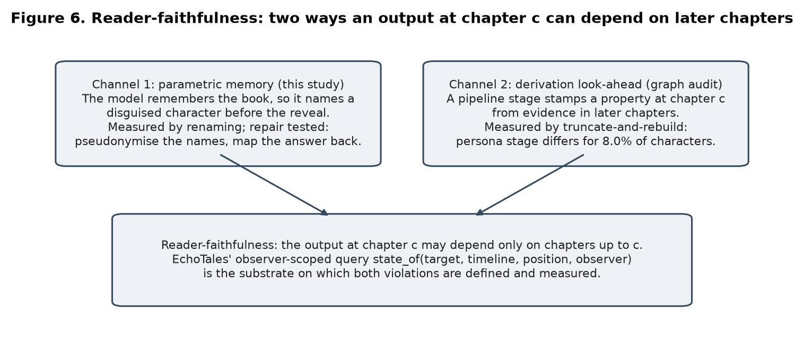
The problem: a chapter-c reader should not hear chapter c+50
• Serials run to hundreds of chapters; identity is hidden, then revealed.
• Recaps, profiles and Q&A for a partway reader must use only chapters 1..c: reader-faithfulness.
• Channel 1, parametric memory: the model saw the book in training and names the hidden person early.
• Channel 2, derivation look-ahead: a pipeline stage sets a fact at chapter c from evidence in later chapters.
BCSE306L Artificial Intelligence | Adhyan Jain, Atharva Sheerh Pandey, Aryan Gahlot
2
Notes:
Explain reader-faithfulness with one example: the masked guest in chapter 3 is a named person in chapter 40. A recap tool that names that person at chapter 5 has spoiled the book. Two ways this can happen: the model remembers the book (our main study), or our own pipeline derives a fact from later chapters (our audit). Keep it to 60 seconds.

Slide 3
Research questions
• RQ1 Do LLMs name a disguised character's true identity before the book reveals it, more often with original names than with replaced names? (leakage gap)
• RQ2 Is the gap caused by memory keyed on names, or just by losing name cues like gender and nationality? (cue-preserving pseudonyms)
• RQ3 Does the gap grow with how well-known the book is? (dose-response; pre-registered confirmatory run)
• RQ4 Does the pipeline itself leak: our own graph, and a common whole-book character card? Does versioning fix it? (truncate-and-rebuild, cipher names)
• Rule: pre-register, hash, report nulls and failed replications as such.
BCSE306L Artificial Intelligence | Adhyan Jain, Atharva Sheerh Pandey, Aryan Gahlot
3
Notes:
Read the four questions. Stress that each is answered with a measured number or an explicit null. Mention that hypotheses and thresholds were written and hashed before the data.

Slide 4
Method: a text-derived oracle and four arms
• Event = alias before a reveal sentence, identity after it; 38 events from 38 public-domain books (Project Gutenberg).
• Item = 1,200 characters ending at an alias mention, a cast list and UNDETERMINED. Correct reader answer: UNDETERMINED.
• Premature naming = answering the true identity before the reveal.
• Arms: A original names | B letter cipher | B3 gender- and type-matched pseudonyms | memory probes.
• Leakage gap = rate(A) minus rate(B), event-cluster bootstrap interval.
BCSE306L Artificial Intelligence | Adhyan Jain, Atharva Sheerh Pandey, Aryan Gahlot
4
Notes:
Explain the oracle: the book itself says in one sentence that the alias is the identity; we find that sentence by exact search, so nobody has to judge the truth. Then four arms with identical windows. Say plainly: events were selected by a model and not verified by a person.

Slide 5
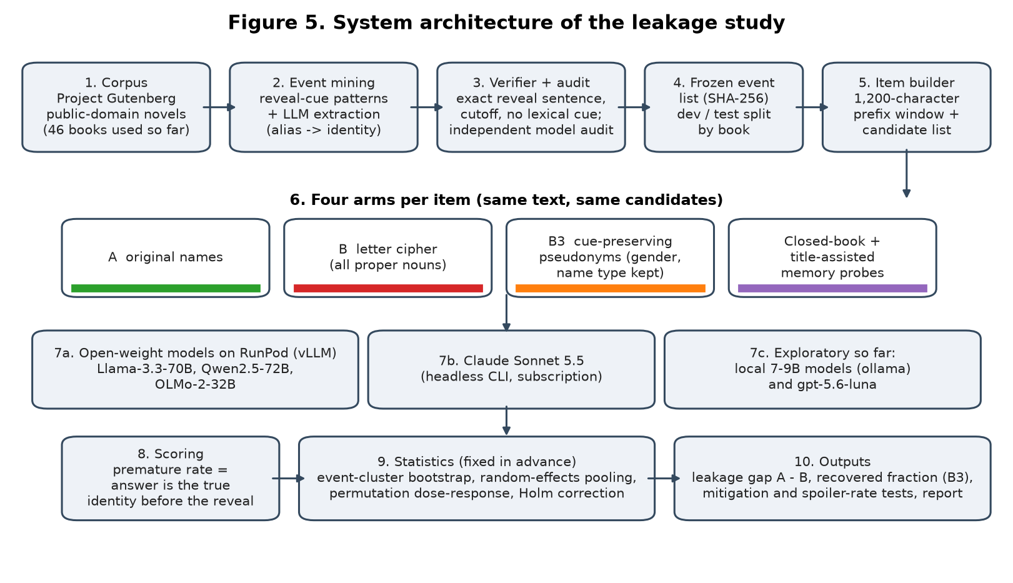
Study architecture
BCSE306L Artificial Intelligence | Adhyan Jain, Atharva Sheerh Pandey, Aryan Gahlot
5
Notes:
Walk through in thirty seconds: corpus, mining, verification, frozen list, item builder, four arms, three model backends, scoring, statistics, outputs. The confirmatory run used the same pipeline at larger scale on a rented GPU; its results are on slide 12.

Slide 6
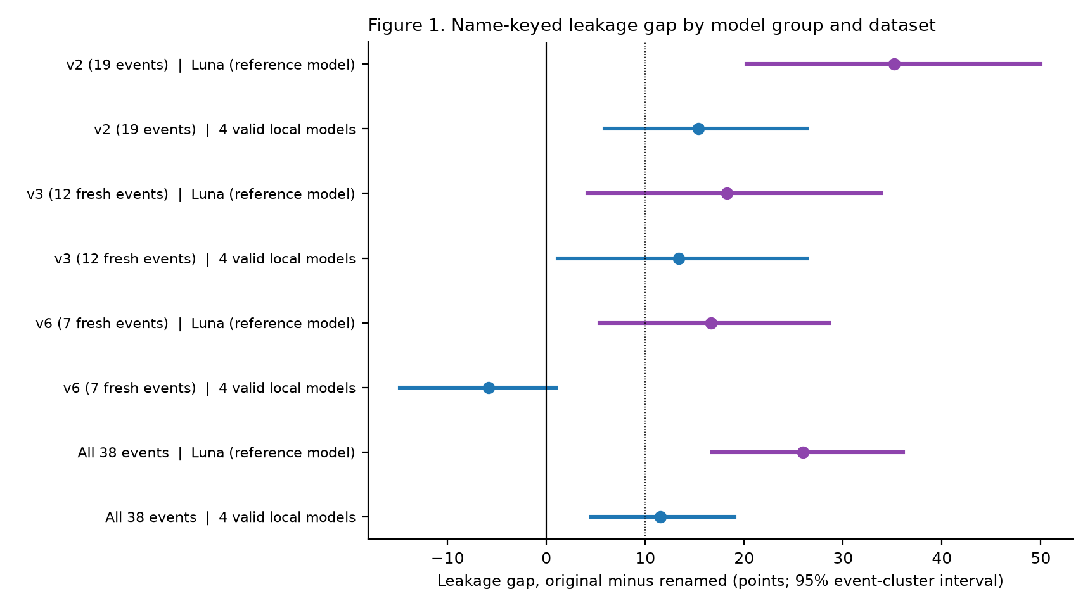
Result 1: the reference model leaks, +26.0 points
• Reference model: +26.0 [16.8, 36.0]
• 22 events up, 1 down
• Valid local pool: +11.5 [4.5, 19.0]
• Replication, 7 fresh books (local): -5.9 [-14.8, 1.0], NOT SUPPORTED
BCSE306L Artificial Intelligence | Adhyan Jain, Atharva Sheerh Pandey, Aryan Gahlot
6
Notes:
Over all 38 events the reference API model's gap is +26.0 points, interval [16.8, 36.0]; 22 events positive and 1 negative. The four valid local 7-9B models pool to +11.5 [4.5, 19.0]. On the seven freshest books the local pool is -5.9 [-14.8, 1.0]: the pre-registered replication failed for small models. Say this out loud; it is the honest result.

Slide 7
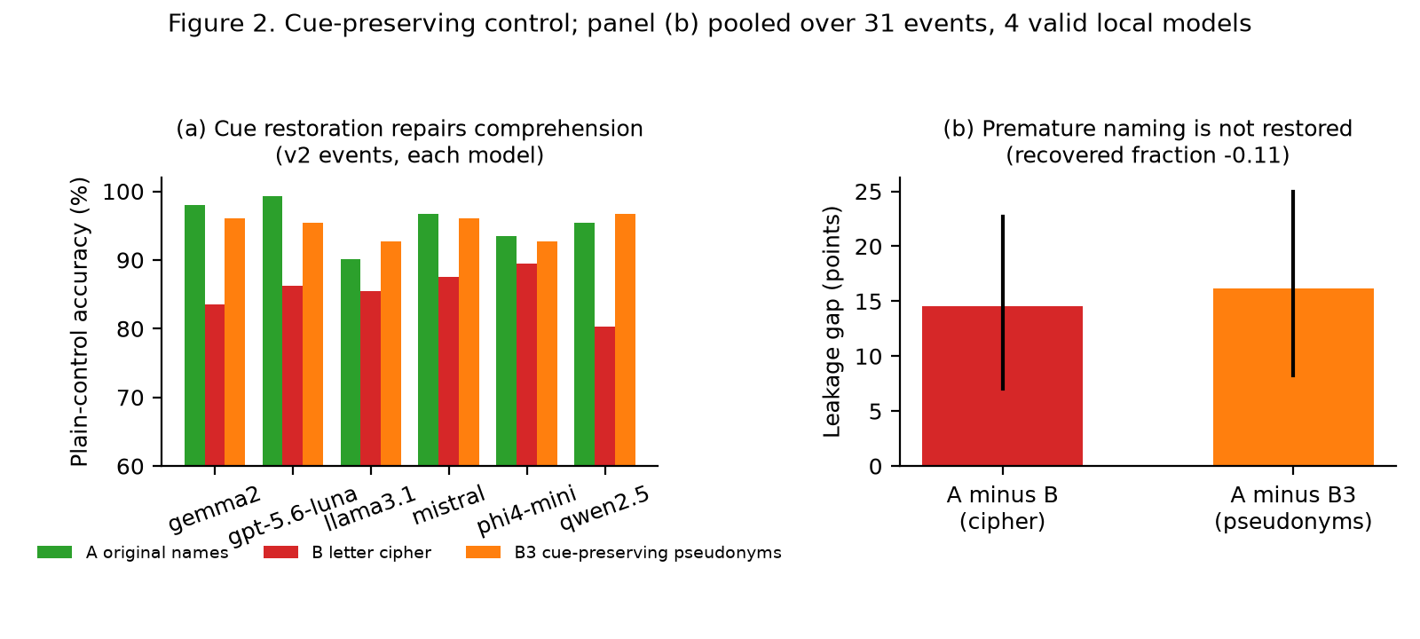
Result 2: pseudonyms restore reading, not the gap
• Gap with cipher +14.6
• Gap with pseudonyms +16.1
• Recovered fraction -0.11
• Memory survives, by the pre-registered line
BCSE306L Artificial Intelligence | Adhyan Jain, Atharva Sheerh Pandey, Aryan Gahlot
7
Notes:
The letter cipher hurts plain-control accuracy by 5 to 15 points, so name cues matter. Gender-matched pseudonyms bring accuracy back, yet the gap stays: +16.1 with pseudonyms versus +14.6 with the cipher; recovered fraction -0.11 [-35.6, 6.1]. What original names carry that pseudonyms do not is the specific name, which is what memory is keyed on.

Slide 8
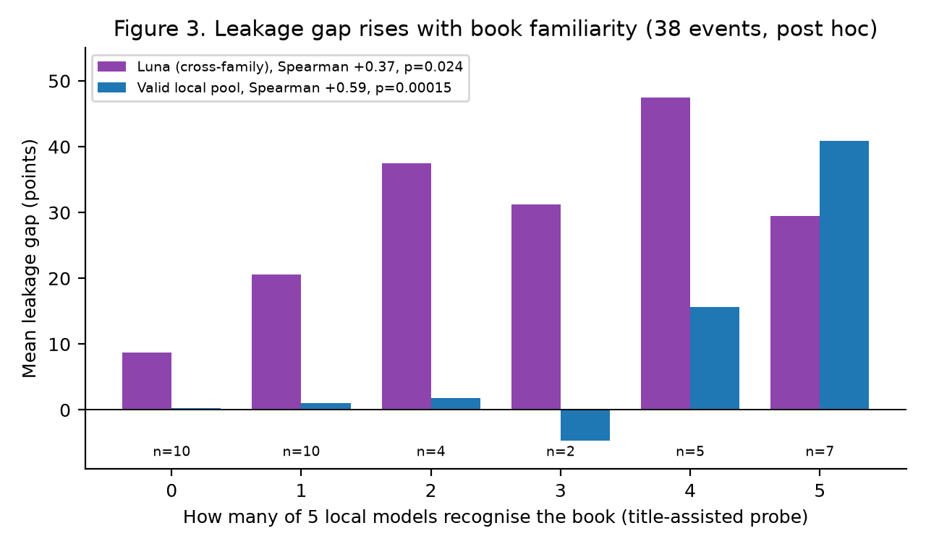
Result 3: the gap rises with book familiarity
• Local pool: Spearman +0.59, p = 0.00015
• Reference model: Spearman +0.37, p = 0.024
• Post hoc here; tested again in the confirmatory run (next slide)
BCSE306L Artificial Intelligence | Adhyan Jain, Atharva Sheerh Pandey, Aryan Gahlot
8
Notes:
Post hoc over 38 events. For the valid local models the gap is about zero when at most two of five local models recognise the book and large when all five do (Spearman +0.59, p = 0.00015). Cross-family check with the reference model: Spearman +0.37, p = 0.024. This explains why the seven obscure books did not replicate for small models. Caveats: post hoc, shared models, small cells.

Slide 9
Confirmatory run: no gap on obscure books
• 68 events, 65 books, 32 primary events; Qwen2.5-32B, OLMo-2-32B, Mistral-Small-3.2-24B; text-derived, no human labels.
• Pooled gap original minus renamed +0.1 points [-5.0, 5.2]: not detected (obscure books; closed book recovers 2 of 68).
• Fame contrast +7.6 [-1.4, 18.3], p = 0.0595: not significant; smallest detectable about 13 points.
• Pseudonyms: premature naming 5.0% to 2.6%, accuracy -6.7 points. Recap spoilers: 0 detected. OLMo training-data link: Spearman +0.13, p = 0.41.
BCSE306L Artificial Intelligence | Adhyan Jain, Atharva Sheerh Pandey, Aryan Gahlot
9
Notes:
68 events from 65 public-domain books, primary set 32 events, 78 percent low-fame; three open models on one rented GPU; pre-registered before any model saw an event. Pooled gap +0.1 points [-5.0, 5.2]. The fame contrast was +7.6 [-1.4, 18.3], p = 0.0595, not significant and underpowered. The closed-book control recovered the identity in only 2 of 68 events, so these books hold little memory to detect. Pseudonyms halved premature naming at a cost in accuracy. Recap spoilers: none detected. Training-data link: none. A Claude arm was stopped by the usage limit and excluded.

Slide 10
Auditing our own graph: causal resolver, leaky persona stage
• Resolver: 0 of 28,165 mention-cut pairs differ (14 cuts, 3 serials); ids stable.
• Persona stage: 23 of 288 character-cuts differ (8.0%): gender from later pronouns, body splits from a whole-volume rule.
• Resolver is close to a normalised-string lookup (adjusted Rand index 0.971 to 0.985).
• Repair: version each fact by the chapter its evidence came from: 0 divergences. Hiding every exposed fact is worse than doing nothing (82 vs 23 of 289).
BCSE306L Artificial Intelligence | Adhyan Jain, Atharva Sheerh Pandey, Aryan Gahlot
10
Notes:
Truncate-and-rebuild: build the graph from chapters 1..k only and from the whole volume, and compare what the reader sees at chapter k. The resolver is causal at 14 cuts over three serials: 0 of 28,165 mention-cut pairs differ. By-design whole-volume passes do break it. The persona stage looks ahead for 23 of 288 character-cuts, 8.0 percent. System-internal checks, no labels; counts only because the serials are copyrighted and stay local.

Slide 11
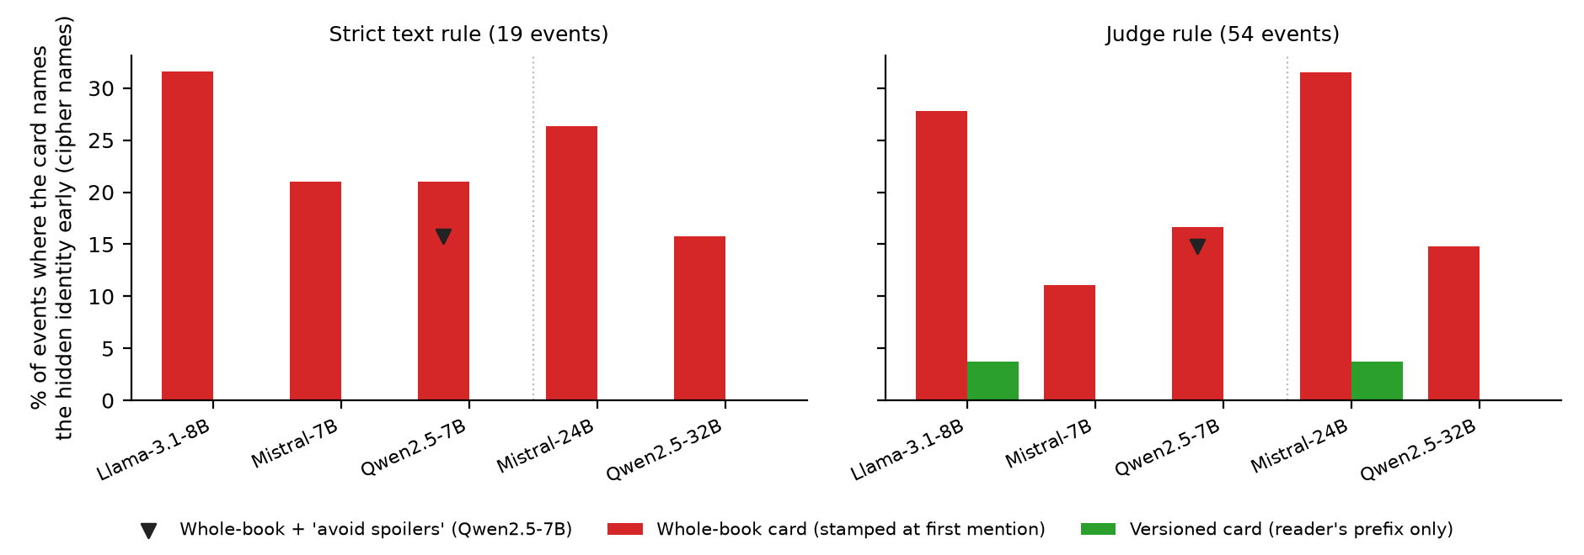
Found and fixed: whole-book character cards leak the reveal
• Whole-book card, renamed names: leak 18.5% (judge), 24.6% (strict text rule)
• Versioned (prefix-built) card: leak 1.2% renamed, 3.7% original names
• Input-channel leak W minus P: +17.3 points [9.3, 26.5]; memory-only leak +2.5 points
• Same frozen events and reveal oracle as the confirmatory study; pre-registered (addenda 6 to 8)
• Larger 24-32B models: whole-book card 23.1% vs versioned 1.9%; memory-only +0.0 points
• 'Avoid spoilers' instruction: whole-book card still leaks 14.8% vs versioned 0.0%; second cipher input leak +31.6 points (strict text rule)
• Earlier reader positions: versioned card 1.9% / 1.9% vs whole-book 16.7%; second prompt input leak +18.5 points
BCSE306L Artificial Intelligence | Adhyan Jain, Atharva Sheerh Pandey, Aryan Gahlot
11
Notes:
Pre-registered before any card was read. The common assistant design builds a character card once from the whole book and shows it from the first appearance. On renamed names no model has seen, it named the hidden identity before the reveal in 18.5 percent of events by the judge and 24.6 percent by the strict text rule; a versioned card built from the prefix leaked in 1.2 percent. So the leak is the pipeline's design, not memory, and the versioned card fixes it at the cost of one rebuild per position.

Slide 12
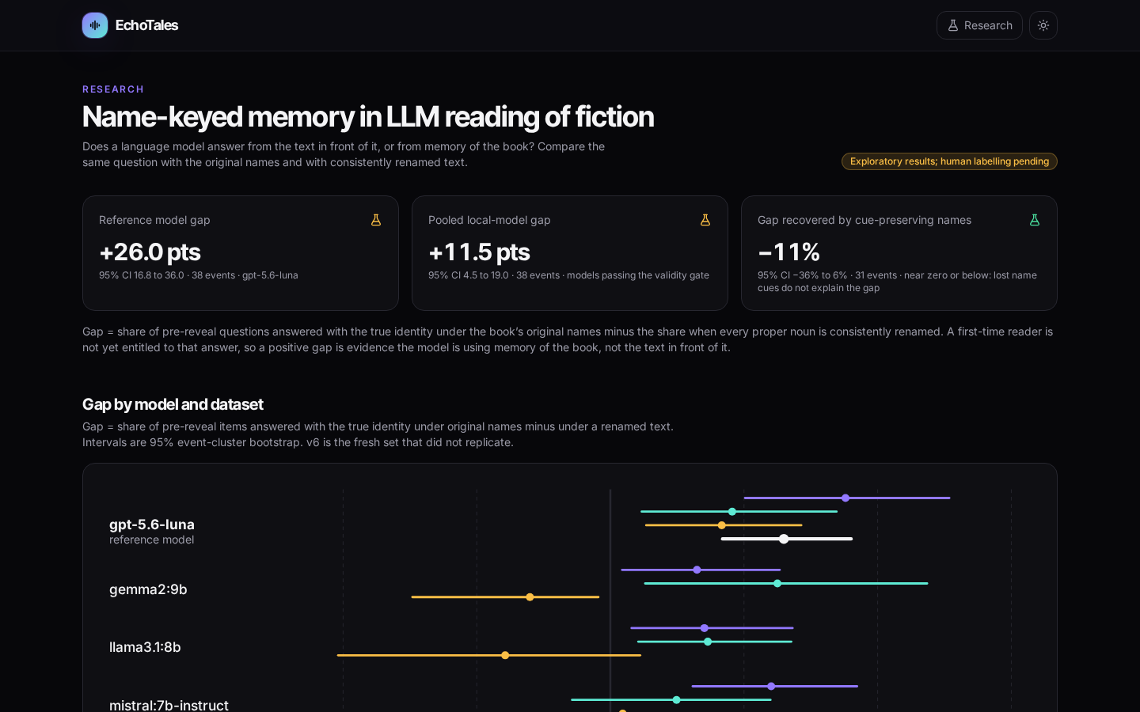
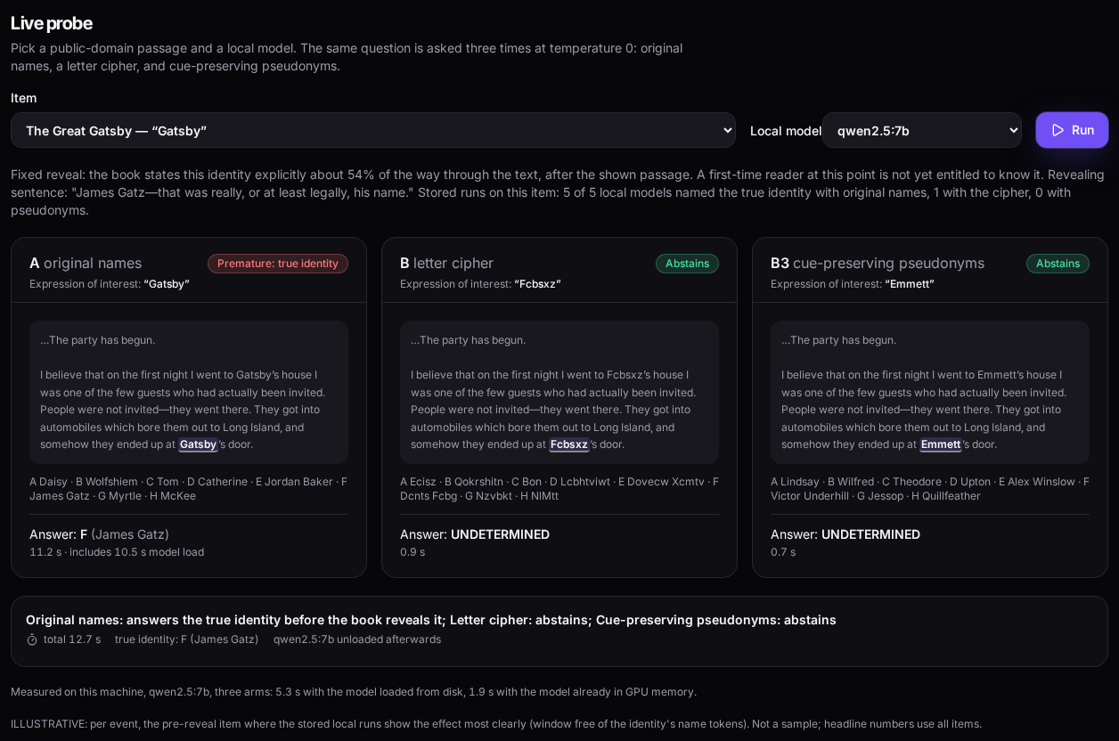
Live demonstration: the Research view
Left: stored study results. Right: a live probe, one public-domain item under original names, cipher and pseudonyms, with timings.
BCSE306L Artificial Intelligence | Adhyan Jain, Atharva Sheerh Pandey, Aryan Gahlot
12
Notes:
Switch to the browser (script in Demo_Video_Script). Show overview cards, gap by model, cue-preserving panel and dose-response, then run the live probe on a public-domain item with a local model and point at the per-arm timings. If it is slow, quote stored timings: 4 to 16 minutes per model for a full 500 to 1,100 call run.

Slide 13
What this does and does not show
• Events were selected by a model and checked against the book's text, not by people. No human annotation is used or claimed.
• One leak rule uses a judge model; checked against the strict text rule it finds 92% of leaks with 0.9% false alarms (kappa 0.92).
• One card prompt and one reader position per event in the main test; extra positions, a second prompt and a second cipher were run on one model.
• Memory leakage is clear only on famous books (exploratory); on obscure books it stays under about 5 points.
• All tests were pre-registered before their results existed; nulls are reported as nulls.
BCSE306L Artificial Intelligence | Adhyan Jain, Atharva Sheerh Pandey, Aryan Gahlot
13
Notes:
Read these limits without being asked; the audience should hear them from us. No human annotation is used or claimed.

Slide 14
Takeaways
• A common assistant design, a whole-book character card, names the hidden identity early in 18.5-23.1% of events even on cipher names: the pipeline leaks, not the model's memory.
• A versioned card built from the reader's prefix fixes it (1.2% leak); an 'avoid spoilers' instruction does not.
• The same look-ahead appears in our own knowledge graph (6.0% of character facts); horizon versioning gives 0, naive hiding is worse.
• Model memory leaks on famous books (+26.0 points, exploratory) and stays under about 5 points on obscure ones (pre-registered).
• All tests were pre-registered; nulls are reported as nulls; no human labels are claimed.
BCSE306L Artificial Intelligence | Adhyan Jain, Atharva Sheerh Pandey, Aryan Gahlot
14
Notes:
Close in thirty seconds, then invite questions. Lead with the pipeline result, then the memory boundary.

Slide 15
Team and contributions
• Adhyan Jain (24BCI0111): Narrative graph architecture (bitemporal state_of query), truncate-and-rebuild causality audit, Channel 2 horizon repairs, and pipeline integration.
• Atharva Sheerh Pandey (24BCI0069): Alias-reveal task formulation, Gutenberg event mining, multi-arm renaming controls (cipher & pseudonyms), local model test harness, and live probe UI.
• Aryan Gahlot (24BCI0033): Confirmatory study deployment on RunPod (24-32B models), event-cluster bootstrap statistics, memory-free validity gates, and E2 unseen-text negative controls.
BCSE306L Artificial Intelligence | Adhyan Jain, Atharva Sheerh Pandey, Aryan Gahlot
15
Notes:
The project work was divided equally among all three team members (33.3% each). Adhyan led narrative graph architecture and the prefix causality audit; Atharva led experimental methodology, event mining, and local model leakage probing; Aryan led confirmatory cloud benchmarking, statistical meta-analysis, and negative controls.

Slide 16
Key references
• Chang et al. 2023, Speak, Memory (EMNLP): books known to ChatGPT/GPT-4.
• Jiang and Ferraro 2026, Beyond Math: name replacement as a memorisation constraint (arXiv:2412.14368).
• Ahn et al. 2024, TimeChara: point-in-time character hallucination (Findings of ACL).
• Deußer et al. 2026, anonymisation and LLM performance (arXiv:2609.11335).
• Gu et al. 2026, SynthWorlds (ICLR).
• Kim et al. 2024, KoCoNovel; Bamman et al. 2020, LitBank; Martinelli et al. 2025, BOOKCOREF.
• Efron and Tibshirani 1993; Holm 1979; DerSimonian and Laird 1986; Nosek et al. 2018.
BCSE306L Artificial Intelligence | Adhyan Jain, Atharva Sheerh Pandey, Aryan Gahlot
16
Notes:
Do not read these out; they are on screen for the marker. The full MLA list is in section 15 of the project document.

