Slide 1

Bus Transportation Database Management System
Professor:
Manuel Montrond
Contributors:
Ritvik Saxena (002747239)
Adhyantini Bogawat (002766612)
Niharika Karri (002727629)

Slide 2
Project Objectives
About Project
We have designed a database for a bus transportation company, to provide a centralized database for storing, managing and analyzing transportation data, including information on buses, routes and managing driver information.
Streamlining transportation operations: The system aims to improve operational efficiency by automating and centralizing transportation-related data management.
Enhancing decision-making: The system will provide real-time and historical performance data to support informed decision-making and continuous improvement.
Improving customer service: The system will help transportation management companies provide better service to customers by streamlining the travel process and reducing wait times.
Reducing costs: By reducing manual data entry and reducing the need for paper-based processes, the system aims to lower operational costs.
Enhancing security: The system will provide secure access to transportation data and support compliance with data privacy regulations.

Slide 3
Higher-Level Design
Performance
Optimization
To optimize our database we designed indexes, views, and ensure that the database is properly tuned for the expected workload
Requirements
Identification
Develop data access layer
After creating the ER diagram, we start developing the DDL and DML for our database
We started by determining what data needs to be stored, how it will be accessed, and what types of reports and analyses will be needed for Bus Database management
Implement security measures:
Determine data schema
We have implemented Encryption for the Username and Password field in Passenger table to make it secure
Based on the requirement we identify the different types of entities, such as buses, drivers, and routes, and their relationships.

Slide 4
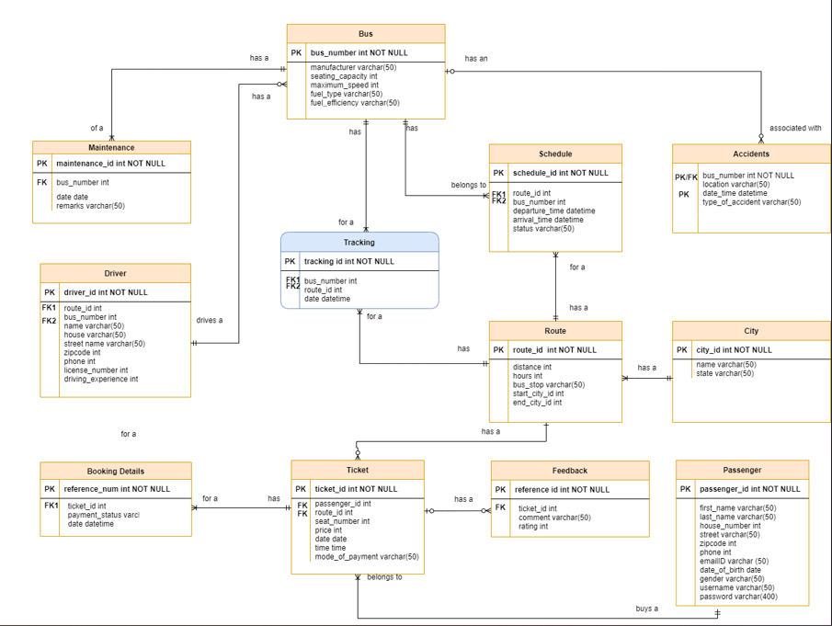
E-R Diagram

Slide 5
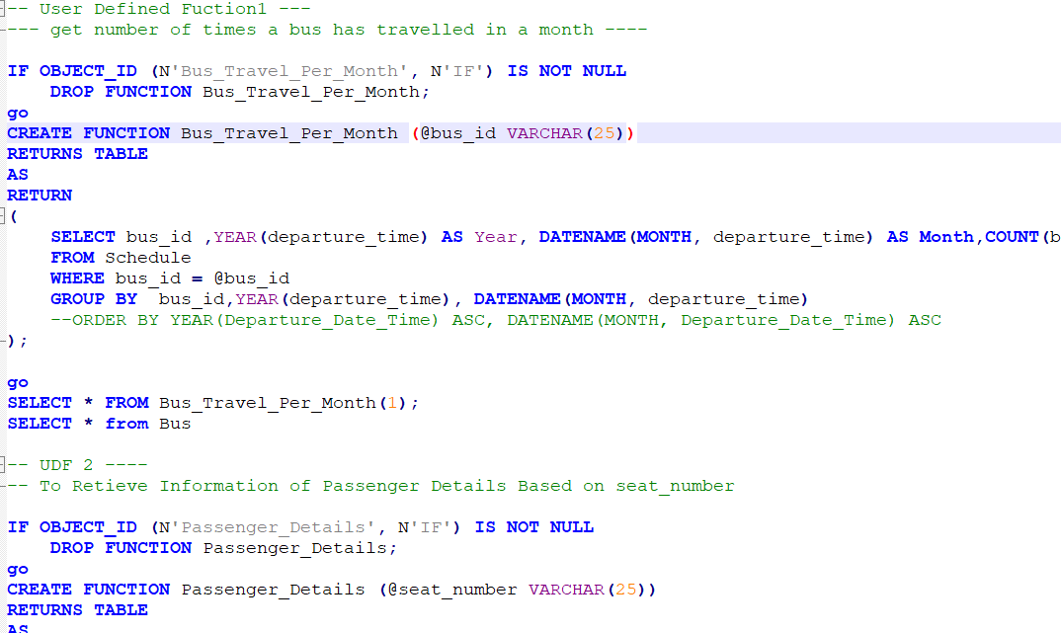
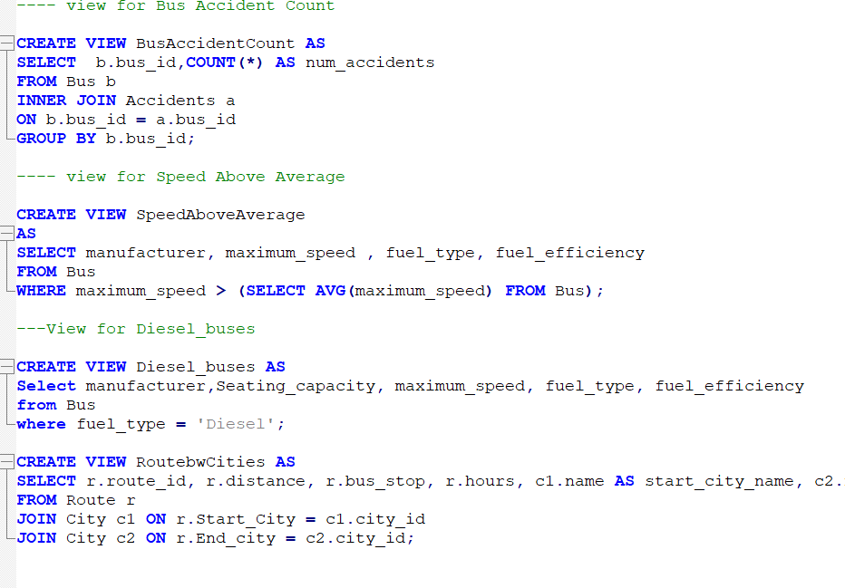
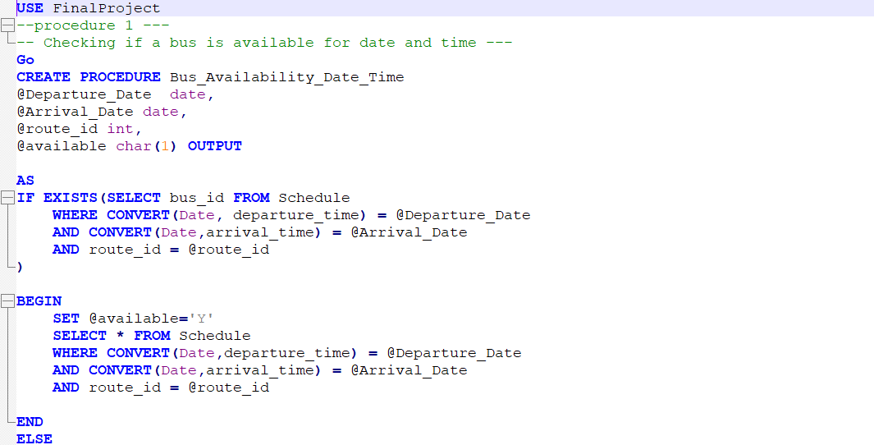
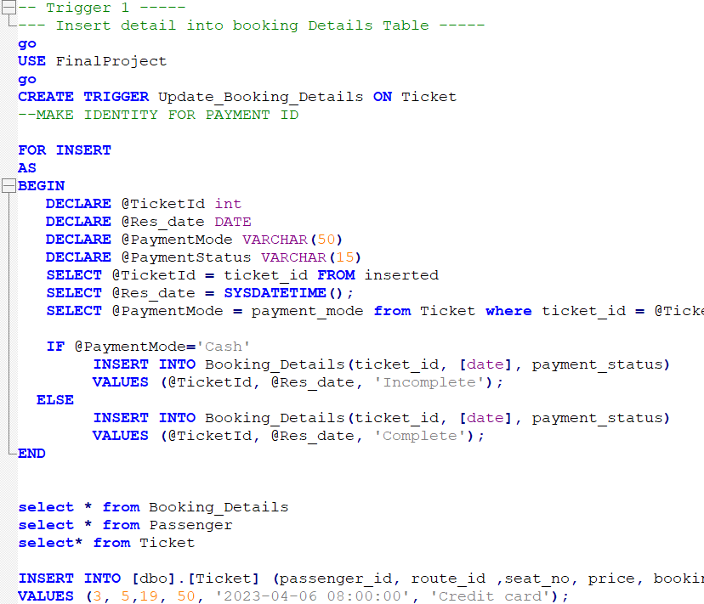
Database Objects Created
User Defined Functions
Views
Procedure
Triggers

Slide 6
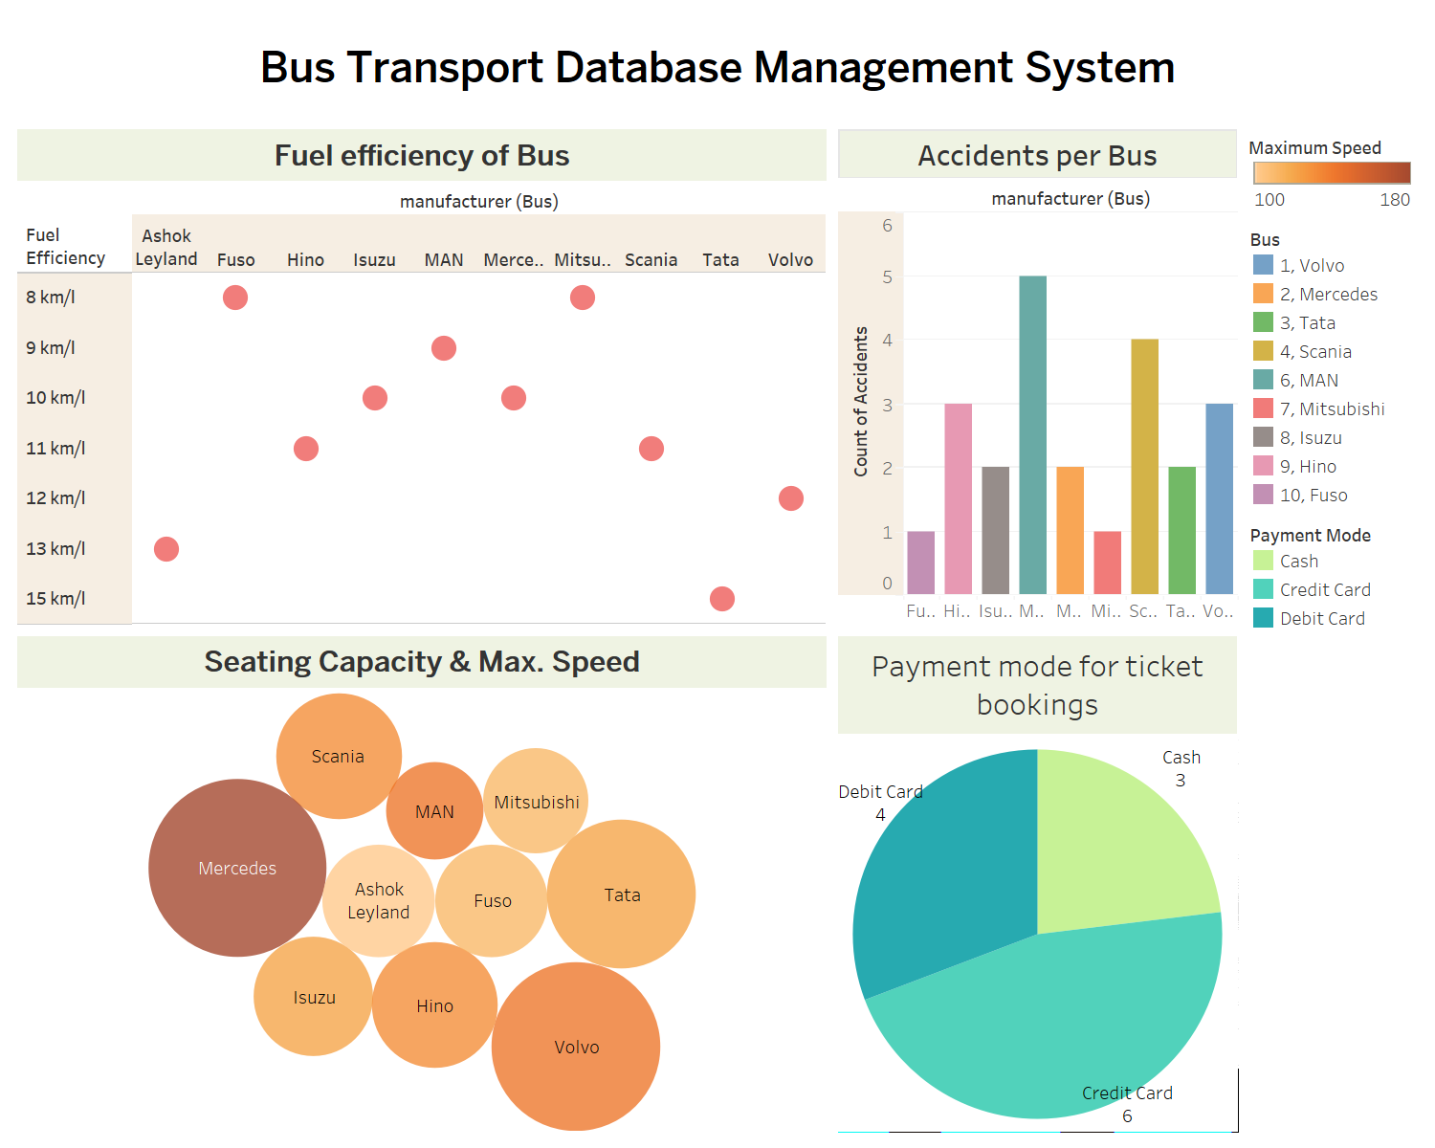
Data
Visualization

Slide 7
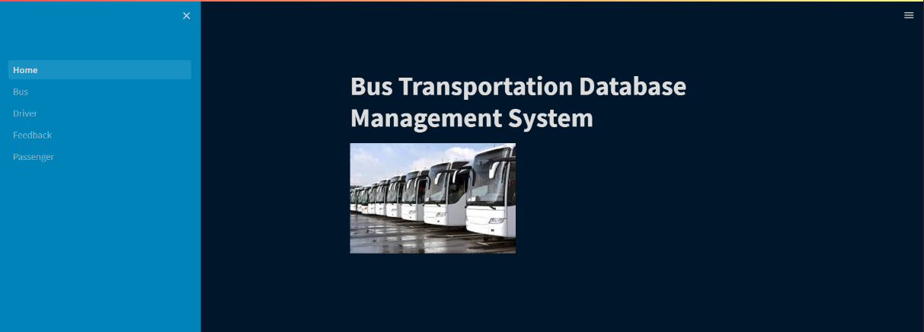
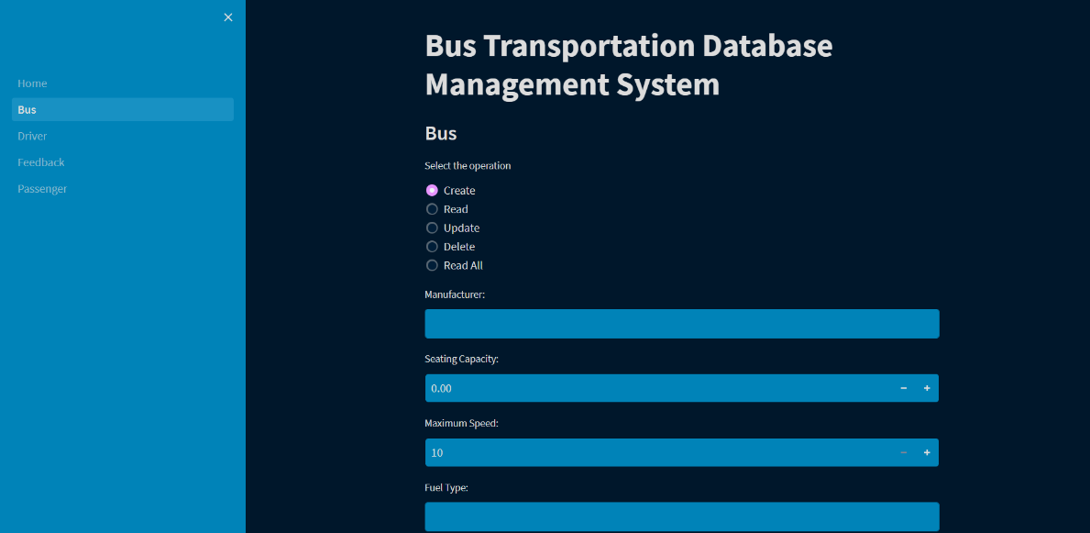
GUI

Slide 8
GitHub
https://github.com/adhyantini-bogawat/DMDD-Project
THANKYOU

