Slide 1

DATA ANALYTICS PROJECT
Hilton Revenue Management & Pricing Optimization
50,000+ records · 5 analytical tables · Python · MySQL · Power BI

Slide 2
INTRODUCTION
Optimizing Hotel Performance Through Data
High-Performing Rooms
Seasonal Demand
Identify top revenue categories
Analyze pricing opportunities
Competitive Position
Guest Satisfaction
Evaluate Hilton's ADR vs market
Measure impact on booking value

Slide 3


DATASET OVERVIEW
Five Tables, One Story
1
Bookings
Revenue, ADR, room type, channel, guest segment
2
Hotel KPI Daily
Occupancy, seasonality, demand indicators
3
Competitor Pricing
Market ADR comparison
4
Guest Reviews
Ratings and customer sentiment
5
Market Events
Events influencing demand

Slide 4
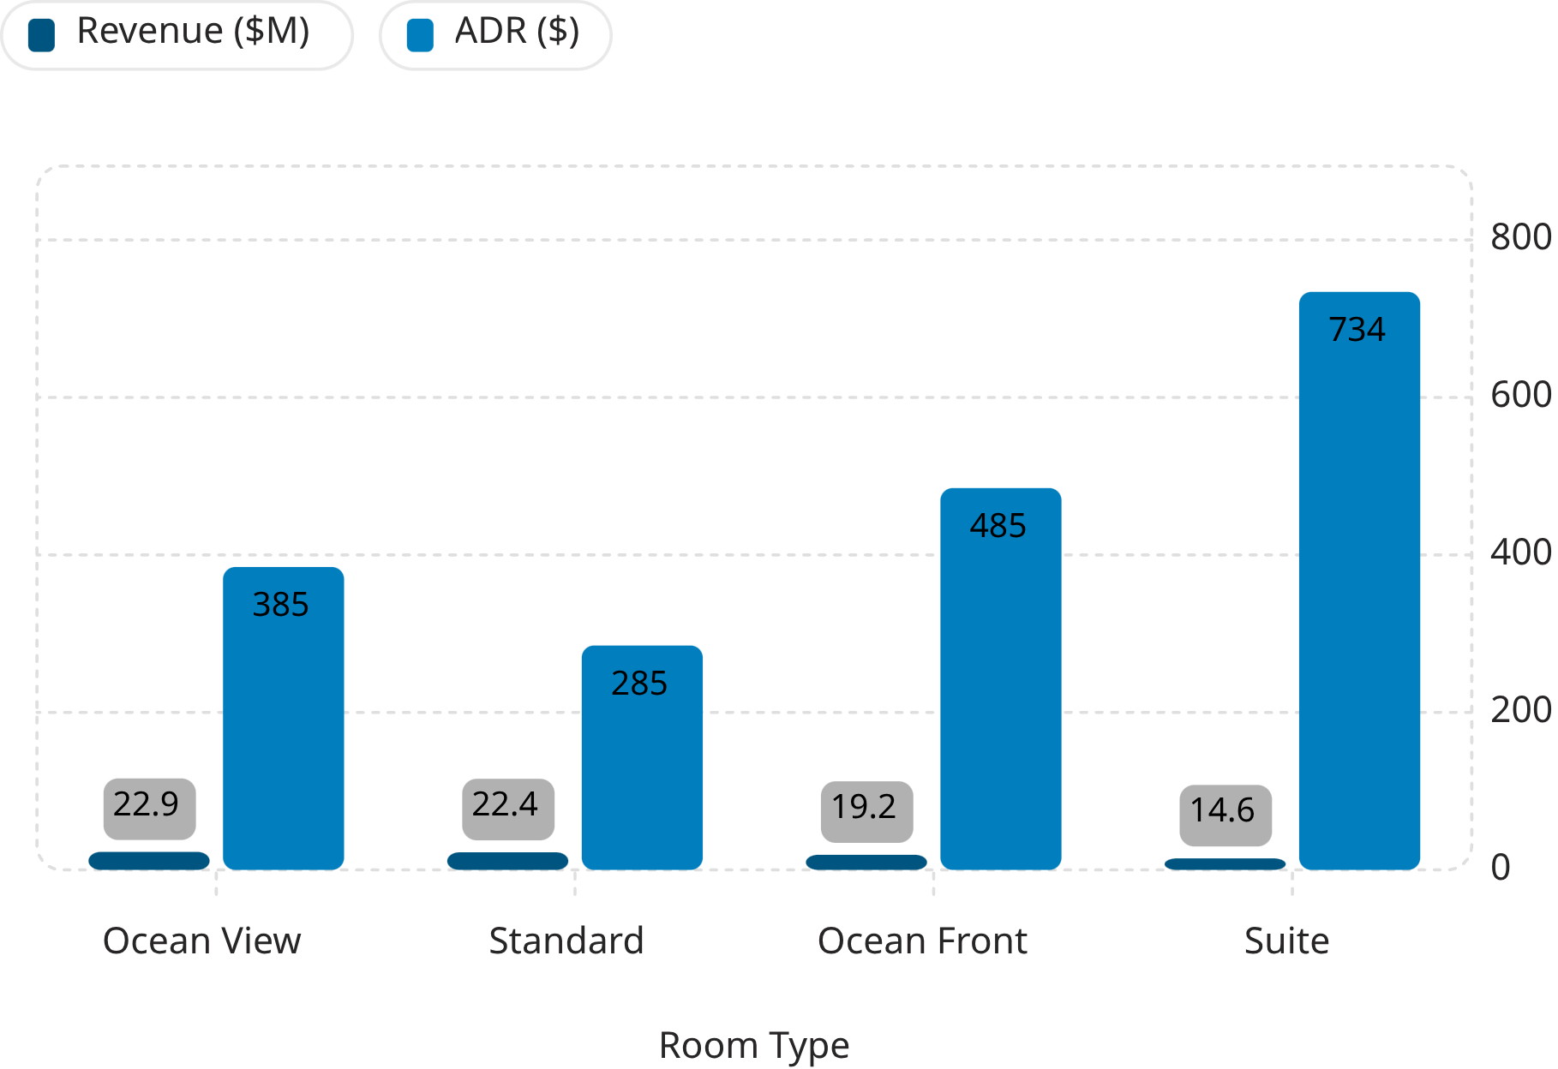
SQL ANALYSIS
Room Revenue & Seasonal Performance
Key Insights
Ocean View Rooms: $22.87M revenue (28.92% of total) from 15,022 bookings
Suites: highest ADR at $734.11 despite only 5,029 bookings — premium pricing potential
Peak Season occupancy above 88%, ADR reaching $488.75, monthly revenue exceeding $77M
Low Season revenue declined to $24M–$27M

Slide 5
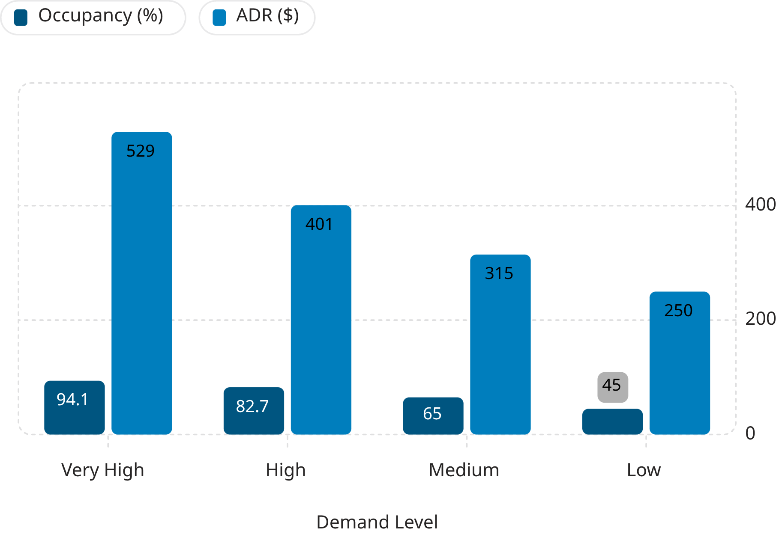


SQL ANALYSIS
Dynamic Pricing Opportunities
Pricing Strategy by Demand
Increase ADR
Maintain Pricing
Very High & High demand periods — occupancy above 82%
Medium demand periods — 64-65% occupancy
Discount & Promote
Low demand periods — 45% occupancy, $249.83 ADR

Slide 6
SQL ANALYSIS
Competitive Pricing Position
Within ±$1 of all competitors
Competitor
Comp ADR
Hilton ADR
Diff
Marriott Waikiki
$368.17
$368.02
-$0.15
Hyatt Regency
$368.15
$368.02
-$0.13
Hilton's ADR of $368.02 reflects a well-balanced, competitive pricing strategy across all major competitors.
Room-type pricing gaps remain within $0.61 of competitor ADRs — limited room for adjustment.
Outrigger
$367.85
$368.02
+$0.18
Sheraton
$367.48
$368.02
+$0.55
Alohilani
$367.11
$368.02
+$0.91

Slide 7
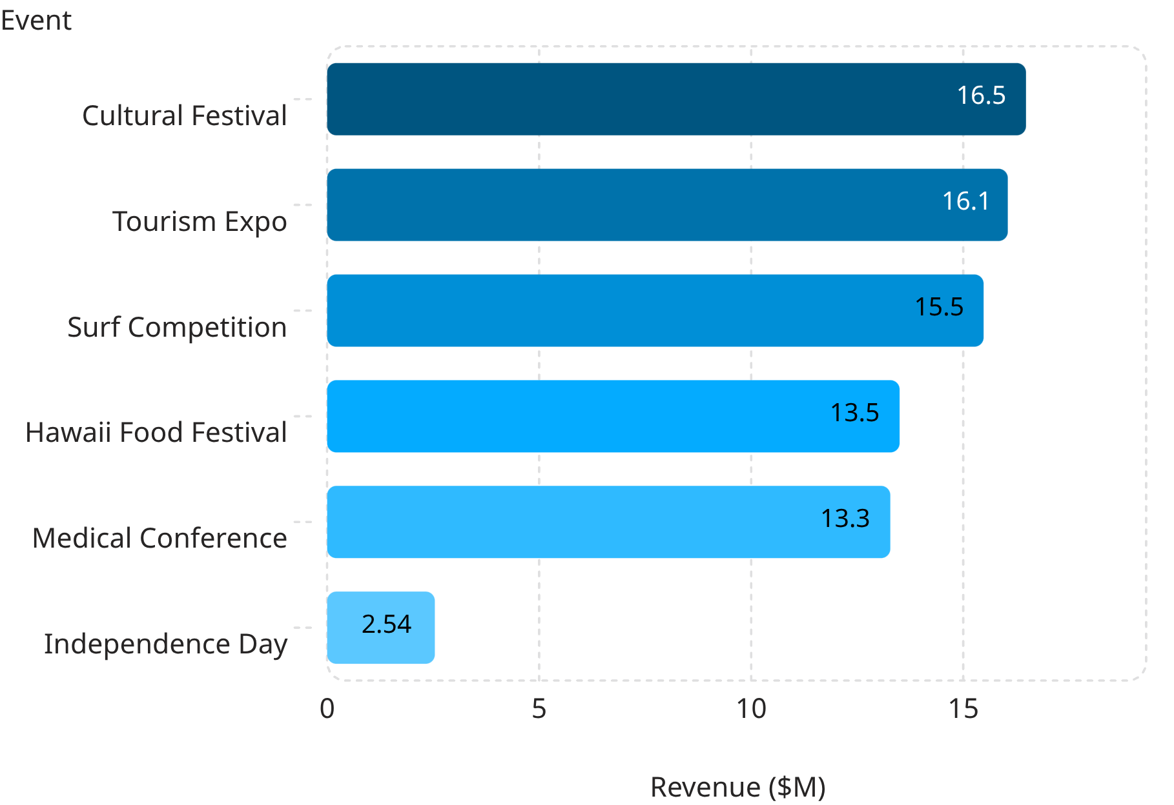
SQL ANALYSIS
Events Drive Revenue
Event Impact Highlights
Independence Day: 89.95% occupancy, $492 ADR
Cultural Festival: 90.68% occupancy, $478 ADR
Surf Competition: 83.66% occupancy, $434 ADR
Major events consistently drive both occupancy and ADR upward — prioritize for revenue optimization.

Slide 8
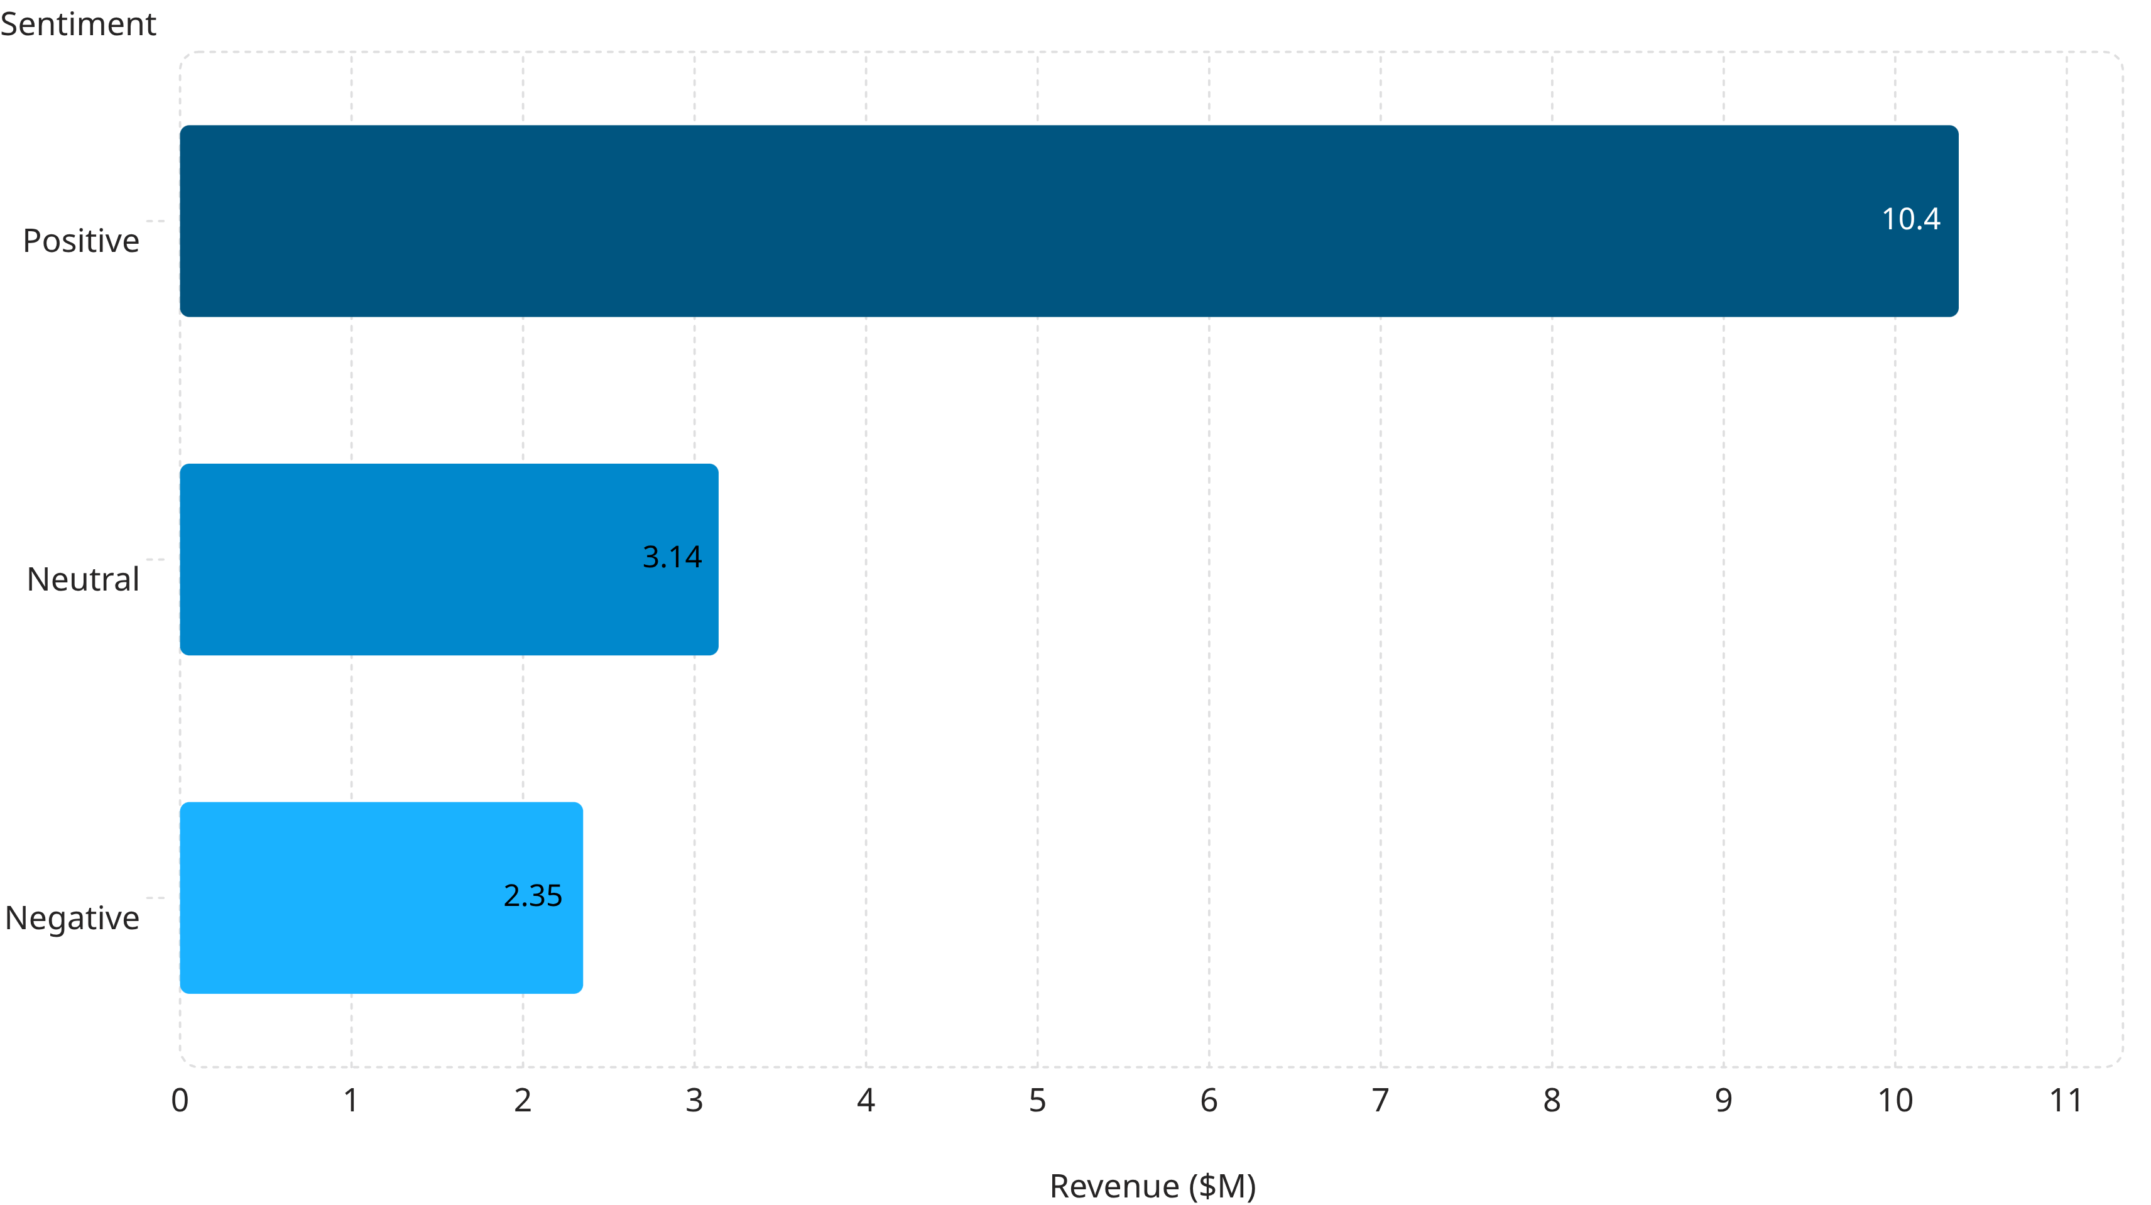
SQL ANALYSIS
Guest Satisfaction Drives Revenue
Satisfaction Scores by Category
3.72/5
3.72/5
3.64/5
3.66/5
Check-in Experience
Cleanliness
Food & Dining
Location
Highest rated
Top performer
Improvement opportunity
Improvement opportunity

Slide 9
POWER BI DASHBOARD
Interactive Revenue Management Dashboard
$79.1M
50K
71.5%
$368
Total Revenue
Total Bookings
Occupancy
Avg ADR
3.7
4.49
Guest Rating
Avg Stay
Dashboard Visualizations
Monthly Revenue Performance
Revenue Contribution by Booking Channel
Revenue by Room Type & Guest Segment
Market Events Impact
Interactive filters: Booking Month, Room Type, Season, Booking Channel
Direct Website leads booking channels at 35.27% of revenue

Slide 10
RECOMMENDATIONS & CONCLUSION
Data-Driven Revenue Strategy
01
02
03
Dynamic Pricing
Premium Room Focus
Event Strategies
Increase ADR in peak periods; promote during low demand
Maximize Ocean View & Suite revenue through targeted campaigns
Dedicated pricing plans for Cultural Festivals, Expos, Surf Competitions
04
05
Competitor Benchmarking
Guest Experience
Continuously monitor market pricing for new opportunities
Positive reviews generate 4× the booking revenue of negative ones

