Slide 1

The Profession of a Painter
Turning imagination into reality through colors.
CLASS 9 PRESENTATION

Slide 2
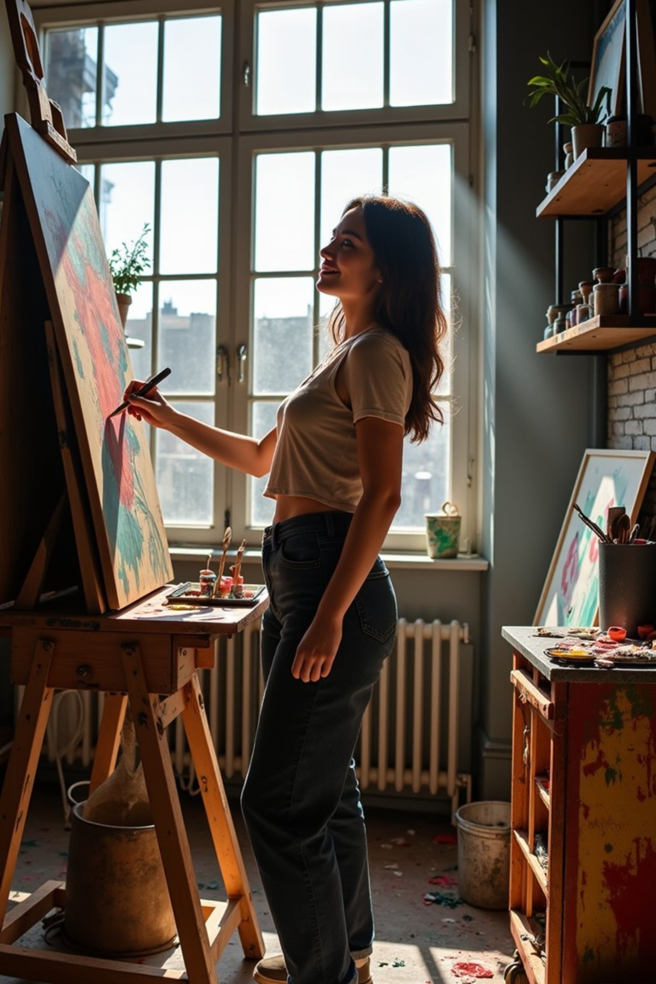
Who is a Painter?
An Artist Who Creates
A painter uses colors, brushes, and imagination to create visual art on canvas, walls, paper, or digital screens.
More Than a Hobby
Painting is a respected profession — painters work in galleries, film studios, advertising, and even video games.
A Universal Language
Art crosses language barriers. A painting can express emotions, tell stories, and capture history without a single word.

Slide 3
Types of Painters
Painters specialize in different styles and fields — here are six major types.
Fine Artist
Portrait Artist
Creates original artwork for galleries and exhibitions.
Captures the likeness and personality of people.
Landscape Artist
Mural Artist
Paints natural scenery — mountains, rivers, forests.
Paints large-scale artwork directly on walls and buildings.
Digital Artist
Industrial Painter
Creates art using software, tablets, and digital tools.
Applies paint to structures, vehicles, and products professionally.

Slide 4
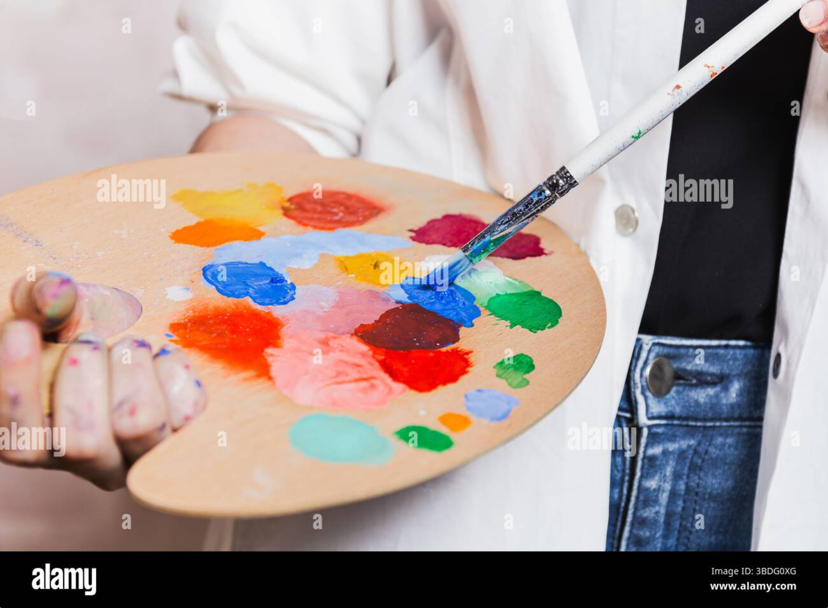
Skills Every Painter Needs
Creativity
Imagining original ideas and unique compositions.
Patience
Art takes time — layering, drying, and refining.
Observation
Noticing light, shadow, and fine details in the world.
Color Sense
Understanding how colors blend and create mood.
Drawing Skills
Sketching forms and proportions before painting.

Slide 5
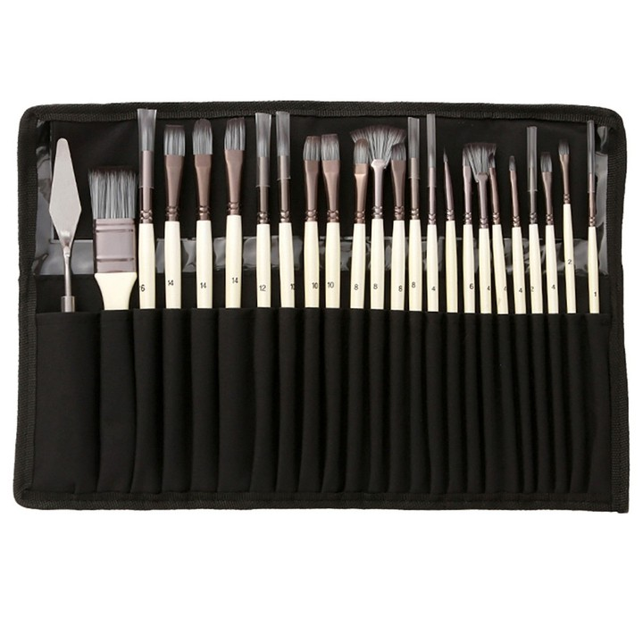

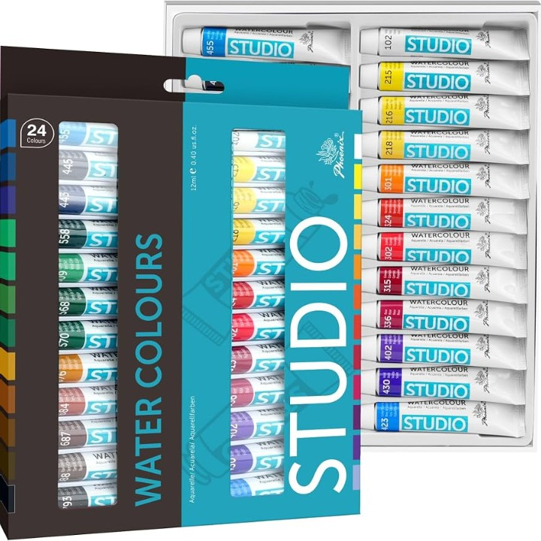
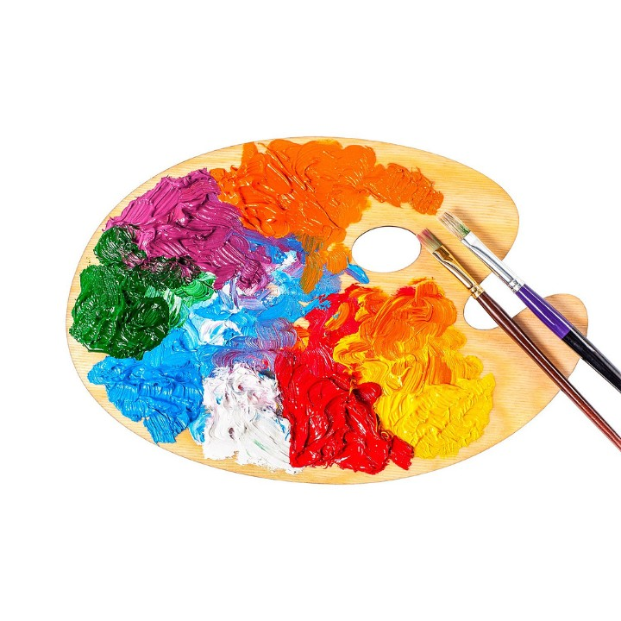
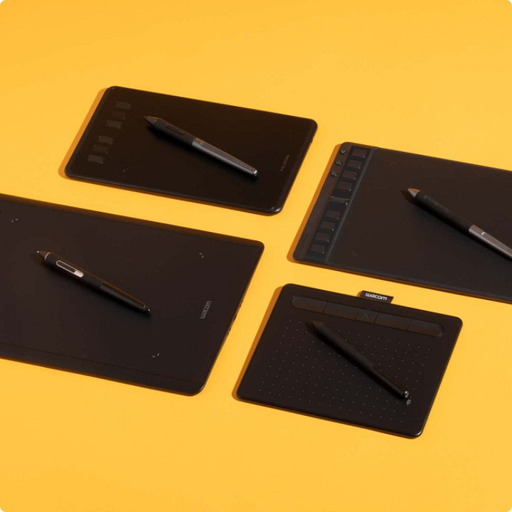
Tools of the Profession
Every painter has a toolkit — from traditional brushes to modern tablets.
Brushes
Canvas
Paints
Palette
Various shapes and sizes for different strokes and textures.
The surface on which paintings come to life.
Oil, acrylic, and watercolor — each with unique properties.
Used to mix and blend colors before applying to canvas.
Graphic Tablet & Stylus
Digital tools for modern painters and illustrators.

Slide 6
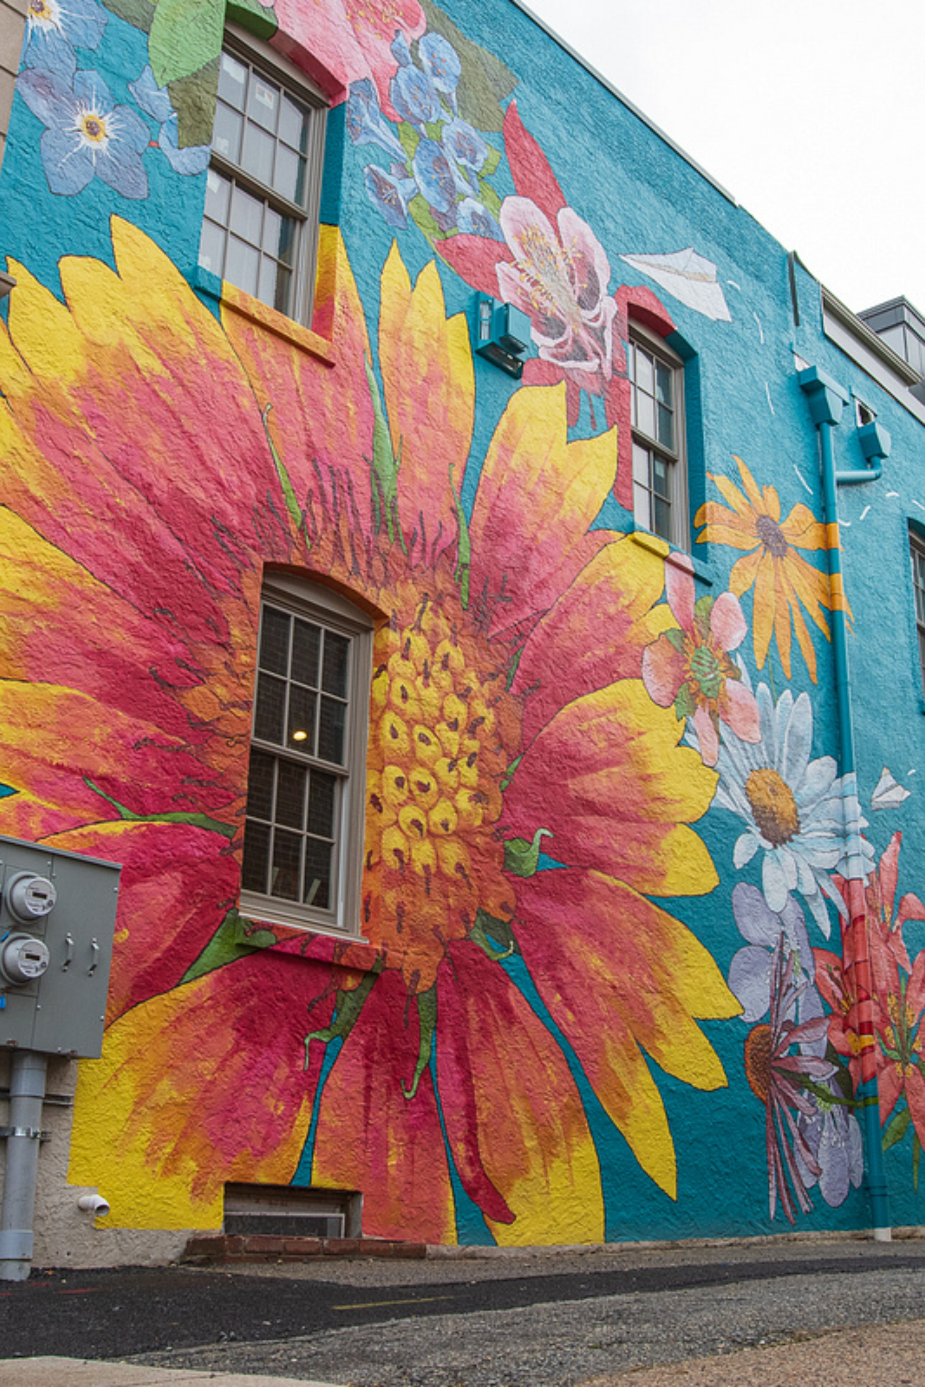
Why Are Painters Important?
🎭 Culture & History
Paintings preserve traditions, stories, and moments in time.
💡 Emotions & Expression
Art communicates feelings words sometimes cannot.
🏠 Decoration & Design
Paintings beautify homes, offices, and public spaces.
🎬 Films, Games & Ads
Concept artists shape the look of movies, games, and campaigns.

Slide 7
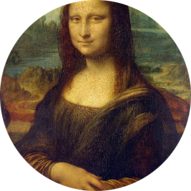
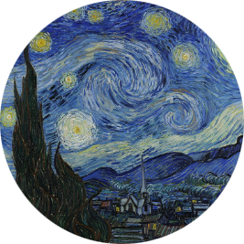
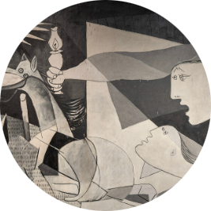
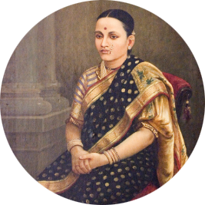
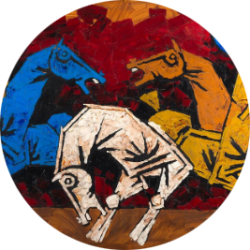
Famous Painters
Legends who changed the world with a brush.
Leonardo da Vinci
Vincent van Gogh
Pablo Picasso
Raja Ravi Varma
Co-founded Cubism, revolutionizing modern art.
Fused Indian themes with European techniques — a national treasure.
Painted the Mona Lisa — the most recognized artwork ever.
Created The Starry Night with bold, emotional brushstrokes.
M. F. Husain
India's most celebrated modern artist — known for vibrant, dynamic canvases.

Slide 8
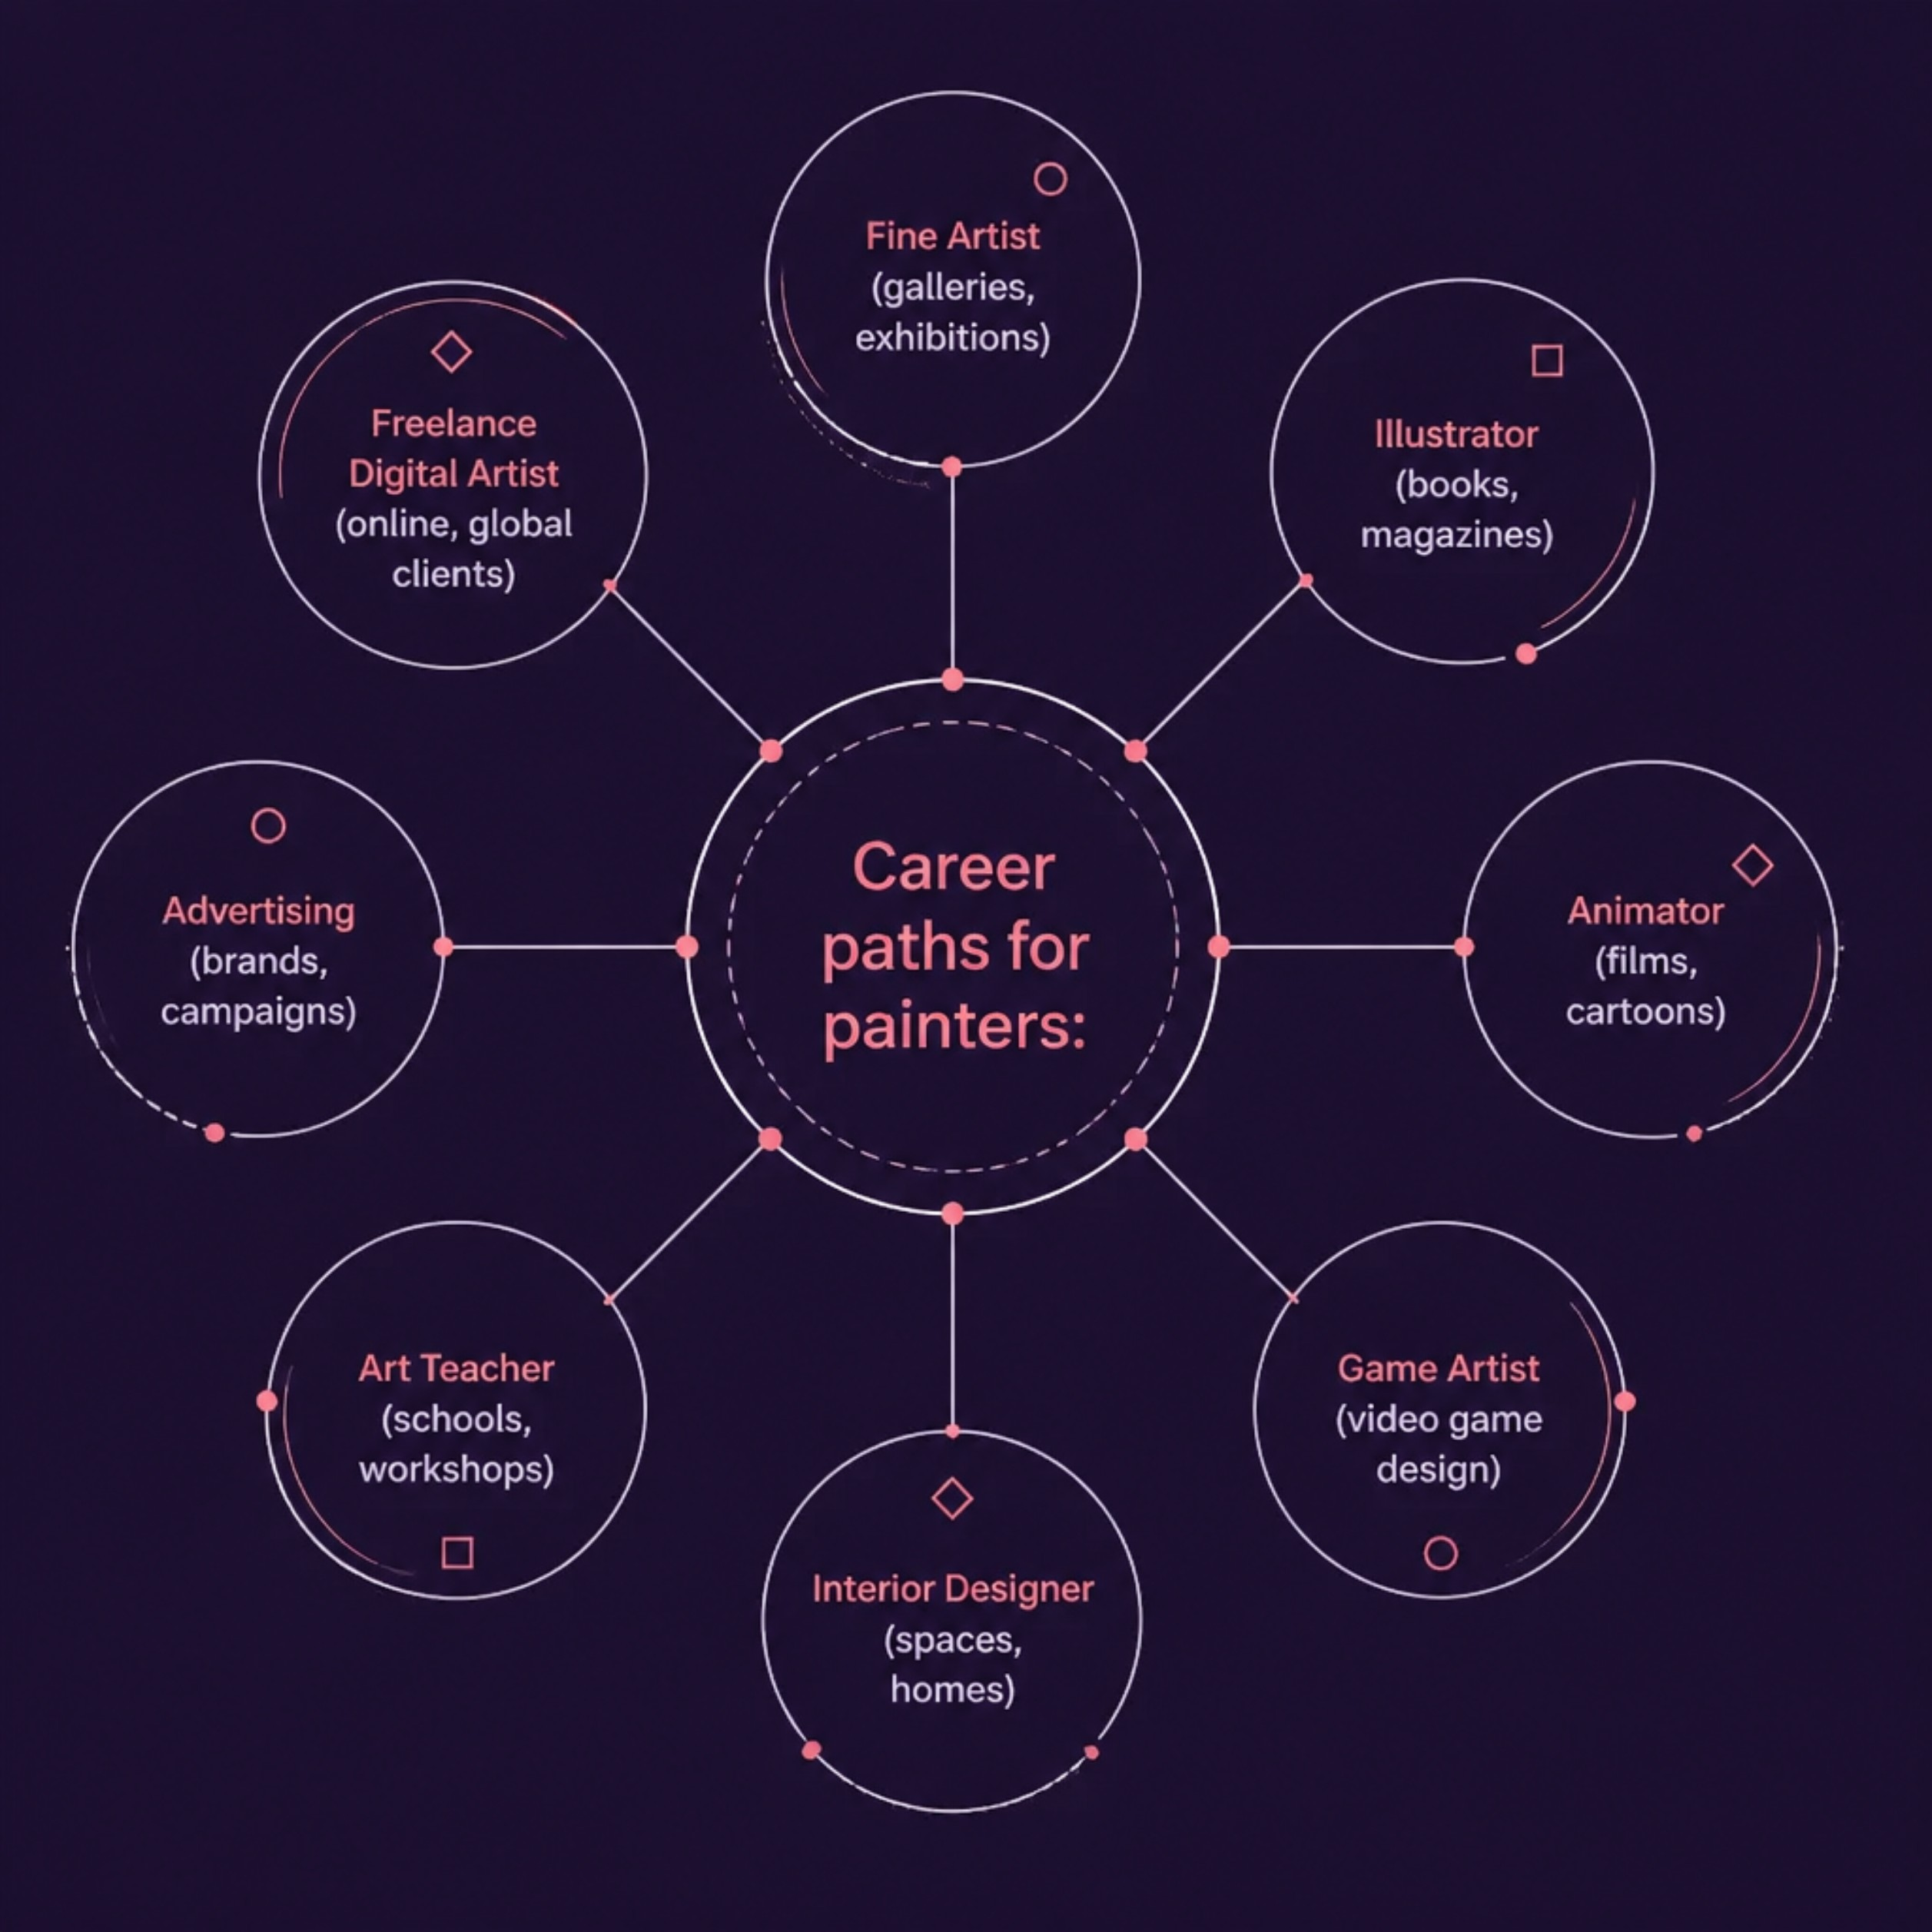

Career Opportunities
Art opens many doors — here's where a painter's skills can take you.
Art is Everywhere
From book covers to video games, from murals to movie sets — painters are needed
across industries.
The global digital art market is growing fast — skills learned today can become
careers tomorrow.

Slide 9
🎉 Fun Facts About Painting
Amazing facts that show how fascinating the world of painting really is!
Mysterious Mona Lisa
Van Gogh's Value
Ancient Art
Giant Canvas
The Mona Lisa has no visible eyebrows, making it one of the most talked-about paintings in history.
Vincent van Gogh sold only one painting during his lifetime, but today his artworks are worth millions.
Some cave paintings are over 30,000 years old, showing painting is one of humanity's oldest forms of communication.
The largest painting on canvas is more than 1,500 square meters in size — truly massive!
Concept Art
Many modern movies, animations, and video games begin with digital concept paintings.

Slide 10
"Every masterpiece begins with a single brushstroke."
Whether you dream of galleries, game studios, or designing the world around you — art is a powerful profession worth exploring.
Create
Learn
Start with what you love
Study the masters, practice daily
Share
Show your work to the world
Thank You! Any Questions?

