Slide 1
RELIABILITY

Slide 2
Introduction
Reliability is “quality changing over time” or a motion picture instead of a snapshot
Reliability is a measure of the result of the quality of the product over the long run.
Reliability terminates with a failure – i.e., unreliability occurs.

Slide 3
Introduction
Reliability is an engineering discipline for applying scientific know-how to a component, assembly, plant, or a process so it will perform its intended function, without failure, for the required time duration when installed and operated correctly in a specific environment.
Reliability is the probability than an item can perform its intended function without failure for a specific interval under stated conditions.

Slide 4
Four Aspects of Reliability
Reliability is a probability based on concepts; the numerical value of the reliability is between 0 and 1
The functional performance of the product has to meet certain stipulations and a functional definition of failure is needed. For example, a failure means different things to the user and to the repair person.
It implies a successful operation over a certain period of time.
Operating or environmental conditions under which product use takes place are specified

Slide 5
Cost of Unreliability
Finding the cost of unreliability (COUR) starts with a big-picture view and helps direct cost improvement programs by identifying:
Where is the cost problem- what sections of the plant
What magnitude is the problem-all business loss costs are included in the calculation, and
What major types of problems occur

Slide 6
Designing for Reliability
Reliability does not just happen. It requires that the following three key elements been in place
A commitment from top management to ensuring reliability
A reliability policy(that goes hand-in-hand with a quality Policy)
A philosophy that designs reliability in at an early stage

Slide 7
Ways to Improve Reliability
Use proven designs
Use the simplest possible designs
Use proven components that have undergone reliability component testing
Use redundant parts in high risks areas. Placing two components in parallel will reduce the overall probability of failure
Always design fail safe
Specific and use proven manufacturing methods

Slide 8
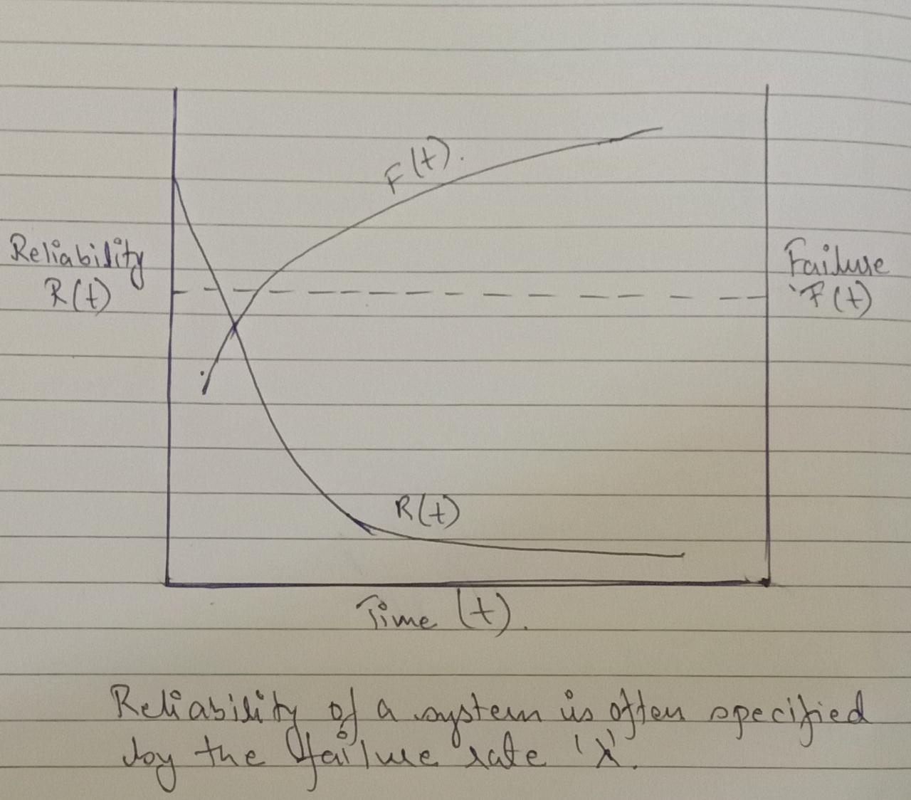
Measures of Reliability
Reliability is the probability that a system will still be functioning at time ‘t’. This can be expressed as “the cumulative distribution of failure” Reliability measurement is based on the failure rate :

Slide 9
Bath Tub Curve
Most products go through three distinct phases from product inception to wear out
Infancy / Green / Debugging / Burn-in-period
Chance failure / Normal Operating Life
Wear out / Ageing

Slide 10
Bath Tub Curve
Infant mortality
Wearout
A
D

Slide 11
Infancy / Green / Debugging / Burn-in-period
Many components fail very soon after they are put into service.
Failures within this period are caused by defects and poor design that cause an item to be legitimately bad.
These are called infant mortality failures and the failure rate in this period is relatively high.
Good system vendors will perform an operation called “burn in” where they put together and test a system for several days to try to weed out these types of problems so the customer doesn't see them.

Slide 12
Chance failure / Normal Operating Life
If a component does not fail within its infancy, it will generally tend to remain trouble-free over its operating lifetime
The failure rate during this period is typically quite low.
This phase, in which the failure rate is constant, typically represents the useful life of the product.

Slide 13
Wear out / Ageing
After a component reaches a certain age, it enters the period where it begins to wear out, and failures starts to increase.
The period where failures start to increase is called the wear out phase of component life.

Slide 14
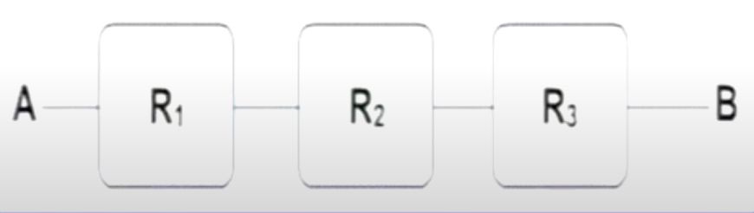
System Reliability
Series System: When components are in series and each component has a reliability Ri . If one component fails, the system fails.

Slide 15
The Overall Reliability of a series system can be calculated as:
RAB = R1 * R2* R3
If R1 = R2 = R3 = 0.95
RAB =R1*R2*R3 = 0.95*0.95*0.95
= 0.86
R total is always < than R1 or R2 or R3

Slide 16
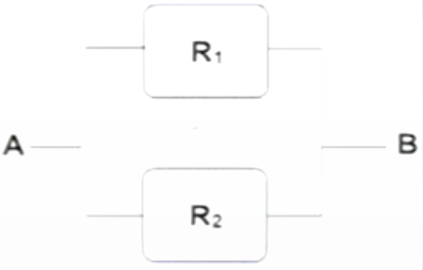
System Reliability
Parallel System : When components are in parallel and each component has a reliability Ri. If one component fails, the system does not fail

Slide 17
RAB=1 – probability (1 & 2 both fail)
The probability of 1 failing is = ( 1- R1)
The probability of 2 failing is = ( 1- R2)
Overall reliability is RAB =1 – (1 – R 1 ) (1-R 2)
If R1 = 0.9 and R2 = 0.8
RAB = 1 – (1 -0.9) (1-0.8) = 0.98
R Total is always > than R1 or R2

Slide 18
Basic Reliability Terms
Failure - A failure is an event when an item is not available to perform its function at specified conditions when scheduled or is not capable of performing functions to specification.
Failure Rate - The number of failures per unit of gross operating period in terms of time, events, cycles.
MTBF - Mean Time Between Failures - The average time between failure occurrences. The number of items and their operating time divided by the total number of failures. For Repairable Items
MTTF - Mean Time To Failure - The average time to failure occurrence. The number of items and their operating time divided by the total number of failures. For Repairable Items and Non-repairable Items

Slide 19
Basic Reliability Terms
Maintainability - A characteristic of design, installation and operation, usually expressed as the probability that an item can be retained in, or restored to, specified operable condition within a specified interval of time when maintenance is performed in accordance with prescribed procedures.
MTTR - Mean Time To Repair - The average time to restore the item to specified conditions.

Slide 20
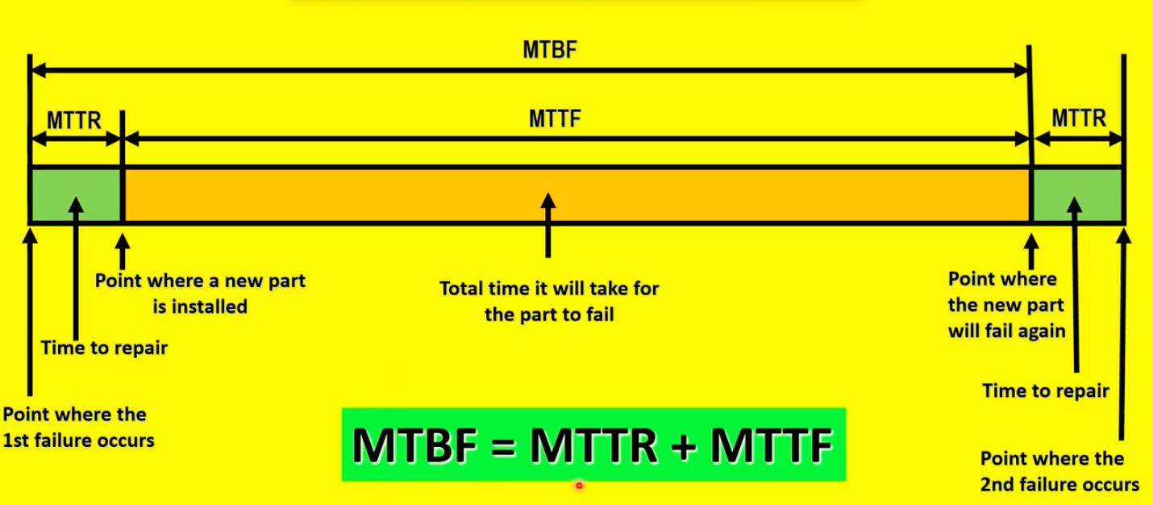
MTBF/MTTF & MTTR

Slide 21
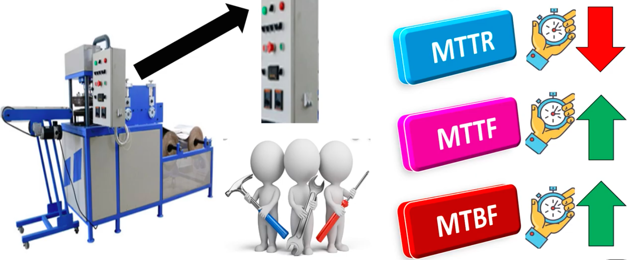
What Management wants ?

Slide 22
Sample Questions
MTBF θ = Total time / Total Number of failures
Average Failure Rate λ = 1 / θ → λ θ = 1
300 cars have accumulated 45000 hours, 10 failures are observed. What is the MTBF? What is the failure rate? Ans= 4500hr, 0.00022/hr
Five oil pumps were tested with failure hours of 45, 33, 62, 94 and 105. What is the MTTF and failure rate?67.8hrs,(1/mttf)1/67.8(same as mtbf)

Slide 23
Sample Questions
10 components were tested. The components (not repairable) failed as follows:
Component 1,2,3,4,5 failed after 75,125, 130, 325, 525 hours. Find the failure rate and mean time till failure..

