Slide 1
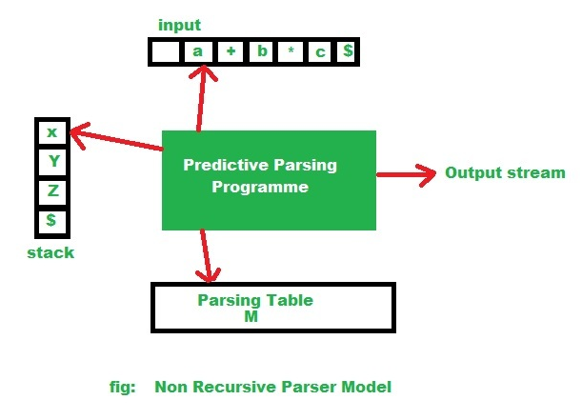
Non- Recursive Predictive Parsing
Implemented using stack instead of recursive calls.
Key problem- determining the production to be used for a non-terminal.
(Source: https://www.geeksforgeeks.org/algorithm-for-non-recursive-predictive-parsing)

Slide 2
SYNTAX ANALYSIS
FIRST and FOLLOW Set in Parsing.
The construction of a predictive parser is aided by two functions associated with a grammar G. These functions, FIRST and FOLLOW, allow us to fill in the entries of a predictive parsing table for G, whenever possible.
Why FIRST set is required?
Back tracking in syntax analysis is really a complex process to implement. The easier process is as follows:
If the compiler would have come to know in advance, that what is the “first character of the string produced when a production rule is applied”, and comparing it to the current character or token in the input string it sees, it can wisely take decision on which production rule to apply.
Source: https://www.geeksforgeeks.org/why-first-and-follow-in-compiler-design/

Slide 3
Let us consider the following grammar:
S→cAd
A→bc | a
Input string is “cad”.
In the above example, if it knew that after reading character ‘c’ in the input string and applying the rule: S → cAd, next character in the input string is ‘a’, then it would have ignored the production rule A->bc (because ‘b’ is the first character of the string produced by this production rule, not ‘a’ ), and directly use the production rule A->a.
Source:https://www.geeksforgeeks.org/why-first-and-follow-in-compiler-design/

Slide 4
Hence it is validated that if the compiler/parser knows about first character of the string that can be obtained by applying a production rule, then it can wisely apply the correct production rule to get the correct syntax tree for the given Input string.
Why FOLLOW set is required?
Let us consider the grammar:
A →aBb
B →c | ε
Suppose the string to be parsed is “ab”.
Source: https://www.geeksforgeeks.org/why-first-and-follow-in-compiler-design/

Slide 5
As the first character in the input is a, the parser applies the rule A→aBb.
A
/ | \
a B b
Now the parser checks for the second character of the input string which is b, and the Non-Terminal to derive is B, but the parser can’t get any string derivable from B that contains b as first character.
Source: https://www.geeksforgeeks.org/why-first-and-follow-in-compiler-design/

Slide 6
But the Grammar does contain a production rule B -> ε, if that is applied then B will vanish, and the parser gets the input “ab” , as shown below. But the parser can apply it only when it knows that the character that follows B in the production rule is same as the current character in the input.
In RHS of A -> aBb, b follows Non-Terminal B, i.e. FOLLOW(B) = {b}, and the current input character read is also b. Hence the parser applies this rule. And it is able to get the string “ab” from the given grammar.
Source: https://www.geeksforgeeks.org/why-first-and-follow-in-compiler-design/

Slide 7
A A
/ | \ / \
a B b => a b
|
ε
FIRST and FOLLOW sets for a given grammar, so that the parser can properly apply the needed rule at the correct position.
Source: https://www.geeksforgeeks.org/why-first-and-follow-in-compiler-design/

Slide 8
Algorithm for finding FIRST(α).
If a is any string of grammar symbols, let FIRST(a) be the set of terminals that begin the strings derived from a. If a=> ε then ε is also in FIRST(α).
To compute FIRST(X) for all grammar symbols X, apply the following rules until no more terminals or ε can be added to any FIRST set:
1. If X is terminal, then FIRST(X) is {X}.
2. If X→ε is a production, then add ε to FIRST(X).
3. If A→ BC then FIRST (A) = FIRST (B) if FIRST (B) doesn’t contain ε. If FIRST (B) contains ε then we have to substitute ε in place of B. We then have FIRST (A)= FIRST (B) U FIRST (C) .
Source: https://www.geeksforgeeks.org/why-first-and-follow-in-compiler-design/

Slide 9
Example:
Find the FIRST set from the following grammar:
E → T E’
E’ → + T E’|ε
T → F T’
T’ → * F T’|ε
F → ( E ) | id
FIRST(E) = FIRST(T) = FIRST(F) = {( , id}
FIRST(E’) = {+, ε}
FIRST(T’) = {*, ε}

Slide 10
Consider the production rule-
A → abc / def / ghi
Calculate the FIRST set.
FIRST (A)= {a,d,g}
Source: https://www.gatevidyalay.com/first-and-follow-compiler-design/

Slide 11
Calculate the FIRST set for the given grammar-
S → aBDh
B → cC
C → bC / ∈
D → EF
E → g / ∈
F → f / ∈
First(S) = { a } First(C) = { b , ∈ } First(F) = { f , ∈ }
First(B) = { c } First(D) = { First(E) – ∈ } ∪ First(F) = { g , f , ∈ } First(E) = { g , ∈ }
Source: https://www.gatevidyalay.com/first-and-follow-compiler-design/

Slide 12
Calculate the FIRST set for the given grammar-
S→ Aa
A → BD
B → b | ε
D → d | ε
FIRST (S) ={b, d, a}
FIRST (A)={b, d, ε}
FIRST (B)={b, ε}
FIRST (D)={d, ε}

Slide 13
Calculation of the FOLLOW set
Follow(α) is a set of terminal symbols that appear immediately to the right of α.
Rules For Calculating Follow Function-
1. For the start symbol S, place $ in Follow(S).
2. For any production rule A → αB, we have:
Follow(B) = Follow(A)
3. For any production rule A → αBβ, we have:
If ∈ ∉ First(β), then Follow(B) = First(β)
If ∈ ∈ First(β), then Follow(B) = { First(β) – ∈ } ∪ Follow(A)

Slide 14
Note:
∈ may appear in the first function of a non-terminal.
∈ will never appear in the follow function of a non-terminal.
Before calculating the first and follow functions, eliminate Left Recursion from the grammar, if present.
We calculate the FOLLOW function of a non-terminal by looking where it is present on the RHS of a production rule.

Slide 15
Solved Problems:
1. Calculate the FOLLOW functions for the given grammar-
S → aBDh
B → cC
C → bC / ∈
D → EF
E → g / ∈
F → f / ∈
First(S) = { a }
First(B) = { c }

Slide 16
First(C) = { b , ∈ }
First(D) = { First(E) – ∈ } ∪ First(F) = { g , f , ∈ }
First(E) = { g , ∈ }
First(F) = { f , ∈ }
Follow(S) = { $ } Follow(B) = { First(D) – ∈ } ∪ First(h) = { g , f , h }
Follow(C) = Follow(B) = { g , f , h } Follow(D) = First(h) = { h }

Slide 17
Follow(E) = { First(F) – ∈ } ∪ Follow(D) = { f , h }
Follow(F) = Follow(D) = { h }
2. Calculate the follow functions for the given grammar:
S → A
A → aB / Ad
B → b
C → g
We need to eliminate Left Recursion from the given grammar. After left recursion removal, we have the grammar as follows:

Slide 18
S → A
A → aBA’
A’ → dA’ / ∈
B → b
C → g
First(S) = First(A) = { a }
First(A) = { a }
First(A’) = { d , ∈ }
First(B) = { b }
First(C) = { g }

Slide 19
Follow(S) = { $ } Follow(B) = { First(A’) – ∈ } ∪ Follow(A) = { d , $ }
Follow(A) = Follow(S) = { $ }
Follow(A’) = Follow(A) = { $ }

Slide 20
Calculate the follow functions for the given grammar-
S → ACB / CbB / Ba
A → da / BC
B → g / ∈
C → h / ∈
First(S) = { First(A) – ∈ } ∪ { First(C) – ∈ } ∪ First(B) ∪ First(b) ∪ { First(B) – ∈ } ∪ First(a) = { d , g , h , ∈ , b , a }
First(A) = First(d) ∪ { First(B) – ∈ } ∪ First(C) = { d , g , h , ∈ }
First(B) = { g , ∈ } First(C) = { h , ∈ }

Slide 21
Follow(S) = { $ }
Follow(A) = { First(C) – ∈ } ∪ { First(B) – ∈ } ∪ Follow(S) = { h , g , $ }
Follow(B) = Follow(S) ∪ First(a) ∪ { First(C) – ∈ } ∪ Follow(A) = { $ , a , h , g }
Follow(C) = { First(B) – ∈ } ∪ Follow(S) ∪ First(b) ∪ Follow(A) = { g , $ , b , h }.

Slide 22
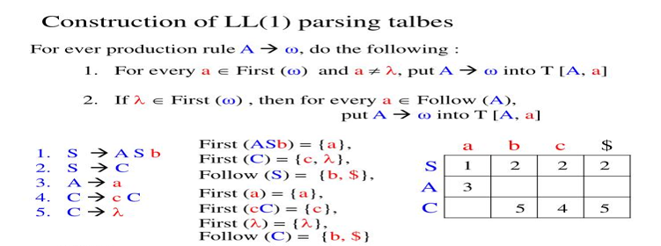
LL(1) parsing table

Slide 23
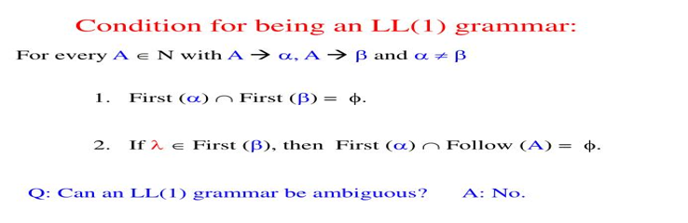

Slide 24
Left Factoring a grammar
Grammar With Common Prefixes-
A → αβ₁ / αβ₂ / αβ₃
This kind of grammar creates a problematic situation for Top down parsers.
Top down parsers can not decide which production must be chosen to parse the string in hand.
To remove this confusion, we use left factoring.
(Source: https://www.gatevidyalay.com/tag/left-factoring-in-compiler-design-ppt/)

Slide 25
In left factoring,
We make one production for each common prefixes.
The common prefix may be a terminal or a non-terminal or a combination of both.
Rest of the derivation is added by new productions.
The grammar obtained after the process of left factoring is called as Left Factored Grammar.
(Source: https://www.gatevidyalay.com/tag/left-factoring-in-compiler-design-ppt/)

Slide 26
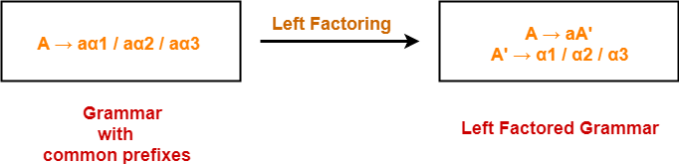
Example-
(Source: https://www.gatevidyalay.com/tag/left-factoring-in-compiler-design-ppt/)

Slide 27
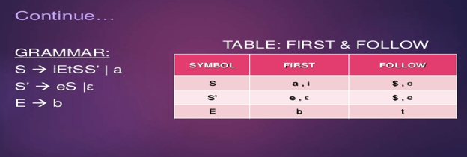
Source: https://www.slideshare.net/ll1-parser-in-compilers

Slide 28
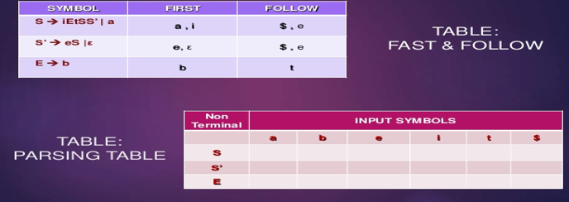
Source: https://www.slideshare.net/ll1-parser-in-compilers

Slide 29
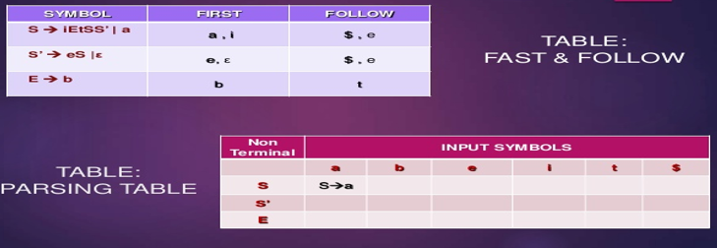
Source: https://www.slideshare.net/ll1-parser-in-compilers

Slide 30
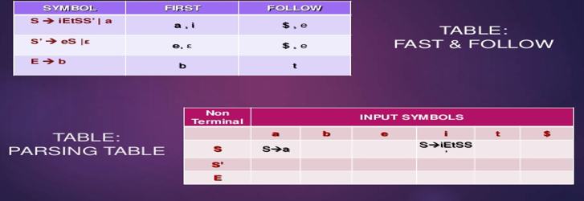
Source: https://www.slideshare.net/ll1-parser-in-compilers

Slide 31
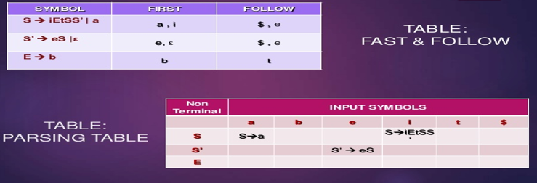
Source: https://www.slideshare.net/ll1-parser-in-compilers

Slide 32
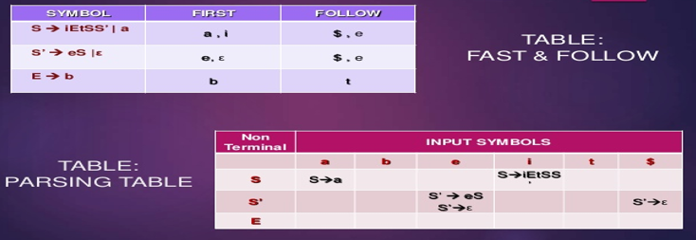
Source: https://www.slideshare.net/ll1-parser-in-compilers

Slide 33
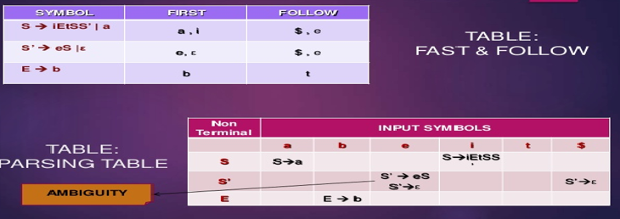
Source: https://www.slideshare.net/ll1-parser-in-compilers

Slide 34
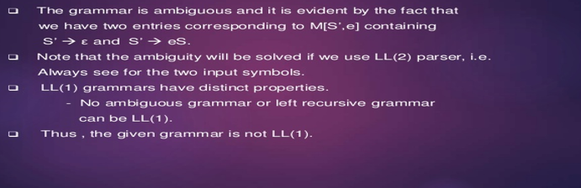
Conclusion:
Source: https://www.slideshare.net/ll1-parser-in-compilers

