Slide 1
COMPILER DESIGN LAB CS1762

Slide 2
PROGRAM3
To implement a Recursive Descent Parsing.

Slide 3
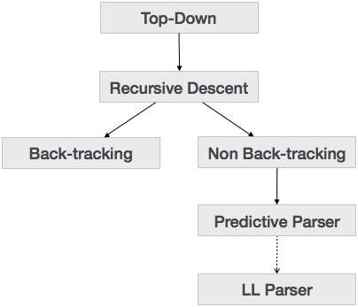
Types of Parsing

Slide 4
Recursive Descent Parsing
Recursive descent is a top-down parsing technique that constructs the parse tree from the top and the input is read from left to right. It uses procedures for every terminal and non-terminal entity. This parsing technique recursively parses the input to make a parse tree, which may or may not require back-tracking. But the grammar associated with it (if not left factored) cannot avoid back-tracking. A form of recursive-descent parsing that does not require any back-tracking is known as predictive parsing.
This parsing technique is regarded recursive as it uses context-free grammar which is recursive in nature.

Slide 5
Parsing
Back-tracking
Top- down parsers start from the root node (start symbol) and match the input string against the production rules to replace them (if matched). To understand this, take the following example of CFG:
S → rXd | rZd X → oa | ea Z → ai
For an input string: read, a top-down parser, will behave like this:
It will start with S from the production rules and will match its yield to the left-most letter of the input, i.e. ‘r’. The very production of S (S → rXd) matches with it. So the top-down parser advances to the next input letter (i.e. ‘e’). The parser tries to expand non-terminal ‘X’ and checks its production from the left (X → oa). It does not match with the next input symbol. So the top-down parser backtracks to obtain the next production rule of X, (X → ea).
Now the parser matches all the input letters in an ordered manner. The string is accepted.

Slide 6
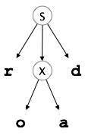
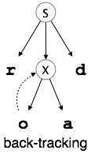
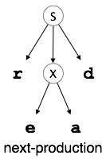
Parsing

Slide 7
Recursive Descent Parsing
Recursive descent parsing is a top down parsing technique
Consists of a set of procedures one for each non-terminal

Slide 8
How it works?
Execution begins with the procedure for the start symbol which halts and announces success if its procedure body scans the entire input string.
Start with top-level non-terminal S
Try the rules for S in order
Use Backtracking if production is wrong

Slide 9
EXAMPLE:
Consider the grammar
S → c A d
A →a b | a
w=cad
S()
S
A()
c
A
d

Slide 10
EXAMPLE:
w=cad
S()
S()
S
S
A()
A()
c
A
d
c
A
d
a
a
b

Slide 11
Implementation of Recursive Descent Parsing
Algorithm:
Step 1: Start.
Step 2: Function for start symbol, S()
Step2.1 check if first input symbol corresponds to start production.
Step2.2 if true
Step2.3 match the next symbol
Step2.4 Call function for nonterminal to scan for symbols
Step2.5 else
error

Slide 12
Implementation of Recursive Descent Parsing
Step 3: Function for Nonterminal A().
Step3.1Choose an A- production,
A→ X₁X₂……………X_{k}
Step3.2 for (i=J to k)
Step3.3 if (X_{i} is non terminal)
Call procedure X_{i}();
Step3.4 else if (X_{i} equal the current input symbol)
Advance the input to next symbol
Step3.5 else
error
Step 4: Stop.

Slide 13
Assignment:
Consider the following Grammar:
S → a|aB
B→ bC
C→ c|cC
W=abcc

Slide 14
Assignment:
2. Consider the following Grammar:
S → c A d
A →a |b|a b
W=cabd

Slide 15
Assignment:
3. Consider the following Grammar:
S →A
A →x|x * A|( A)
W=(x )

Slide 16
Instructions
Input:
Given a String.
Output:
1. String is derived or not
[check for both the condition]
2. Draw the derivation trees for all the conditions showing the backtracking.

Slide 17
Instructions
SL. No | Roll Numbers | Question
1 | 1-20 | 2
2 | 21-40 | 3
3 | 41-rest | 1

