Slide 1
COMPILER DESIGN LAB CS1762

Slide 2
PROGRAM3
To implement the removal of left recursion from a grammar.

Slide 3
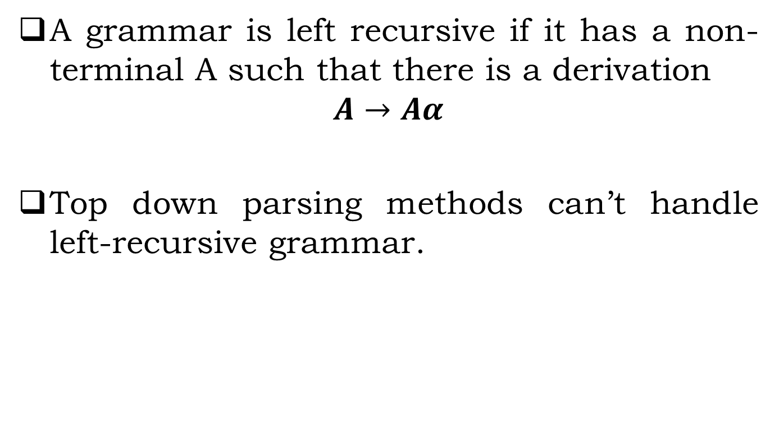
Left Recursive Grammar
A grammar is left recursive if it has a non-terminal A such that there is a derivation
$$A→Aα$$
Top down parsing methods can’t handle left-recursive grammar.

Slide 4
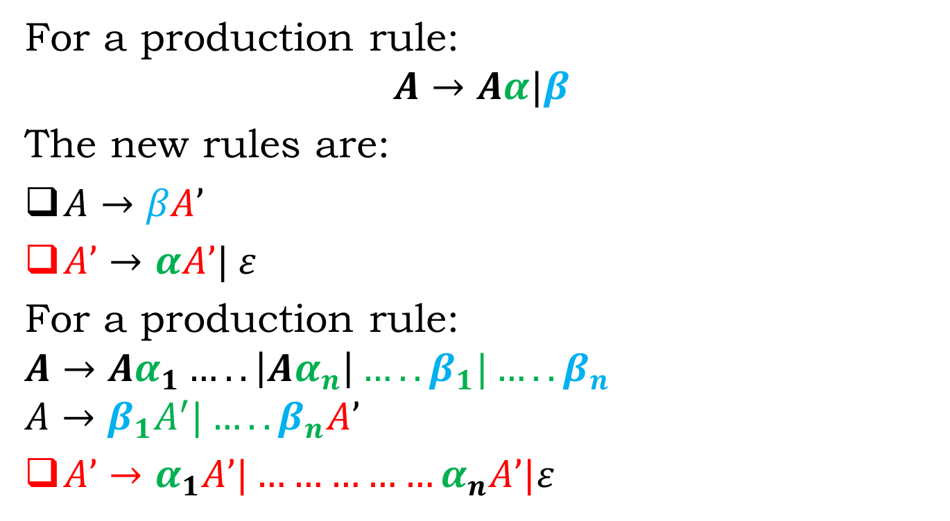
Eliminate
For a production rule:
$$A→Aα|β$$
The new rules are:
$A→βA’$
$A’→αA’| ε$
For a production rule: $A→Aα_{1}…..\left|Aα_{n}\right|…..β_{1}|…..β_{n}$
$$A→β_{1}A^{′}|…..β_{n}A’$$
$A’→α_{1}A’|……………α_{n}A’|ε$

Slide 5
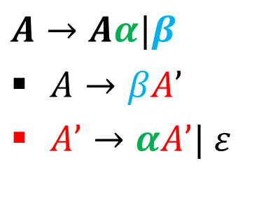
EXAMPLE:
$$A→Aα|β$$
$A→βA’$
$A’→αA’| ε$
E → E + T | T
T→T*F | F
F→ (E) | id
After eliminating:
E→TE'
E'→+ TE' | ε
T→ FT'
T'→ *FT' | ε
F→ (E) | id

Slide 6
Left recursion elimination algorithm:
–Arrange the nonterminal in some order 1, 2, … , .
for (each i from 1 to n)
{
for (each j from 1 to i-1)
{
Replace each production of the form A→Aα|β by the production A→βA’
A’→αA’| ε
}
Eliminate left recursion among the given productions
}

Slide 7
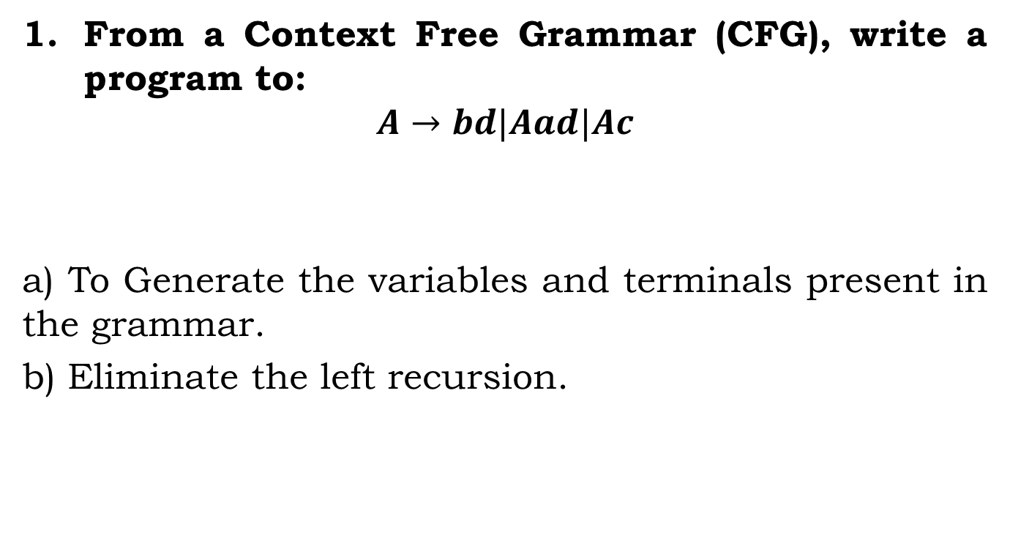
Assignment:
From a Context Free Grammar (CFG), write a program to:
$$A→bd|Aad|Ac$$
a) To Generate the variables and terminals present in the grammar.
b) Eliminate the left recursion.

Slide 8
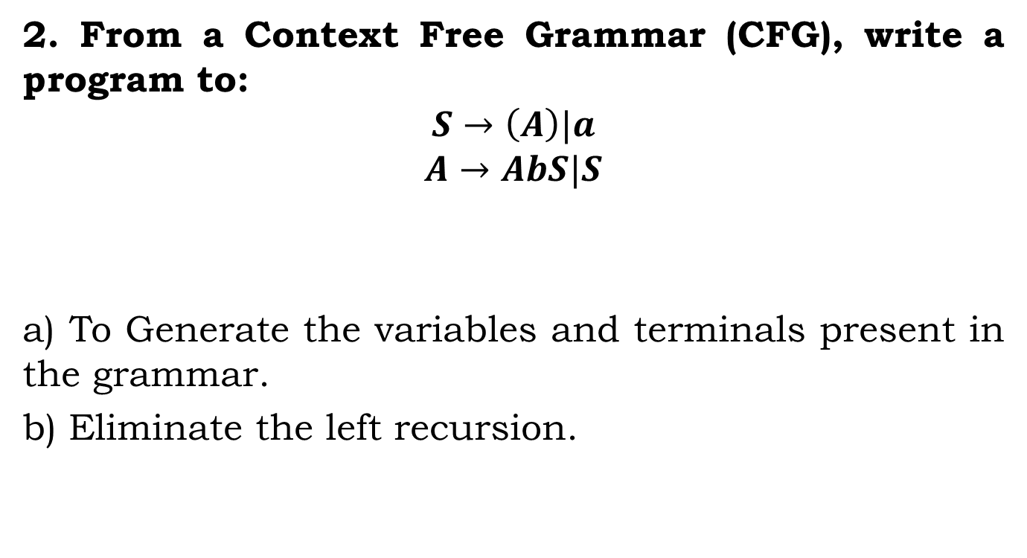
Assignment:
2. From a Context Free Grammar (CFG), write a program to:
$$S→\left(A\right)|a$$
$$A→AbS|S$$
a) To Generate the variables and terminals present in the grammar.
b) Eliminate the left recursion.

Slide 9
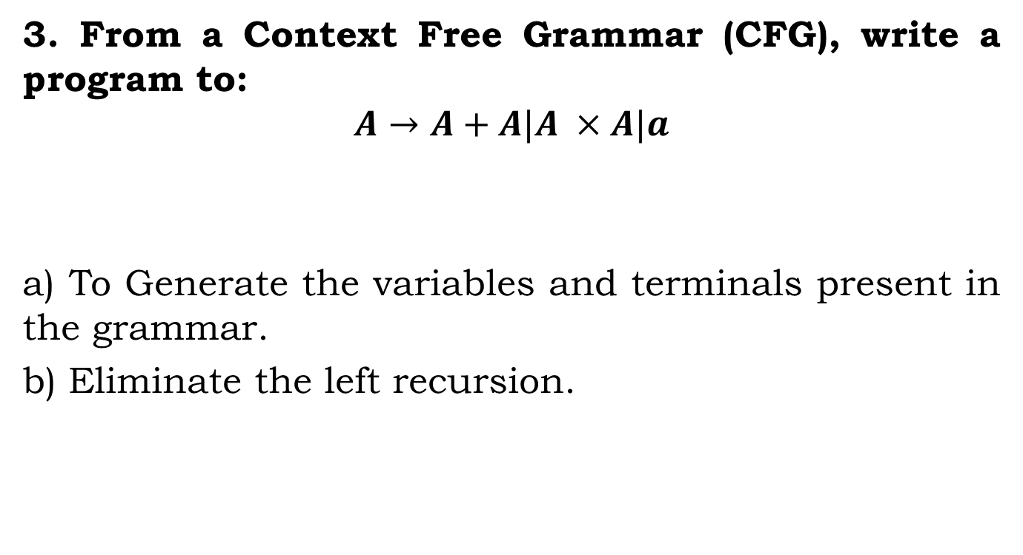
Assignment:
3. From a Context Free Grammar (CFG), write a program to:
$$A→A+A|A ×A|a$$
a) To Generate the variables and terminals present in the grammar.
b) Eliminate the left recursion.

Slide 10
Instructions
Input:
Given a grammar.
Output:
1. Generate the variables and terminals present in the grammar
2. Display the new productions after left recursion removal.

Slide 11
Instructions
SL. No | Roll Numbers | Question
1 | 1-23 | 1
2 | 24-45 | 2
3 | 46-rest | 3

