Slide 1
COMPILER DESIGN LAB CS1762

Slide 2
PROGRAM5
To implement Top down parsing technique- Recursive Predictive technique.

Slide 3
Recursive Predictive Parsing
It is like Recursive Descent parsing technique.
No backtracking (pre deterministic parser).
Constructed for a class of grammars called LL(1).
First “L” : scanning the input from left to right.
Second “L”: for producing a leftmost derivation
“1” : for using one input symbol of lookahead at each step to make parsing action decisions.

Slide 4
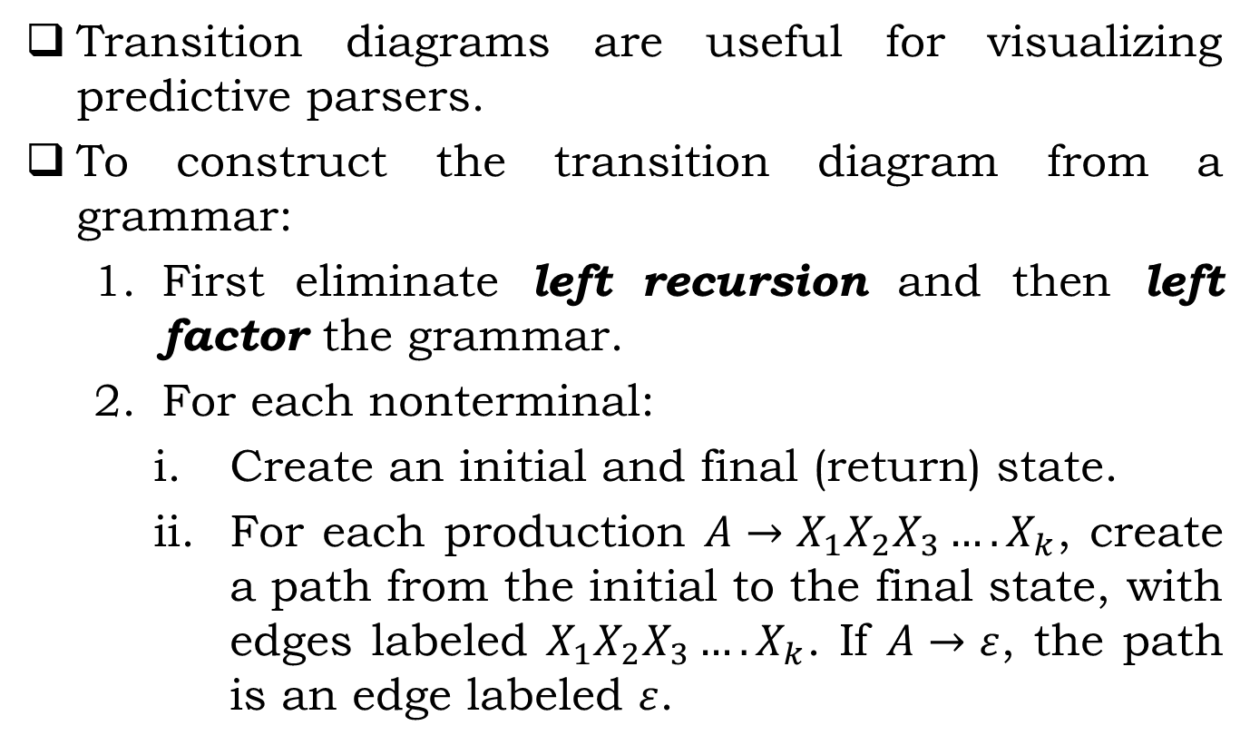
Procedure
Transition diagrams are useful for visualizing predictive parsers.
To construct the transition diagram from a grammar:
First eliminate left recursion and then left factor the grammar.
For each nonterminal:
Create an initial and final (return) state.
For each production $A→X_{1}X_{2}X_{3}….X_{k}$, create a path from the initial to the final state, with edges labeled $X_{1}X_{2}X_{3}….X_{k}$. If $A→ε$, the path is an edge labeled $ε$.

Slide 5

EXAMPLE
$$E→E+T|T$$
$$T→T∗F|F$$
$$F→(E)|id$$
E:
T
E’
0
1
2
After Removing Left Recursion:
E→TE'
E'→+ TE' | ε
T→ FT'
T'→ *FT' | ε
F→ (E) | id
E’:
+
E’
T
3
4
5
6
ε

Slide 6
EXAMPLE
T:
F
T’
E→TE'
E'→+ TE' | ε
T→ FT'
T'→ *FT' | ε
F→ (E) | id
7
8
9
T’:
+
E’
T
10
11
12
13
ε
F:
(
)
E
14
15
16
17
id

Slide 7
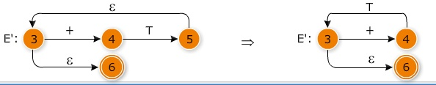
EXAMPLE
Further improve on the transition diagrams to better code the parser as, transition diagram for E' can be transformed as :

Slide 8
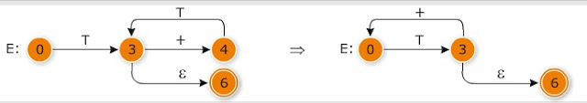
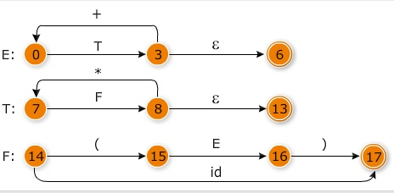
EXAMPLE

Slide 9
Implementation of Recursive Predictive Parsing(RPP)
E(){
Call T();
if input[i] = '+' then{
i++;
return true;
}//-------Need to call T() recursively. See the TD. Try it.
}
T(){
call F();
if input[i] = '*' then{
i++;
return true;
} //-------Need to call F() recursively. See the TD. Try it.
}

Slide 10
Implementation of Recursive Predictive Parsing(RPP)
F(){
if input[i] = '(' then{
i++;
call E();
if input[i] = ')' then {
i++;
return true;
}
}
else{
if input[i] = 'id' then{
i++;
return true;
}
}
return false;
}

Slide 11
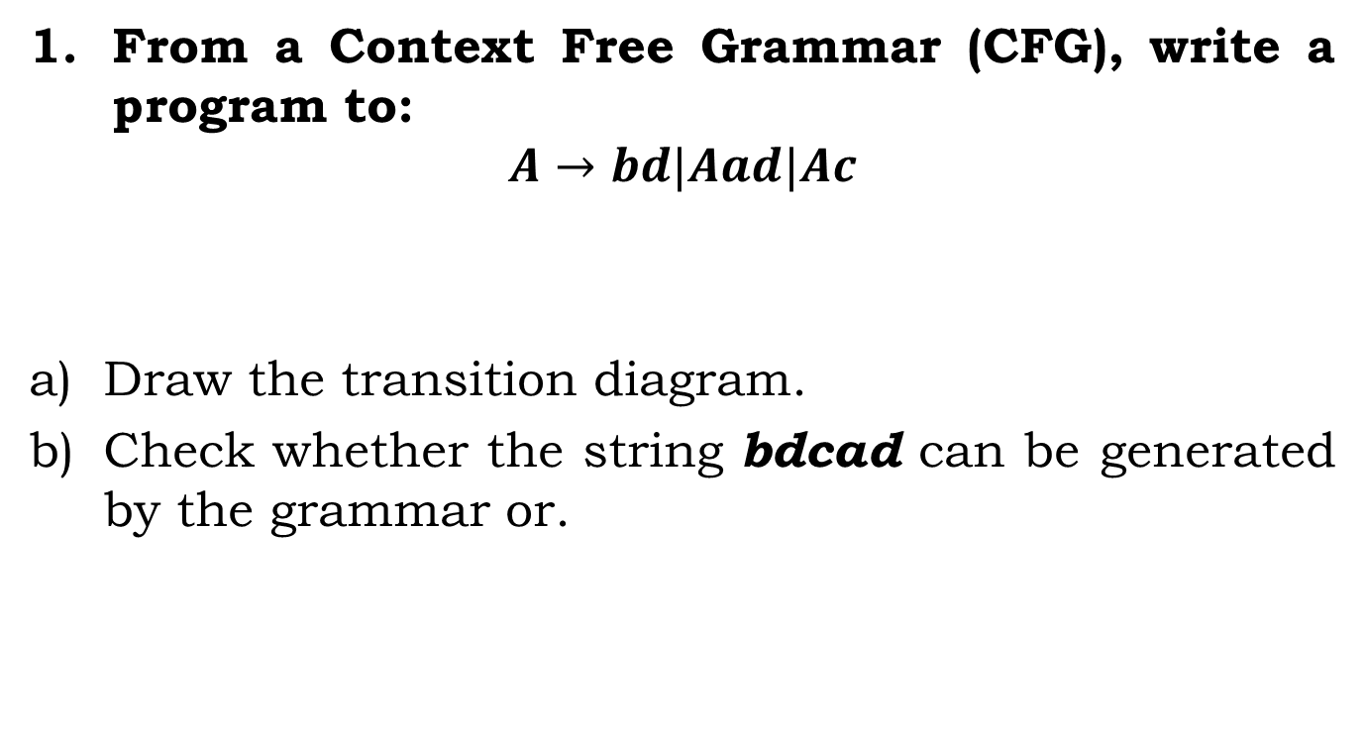
Assignment:
From a Context Free Grammar (CFG), write a program to:
$$A→bd|Aad|Ac$$
Draw the transition diagram.
Check whether the string bdcad can be generated by the grammar or.

Slide 12
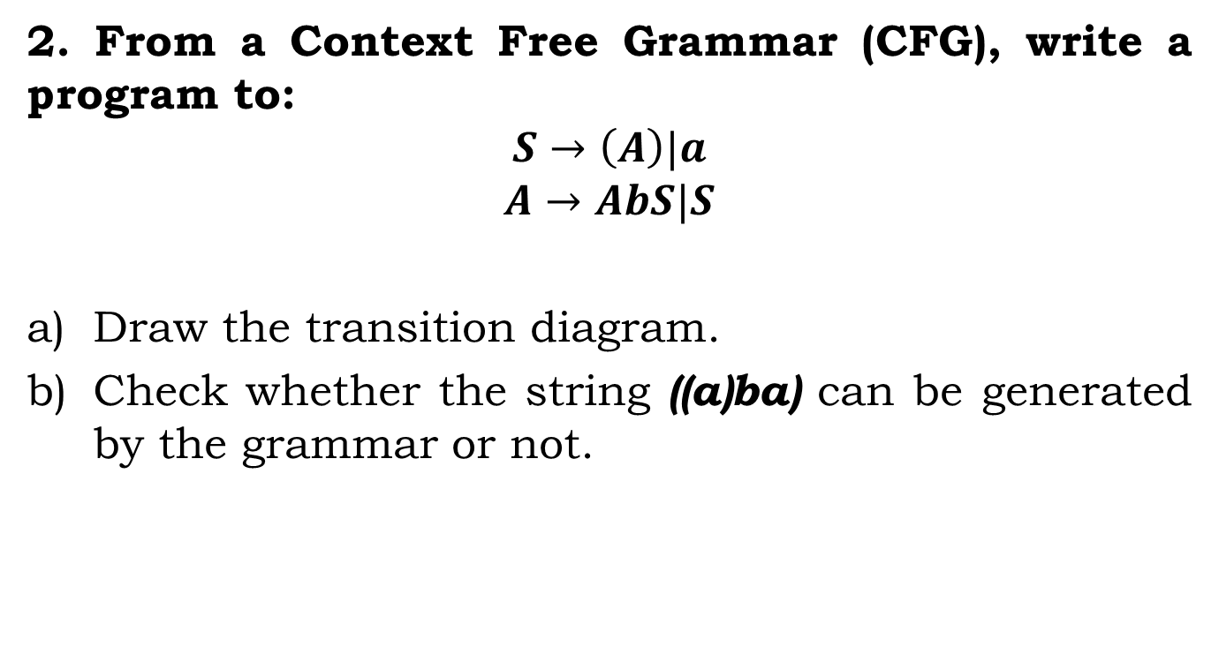
Assignment:
2. From a Context Free Grammar (CFG), write a program to:
$$S→\left(A\right)|a$$
$$A→AbS|S$$
Draw the transition diagram.
Check whether the string ((a)ba) can be generated by the grammar or not.

Slide 13
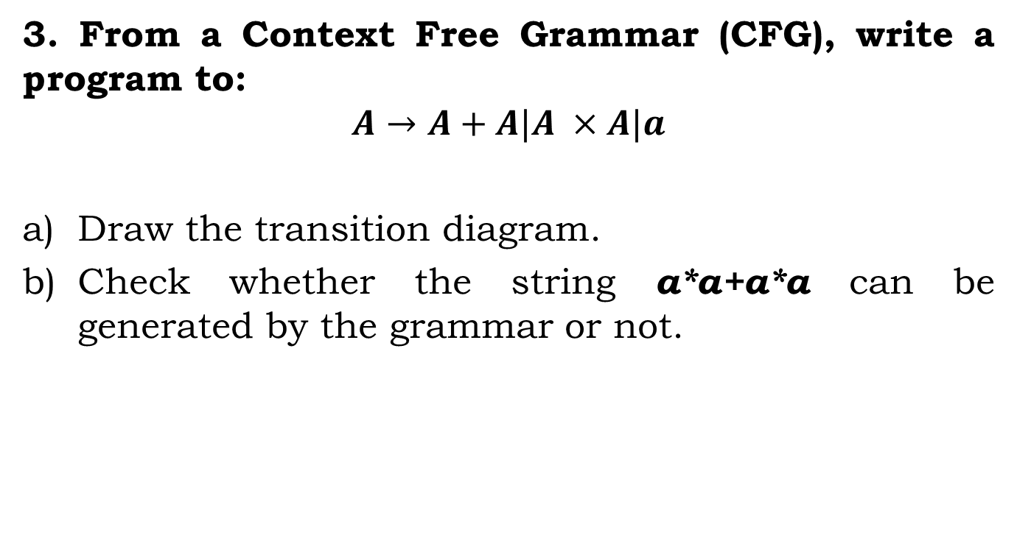
Assignment:
3. From a Context Free Grammar (CFG), write a program to:
$$A→A+A|A ×A|a$$
Draw the transition diagram.
Check whether the string a*a+a*a can be generated by the grammar or not.

Slide 14
Instructions
Input:
Given a grammar without the left recursion.
Output:
1. Display the optimized grammar after the drawing the transition diagram.
2. Check whether a given string can be derived or not by the grammar.
[display both the condition ]

Slide 15
Instructions
SL. No | Roll Numbers | Question
1 | 1-22 | 3
2 | 23-45 | 1
3 | 46-rest | 2

