Slide 1
COMPILER DESIGN LAB CS1762

Slide 2
PROGRAM 6
To generate First set of a Context Free Grammar.

Slide 3
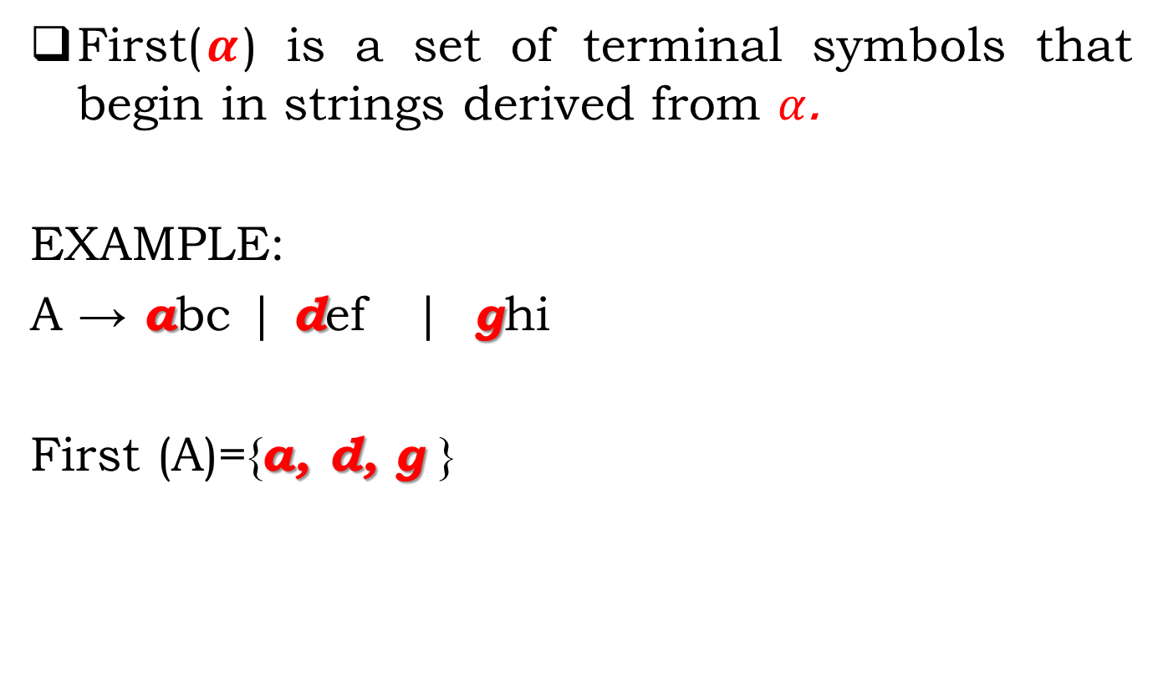
First() Set
First($α$) is a set of terminal symbols that begin in strings derived from $α$.
EXAMPLE:
A → abc| def | ghi
First (A)={a, d, g }

Slide 4

Rules For Calculating First Function-
For a production rule $:$
$$A → ∈$$
$First\left(A\right)=\{∈\}$
2. For any terminal symbol ‘a’,
$$First\left(a\right)=\{a\}$$

Slide 5
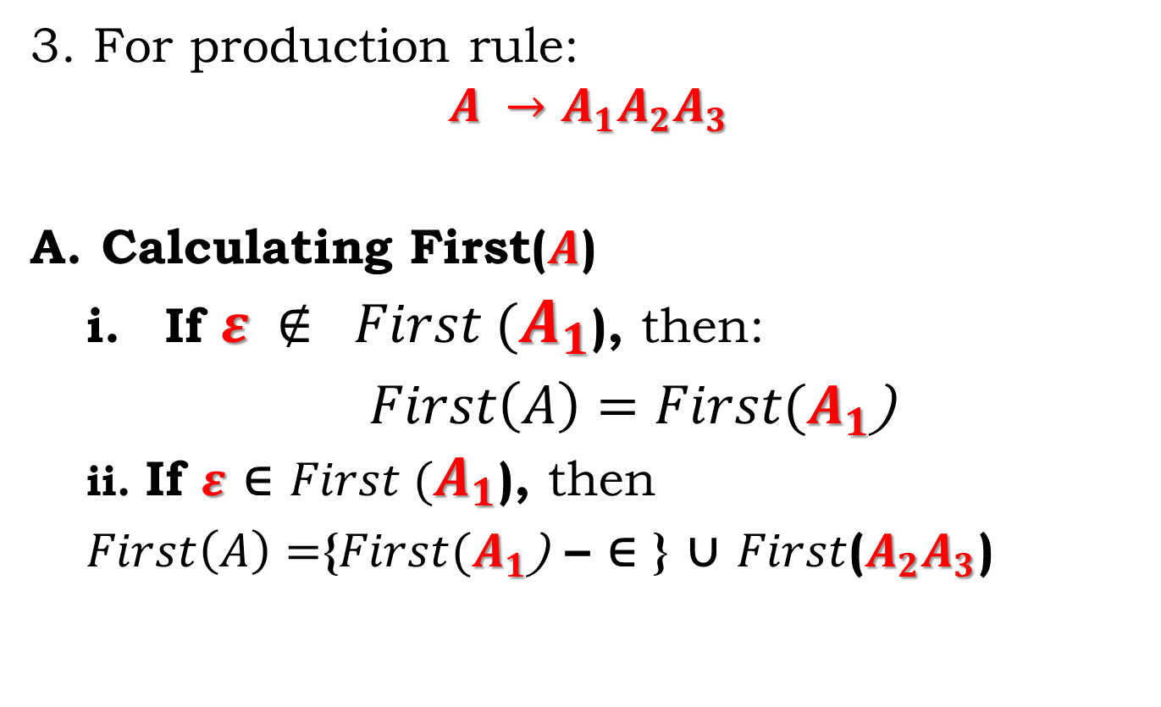
Rules For Calculating First Function-
3. For production rule:
$$A →A_{1}A_{2}A_{3}$$
Calculating First($A$)
If $ε ∉ First (A_{1}$), then:
$First\left(A\right)=First(A_{1}$)
ii. If $ε$ ∈ $First (A_{1}$), then
$First\left(A\right)=${$First(A_{1}$) – ∈ } ∪ $First$($A_{2}A_{3}$)

Slide 6
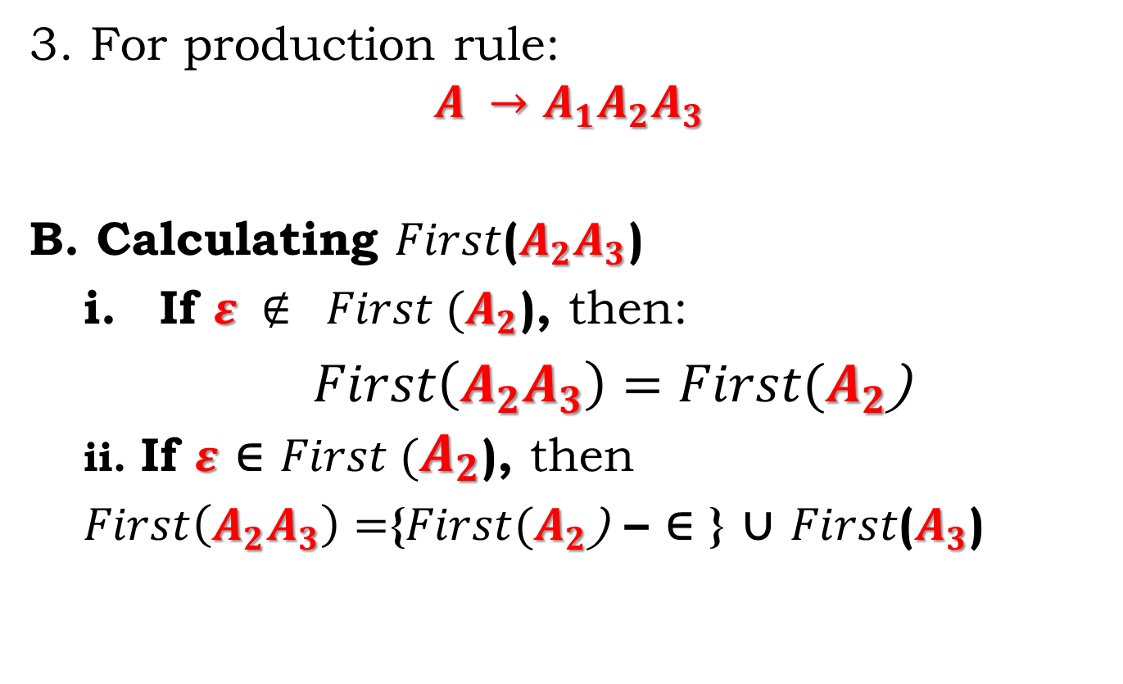
Rules For Calculating First Function-
3. For production rule:
$$A →A_{1}A_{2}A_{3}$$
B. Calculating $First$($A_{2}A_{3}$)
If $ε ∉ First (A_{2}$), then:
$First\left(A_{2}A_{3}\right)=First(A_{2}$)
ii. If $ε$ ∈ $First (A_{2}$), then
$First\left(A_{2}A_{3}\right)=${$First(A_{2}$) – ∈ } ∪ $First$($A_{3}$)

Slide 7
EXAMPLE:
E → E + T | T
T→T*F | F
F→ (E) | id
After eliminating:
1. E→TE'
2. E'→+ TE' | ε
3. T→ FT'
4. T'→ *FT' | ε
5. F→ (E) | id
5. FIRST(F) = { (, id } ......Rule 3(Ai)
4. FIRST(T') = { *, ε }…….Rule 3(Aii)
3. FIRST(T) = { (, id } ……. Rule 3(Bi)
2. FIRST(E') = { +, ε }, ……. Rule 3(Aii)
1. FIRST(E) = { (, id } ……. Rule 3(Bi)

Slide 8
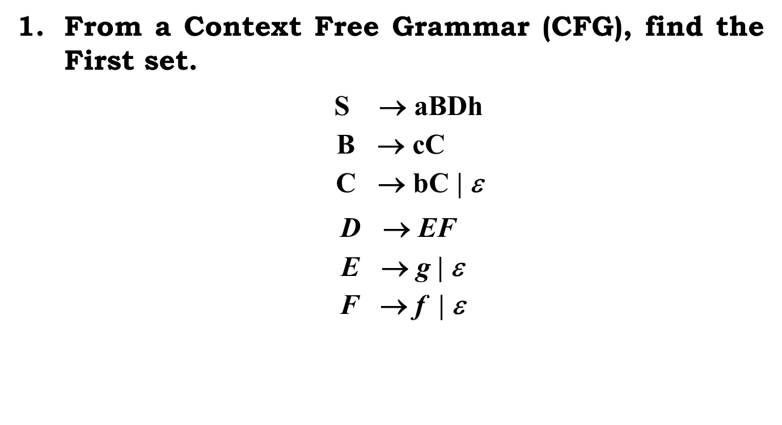
Assignment:
From a Context Free Grammar (CFG), find the First set.
$\text{S} \text{→ }\text{aBDh}$
$$\text{B}\text{ → }\text{cC}$$
$$\text{C}\text{  }\text{bC}\text{ | }\text{}$$
$\text{D}\text{ → }\text{EF}$
$$\text{E}\text{  }\text{g}\text{ |  }$$
$$\text{F}\text{  }\text{f}\text{ | }$$

Slide 9
Assignment:
2. From a Context Free Grammar (CFG), find the First set.
S → 1AB | ε
A → 1AC | 0C
B → 0S
C → 1

Slide 10

Assignment:
3. From a Context Free Grammar (CFG), find the First set.
$$S →ACB | Cbb | Ba$$
$$A→da | BC$$
$$B→ g |\text{ε}$$
$$C→h |\text{ε}$$

Slide 11
Instructions
Input:
Given a grammar without the left recursion.
Output:
Generate the First set

Slide 12
Instructions
SL. No | Roll Numbers | Question
1 | 1-22 | 2
2 | 23-45 | 3
3 | 46-rest | 1

