Slide 1
COMPILER DESIGN LAB CS1762

Slide 2
PROGRAM7
To generate Follow set of a Context Free Grammar.

Slide 3
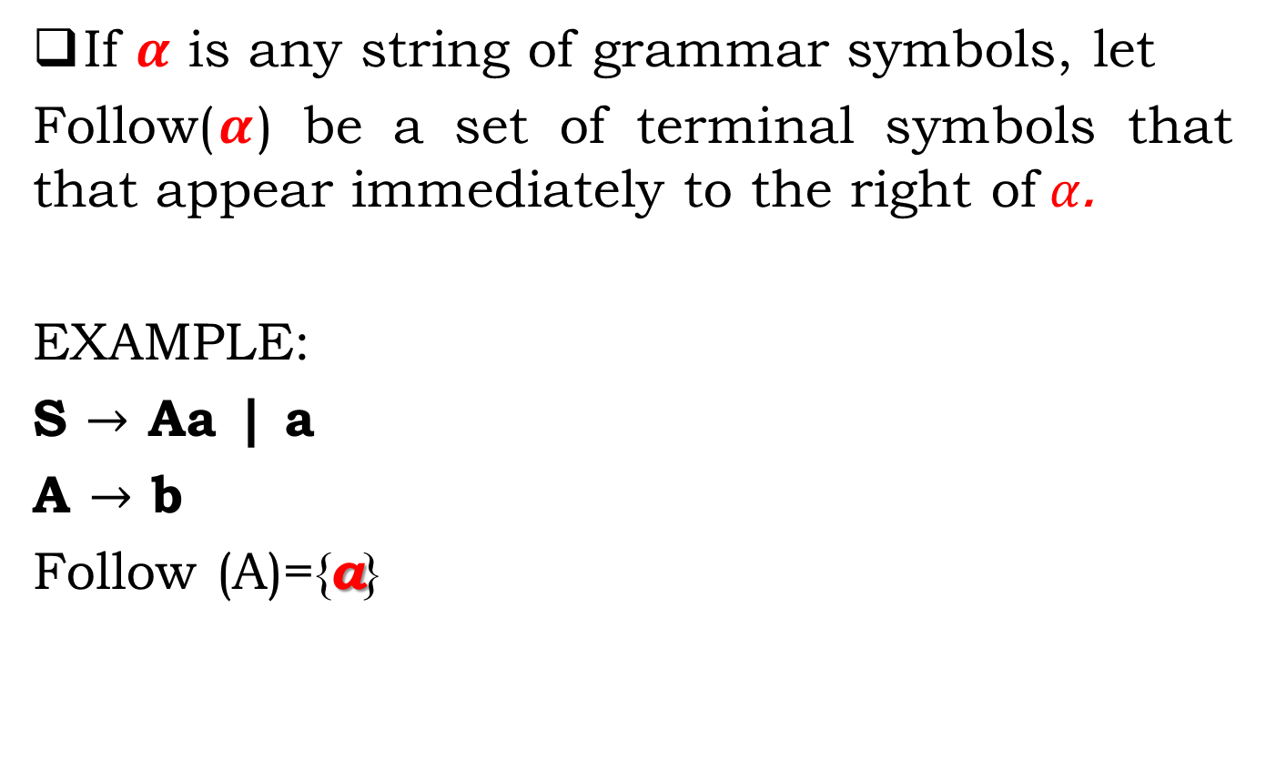
FOLLOW() Set
If $α$ is any string of grammar symbols, let
Follow($α$) be a set of terminal symbols that that appear immediately to the right of$α$.
EXAMPLE:
S $→$ Aa | a
A $→$ b
Follow (A)={a}

Slide 4
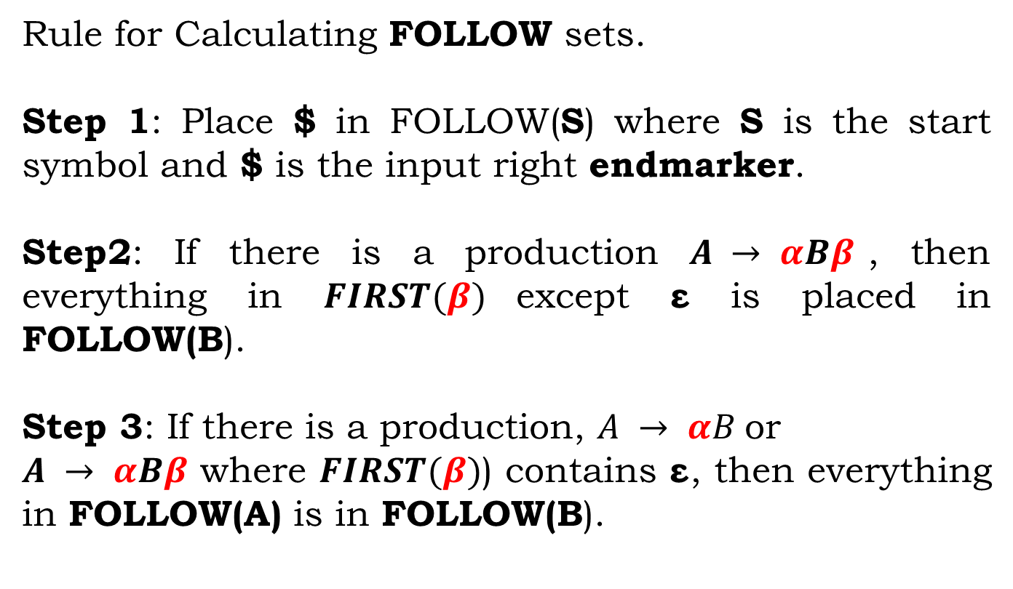
Calculation of FOLLOW Sets
Rule for Calculating FOLLOW sets.
Step 1: Place $ in FOLLOW(S) where S is the start symbol and $ is the input right endmarker.
Step2: If there is a production $A → αBβ$, then everything in $FIRST(β)$except ε is placed in FOLLOW(B).
Step 3: If there is a production, $A → αB$or
$A → αBβ$ where $FIRST(β)$) contains ε, then everything in FOLLOW(A) is in FOLLOW(B).

Slide 5
Note:
Before calculating the FIRST and FOLLOW functions, eliminate Left Recursion from the grammar, if present.
ε may appear in the FIRST function of a non-terminal.
ε will never appear in the FOLLOW function of a non-terminal.
Calculate the FOLLOW function of a non-terminal by looking where it is present on the RHS of a production rule.

Slide 6
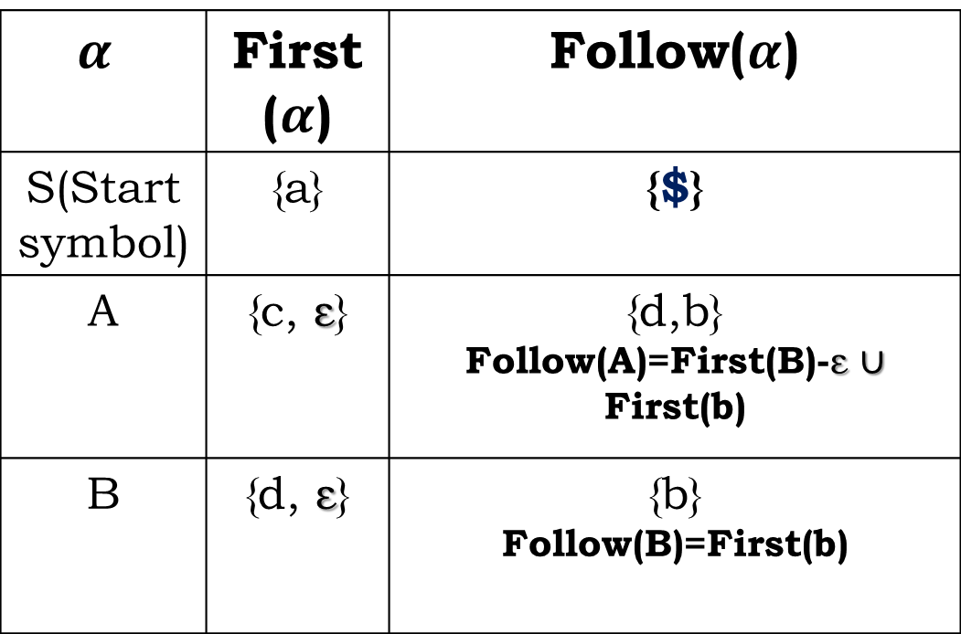
EXAMPLE:
S → aABb
A → c| ε
B→ d | ε
$$α$$ | First ($α$) | Follow($α$)
S(Start symbol) | {a} | {$}
A | {c, ε} | {d,b} Follow(A)=First(B)-ε $∪$ First(b)
B | {d, ε} | {b} Follow(B)=First(b)

Slide 7
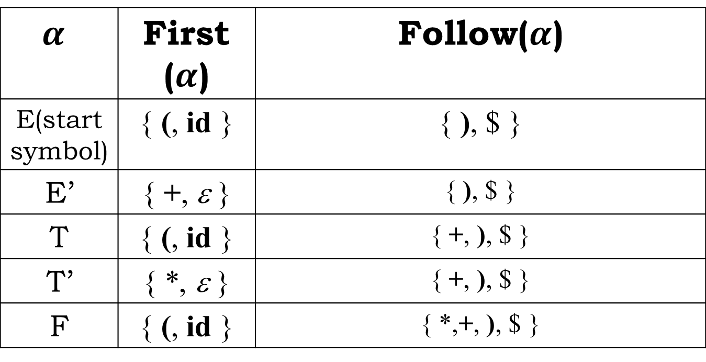
An Example
EXAMPLE
E → T E'
E' → + T E' | ε
T → F T'
T' → * F T' | ε
F → ( E ) | id
$$α$$ | First ($α$) | Follow($α$)
E(start symbol) | { (, id } | { ), $ }
E’ | { +, ε } | { ), $ }
T | { (, id } | { +, ), $ }
T’ | { *, ε } | { +, ), $ }
F | { (, id } | { *,+, ), $ }

Slide 8
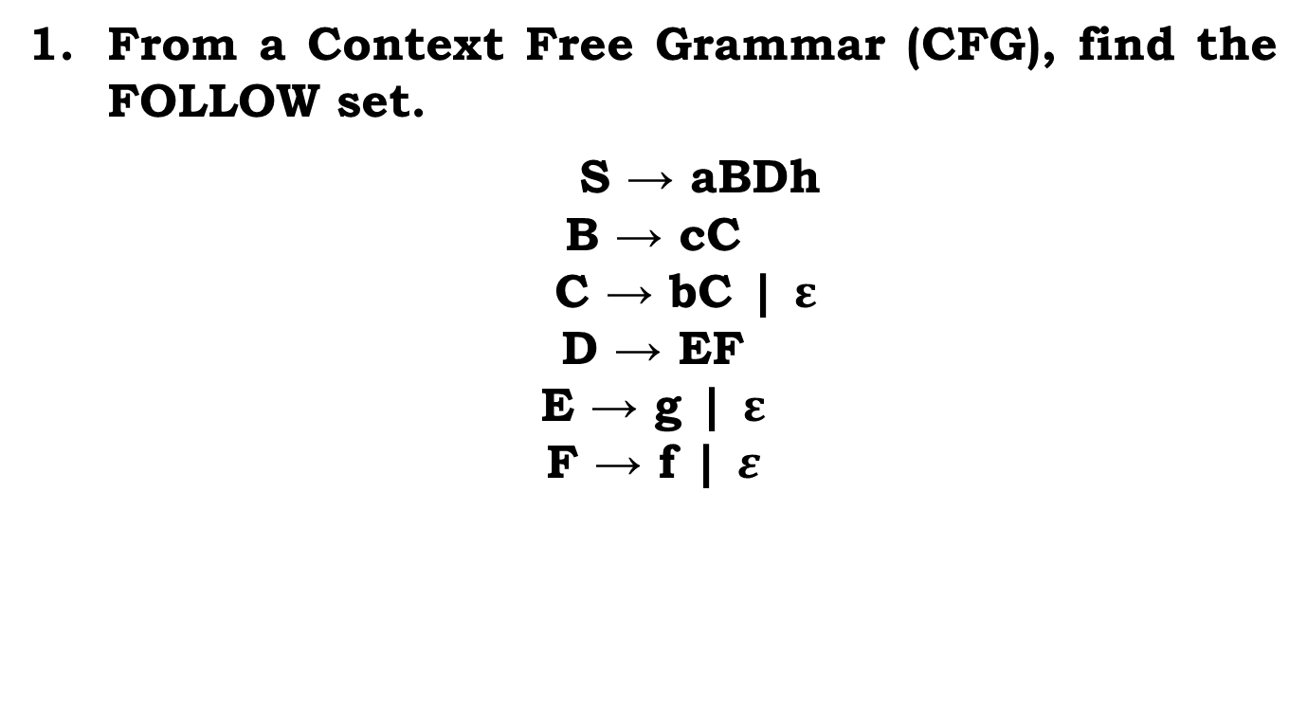
Assignment:
From a Context Free Grammar (CFG), find the FOLLOW set.
$$\text{E}\text{ → }\text{g}\text{ | }ε\text{D}\text{ → }\text{EF}$$
$$\text{F}\text{ → }\text{f}\text{ | }ε$$

Slide 9
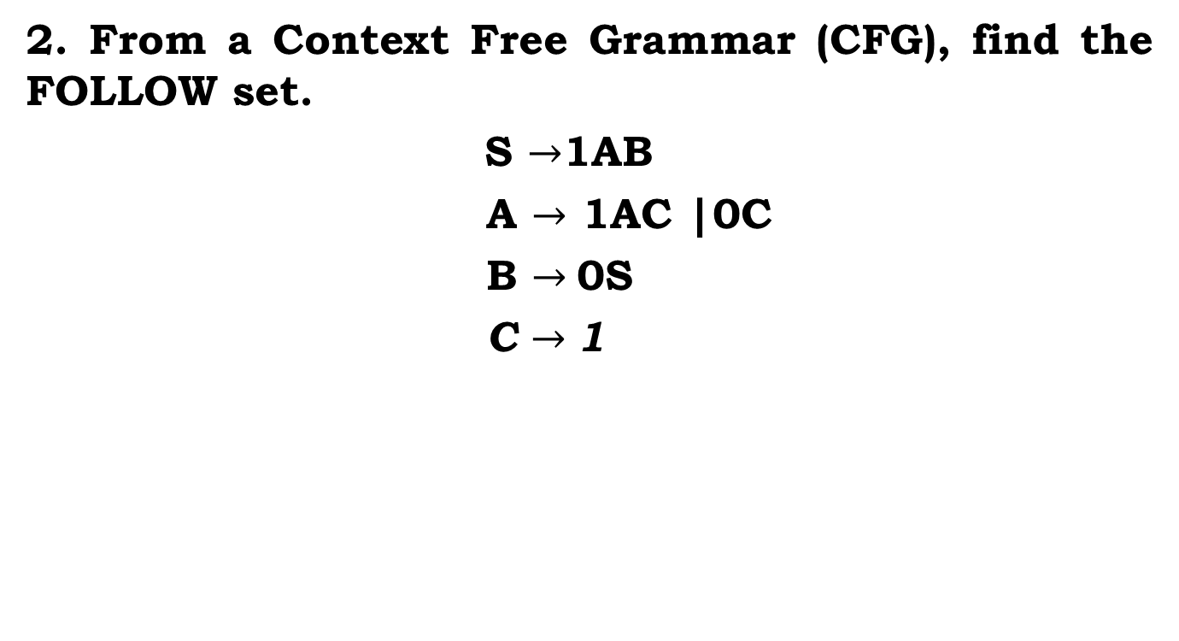
Assignment:
2. From a Context Free Grammar (CFG), find the FOLLOW set.
S $→$1AB
A $→$ 1AC |0C
B $→$0S
C $→$1

Slide 10
Assignment:
3. From a Context Free Grammar (CFG), find the FOLLOW set.
S → ACB | CbB | Ba
A → da | BC
B → g |ε
C → h | ε

Slide 11
Instructions
Input:
Given a grammar without the left recursion.
Output:
Generate the Follow Set

Slide 12
Instructions
SL. No | Roll Numbers | Question
1 | 1-22 | 1
2 | 23-45 | 2
3 | 46-rest | 3

