Slide 1
DATA ANALYSIS
RECLASSIFICATION & NEIGHBOURHOOD FUNCTIONS

Slide 2
RECLASSIFICATION
Classification is the procedure of identifying a set of features as belonging to a group. Some form of classification function is provided within every GIS.
The simplest form of this function occurs in a raster-based GIS, with similar numerical values used to indicate classes.

Slide 3
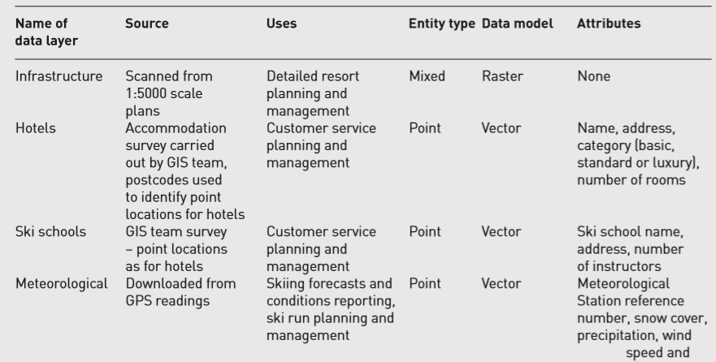
Data in Happy Valley GIS

Slide 4
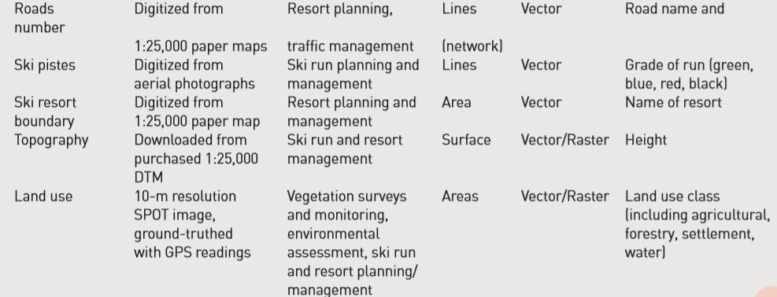
Data in Happy Valley GIS

Slide 5
RECLASSIFICATION
Reclassification is the basis for defining patterns, and one of the most important functions of a GIS is to assist in recognizing new patterns.
Reclassification is an important variation on the query idea in GIS, and can be used in place of a query in raster GIS.

Slide 6
Reclassification
For example, if cells representing forestry in the original image had a value of 10.
A set of rules for the reclassification could be:
Cells with values = forestry (value 10) should take the new value of 1
Cells with values ≠ forestry should take the new value of 0

Slide 7
Reclassification
Reclassification would result in a new image with all areas of forestry coded with value 1, and
all are as that were not forest coded with value 0. This is a Boolean image.
Reclassification of this nature, producing a two-code image from a complex original image, is a very useful technique because it allows the resulting image to be used in further analysis.

Slide 8
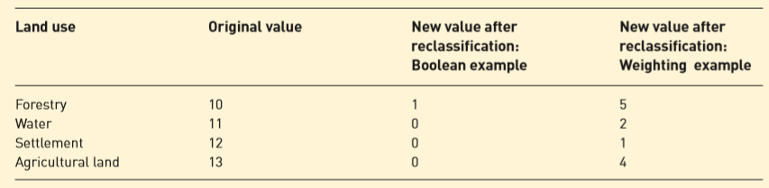
Reclassification values for the land use data layer

Slide 9
BUFFERING AND NEIGHBOURHOOD FUNCTION
Buffering allow a spatial entity to influence its neighbours, or the neighbours to influence the character of an entity.
Buffering, as already stated, is used to identify a zone of interest around an entity, or set of entities. If a point is buffered a circular zone is created. Buffering lines and areas creates new areas.
Data filtering involves the recalculation of cells in a raster image based on the characteristics of neighbours.

Slide 10
BUFFERING AND NEIGHBOURHOOD FUNCTION
‘Which hotels are within 200 m of a main road?’ could be approached in a number of ways.
One option would be, first, to produce a buffer zone identifying all land up to 200 m from the main roads; and
second, to find out which hotels fall within this buffer zone using a point-in polygon overlay.

Slide 11
BUFFERING AND NEIGHBOURHOOD FUNCTION
Buffering is very simple conceptually but a complex computational operation.
Creating buffer zones around point features is the easiest operation;
A circle of the required radius is simply drawn around each point.
Creating buffer zones around line and area features is more complicated.

Slide 12
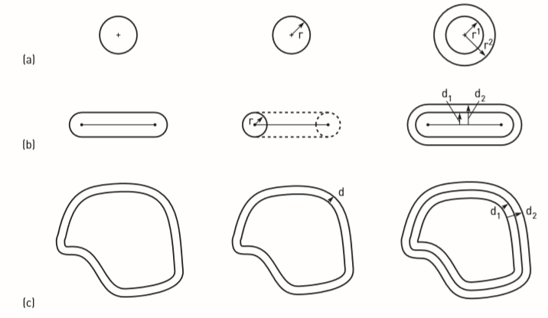
BUFFERING AND NEIGHBOURHOOD FUNCTION
Buffer Zones around (a) point, (b) line and (c) area features

Slide 13
Buffer Zones
Some GIS do this by placing a circle of the required radius at one end of the line or area boundary to be buffered.
This circle is then moved along the length of the segment.
The path that the edge of the circle tangential to the line makes is used to define the boundary of the buffer zone.

Slide 14
Buffer Zones
Buffer zones are often created with the use of one command or option in vector GIS, a different approach is used in many raster GIS. Here proximity is calculated.
This method will result in a new raster data layer where the attribute of each cell is a measure of distance.

Slide 15
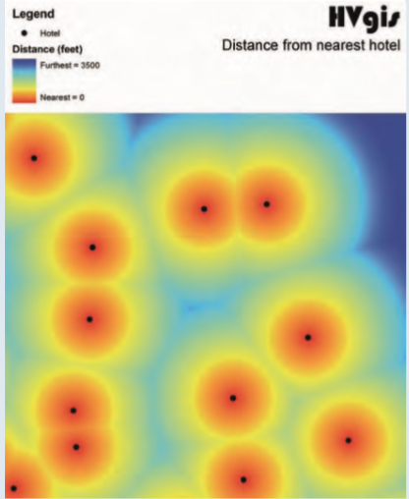
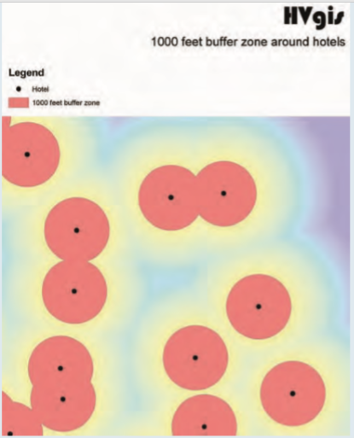
Buffer Zones
Example of a proximity map produced for the hotels in Happy Valley, subsequently re-classed to create a buffer zone of 125 m for each of the hotels.
Distance Surface
125 m buffer zone

Slide 16
Buffer Zones
Operations in raster GIS where the values of individual cells are altered on the basis of adjacency are called neighbourhood functions.
Filtering is one example used for the processing of remotely sensed imagery. Filtering will change the value of a cell based on the attributes of neighbouring cells.
The filter is defined as a group of cells around a target cell. The size and shape of the filter are determined by the operator.
Common filter shapes are squares and circles, and the dimensions of the filter determine the number of neighbouring cells used in the filtering process.

Slide 17
Filtering
The filter is passed across the raster data set and used to recalculate the value of the target cell that lies at its centre.
Example: The maximum cell value within the filter, the most frequent value and other filtering techniques are shown.
Filtering operations applied in the preparation of the forestry data layer in the Happy Valley GIS.
The raster data obtained from a classified satellite image may require filtering to ‘smooth’ noisy data caused by high spatial variability in vegetation cover or problems with the data collection device.

Slide 18
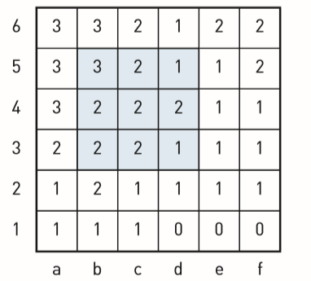
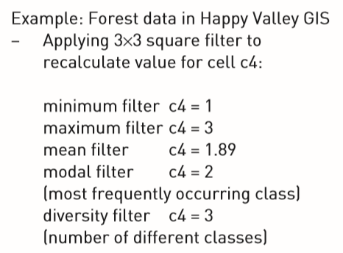
Filtering Operations
Raster GIS filter operations

Slide 19
Proximity Calculations
Example climbing or descending a hill
A combination of distance and neighbourhood operations can be used to perform some quite complex distance or proximity calculations that take into account not only horizontal linear distance but also the effects of vertical distance or slope.
Other cost factors that can be accounted for include the effect of wind speed or resistance, trafficability, load carried or other push/pull factors.

Slide 20
Proximity Calculations
Cost factors such as slope and wind speed are not the same in all directions, so proximity models need to take this into account.
When the factors controlling relative distance are the same in all directions, proximity models are said to be ‘isotropic’ (e.g. simple buffering or linear distance surfaces).
When the factors controlling relative distance are not the same in all directions, promixity models are said to be ‘anisotropic’.

