Slide 1
MapReduce
Understanding With Real-Life problem

Slide 2
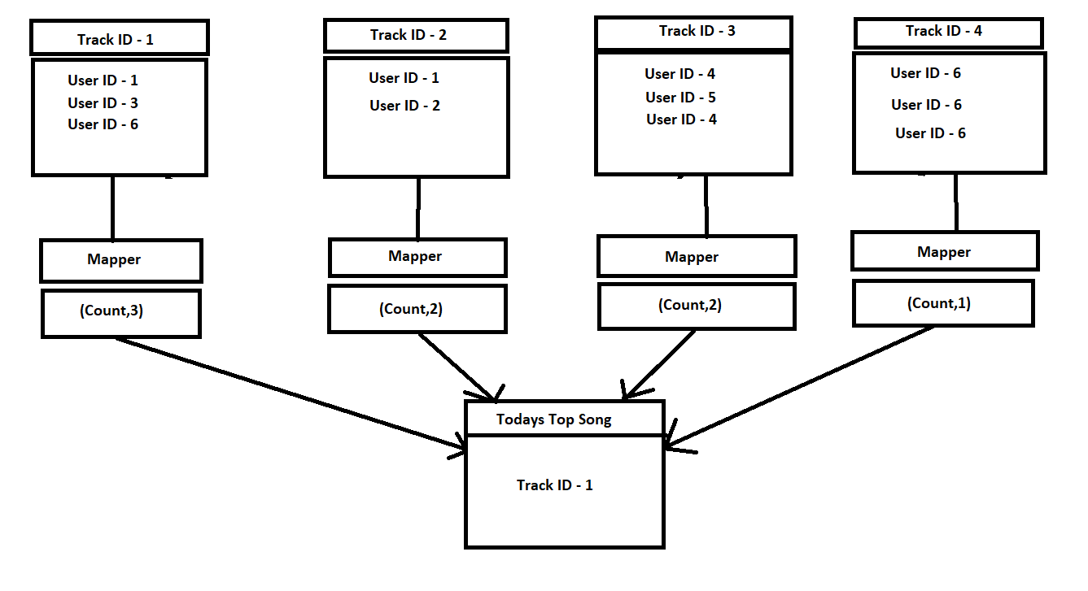
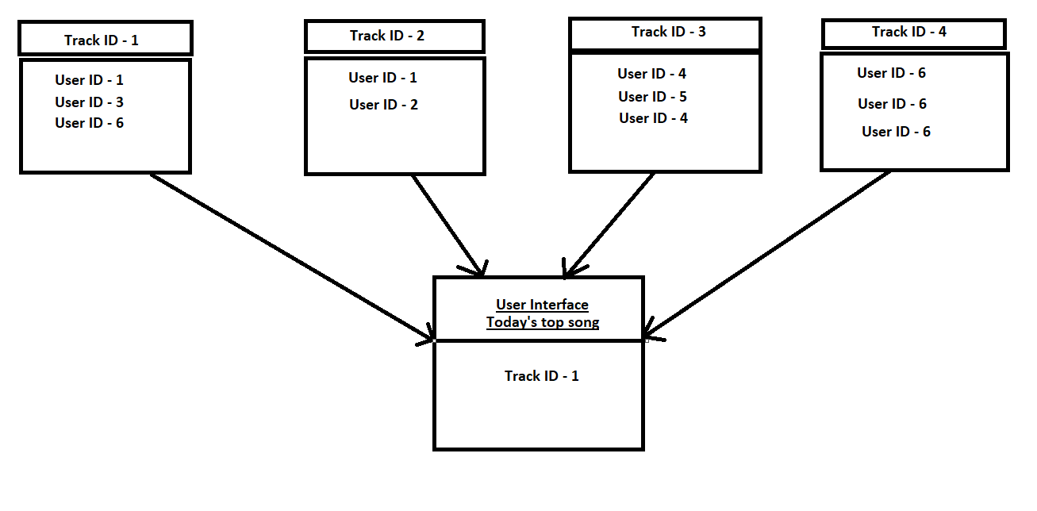
MapReduce

Slide 3
Description
An Online music streaming website is trying to find out the most played song of the day.
There is a unique track ID for each and every song, also there is a unique user ID associated to every user.
The website wants to find out the song which is played by maximum number of unique users
Mapper in this case will find out the total number of unique users for each track id.
Reducer will combine all the outputs of mapper and it will only store the track which has maximum number of unique users as the output.

