Slide 1
COMPILER DESIGN LAB CS1762

Slide 2
PROGRAM 8
To construct a predictive parsing table M for a grammar G.

Slide 3
Parsing Table
The algorithm collects the information from FIRST and FOLLOW sets into a predictive parsing table M [A,a].
The table is a two-dimensional array, where A is a nonterminal, and a is a terminal or the symbol $, the input end-marker.

Slide 4
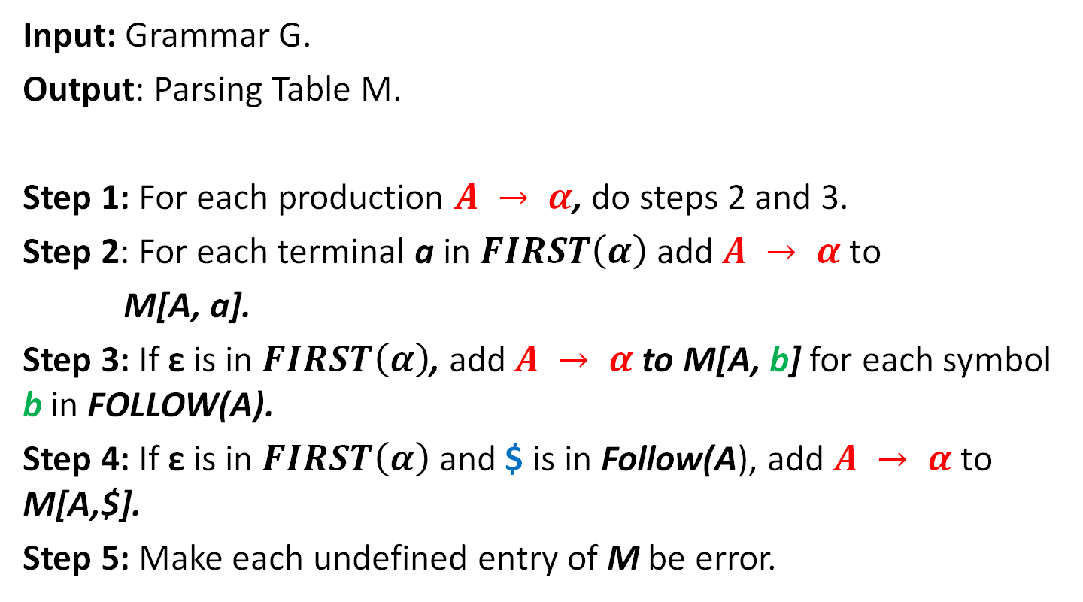
Algorithm
Input: Grammar G.
Output: Parsing Table M.
Step 1: For each production $A → α$, do steps 2 and 3.
Step 2: For each terminal a in $FIRST\left(α\right)$ add $A → α$to
M[A, a].
Step 3: If ε is in $FIRST\left(α\right)$, add $A → α$to M[A, b] for each symbol b in FOLLOW(A).
Step 4: If ε is in $FIRST\left(α\right)$ and $ is in Follow(A), add $A → α$to M[A,$].
Step 5: Make each undefined entry of M be error.

Slide 5
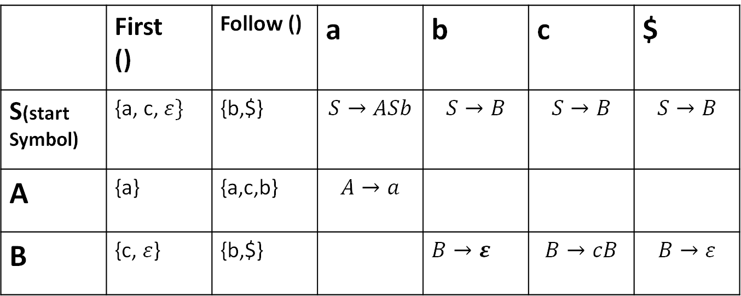

EXAMPLE
$$S→ASb|B$$
$$A→a$$
$$B→cB|ε$$
 | First () | Follow () | a | b | c | $
S(start Symbol) | {a, c, $ε\}$ | {b,$} | $$S→ASb$$ | $$S→B$$ | $$S→B$$ | $$S→B$$
A | {a} | {a,c,b} | $$A→a$$
B | {c, $ε$} | {b,$} |  | $$B→ε$$ | $$B→cB$$ | $$B→ε$$

Slide 6

Assignment:
Construct the LL(1) parsing table for the following grammar.
$\text{S} \text{→ } \text{aBDh}$
$$\text{B}\text{ → } \text{cC}$$
$$\text{C}\text{  } \text{bC}\text{ | }\text{}$$
$\text{D}\text{ → } \text{EF}$
$$\text{E}\text{  } \text{g}\text{ |  }$$
$$\text{F}\text{  } \text{f}\text{ | }$$

Slide 7
Assignment:
2. Construct the LL(1) parsing table for the following grammar.
S → 1AB | ε
A → 1AC | 0C
B → 0S
C → 1

Slide 8

Assignment:
3. Construct the LL(1) parsing table for the following grammar.
$$S →ACB | Cbb | Ba$$
$$A→da | BC$$
$$B→ g |\text{ε}$$
$$C→h |\text{ε}$$

Slide 9
Instructions
Input: First () and Follow () sets for the given grammar G.
Output: Parsing table M.

Slide 10
Instructions
SL. No | Roll Numbers | Question
1 | 1-22 | 3
2 | 23-45 | 1
3 | 46-rest | 2

