Slide 1
COMPILER DESIGN LAB CS1762

Slide 2
PROGRAM 9
To implement non-recursive predictive parsing technique.

Slide 3
Objective: To efficiently implement by handling the stack of activation record explicitly.
Theory:
Predictive parsers are those recursive descent parsers needing no backtracking. Grammars for which we can create predictive parsers are called LL(1)
–The first L means scanning input from left to right
–The second L means leftmost derivation
–And 1 stands for using one input symbol for look-ahead.

Slide 4
A grammar G is LL(1) if and only if whenever A→ α|β are two distinct productions of G, the following conditions hold:
• For no terminal ‘a’ do α and β both derive strings beginning with a
• At most one of α or β can derive empty string ε.
• If β ⇒ ε, then α does not derive any string beginning with a terminal in FOLLOW(A).
• Likewise, if α ⇒ε, then β does not derive any string beginning with a terminal in FOLLOW(A).

Slide 5
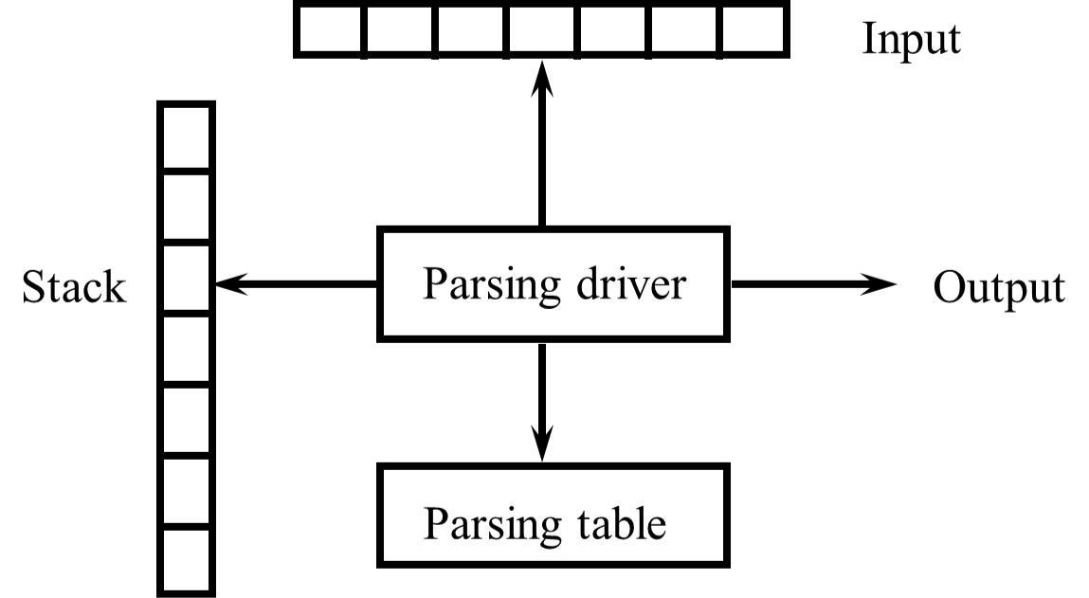
Syntax Analyzer

Slide 6
Algorithm:
Input: String w and Parsing Table M
Output: Successful parsing or Error message. Push $S onto the stack, where S is the start symbol set ip to point to the first symbol of w$;
repeat
let X be the top stack symbol and a the symbol pointed to by ip; if X is a terminal or $ then
if X = a then
pop X from the stack and advance ip
else error

Slide 7
else /* X is a non terminal */
if M[X, a] = X → Y1 Y2 ... Yk then
pop X from the stack and push Yk ... Y2 Y1 onto the stack else error
until X = $ and a = $

Slide 8
Example:
Consider the grammar:
E → TE’
E’ → +TE’ | ε
T → FT’
T’ → *FT’ | ε
F → (E) | id
Show the actions of the parser in parsing the string ‘id+id*id’.

Slide 9
Parsing Table ‘M’
NT/T | id | + | * | ( | ) | $
E | E→ TE’ |  |  | E→ TE’
E’ |  | E’ →+TE’ |  |  | E’ → ε | E’ → ε
T | T→ FT’ |  |  | T→ FT’
T’ |  | T’ →ε | T’ →*FT’ |  | T’ → ε | T’ →ε
F | F→ id |  |  | F→ (E)

Slide 10
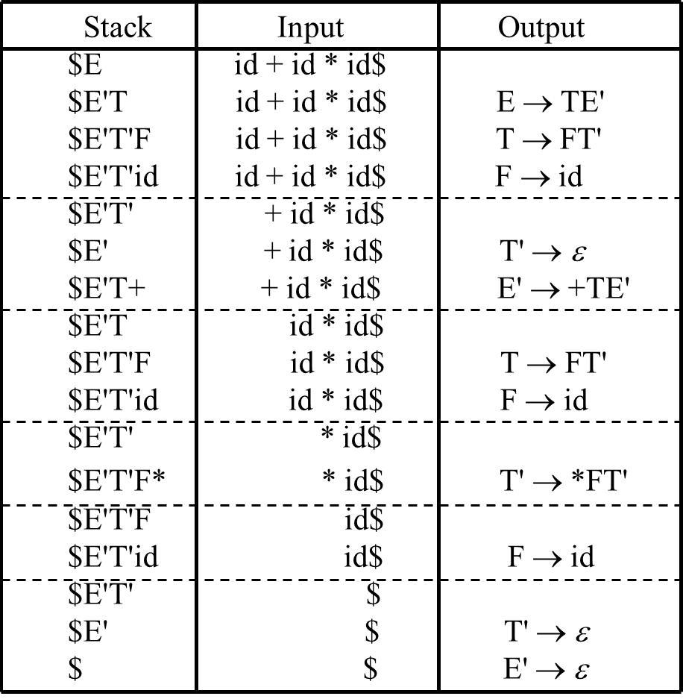
Actions of the parser for id+id*id

Slide 11
Assignment:
1. Write a program to construct Non-Recursive Predictive Parser for the given grammar.
E→ TX T → (E) | int Y
X → +E | ε Y → *T | ε
a) Take parsing table as input
b) Show stack implementation
c) Check whether the string int*int could be parsed or not.

Slide 12
Assignment:
2. Write a program to construct Non-Recursive Predictive Parser for the given grammar.
S → 1AB | ε
A → 1AC | 0C
B → 0S
C → 1
a) Take parsing table as input
b) Show stack implementation
c) Check whether the string 11010 could be parsed or not.

Slide 13
Assignment:
3. Write a program to construct Non-Recursive Predictive Parser for the given grammar.
S→ (S)S | ε
a) Take parsing table as input
b) Show stack implementation
c) Check whether the string (()) could be parsed or not.

Slide 14
Instructions
Input:
Parsing table M.
Output:
Show whether a string can be parsed or not.

Slide 15
Instructions
SL. No | Roll Numbers | Question No.
1 | 1-22 | 1
2 | 23-45 | 2
3 | 46-rest | 3

