Slide 1
MapReduce
Understanding With Real-Life problem

Slide 2
Problem Statement
A music streaming website is trying to find out the best songs of the year.
According to the website, the popularity of a song is determined by the total number of unique users played that song.
After counting the user ids of each song, it wants to create a playlist in which the songs are arranged in decreasing order of their popularity.

Slide 3
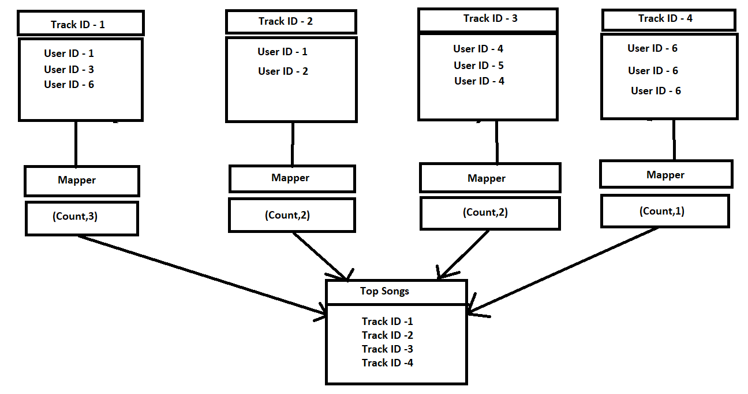
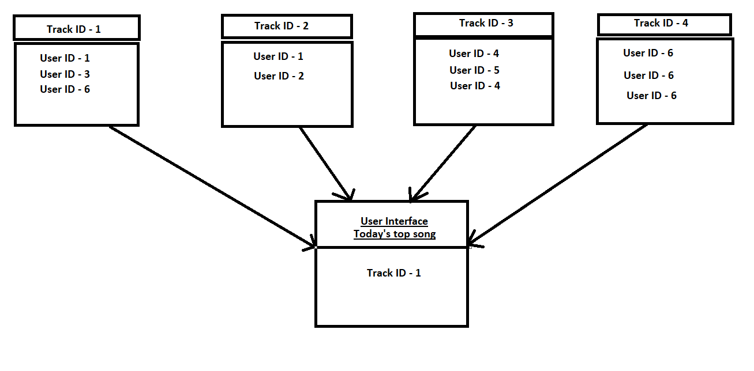
MapReduce

Slide 4
Description
There is a unique track ID for each and every song, also there is a unique user ID associated to every user.
The website wants to find out the song which is played by maximum number of unique users
Mapper in this case will find out the count of unique users for each track id.
Reducer will combine all the outputs of mapper and it will store the tracks in the decreasing order of their count.

Slide 5
Solution
Mapper :
Mapper will find out the total number of unique user ids under each track.
The count will then be passed to reducer.
Reducer:
Identi Reducer will combine the output of all the mappers and sort them according to their count.

