Slide 1
MapReduce
Understanding With Real-Life problem
Name – Adhyyan Tripathi
Reg no – 201700403
Sec - C

Slide 2
Problem Statement
A music streaming website is trying to find out the best songs of the year.
According to the website, the popularity of a song is determined by the total number of unique users played that song.
After counting the user ids of each song, it wants to create a playlist in which the songs are arranged in decreasing order of their popularity.

Slide 3
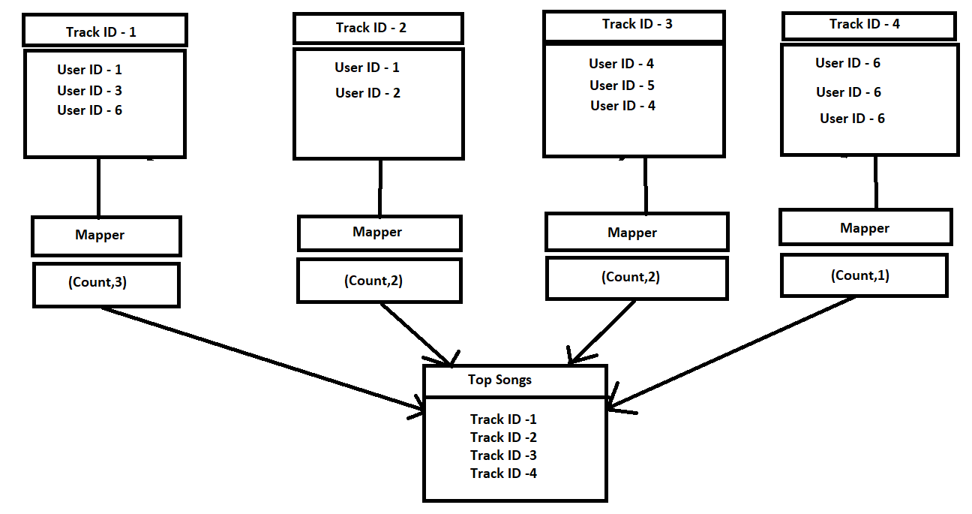
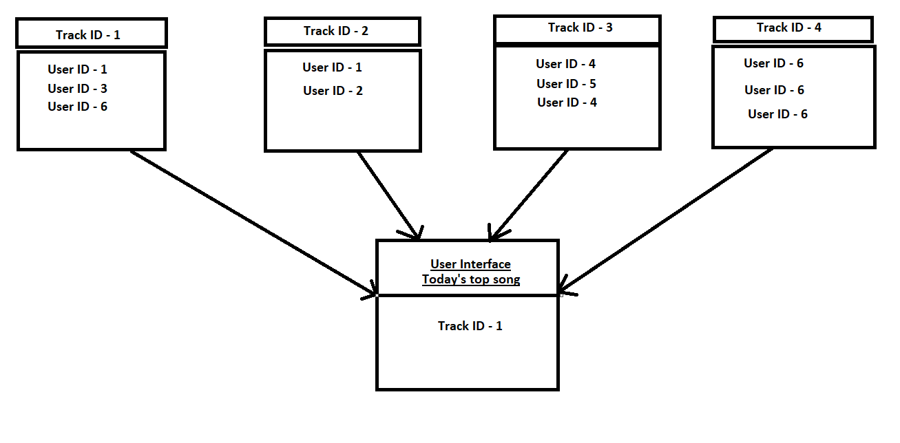
MapReduce

Slide 4
Solution
Mapper :
Mapper will find out the total number of unique user ids under each track.
The count will then be passed to reducer.
Reducer:
Identi Reducer will combine the output of all the mappers and sort them according to their count.

