Slide 1
Semantic Analysis
Semantic Analyzer
Attribute Grammars
Top-Down Translators
Bottom-Up Translators
Recursive Evaluators
Type Checking

Slide 2
Semantic Analyzer
source
program
Lexical
Analyzer
Syntax
Analyzer
Semantic
Analyzer
correct
program
Symbol
Table

Slide 3
Semantics
Type of each construct
Interpretation of each construct
Translation of each construct

Slide 4
Attribute Grammars
An attribute grammar is a context free grammar with associated attributes and semantic rules
Each grammar symbol is associated with a set of attributes
Each production is associated with a set of semantic rules for computing attributes

Slide 5
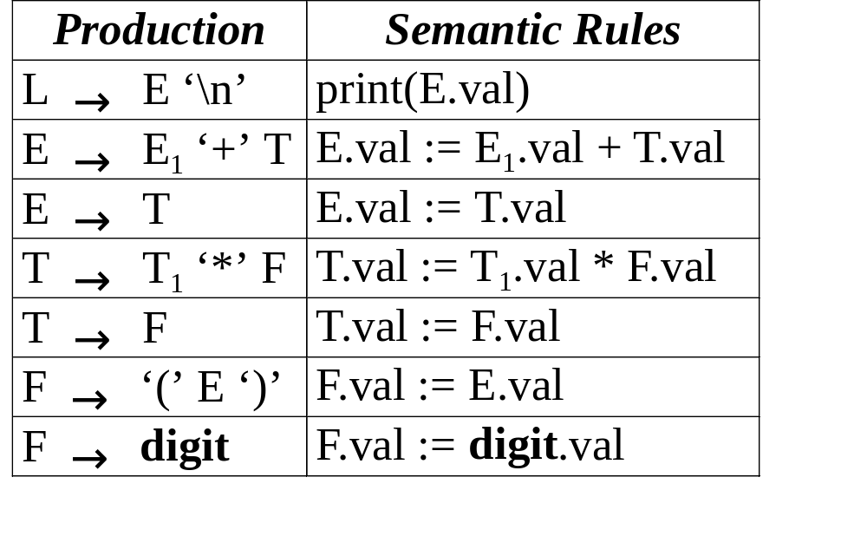
An Example
The attribute val represents the value of an expression

Slide 6
Annotated Parse Trees
L
print(E.val)
3 * 5 + 4
E.val = 19
‘\n’
E.val = 15
‘+’
T.val = 4
T.val = 15
F.val = 4
T.val = 3
‘*’
F.val = 5
digit.val = 4
F.val = 3
digit.val = 5
digit.val = 3

Slide 7
Attributes
An attribute of a node (grammar symbol) in the parse tree is synthesized if its value is computed from that of its children
An attribute of a node in the parse tree is inherited if its value is computed from that of its parent and siblings

Slide 8
Synthesized Attributes

Slide 9
Synthesized Attributes
L
print(E.val)
3 * 5 + 4
E.val = 19
‘\n’
E.val = 15
‘+’
T.val = 4
T.val = 15
F.val = 4
T.val = 3
‘*’
F.val = 5
digit.val = 4
F.val = 3
digit.val = 5
digit.val = 3

Slide 10
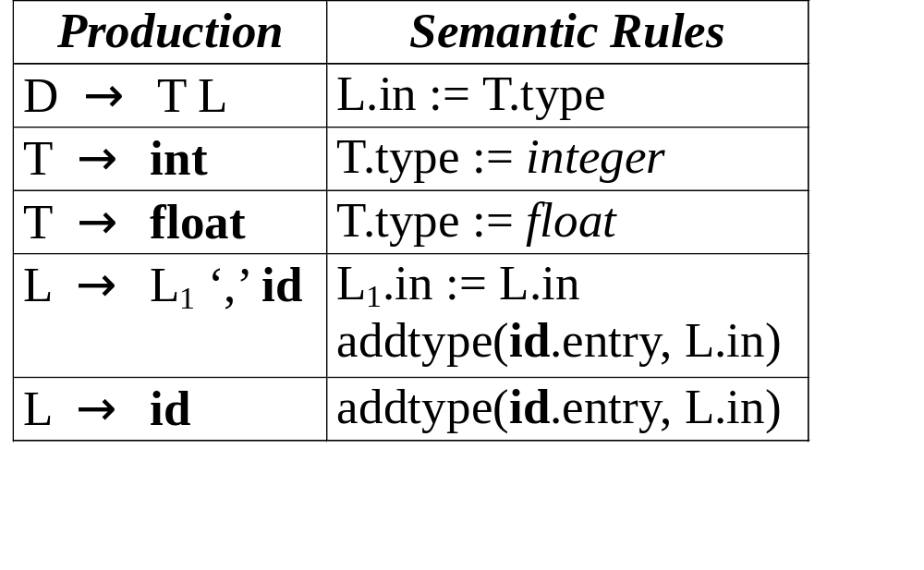
Inherited Attributes

Slide 11
Inherited Attributes
D
T.type = float
L.in = float
float
L.in = float
‘,’
id₃
L.in = float
‘,’
id₂
id₁

Slide 12
Two Notations
Syntax-Directed Definitions
Translation Schemes

Slide 13
Syntax-Directed Definitions
Each grammar production A → α is associated with a set of semantic rules of the form
b := f (c₁, c₂, …, c_{k})
where f is a function and
1. b is a synthesized attribute of A and c₁, c₂, …, c_{k} are attributes of A or grammar symbols in
α, or
2. b is an inherited attribute of one of the grammar symbols in α and c₁, c₂, …, c_{k} are attributes of A or grammar symbols in α

Slide 14
Dependencies of Attributes
In the semantic rule
b := f(c₁, c₂, …, c_{k})
we say b depends on c₁, c₂, …, c_{k}
The semantic rule for b must be evaluated after the semantic rules for c₁, c₂, …, c_{k}
The dependencies of attributes can be represented by a directed graph called dependency graph

Slide 15
Dependency Graphs
D
T
1 type
in 2
L
4
float
in 5
L
7
‘,’
id₃
3 entry
in 8
L
10
‘,’
id₂
6 entry
id₁
9 entry

Slide 16
Evaluation Order
Apply topological sort on dependency graph
a1 := float
a2 := a1
addtype(a3, a2) /* a4 */
a5 := a2
addtype(a6, a5) /* a7 */
a8 := a5
addtype(a9, a8) /* a10 */
a1 := float
a2 := a1
a5 := a2
a8 := a5
addtype(a9, a8) /* a10 */
addtype(a6, a5) /* a7 */
addtype(a3, a2) /* a4 */

Slide 17
S-Attributed Definitions
A syntax-directed definition is S-attributed if it uses synthesized attributes exclusively

Slide 18
An Example

Slide 19
L-Attributed Definitions
A syntax-directed definition is L-attributed if each attribute in each semantic rule for each production
A → X₁ X₂ … X_{n}
is a synthesized attribute, or an inherited attribute of X_{j}, 1 ≤ j ≤ n, depending only on
1. the attributes of X₁, X₂, …, X_{j-1}
2. the inherited attributes of A

Slide 20

An Example

Slide 21
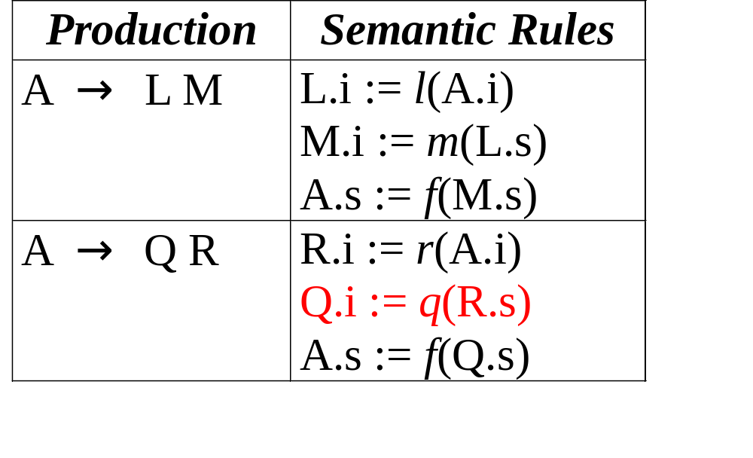
A Counter Example

Slide 22
Translation Schemes
A translation scheme is an attribute grammar in which semantic rules are enclosed between braces { and }, and are inserted within the right sides of productions
The value of an attribute must be available when a semantic rule refers to it

Slide 23
An Example
D → T {L.in := T.type} L
T → int {T.type := integer}
T → float {T.type := float}
L → {L₁.in := L.in} L₁ ‘,’ id {addtype(id.entry, L.in)}
L → id {addtype(id.entry, L.in)}

Slide 24
An Example
D
T
{L.in := T.type}
L
float
{T.type := float}
{L₁.in := L.in}
L
‘,’
id₃
{addtype()}
{L₁.in := L.in}
L
‘,’
id₂
{addtype()}
id₁
{addtype()}

Slide 25
An Example
E → T R
T → num {print(num.val)}
R → addop T {print(addop.lexeme)} R
R → ε
E
9 - 5 + 2
T
R
9 5 - 2 +
9
{print(‘9’)}
‘-’
T
{print(‘-’)}
R
5
{print(‘5’)}
‘+’
T
{print(‘+’)}
R
2
{print(‘2’)}
ε

Slide 26
Restrictions on Translation Schemes
An inherited attribute for a symbol on the right side must be computed in a semantic rule before that symbol
A semantic rule must not refer to a synthesized attribute for a symbol to its right
A synthesized attribute for the symbol on the left can be computed after all attributes it depends on have been computed

Slide 27
From L-Attributed Definitions to Translation Schemes
The mathematics-formatting language EQN
E₁.val

Slide 28
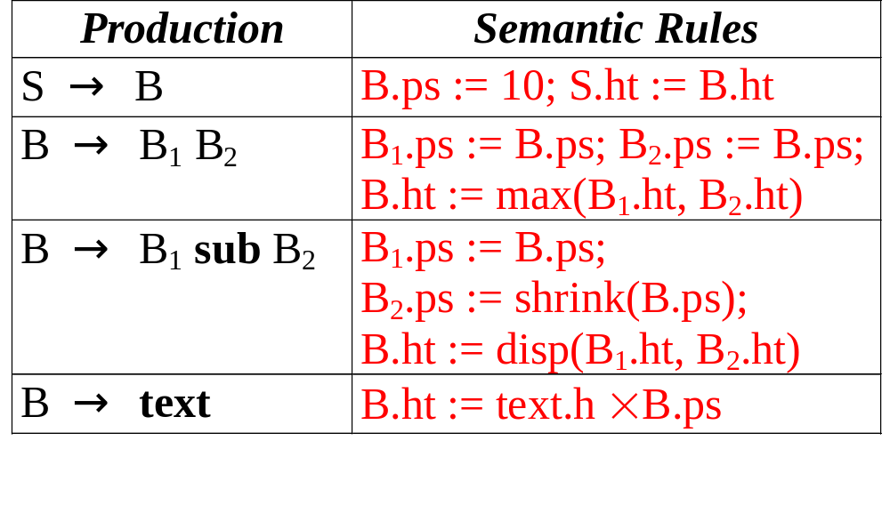
From L-Attributed Definitions to Translation Schemes

Slide 29
From L-Attributed Definitions to Translation Schemes
S → {B.ps := 10} B
{S.ht := B.ht}
B → {B₁.ps := B.ps} B₁
{B₂.ps := B.ps} B₂
{B.ht := max(B₁.ht, B₂.ht)}
B → {B₁.ps := B.ps} B₁ sub
{B₂.ps := shrink(B.ps)} B₂
{B.ht := disp(B₁.ht, B₂.ht)}
B → text {B.ht := text.ht × B.ps}

Slide 30
Construction of Syntax Trees
An abstract syntax tree is a condensed form of parse tree useful for representing constructs
if-stmt
E
if
expr
then
stmt
else
stmt
E
+
T
+
E
*
T
F
*
4
T
F
4
3
5
if-stmt
F
5
expr
stmt
stmt
3

Slide 31
Syntax Trees for Expressions
Interior nodes are operators
Leaves are identifiers or numbers
Functions for constructing nodes
  mknode(op, left, right)
  mkleaf(id, entry)
  mkleaf(num, value)

Slide 32
An Example
a - 4 + b
+
p1 := mkleaf(id, entry_{a});
p2 := mkleaf(num, 4);
p3 := mknode(‘-’, p1, p2);
p4 := mkleaf(id, entry_{b});
p5 := mknode(‘+’, p3, p4);
-
id
b
id
a
num
4

Slide 33
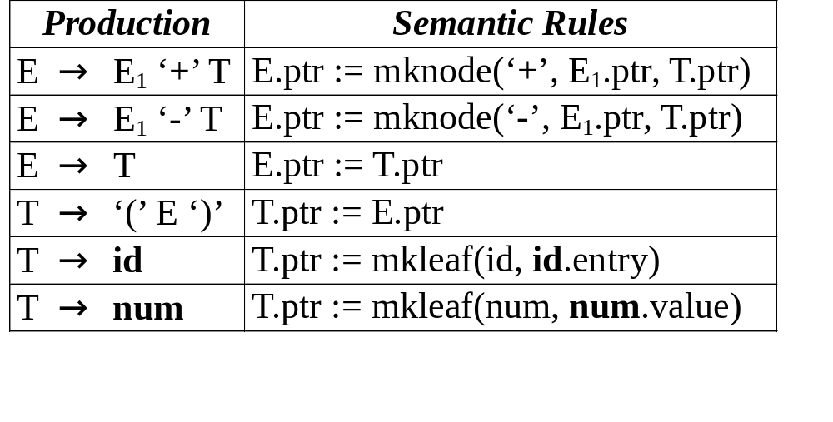
An Example

Slide 34
Top-Down Translators
For each nonterminal A,
  inherited attributes → formal parameters
  synthesized attributes → returned values
For each production,
  for each terminal X with synthesized attribute x,
  save X.x; match(X); advance input;
  for nonterminal B, c := B(b₁, b₂, …, b_{k});
  for each semantic rule, copy the rule to the parser

Slide 35
An Example
E → T { R.i := T.nptr }
R { E.nptr := R.s }
R → addop
T { R₁.i := mknode(addop.lexeme, R.i, T.nptr) }
R₁ { R.s := R₁.s }
R → ε { R.s := R.i }
T → “(” E “)” { T.nptr := E.nptr }
T → num { T.nptr := mkleaf(num, num.value) }

Slide 36
An Example
syntax_tree_node *E( );
syntax_tree_node *R( syntax_tree_node * );
syntax_tree_node *T( );
syntax_tree_node *E( ) {
syntax_tree_node *enptr, *tnptr, *ri, *rs;
tnptr = T( );
ri = tnptr; /* R.i := T.nptr */
rs = R(ri);
enptr = rs; /* E.nptr := R.s */
return enptr;
}

Slide 37
An Example
syntax_tree_node *R(syntax_tree_node * i) {
syntax_tree_node *nptr, *i1, *s1, *s;
char addoplexeme;
if (lookahead == addop) {
addoplexeme = lexval;
match(addop);
nptr = T();
i1 = mknode(addoplexeme, i, nptr);
/* R₁.i := mknode(addop.lexeme, R.i, T.nptr) */
s1 = R(i1);
s = s1; /* R.s := R₁.s */
} else s = i; /* R.s := R.i */
return s;
}

Slide 38
An Example
syntax_tree_node *T( ) {
syntax_tree_node *tnptr, *enptr;
int numvalue;
if (lookahead == ‘(’ ) {
match(‘(’); enptr = E( ); match(‘)’);
tnptr = enptr; /* T.nptr := E.nptr */
} else if (lookahead == num ) {
numvalue = lexval; match(num);
tnptr = mkleaf(num, numvalue);
/* T.nptr := mkleaf(num, num.value) */
} else error( );
return tnptr;
}

Slide 39
Bottom-Up Translators
Keep the values of synthesized attributes on the parser stack
A → X Y Z A.a := f(X.x, Y.y, Z.z);
symbol
val
...
...
X
X.x
val[top-2]
Y
Y.y
val[top-1]
top
Z
Z.z
val[top]
A → X Y Z val[ntop] := f(val[top-2], val[top-1], val[top]);

Slide 40
Evaluation of Synthesized Attributes
When a token is shifted onto the stack, its attribute value is placed in val[top]
Code for semantic rules are executed just before a reduction takes place
If the left-hand side symbol has a synthesized attribute, code for semantic rules will place the value of the attribute in val[ntop]

Slide 41
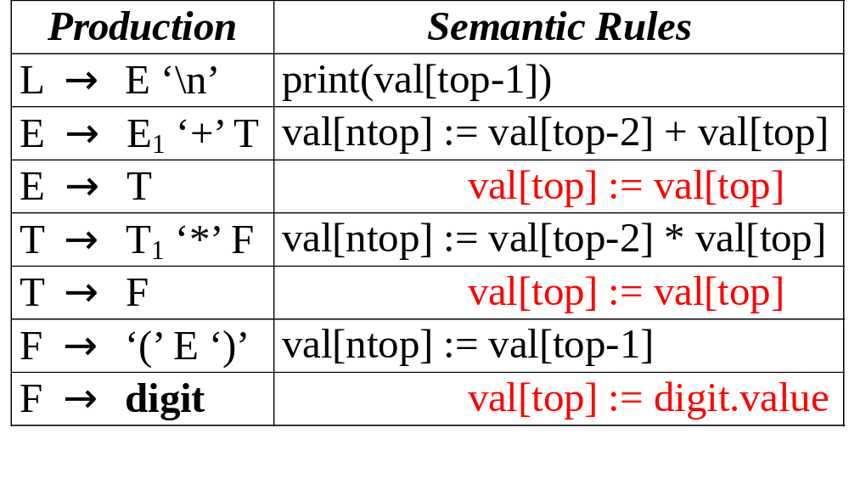
An Example

Slide 42
An Example
Input symbol val production used
3*5+4n
*5+4n digit 3
*5+4n F 3 F → digit
*5+4n T 3 T → F
5+4n T * 3 _
+4n T * digit 3 _ 5
+4n T * F 3 _ 5 F → digit
+4n T 15 T → T * F
+4n E 15 E → T

Slide 43
An Example
Input symbol val production used
+4n E 15 E → T
4n E + 15 _
n E + digit 15 _ 4
n E + F 15 _ 4 F → digit
n E + T 15 _ 4 T → F
n E 19 E → E + T
E n 19 _
L _ L → E n

Slide 44
Evaluation of Inherited Attributes
Removing embedding actions from translation scheme by introducing marker nonterminals
E → T R
R → “+” T {print(‘+’)} R | “-” T {print(‘-’)} R | ε
T → num {print(num.val)}
E → T R
R → “+” T M R | “-” T N R | ε
T → num {print(num.val)}
M → ε {print(‘+’)}
N → ε {print(‘-’)}

Slide 45
Evaluation of Inherited Attributes
Inheriting synthesized attributes on the stack
A → X {Y.i := X.s} Y
symbol
val
...
...
X
X.s
top
Y

Slide 46
An Example
D → T {L.in := T.type}
L
T → int {T.type := integer}
T → float {T.type := float}
L → {L₁.in := L.in}
L₁ ‘,’ id {addtype(id.entry, L.in)}
L → id {addtype(id.entry, L.in)}
D → T L
T → int {val[ntop] := integer}
T → float {val[ntop] := float}
L → L₁ ‘,’ id {addtype(val[top], val[top-3])}
L → id {addtype(val[top], val[top-1])}

Slide 47
An Example
Input symbol val production used
int p,q,r
p,q,r int _
p,q,r T i T → int
,q,r T id i e
,q,r T L i _ L → id
q,r T L , i _ _
,r T L , id i _ _ e
,r T L i _ L → L “,” id
r T L , i _ _
T L , id i _ _ e
T L i _ L → L “,” id
D

Slide 48
Evaluation of Inherited Attributes
Simulating the evaluation of inherited attributes
Inheriting the value of a synthesized
attribute works only if the grammar
allows the position of the attribute value
to be predicted

Slide 49
An Example
S → a A C {C.i := A.s}
S → b A B C {C.i := A.s}
C → c {C.s := g(C.i)}
S → a A C {C.i := A.s}
S → b A B M C {M.i := A.s; C.i := M.s}
C → c {C.s := g(C.i)}
M → ε {M.s := M.i}

Slide 50
Another Example
S → a A C {C.i := f(A.s)}
S → a A N C {N.i := A.s; C.i := N.s}
N → ε {N.s := f(N.i)}

Slide 51
From Inherited to Synthesized
D → L “:” T
L → L “,” id | id
T → integer | char
D → id L
L → “,” id L | “:” T
T → integer | char
D
D
L
:
T
id
L
,
,
id
L
L
id
int
,
,
id
L
L
id
:
T
id
int

Slide 52
Bison
%token DIGIT
%%
line : expr ‘\n’ {printf(“%d\n”, $1);}
;
expr: expr ‘+’ term {$$ = $1 + $3;}
| term
;
term: term ‘*’ factor {$$ = $1 * $3;}
| factor
;
factor: ‘(’ expr ‘)’ {$$ = $2;}
| DIGIT
;

Slide 53
Bison
%union {
char op_type; int value;
}
%token <value> DIGIT
%type <op_type> op
%type <value> expr factor
%%
expr: expr op factor {$$ = $2 == ‘+’ ? $1 + $3 : $1 - $3;}
| factor
;
op: + {$$ = ‘+’;}
| - {$$ = ‘-’;}
;
factor: DIGIT ;

Slide 54
Recursive Evaluators
The parser constructs a parse tree explicitly
A recursive evaluator is a function that traverses the parse tree and evaluates attributes
A recursive evaluator can traverse the parse tree in any order
A recursive evaluator can traverse the parse tree multiple times

Slide 55
An Example
S → { B.ps := 10 }
B { S.ht := B.ht }
B → { B₁.ps := B.ps }
B₁ { B₂.ps := B.ps }
B₂ { B.ht := max(B₁.ht, B₂.ht) }
B → { B₁.ps := B.ps }
B₁
sub { B₂.ps := shrink(B.ps) }
B₂ { B.ht := disp(B₁.ht, B₂.ht) }
B → text { B.ht := text.h × B.ps }

Slide 56
An Example
S
ht
ps B ht
ps
B
ht
ps
B
ht
ps B₁ ht
ps B₂ ht
text
h

Slide 57
An Example
function B(n, ps);
var ps1, ps2, ht1, ht2;
begin
case production at node n of
‘B → B₁ B₂’:
ps1 := ps; ht1 := B(child(n, 1), ps1); ps2 := ps;
ht2 := B(child(n, 2), ps2); return max(ht1, ht2);
‘B → B₁ sub B₂’:
ps1 := ps; ht1 := B(child(n, 1), ps1); ps2 := shrink(ps);
ht2 := B(child(n, 3), ps2); return disp(ht1, ht2);
‘B → text’:
return ps × text.h;
default: error end
end;

Slide 58
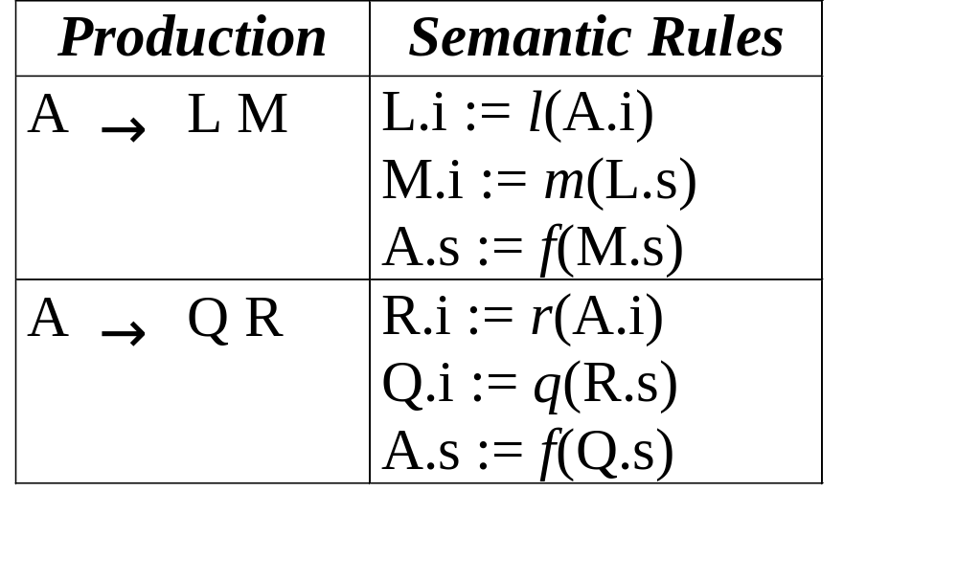
Another Example

Slide 59
An Example
i A s
i A s
i L s
i M s
i Q s
i R s

Slide 60
An Example
function A(n, ai);
var li, ls, mi, ms, ri, rs, qi, qs;
begin
case production at node n of
‘A → L M’:
li := l(ai); ls := L(child(n, 1), li); mi := m(ls);
ms := M(child(n, 2), mi); return f(ms);
‘A → Q R’:
ri := r(ai); rs := R(child(n, 2), ri); qi := q(rs);
qs := Q(child(n, 1), qi); return f(qs);
default: error
end
end;

Slide 61
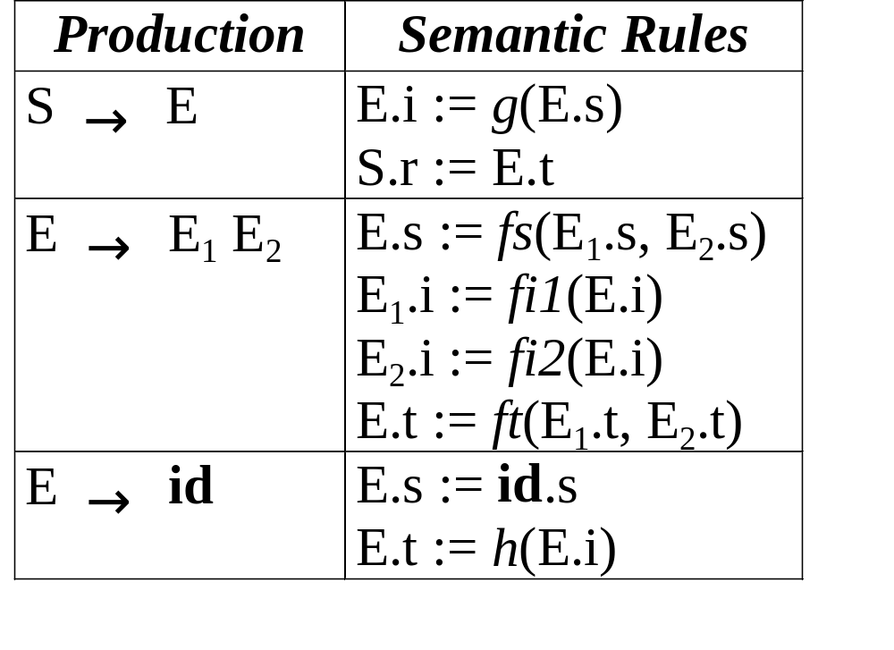
An Example

Slide 62
An Example
S
r
S
r
i
E
s
t
i
E
s
t
i
E
s
t
i
E₁
s
t
i
E2
s
t
i
E
s
t
i
E
s
t
i
E
s
t
id
s
id
s
id
s

Slide 63
An Example
function Es(n);
var s1, s2;
begin
case production at node n of
‘E → E₁ E₂’:
s1 := Es(child(n, 1)); s2 := Es(child(n, 2));
return fs(s1, s2);
‘E → id’:
return id.s;
default: error
end
end;

Slide 64
An Example
function Et(n, i);
var i1, t1, i2, t2;
begin
case production at node n of
‘E → E₁ E₂’:
i1 := fi1(i); t1 := Et(child(n, 1), i1);
i2 := fi2(i); t2 := Et(child(n, 2), i2);
return ft(t1, t2);
‘E → id’:
return h(i);
default: error
end
end;

Slide 65
An Example
function Sr(n);
var s, i, t;
begin
s := Es(child(n, 1));
i := g(s);
t := Et(child(n, 1), i);
return t
end;

Slide 66
Type Systems
A type system is a collection of rules for assigning types to the various parts of a program
A type checker implements a type system
Types are represented by type expressions

Slide 67
Type Expressions
A basic type is a type expression
  boolean, char, integer, real, void, type_error
A type constructor applied to type expressions is a type expression
  array: array(I, T)
  product: T₁ × T₂
  record: record((N₁ × T₁) × (N₂ × T₂))
  pointer: pointer(T)
  function: D → R

Slide 68
Type Declarations
P → D “;” E
D → D “;” D
| id “:” T { addtype(id.entry, T.type) }
T → char { T.type := char }
T → integer { T.type := integer }
T → “*” T₁ {T.type := pointer(T₁.type) }
T → array “[” num “]” of T₁
{ T.type := array(num.value, T₁.type) }

Slide 69
Type Checking of Expressions
E → literal {E.type := char}
E → num {E.type := int}
E → id {E.type := lookup(id.entry)}
E → E₁ mod E₂
{E.type := if E₁.type = int and E₂.type = int
then int else type_error}
E → E₁ “[” E₂ “]”
{E.type := if E₁.type = array(s, t) and E₂.type = int
then t else type_error}
E → “*” E₁
{E.type := if E₁.type = pointer(t)
then t else type_error}

Slide 70
Type Checking of Statements
P → D “;” S
S → id “:=” E
{S.type := if lookup(id.entry) = E.type
then void else type_error}
S → if E then S₁
{S.type := if E.type = boolean
then S₁.type else type_error}
S → while E do S₁
{S.type := if E.type = boolean
then S₁.type else type_error}
S → S₁ “;” S₂
{S.type := if S₁.type = void and S₂.type = void
then void else type_error}

Slide 71
Type Checking of Functions
T → T₁ “→” T₂
{T.type := T₁.type → T₂ .type}
E → E₁ “(” E₂ “)”
{E.type := if E₁.type = s → t and E₂.type = s
then t else type_error}

