Slide 1
Industrial Automation
(IE423 Computer Integrated Manufacturing)
(IE215 Design and Make)
David O’Sullivan
www.owl.ie

Slide 2
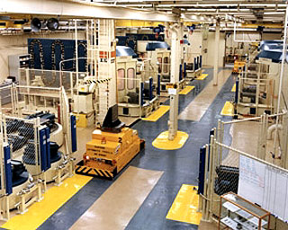
Industrial Automation - Machines
Storage Systems
Handling Systems
Assembly Lines
  Assembly Cells
  Machines
    Actuators
    Sensors
Production Lines
  Production Cells
  Machines
    Actuators
    Sensors

Slide 3
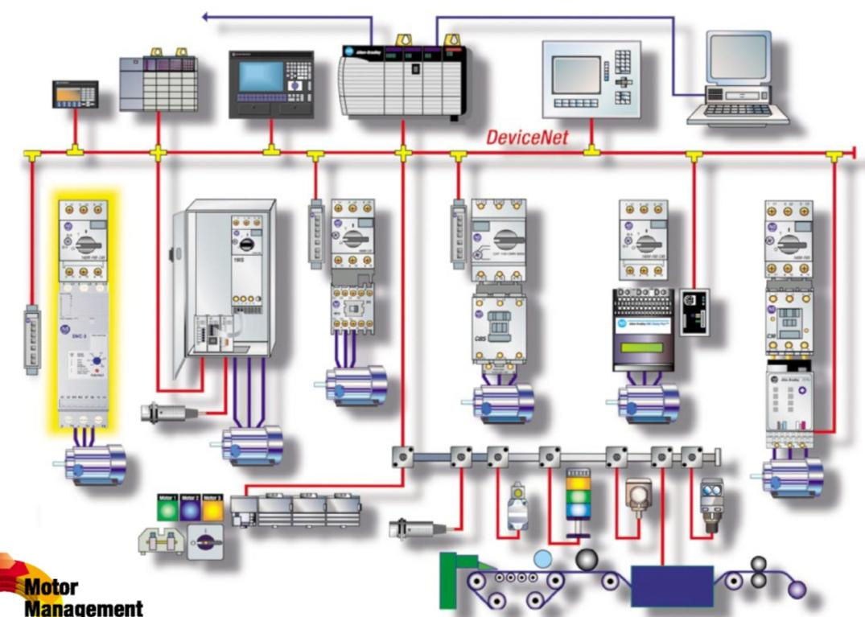
Industrial Automation - Computing
Computers
Controllers
  Actuators
  Sensors
Software

Slide 4
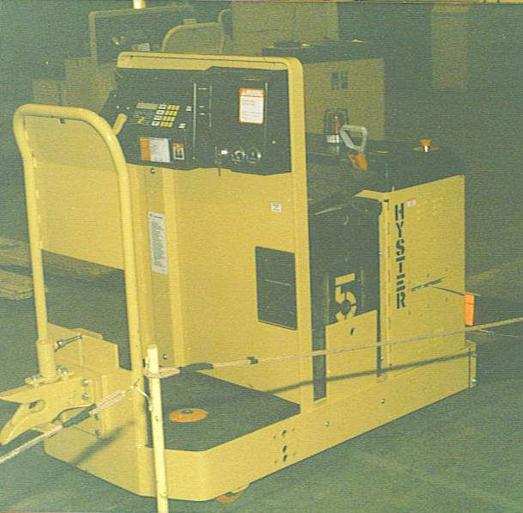
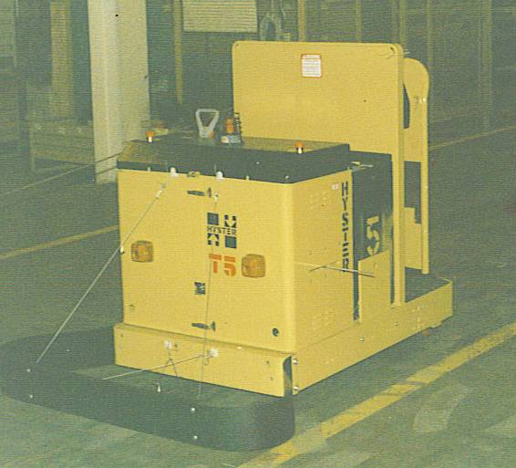

Slide 5
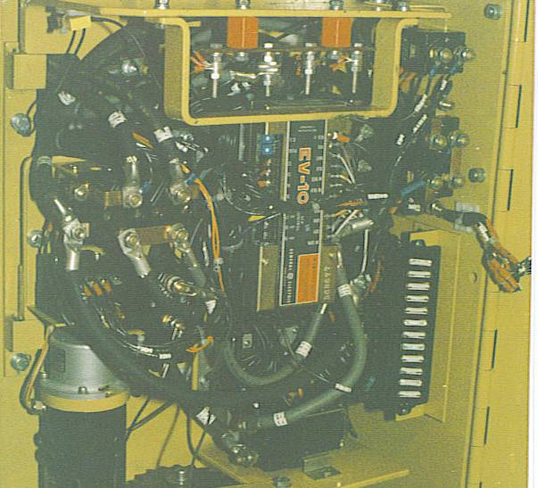
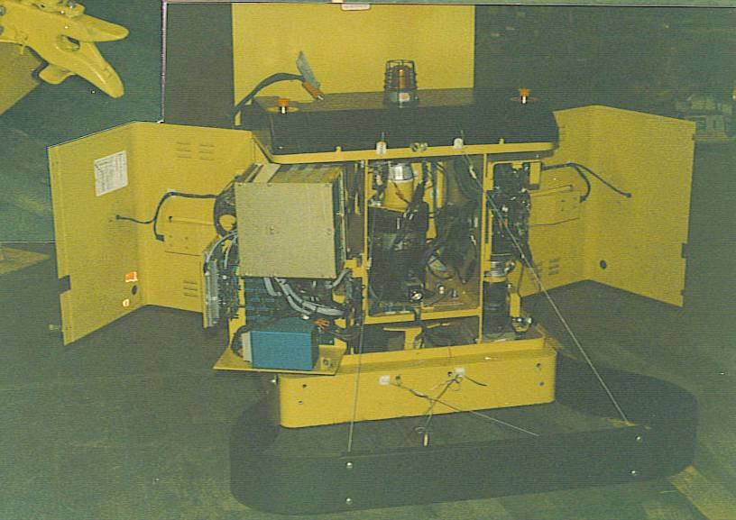

Slide 6
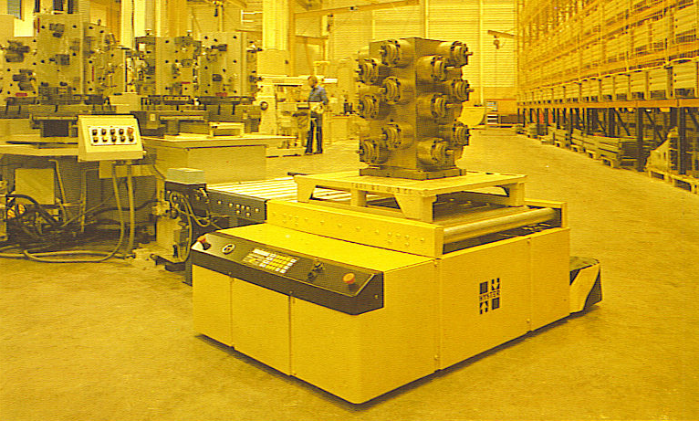
Video

Slide 7
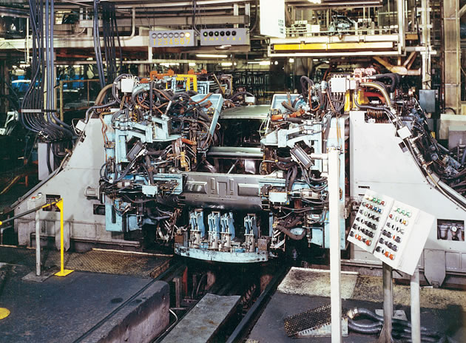

Slide 8
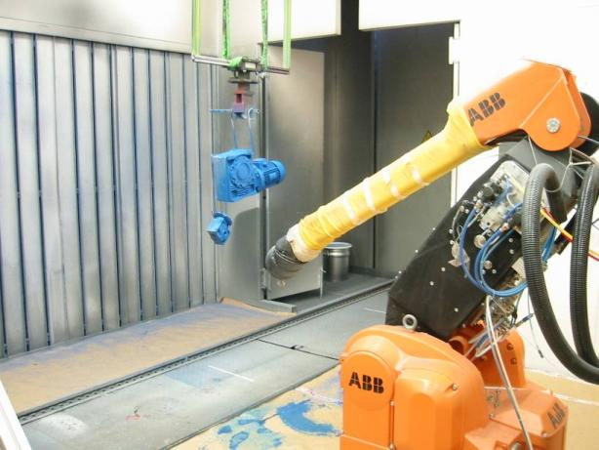
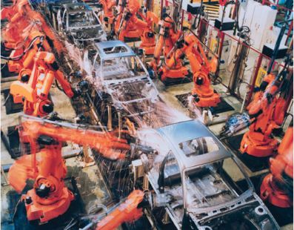
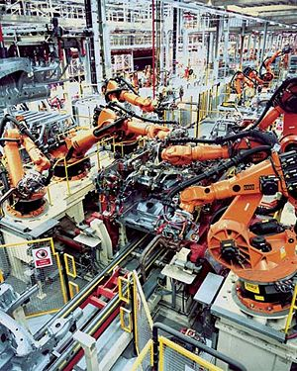
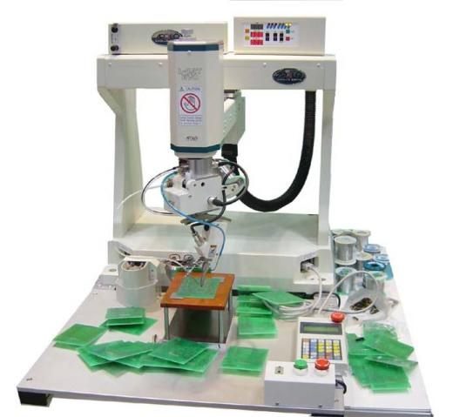

Slide 9
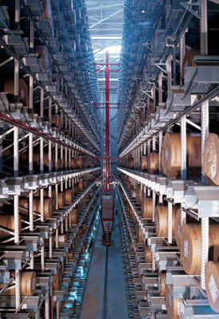
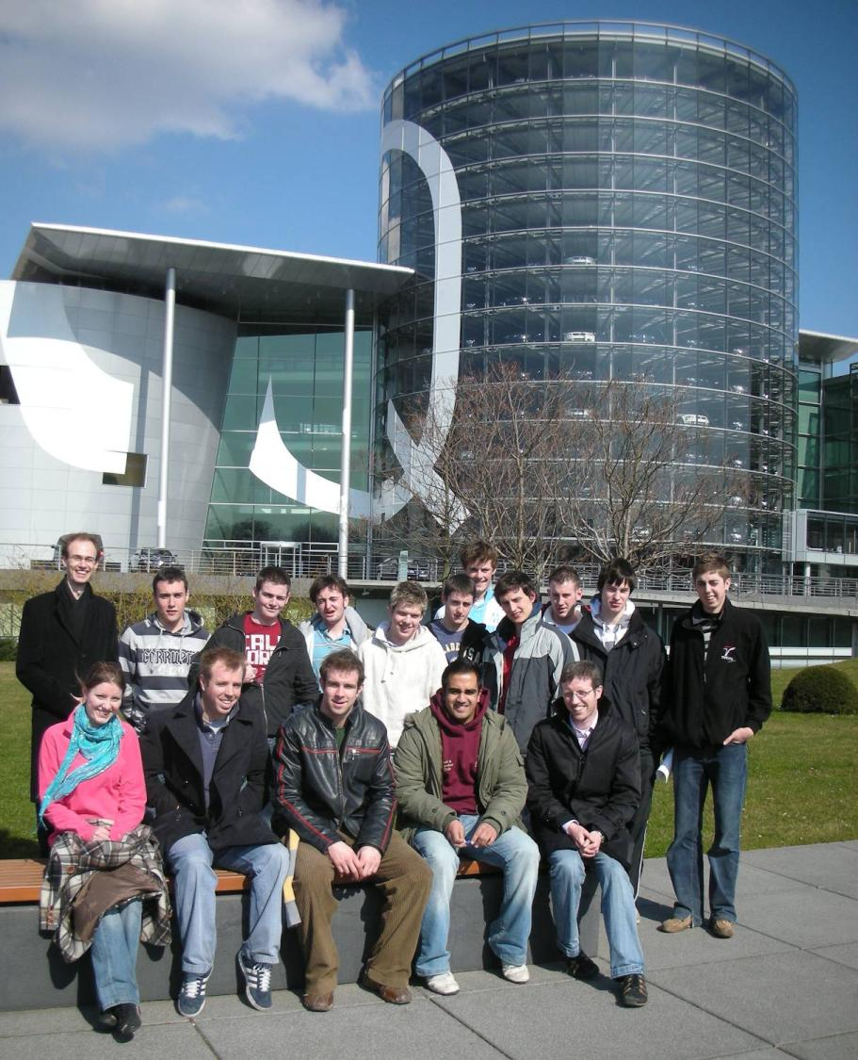

Slide 10
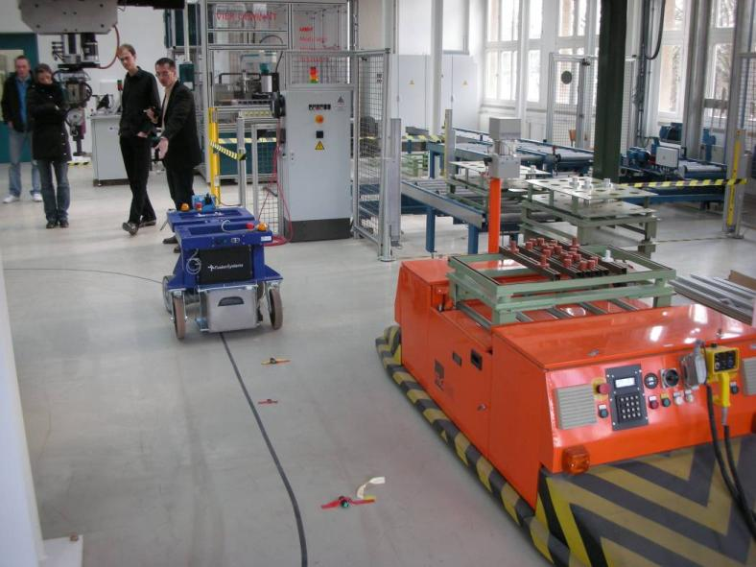
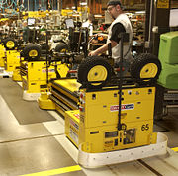
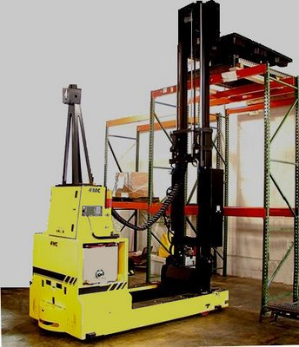
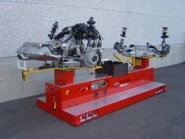

Slide 11
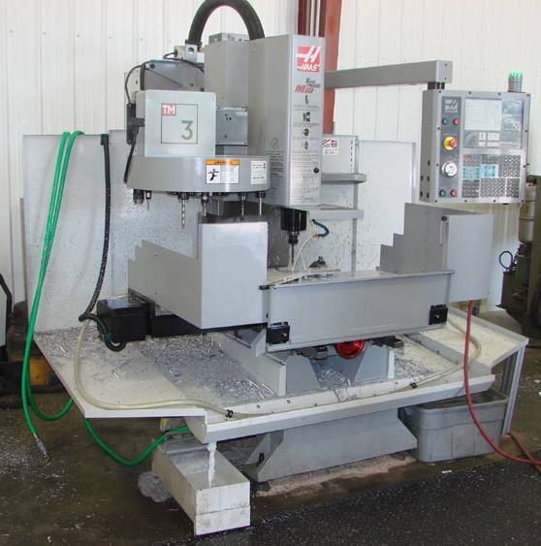
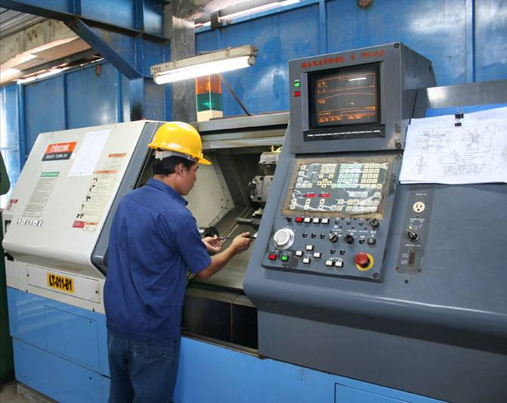
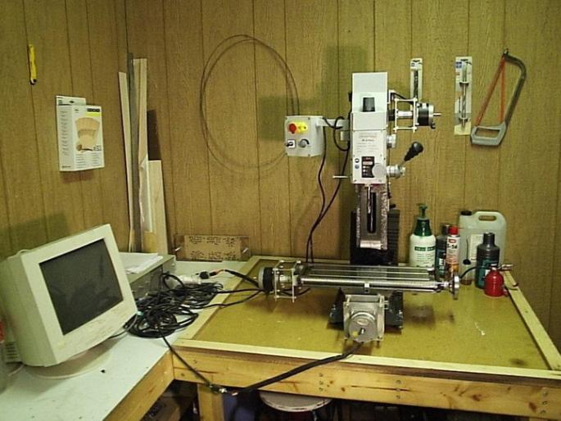

Slide 12
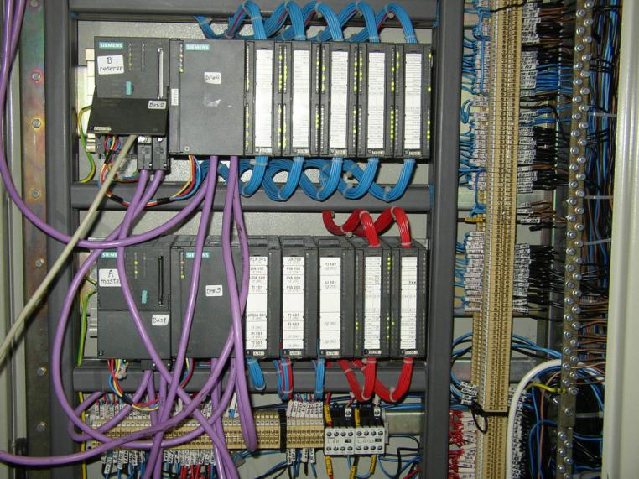
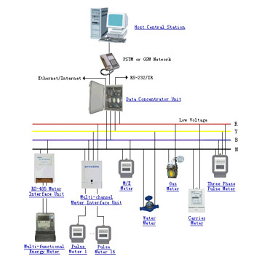
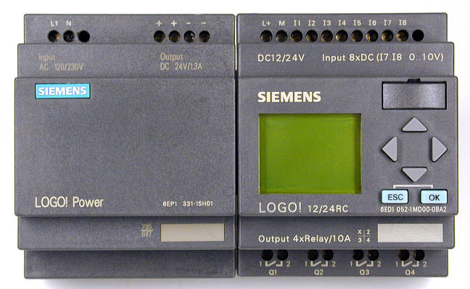

Slide 13
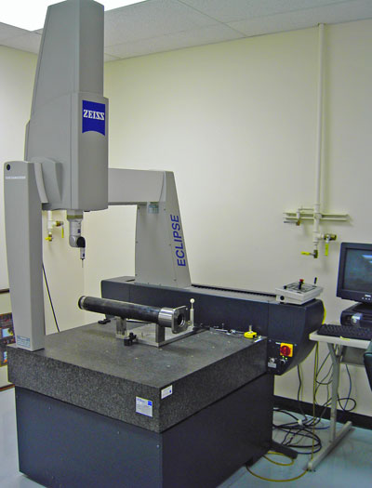
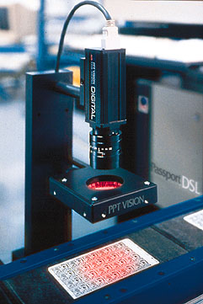
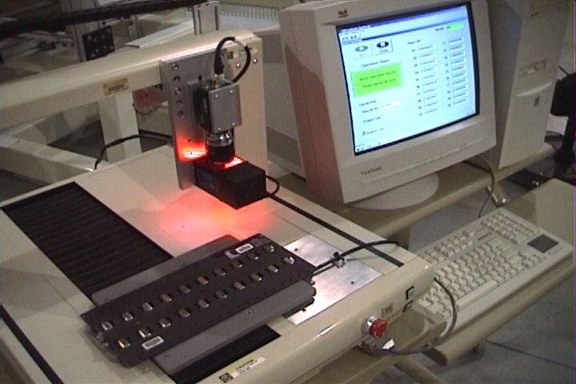

Slide 14
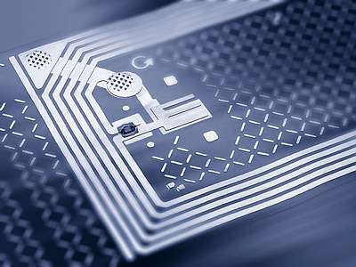
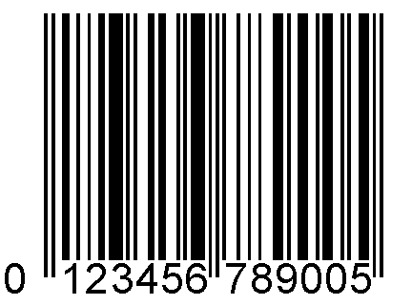


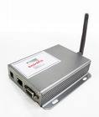
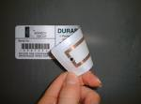

Slide 15
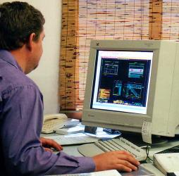
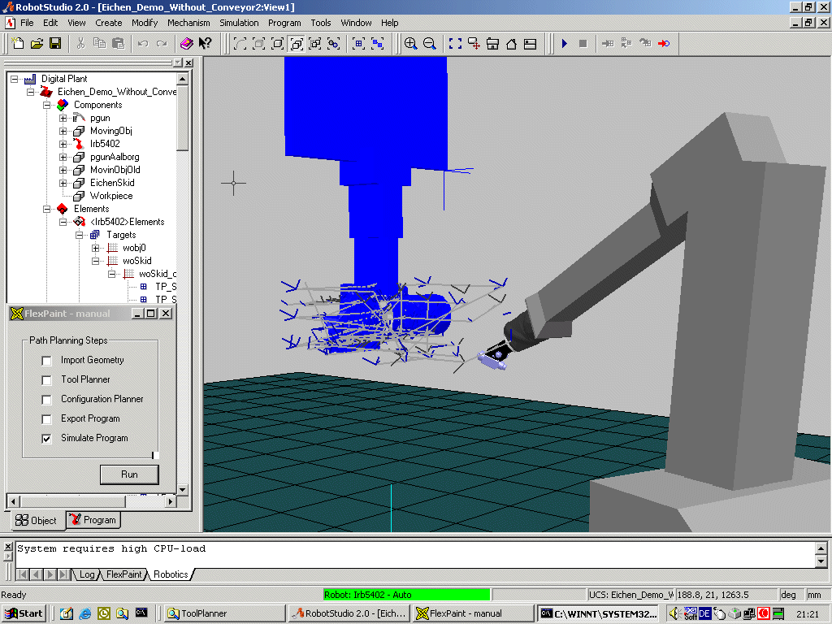
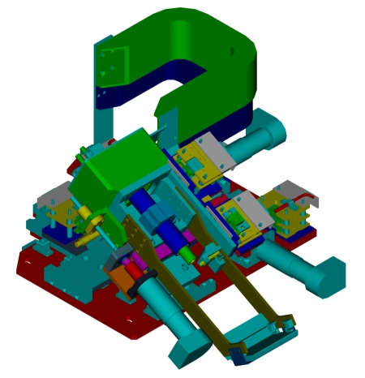
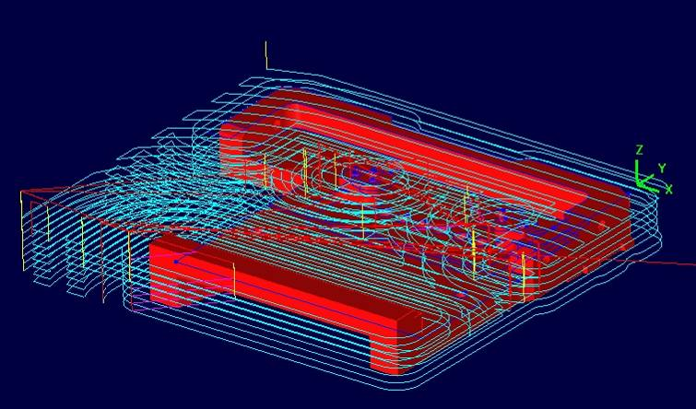

Slide 16
Unit 1 Industrial Automation
Sections:
Production Systems
Automation in Production Systems
Manual Labor in Production Systems
Automation Principles and Strategies
Organization of the Course

Slide 17
The Realities of Modern Manufacturing
Globalization - Once underdeveloped countries (e.g., China, India, Mexico) are becoming major players in manufacturing
International outsourcing - Parts and products once made locally are now being made offshore (in China or India) or near-shore (in Eastern Europe)
Local outsourcing - Use of suppliers locally to provide parts and services

Slide 18
More Realities of Modern Manufacturing
Contract manufacturing - Companies that specialize in manufacturing entire products, not just parts, under contract to other companies
Trend toward the service sector
Quality expectations - Customers, both consumer and corporate, demand products of the highest quality
Need for operational efficiency - manufacturers must be efficient in in their operations to overcome the labor cost advantage of international competitors

Slide 19
Manufacturing Approaches
Automation
Flexible manufacturing
Quality programs
Integration
Lean production

Slide 20
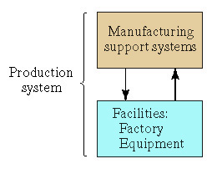
Production System Defined
A collection of people, equipment, and procedures organized to accomplish the manufacturing operations of a company

Slide 21
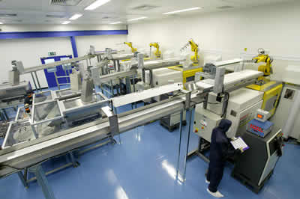
Facilities – Factory and Equipment
Factory, production machines and tooling, material handling equipment, inspection equipment, and computer systems that control the manufacturing operations

Slide 22
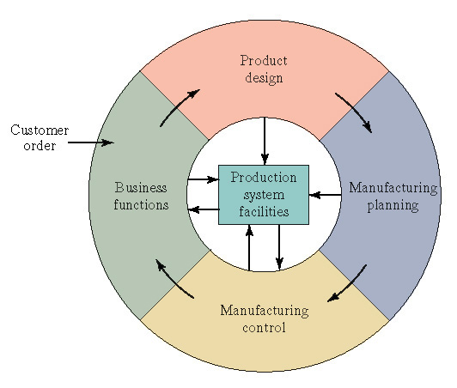
Manufacturing Support Systems
  Business functions - sales and marketing, order entry, cost accounting, customer billing
  Product design - research and development, design engineering, prototype shop
  Manufacturing planning - process planning, production planning, MRP, capacity planning
  Manufacturing control
  shop floor control,
  inventory control, quality control

Slide 23
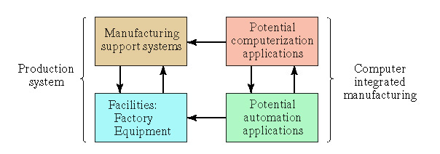
Computer Integrated Manufacturing

Slide 24
Automated System
Examples:
Automated machine tools
Transfer lines
Automated assembly systems
Industrial robots
Automated material handling and storage systems
Automatic inspection systems for quality control
Periodic
Worker
Automated
System
Transformation Process

Slide 25
Three Automation Types
Programmable
Automation
Variety
Flexible
Automation
Fixed
Automation
Quantity

Slide 26
Fixed Automation
Sequence of processing (or assembly) operations is fixed by the equipment configuration
Typical features:
Suited to high production quantities
High initial investment for custom-engineered equipment
High production rates
Relatively inflexible in accommodating product variety

Slide 27
Programmable Automation
Capability to change the sequence of operations throug reprogramming to accommodate different product configurations
Typical features:
High investment in programmable equipment
Lower production rates than fixed automation
Flexibility to deal with variations and changes in product configuration
Most suitable for batch production
Physical setup and part program must be changed between jobs (batches)

Slide 28
Flexible Automation
System is capable of changing over from one job to the next with little lost time between jobs
Typical features:
High investment for custom-engineered system
Continuous production of variable mixes of products
Medium production rates
Flexibility to deal with soft product variety

Slide 29
Reasons for Automating
To increase labor productivity
To reduce labor cost
To mitigate the effects of labor shortages
To reduce or remove routine manual and clerical tasks
To improve worker safety
To improve product quality
To reduce manufacturing lead time
To accomplish what cannot be done manually
To avoid the high cost of not automating

Slide 30
Automation Principle
Understand the existing process
  Input/output analysis
  Value chain analysis
  Charting techniques and mathematical modeling
Simplify the process
  Reduce unnecessary steps and moves
Automate the process
  Ten strategies for automation and production systems
  Automation migration strategy

Slide 31
Automation Strategies
Specialization of operations
Combined operations
Simultaneous operations
Integration of operations
Increased flexibility
Improved material handling and storage
On-line inspection
Process control and optimization
Plant operations control
Computer-integrated manufacturing

Slide 32
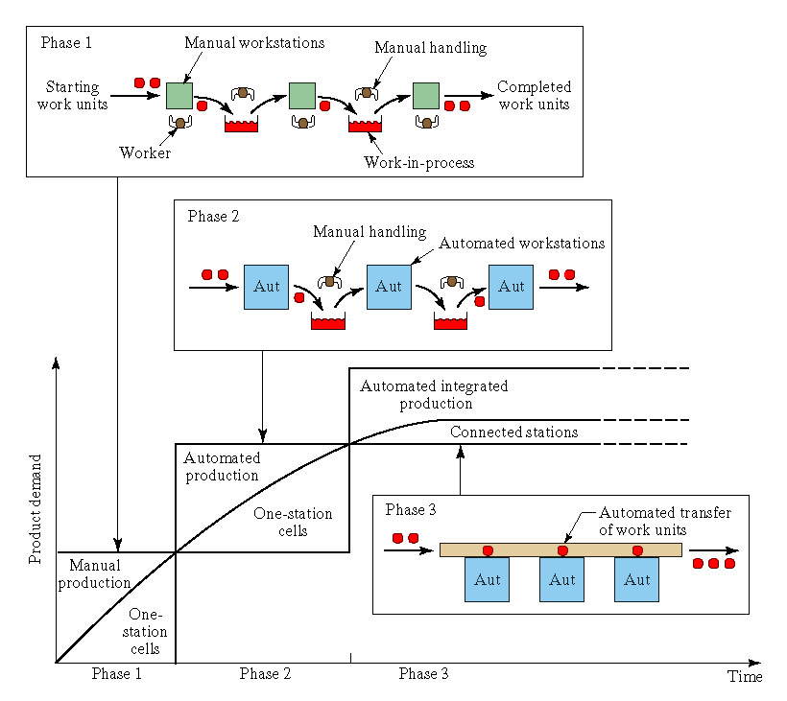
Automation Migration Strategy

Slide 33
Topics
Definition of Industrial Automation
Mathematical Models for Manufacturing
Industrial Systems
  Control Systems
  Sensors and Actuators
  Automated Machine Tools
  Industrial Robotics
  Logic Controllers
  Handling Systems
  Storage Systems
  Identification Systems
  Manufacturing Cells
  Assembly Lines
  Flexible Manufacturing Systems

Slide 34
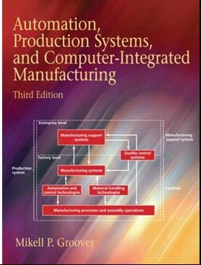
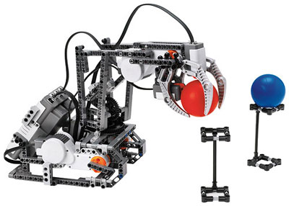
Pedagogy
Lectures
‘Design and Make’ Project
  More details later …
Course Notes (www.owl.ie)
Text Book
Exam – see textbook

Slide 35

YouTube
  Control Systems
  Sensors and Actuators
  Automated Machine Tools
  Industrial Robotics
  Logic Controllers
  Handling Systems
  Storage Systems
  Identification Systems
  Manufacturing Cells
  Assembly Lines
  Flexible Manufacturing Systems

