Slide 1
Ch 1 Introduction
Sections:
Production Systems
Automation in Production Systems
Manual Labor in Production Systems
Automation Principles and Strategies
Organization of the Book

Slide 2
The Realities of Modern Manufacturing
Globalization - Once underdeveloped countries (e.g., China, India, Mexico) are becoming major players in manufacturing
International outsourcing - Parts and products once made in the United States by American companies are now being made offshore (overseas) or near-shore (in Mexico and Central America)
Local outsourcing - Use of suppliers within the U.S. to provide parts and services

Slide 3
More Realities of Modern Manufacturing
Contract manufacturing - Companies that specialize in manufacturing entire products, not just parts, under contract to other companies
Trend toward the service sector in the U.S. economy
Quality expectations - Customers, both consumer and corporate, demand products of the highest quality
Need for operational efficiency - U.S. manufacturers must be efficient in in their operations to overcome the labor cost advantage of international competitors

Slide 4
Modern Manufacturing Approaches and Technologies
Automation - automated equipment instead of labor
Material handling technologies - because manufacturing usually involves a sequence of activities
Manufacturing systems - integration and coordination of multiple automated or manual workstations
Flexible manufacturing - to compete in the low-volume/high-mix product categories
Quality programs - to achieve the high quality expected by today's customers
CIM - to integrate design, production, and logistics
Lean production - more work with fewer resources

Slide 5
Production System Defined
A collection of people, equipment, and procedures organized to accomplish the manufacturing operations of a company
Two categories:
Facilities – the factory and equipment in the facility and the way the facility is organized (plant layout)
Manufacturing support systems – the set of procedures used by a company to manage production and to solve technical and logistics problems in ordering materials, moving work through the factory, and ensuring that products meet quality standards

Slide 6
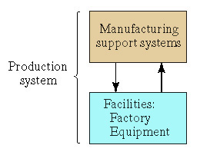
The Production System
Fig. 1.1

Slide 7
Production System Facilities
Facilities include the factory, production machines and tooling, material handling equipment, inspection equipment, and computer systems that control the manufacturing operations
Plant layout – the way the equipment is physically arranged in the factory
Manufacturing systems – logical groupings of equipment and workers in the factory
  Production line
  Stand-alone workstation and worker

Slide 8
Manufacturing Systems
Three categories in terms of the human participation in the processes performed by the manufacturing system:
  Manual work systems - a worker performing one or more tasks without the aid of powered tools, but sometimes using hand tools
  Worker-machine systems - a worker operating powered equipment
  Automated systems - a process performed by a machine without direct participation of a human

Slide 9
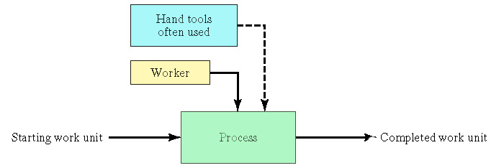
Manual Work System
Fig. 1.2 (a)

Slide 10
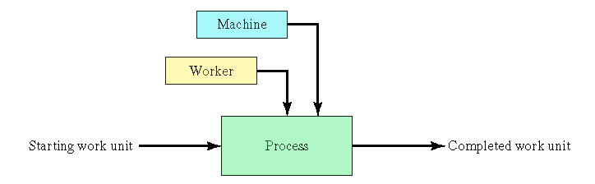
Worker-Machine System
Fig. 1.2 (b)

Slide 11
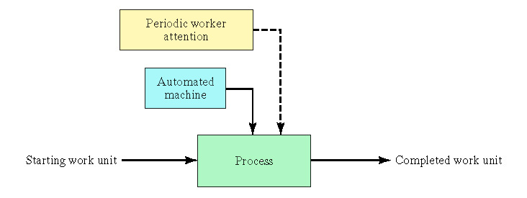
Automated System
Fig. 1.2. (c)

Slide 12
Manufacturing Support Systems
Involves a cycle of information-processing activities that consists of four functions:
  Business functions - sales and marketing, order entry, cost accounting, customer billing
  Product design - research and development, design engineering, prototype shop
  Manufacturing planning - process planning, production planning, MRP, capacity planning
  Manufacturing control - shop floor control, inventory control, quality control

Slide 13
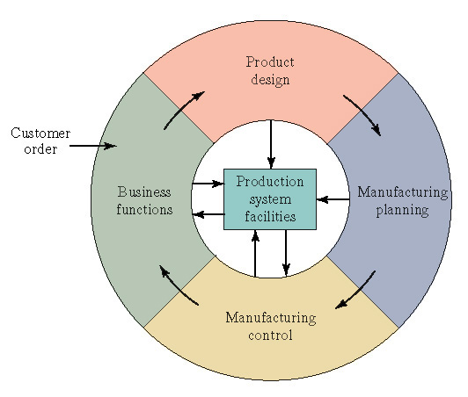
Information Processing Cycle in Manufacturing Support Systems
Fig. 1.3

Slide 14
Automation in Production Systems
Two categories of automation in the production system:
  Automation of manufacturing systems in the factory
  Computerization of the manufacturing support systems
The two categories overlap because manufacturing support systems are connected to the factory manufacturing systems
  Computer-Integrated Manufacturing (CIM)

Slide 15
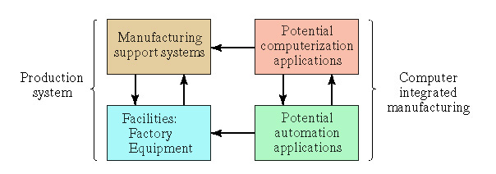
Computer Integrated Manufacturing
Fig. 1.4

Slide 16
Automated Manufacturing Systems
Examples:
Automated machine tools
Transfer lines
Automated assembly systems
Industrial robots that perform processing or assembly operations
Automated material handling and storage systems to integrate manufacturing operations
Automatic inspection systems for quality control

Slide 17
Automated Manufacturing Systems
Three basic types:
  Fixed automation
  Programmable automation
  Flexible automation

Slide 18
Fixed Automation
A manufacturing system in which the sequence of processing (or assembly) operations is fixed by the equipment configuration
Typical features:
Suited to high production quantities
High initial investment for custom-engineered equipment
High production rates
Relatively inflexible in accommodating product variety

Slide 19
Programmable Automation
A manufacturing system designed with the capability to change the sequence of operations to accommodate different product configurations
Typical features:
High investment in general purpose equipment
Lower production rates than fixed automation
Flexibility to deal with variations and changes in product configuration
Most suitable for batch production
Physical setup and part program must be changed between jobs (batches)

Slide 20
Flexible Automation
An extension of programmable automation in which the system is capable of changing over from one job to the next with no lost time between jobs
Typical features:
High investment for custom-engineered system
Continuous production of variable mixes of products
Medium production rates
Flexibility to deal with soft product variety

Slide 21
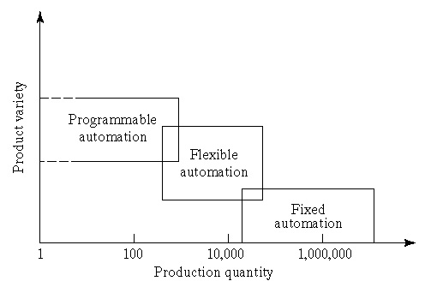
Product Variety and Production Quantity for Three Automation Types
Fig. 1.5

Slide 22
Computerized Manufacturing Support Systems
Objectives of automating the manufacturing support systems:
To reduce the amount of manual and clerical effort in product design, manufacturing planning and control, and the business functions
Integrates computer-aided design (CAD) and computer-aided manufacturing (CAM) in CAD/CAM
CIM includes CAD/CAM and the business functions of the firm

Slide 23
Reasons for Automating
To increase labor productivity
To reduce labor cost
To mitigate the effects of labor shortages
To reduce or remove routine manual and clerical tasks
To improve worker safety
To improve product quality
To reduce manufacturing lead time
To accomplish what cannot be done manually
To avoid the high cost of not automating

Slide 24
Manual Labor in Production Systems
Is there a place for manual labor in the modern production system?
  Answer: YES
Two aspects:
  Manual labor in factory operations
  Labor in manufacturing support systems

Slide 25
Manual Labor in Factory Operations
The long term trend is toward greater use of automated systems to substitute for manual labor
When is manual labor justified?
  Some countries have very low labor rates and automation cannot be justified
  Task is too technologically difficult to automate
  Short product life cycle
  Customized product requires human flexibility
  To cope with ups and downs in demand
  To reduce risk of product failure

Slide 26
Labor in Manufacturing Support Systems
Product designers who bring creativity to the design task
Manufacturing engineers who
  Design the production equipment and tooling
  And plan the production methods and routings
Equipment maintenance
Programming and computer operation
Engineering project work
Plant management

Slide 27
Automation Principles and Strategies
The USA Principle
Ten Strategies for Automation and Process Improvement
Automation Migration Strategy

Slide 28
U.S.A Principle
Understand the existing process
  Input/output analysis
  Value chain analysis
  Charting techniques and mathematical modeling
Simplify the process
  Reduce unnecessary steps and moves
Automate the process
  Ten strategies for automation and production systems
  Automation migration strategy

Slide 29
Ten Strategies for Automation and Process Improvement
Specialization of operations
Combined operations
Simultaneous operations
Integration of operations
Increased flexibility
Improved material handling and storage
On-line inspection
Process control and optimization
Plant operations control
Computer-integrated manufacturing

Slide 30
Automation Migration Strategy
For Introduction of New Products
Phase 1 – Manual production
  Single-station manned cells working independently
  Advantages: quick to set up, low-cost tooling
Phase 2 – Automated production
  Single-station automated cells operating independently
  As demand grows and automation can be justified
Phase 3 – Automated integrated production
  Multi-station system with serial operations and automated transfer of work units between stations

Slide 31
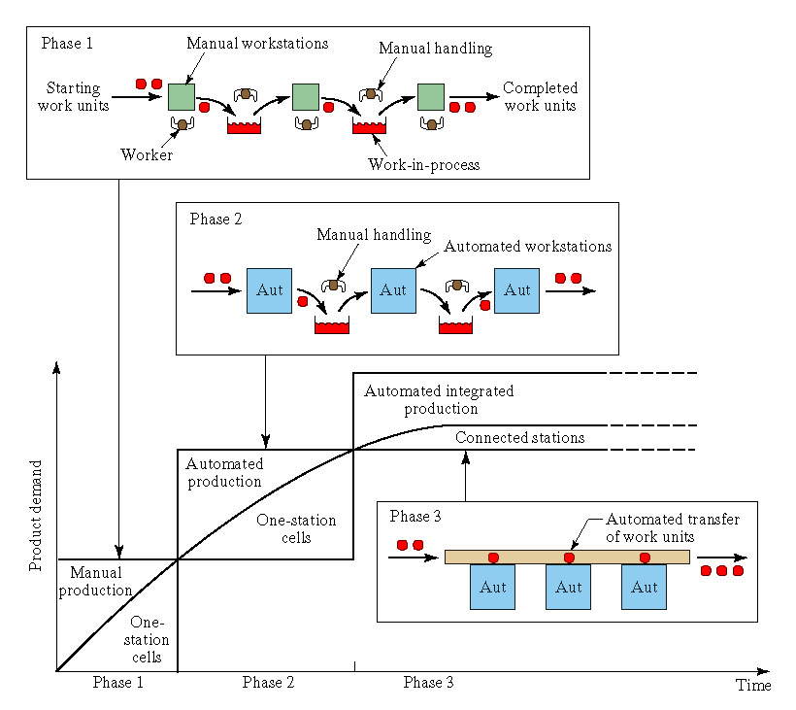
Automation Migration Strategy

Slide 32
Organization of the Book
Overview of Manufacturing
Automation and Control Technologies
Material Handling and Identification Technologies
Manufacturing Systems
Quality Control in Manufacturing Systems
Manufacturing Support Systems

Slide 33
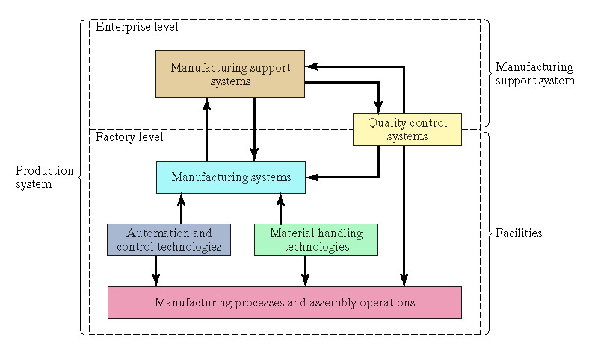
Organization of the Book
Fig.1.7

