Slide 1
Automation
Production Management
Name – Adhyyan Tripathi
Roll no -8
Reg no - 201700403

Slide 2
What is Automation in general ?
Automation is the technology by which a process, or a system operates with minimal or no human assistance.
Some of the application of automation which are currently being applied in the industries are –
Automatic climate control
Flat valve which automatically fills the tank upto a given level.

Slide 3
Manufacturing Systems
There are three technological ways in which new products can be manufactured –
Manual Technology
Mechanized Technology
Automated Technology

Slide 4
Manual Technology
A worker performing one or more tasks without the aid of powered tools, but sometimes using hand tools.
Manual Technology is the most primitive manufacturing system of production, but even today manual technology is quite appropriate because of its following advantages-
Low cost for low volume production
High scalability

Slide 5
Disadvantages of Manual Tech.
It is terribly expensive for high volume production.
Quality problem because of human error and process variation inherent in manual processes.
Longer production cycles.

Slide 6
Mechanized Technology
A worker operating with powered equipment.
Two types of machines – general purpose machines and special machines.
Special machines are used by the worker in mechanized technology to build general purpose machines.
Advantages of Mechanized Technology –
High Efficiency
Quality of Work
Low cost for high volume of production.

Slide 7
Disadvantages of Mechanized Tech.
Heavy Investment
No Power No Work
Break Down of Machine
Slaves of Machines
Noise and Space Problems

Slide 8
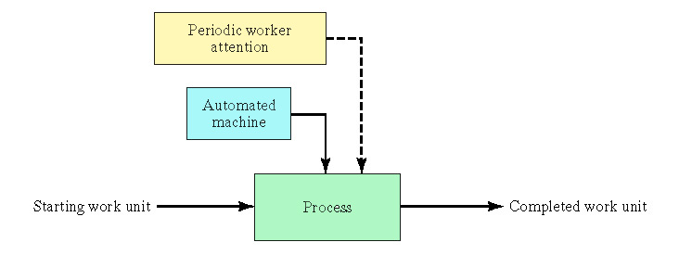
Automated Technology
A process performed by a machine without direct participation of a human.

Slide 9
Types of automated Tech.
Types of automation -
Hard automation – Production lines.
Programmable automation - Robotics and Numerically controlled machine.
Flexible Manufacturing Systems (FMS)
Computer Integrated Manufacturing (CIM)
Computer aided design and manufacturing system (CAD/CAM)

Slide 10
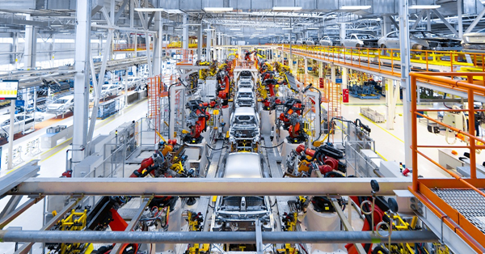
Production Lines
An automated production line consists of a series of workstations connected by a transfer system to move parts between the stations.
Example of this is automobile manufacturing.

Slide 11
Robotics
A robot is a programmable multifunctional manipulator designed to move material, parts, tools or specialized devices through programmed motions.
Advantages of Robots are-
It can even work in harsh conditions.
Can work for long hours without rest breaks.
An average robot costs $6 to $8 per hour where as an average worker is paid more than $ 26 per hour.

Slide 12
Applications of Robots
Assembling high explosive shells in government arsenals.
picking up hot steel rods and placing them in presses.
Handling radioactive rods in nuclear power plants and other nuclear applications.

Slide 13
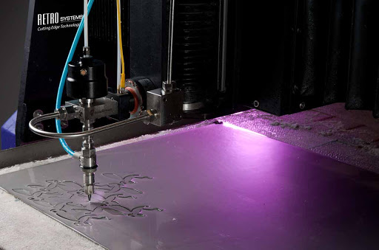
Numerically Controlled (NC) Machines
When position and paths of tools are under the control of a digital computer.
When two dimensions are controlled we have position control.
When three dimensions are
controlled we have contour
control.

Slide 14
Flexible Manufacturing Systems (FMS)
Flexible manufacturing systems combine NC machines in flexible system of production.
The concept of flexible manufacturing was developed by, an American industrial engineer.
Original design was a robot-based system that could weld, rivet, convey, and inspect manufactured goods.

Slide 15
Computer aided design and manufacturing
CAD/CAM stores, processes, and displays large amount of data.
CAD/CAM automates both designing as well as manufacturing procedures.
Computer-aided design –
Uses computer systems for creating, modifying, analyzing, and optimizing the design.
Computer-aided manufacturing –
Assist in the planning and controlling.

Slide 16
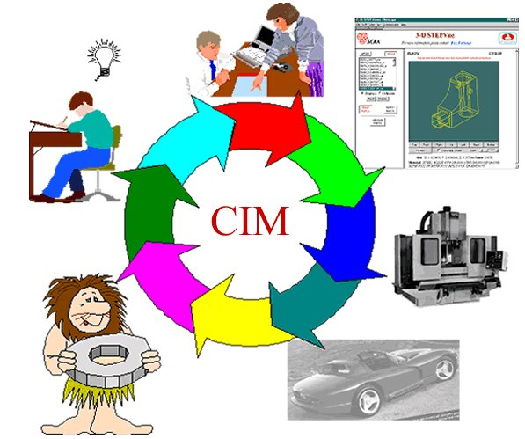
Computer-integrated manufacturing
Computer-integrated manufacturing is a high level automation which includes CAD/CAM and the business functions of the firm as well.

Slide 17
Real World Scenario
Seiko has developed a system for the automatic assembly of watches in which no human input to the assembly process is required.
FANUC (fa-nick), a Japanese robotics company, has been operating as a lights-out factory since 2001.
In the Netherlands, Philips uses lights-out manufacturing to produce electric razors

Slide 18
Thank You !!

