Slide 1

Good Tech Scholars Program
DIGITAL TRANSFORMATION FOR SOCIAL CHANGE
Make technology more accessible for the elderly
BY
Adithya T S
Amrita J
Anjana Anil
Anusha Nair
Rimitha Shajahan
LBS Institute of Technology for Women
Trivandrum, Kerala
1st OCT,2021
…
Oct 2021

Slide 2
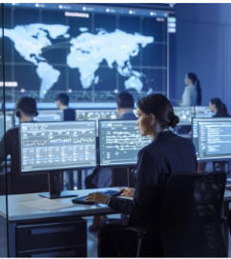


TABLE OF CONTENTS
Problem Statement and relevance
Architecture
Demo

Slide 3


PROBLEM STATEMENT AND RELEVANCE
CONTEXT
PROBLEM SUMMARY
OUTCOMES
IMPACT
To address readability issues related to elderly population while using e-payment apps.
To overcome the problems associated with standing in long queues for making payments.
Increased dependency on youngsters and adoloscents for making payments.
Small font size and icon size.
Background contrast unsuitable for the eyes of elderly population.
No proper guidance for making e-payment.
Chatbot for easy payment of electricity bills
Guidance provided for making e-payment through easily understandable demo.
User-Interface suitable for the elderly population to use e-payment apps.
Using this e-payment application the elderly population will find it easier to pay electricity bills online .
Less effort and faster payment.
Provide independency in paying electricity bills.
Notes:
Revision 1 (20/09/21:09:30AM): <ANBU>
1. Hands-on experience lets them develop industry/pro skills. And opportunity is already mentioned in the sub-title – hence removed.
2. Additional Info to be used as talking points: The UN had the following Sustainable Development Goals to achieve by 2030 – we can mention a few if required: (1) No Poverty, (2) Zero Hunger, (3) Good Health and Well-being, (4) Quality Education, (5) Gender Equality, (6) Clean Water and Sanitation, (7) Affordable and Clean Energy, (8) Decent Work and Economic Growth, (9) Industry, Innovation and Infrastructure, (10) Reducing Inequality, (11) Sustainable Cities and Communities, (12) Responsible Consumption and Production, (13) Climate Action, (14) Life Below Water, (15) Life On Land, (16) Peace, Justice, and Strong Institutions, (17) Partnerships for the Goals.
</ANBU>

Slide 4
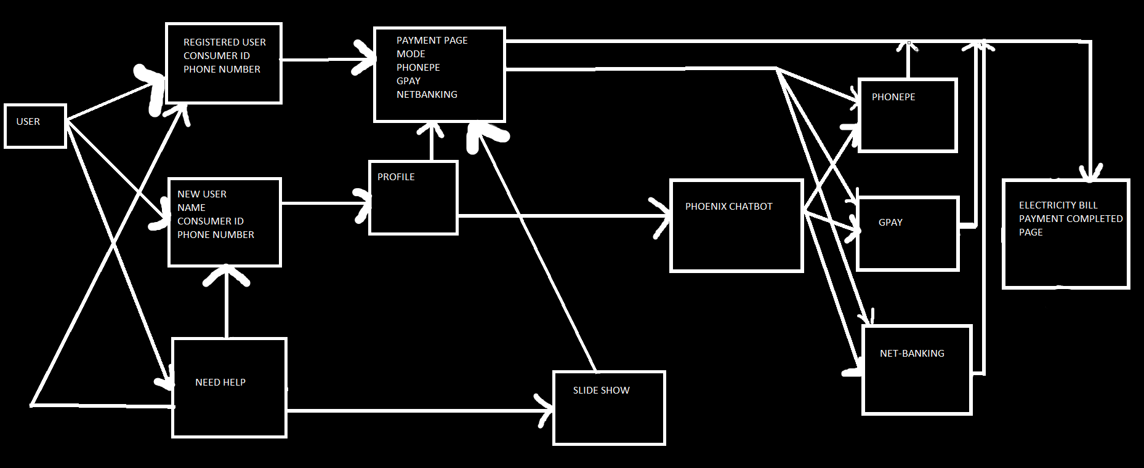
ARCHITECTURE

Slide 5
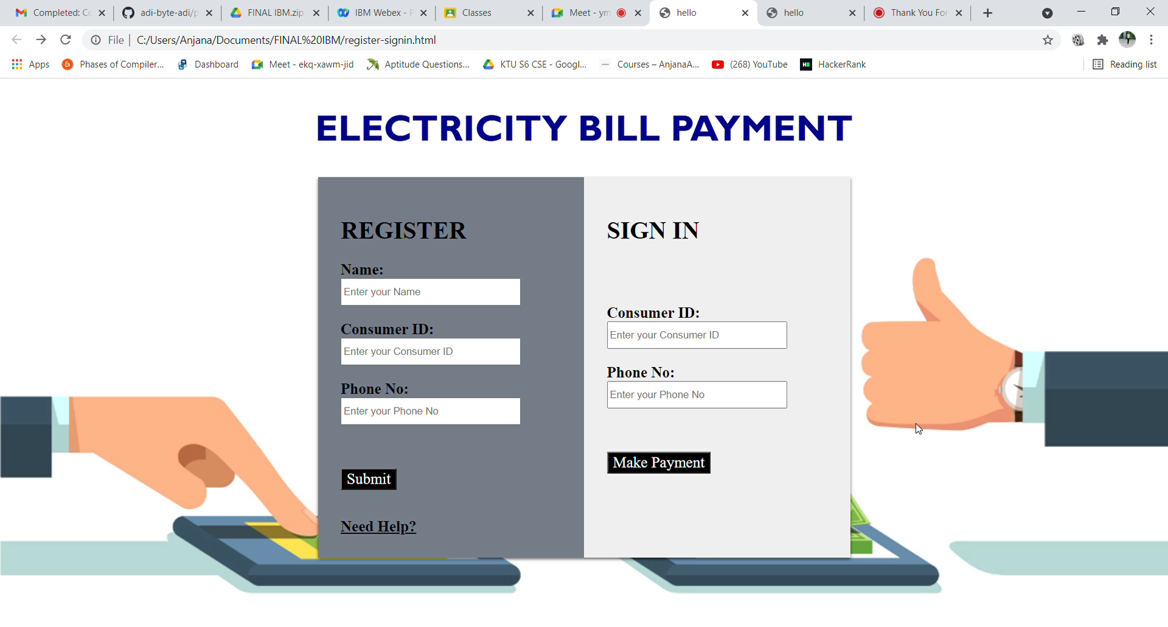
DEMO

