Slide 1
National Institute of Technology Patna​
IMPLEMENTATION
OF
VANET
Presented By​
​
1.Abhay Kumar Chaurasiya (1906081)​
2.Aditya Gupta​ (1906082)
3.Rabin Gaurav Mandal​ (1906083)
Guided By​
Dr. Bhaskar Mondal​
https://github.com/adi-g15/minor-project-veins-1
Date: 29 April 2022​

Slide 2
INTRODUCTION
VANET is the spontaneous creation of a wireless network of mobile devices – to the domain of vehicles.
VANETs were first mentioned and introduced in 2001 under car-to-car ad-hoc mobile communication and
networking" applications.
VANETs are referred as Intelligent Transportation Networks.
Short range radio technologies like WLAN, or cellular technologies or LTE
can be used for VANET.
Research in VANETs started as early as 2000, in universities and research labs, having evolved from
researchers working on wireless ad hoc networks.

Slide 3
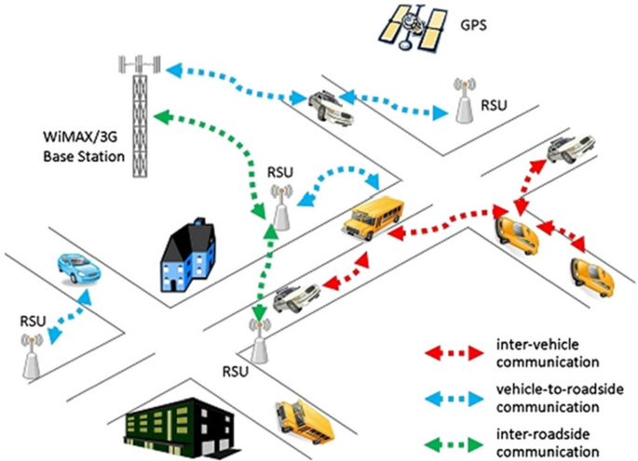
OVERVIEW OF VANET
Fig.1 Vehicular Adhoc Network Overview

Slide 4
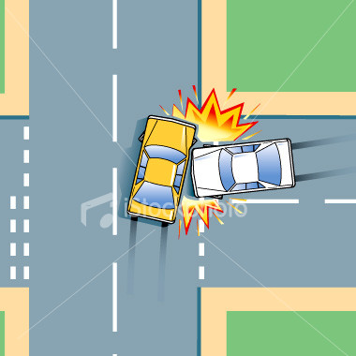
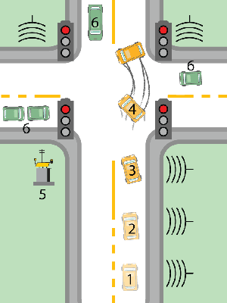
Traffic and Road Conditions

Slide 5
REQUIREMENT OF VANET
The VANET can provide
Safety
Efficiency
Traffic and road conditions
Road signal alarm
Local information

Slide 6
APPLICATION
VANETs support a wide range of applications – from simple one hop information dissemination of,
to multi-hop dissemination of messages over vast distances. Most of the concerns of interest to
mobile ad hoc networks (MANETs).
Some Examples are
Platooning - allows vehicles to closely (down to a few inches) follow a leading vehicle by wirelessly
receiving acceleration and steering information
Electronic brake lights - allow a driver to react to vehicles braking even though they might be
obscured
Road Transportation Emergency Services - used to reduce delays and speed up emergency rescue
operations

Slide 7
TOOLS AND TECHNOLOGIES USED IN OUR PROJECT
SUMO (Simulation of Urban Mobility)
OMNet++
INET (Framework)
Veins (Framework)

Slide 8
SUMO
Simulation of Urban MObility(SUMO) is an open source, highly portable,
microscopic and continuous traffic simulation package designed to handle large
Networks.
It can simulate complex road networks: each vehicle has its own route,
and moves individually through the network. Simulations are deterministic
by default but there are various options for introducing randomness.
FEATURES
Simulation
Space-continuous and time-discrete vehicle movement
Interoperability with other application at run-time
A fast openGL graphical user interface

Slide 9
Network Import
Imports VISUM, Vissim, Shapefiles, OSM, RoboCup, MATsim, OpenDRIVE, and XML-Descriptions
Missing values are determined via heuristics
Routing
Microscopic routes - each vehicle has an own one
Different Dynamic User Assignment algorithms
VERSION USED
SUMO 1.12.0

Slide 10
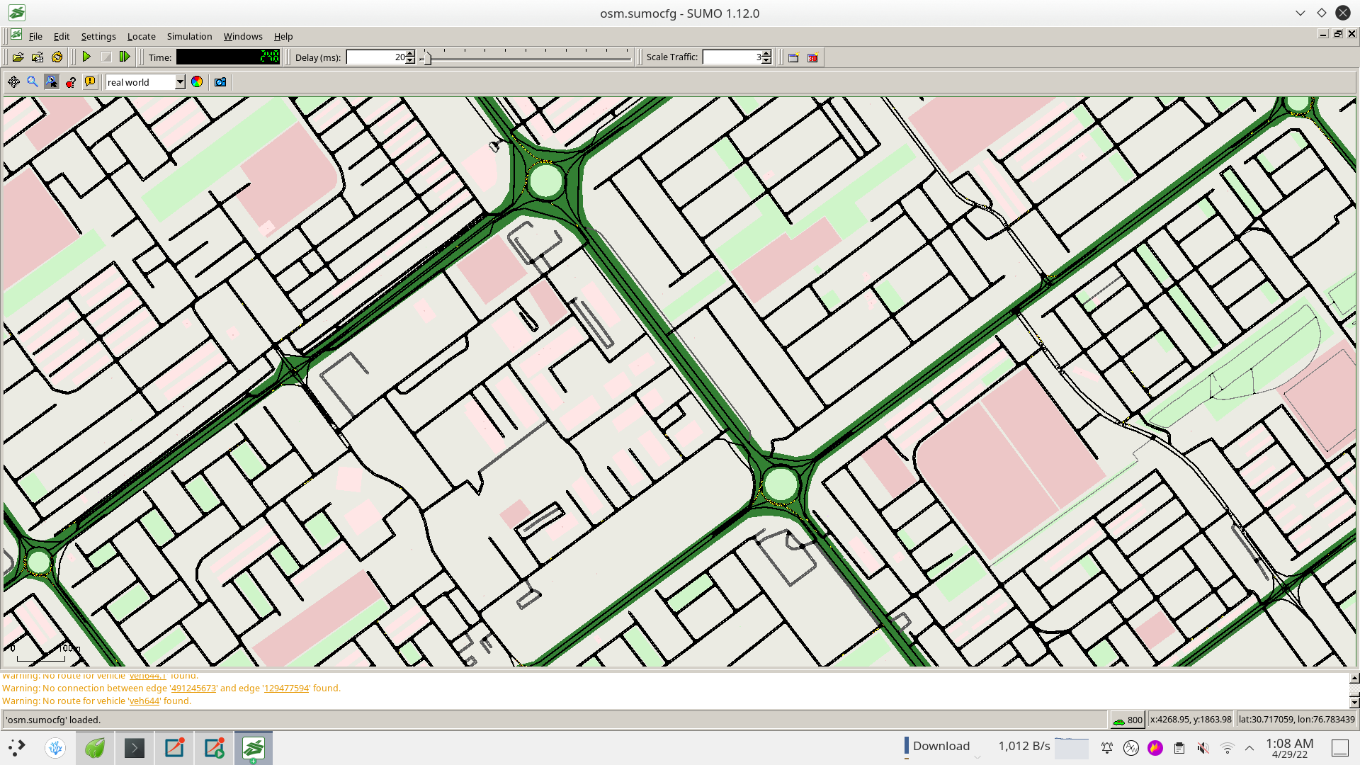

Slide 11
Omnet
OMNeT++ is an extensible, modular, component-based C++ simulation library
and framework,primarily for building network simulators.
Most of computer network simulation models are available in several
external frameworks.Most commonly used framework is INET.
Provides domain specific functionality such as modelling of wired and wireless
networks, Protocol modelling, validating of hardware architectures, etc.
VERSION USED
OMNet++ 6.0

Slide 12
INET
INET Framework is an open-source model library for the OMNeT++ simulation environment.
INET supports a wide class of communication networks, including wired, wireless, mobile, ad
hoc and sensor networks. It contains models for the Internet stack (TCP, UDP, IPv4, IPv6,
OSPF, BGP, etc.)
INET heavily builds upon the modular architecture of OMNeT++
VERSION USED
INET 4.3.7

Slide 13
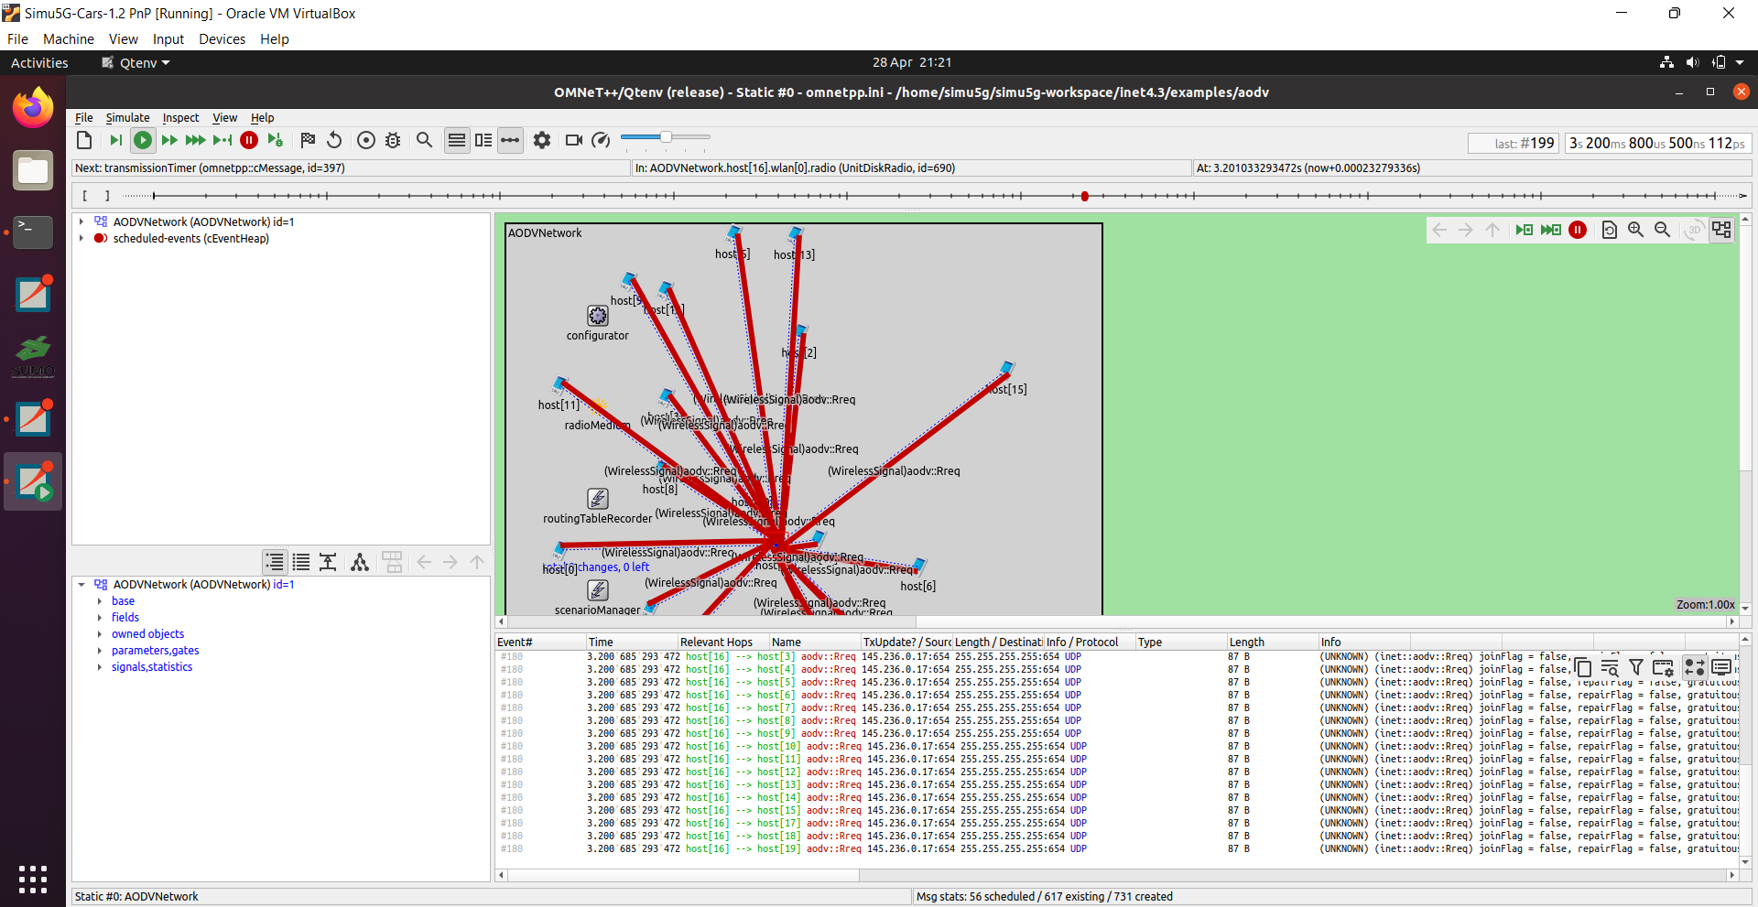

Slide 14
CHALLENGES IN IMPLEMENTING VANET
SECURITY CHALLENGES
There are a numbers of possible attacks in VANETs. The purpose of these attacks is to create problem
for users to access the system or phishing some information
QUALITY OF SERVICE(QOS)
QoS support over VANETs remains a challenge when current routing paths become no longer available
as a result of changes in node velocity, node positioning, network topology or distance between
vehicular nodes.
EFFICIENT ROUTING
In VANET, efficient routing algorithm means a routing scheme with minimum delay, maximum system
capacity and less computational complexity. In VANETs, due to the dynamic nature of mobile nodes,
searching and saving routes is a challenging task.
TECHNICAL CHALLENGE
Network Management, Congestion and collision control, Environmental Impact

Slide 15
Veins
Veins is an open source framework for running vehicular network simulations.
It extends these to offer a comprehensive suite of models for simulation.
It is based on two simulators: OMNeT++, and SUMO.
VERSION USED
Veins 5.2

Slide 16
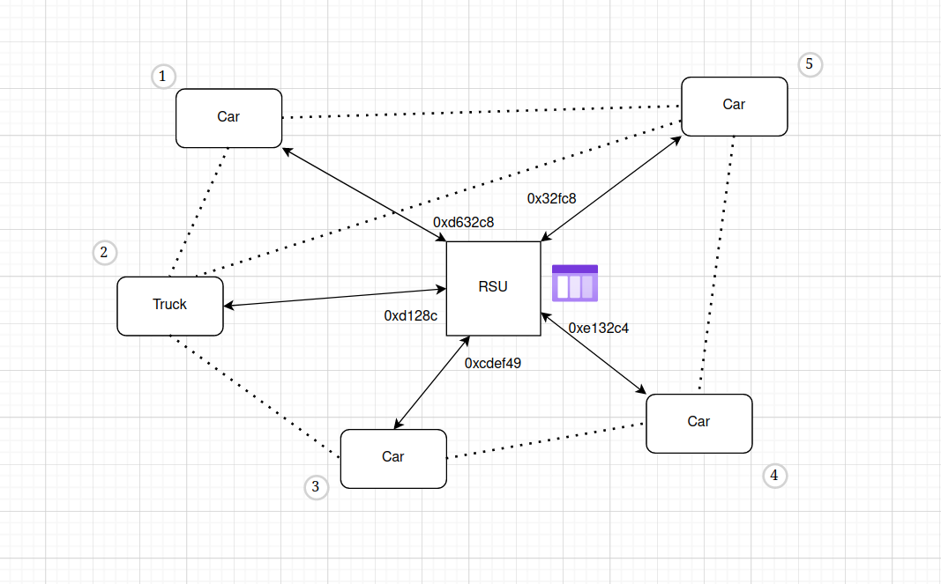

Slide 17
FUTURE SCOPE
As mobiles are familiar and used by us in our day to day life, similarly the future of VANETs is undoubtedly
secure. It has become the part of the government projects.
In our country, National Highways Authority of India
(NHAI) [12] is planning to replace manual toll collections at plazas with electronic toll collection (ETC)
systems across the country. The ETC system will be based on radio frequency identification (RFID),
which will be complemented by a wireless on-board unit (OBU) on a vehicle, as well as a stationery roadside
unit (RSU) at the toll plaza.

Slide 18
REFERENCES
Vehicular Ad-Hoc Networks – A Brief Knowledge, Sandeep N. Kugali, Sneha Kadadevar, 2020
Vehicular Ad-Hoc Networks (VANETs) - An Overview and Challenges; Journal of Wireless Networking and
Communications 2013
“A Location-Based Routing Algorithm for Vehicle to Vehicle
Communication,” R. A. Santos, R. M. Edwards, and L. N. Seed, vol. 00, no. C, pp. 221–226, 2004
NOW -Network on Wheels , http://www.network-on-wheels.de/, 2008,[Online; accessed 20-M ay-2013]

Slide 19
Thanks!
Github: https://github.com/adi-g15/minor-project-veins-1

