Slide 1
Multifaceted Collaborative Filtering Model
SMAI CSE 471
Spring 2019
Dr. Ravi Kiran Sarvadevabhatla
Team Name: Team Houdini (33)
Mentor: Nikhil Gogate
Notes:
Be specific and direct in the title. Use the subtitle to give the specific context of the speech.
-The goal should be to capture the audience’s attention which can be done with a quote, a startling statistic, or fact. It is not necessary to include this attention getter on the slide.

Slide 2
Outline
Problem Statement
What are Recommender Systems ?
Motivation
Dataset
Models
Neighborhood Model
SVD++ Model
Integrated Model
Results
Challenges and Limitations
Notes:
Use the background points to post details that are not common knowledge, or that the audience will need to understand the context of the speech.
-Do not read these main points from the PowerPoint, instead elaborate on these points during the speech.

Slide 3
Problem Statement
To use collaborative filtering techniques to apply on Movie dataset that recommends the movies for users based on the reviews and past data.
Implement baseline CF models
Neighborhood model
SVD++ model
Improve them using technique that integrates the two models.
Notes:
Use the background points to post details that are not common knowledge, or that the audience will need to understand the context of the speech.
-Do not read these main points from the PowerPoint, instead elaborate on these points during the speech.

Slide 4
What are Recommender Systems ?
Information filtering system that seeks to predict the "rating" or "preference" a user would give to an item.
Two main types of Recommender Systems:
Content based
Collaborative Filtering
Neighborhood Model
SVD++(Latent Factor Model)
Used in variety of areas:
Video and music recommenders (Netflix, YouTube, Spotify)
Product recommenders (Amazon, Myntra)
Notes:
Use the background points to post details that are not common knowledge, or that the audience will need to understand the context of the speech.
-Do not read these main points from the PowerPoint, instead elaborate on these points during the speech.

Slide 5
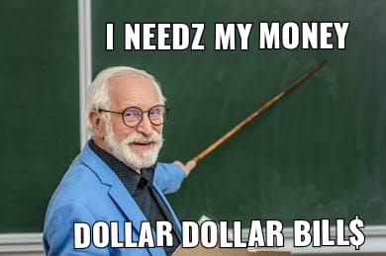
Motivation
Enhancing user satisfaction and loyalty by matching consumers with appropriate products.
Netflix Prize - Open competition for best CF algorithm to predict user rating for films.
“We need to go win a million dollars”
Notes:
Use the background points to post details that are not common knowledge, or that the audience will need to understand the context of the speech.
-Do not read these main points from the PowerPoint, instead elaborate on these points during the speech.

Slide 6
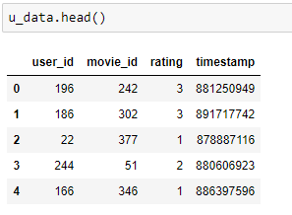
Dataset
MovieLens 100k data.
Collected by the GroupLens Research Project at the University of Minnesota.
100,000 ratings (1-5) from 943 users on 1682 movies.
Each user has rated at least 20 movies.
Fig1 : Dataset entries
Notes:
Use the background points to post details that are not common knowledge, or that the audience will need to understand the context of the speech.
-Do not read these main points from the PowerPoint, instead elaborate on these points during the speech.

Slide 7
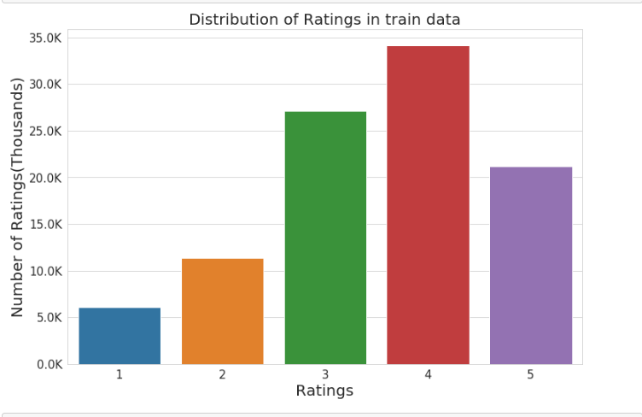
Dataset - EDA
Fig2 : Rating Distribution v/s Number of Ratings
Notes:
Use the background points to post details that are not common knowledge, or that the audience will need to understand the context of the speech.
-Do not read these main points from the PowerPoint, instead elaborate on these points during the speech.

Slide 8
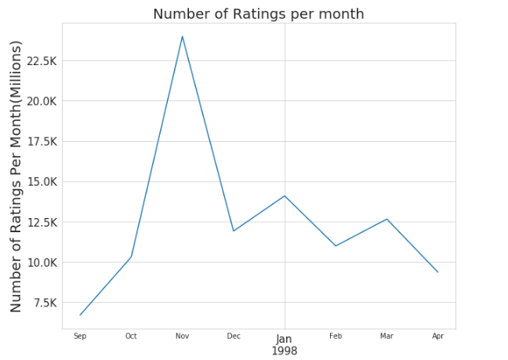
Dataset - EDA
Fig3 : Rating Distribution
Notes:
Use the background points to post details that are not common knowledge, or that the audience will need to understand the context of the speech.
-Do not read these main points from the PowerPoint, instead elaborate on these points during the speech.

Slide 9
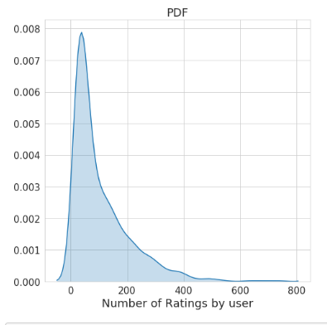
Dataset - EDA
Fig4 : PDF of Number of Ratings by user
PDF graph shows that almost all of the users give very few ratings. There are very few users who's ratings count is high.
Notes:
Use the background points to post details that are not common knowledge, or that the audience will need to understand the context of the speech.
-Do not read these main points from the PowerPoint, instead elaborate on these points during the speech.

Slide 10
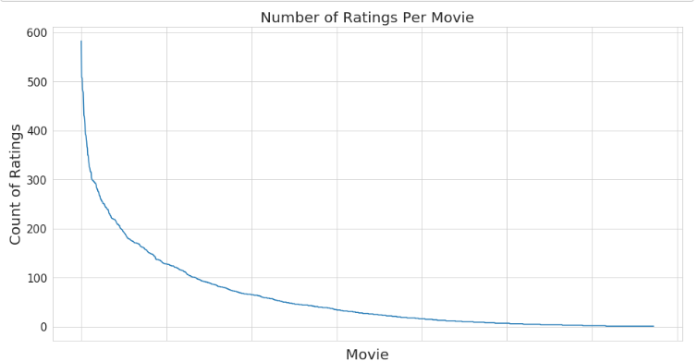
Dataset - EDA
Fig5 : Number of Ratings per Movie
Some movies are very popular and rated by many users vs other movies.
Notes:
Use the background points to post details that are not common knowledge, or that the audience will need to understand the context of the speech.
-Do not read these main points from the PowerPoint, instead elaborate on these points during the speech.

Slide 11
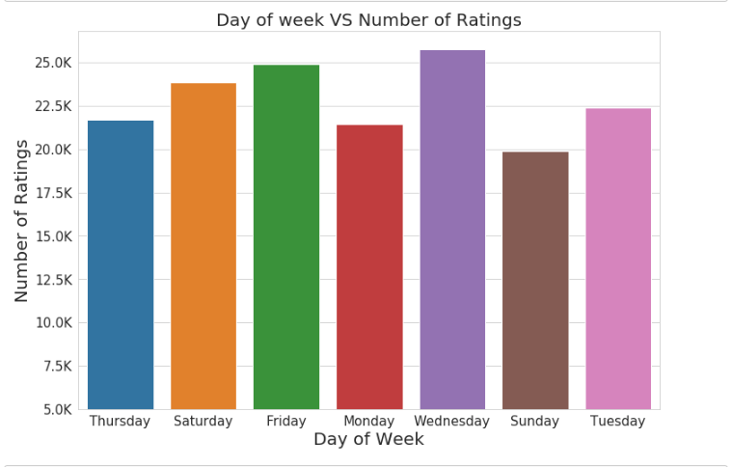
Dataset - EDA
Fig6 : Day of Week v/s Number of Ratings
Notes:
Use the background points to post details that are not common knowledge, or that the audience will need to understand the context of the speech.
-Do not read these main points from the PowerPoint, instead elaborate on these points during the speech.

Slide 12

Baseline estimate
Baseline estimate for predicting rating for movie i by user u (b_{ui})
User bias (b_{u})
Item bias (b_{i})
Rating by user u for item i (r_{ui}).
Implicit feedback (N(u)) contains all items for which implicit preference was provided by user u.)
Notes:
Use the background points to post details that are not common knowledge, or that the audience will need to understand the context of the speech.
-Do not read these main points from the PowerPoint, instead elaborate on these points during the speech.

Slide 13

SVD and SVD++ model
Matrix factorization is a class of collaborative filtering algorithms.
A popular approach to latent factor models is induced by an SVD-like lower rank decomposition of the ratings matrix.
Each user u is associated with a user-factors vector p_{u} ∈ R_{f} , and each item i with an item-factors vector q_{i} ∈ R_{f} .
Prediction is done by the rule:
This is the SVD model. An improvement to this model is Asymmetric SVD which uses implicit feedback.
As we do not really have much independent implicit feedback for the our ml-100k dataset, so we turn towards an improved model.
Notes:
Use the background points to post details that are not common knowledge, or that the audience will need to understand the context of the speech.
-Do not read these main points from the PowerPoint, instead elaborate on these points during the speech.

Slide 14

SVD and SVD++ model
Its results are more accurate than all previously published methods on the Netflix data and other similar movie datasets which struggles with the same implicit feedback limitation.
SVD++ model :
Notes:
Use the background points to post details that are not common knowledge, or that the audience will need to understand the context of the speech.
-Do not read these main points from the PowerPoint, instead elaborate on these points during the speech.

Slide 15

Neighborhood model
User oriented CF system.
Estimate unknown ratings based on recorded ratings of like minded users.
Improved Neighborhood model as described by the equation :
Notes:
Use the background points to post details that are not common knowledge, or that the audience will need to understand the context of the speech.
-Do not read these main points from the PowerPoint, instead elaborate on these points during the speech.

Slide 16

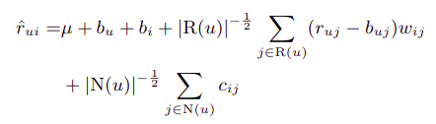
Neighborhood model
We can use implicit feedback, which provide an alternative way to learn user preferences. To this end, we add another set of weights, and rewrite the previous equation :
Final Model :
Notes:
Use the background points to post details that are not common knowledge, or that the audience will need to understand the context of the speech.
-Do not read these main points from the PowerPoint, instead elaborate on these points during the speech.

Slide 17
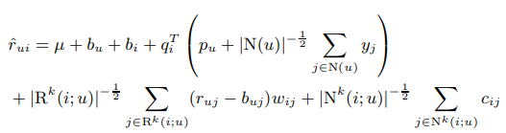
Integrated model
A combined model which will sum the predictions of previously defined neighborhood and SVD++ model.
Notes:
Use the background points to post details that are not common knowledge, or that the audience will need to understand the context of the speech.
-Do not read these main points from the PowerPoint, instead elaborate on these points during the speech.

Slide 18
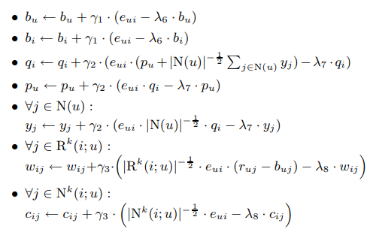
Integrated model
Backprop for Integrated model :
Notes:
Use the background points to post details that are not common knowledge, or that the audience will need to understand the context of the speech.
-Do not read these main points from the PowerPoint, instead elaborate on these points during the speech.

Slide 19
Implementation Insights
We've implemented all three models mentioned
Neighborhood Model
SVD++ Model
Integrated Model
Datasets was around 99% sparse, so we used Sparse Matrix (CSR format) instead of Dense Matrix.
One assumption made was that every user who have watched the movie has rated it.
Number of Latent factors for user and item used were 20 and Epoch count was 30
Notes:
Use the background points to post details that are not common knowledge, or that the audience will need to understand the context of the speech.
-Do not read these main points from the PowerPoint, instead elaborate on these points during the speech.

Slide 20
Implementation Insights
Parameters used :
Meta parameters: γ1 = γ2 = 0.007, γ3 = 0.001, λ6 = 0.005, λ7 = λ8 = 0.015.
We decrease step sizes (the γ’s) by a factor of 0.9 after each iteration.
All results are measured for Epochs of 30.
Epoch time for running the models on Kaggle were :
Neighborhood Model : 1.312 mins
SVD++ model : 2.45 mins
Integrated model : 4.54 mins
Notes:
Use the background points to post details that are not common knowledge, or that the audience will need to understand the context of the speech.
-Do not read these main points from the PowerPoint, instead elaborate on these points during the speech.

Slide 21
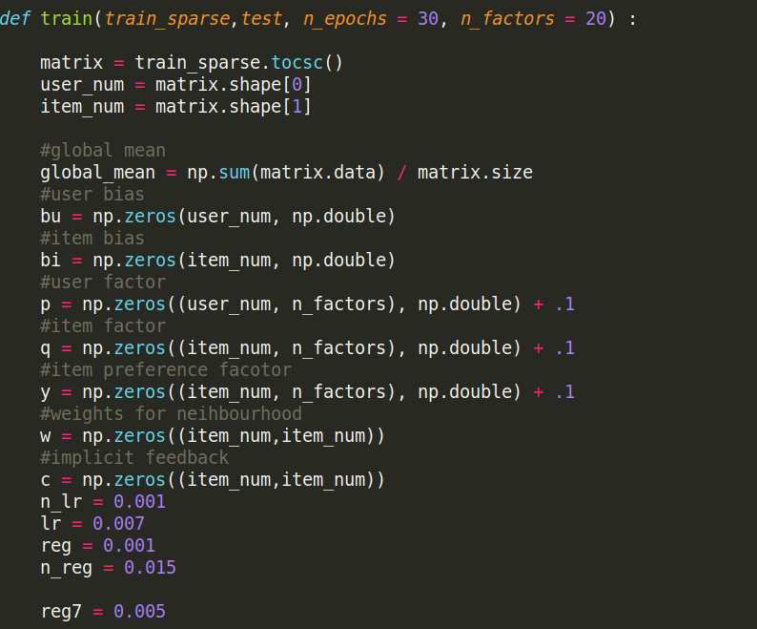
Implementation Insights
Initialization of Parameters
Notes:
Use the background points to post details that are not common knowledge, or that the audience will need to understand the context of the speech.
-Do not read these main points from the PowerPoint, instead elaborate on these points during the speech.

Slide 22
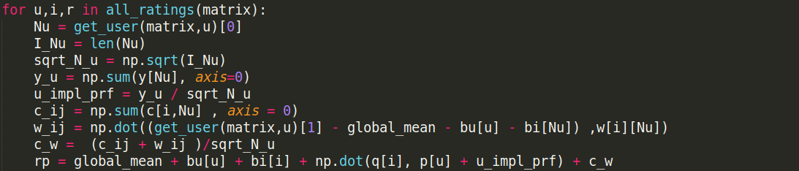
Implementation Insights
Forward Prop
Notes:
Use the background points to post details that are not common knowledge, or that the audience will need to understand the context of the speech.
-Do not read these main points from the PowerPoint, instead elaborate on these points during the speech.

Slide 23
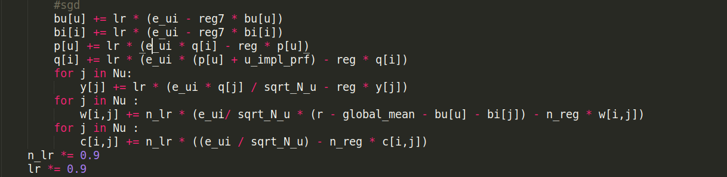
Implementation Insights
Backward Prop
Notes:
Use the background points to post details that are not common knowledge, or that the audience will need to understand the context of the speech.
-Do not read these main points from the PowerPoint, instead elaborate on these points during the speech.

Slide 24
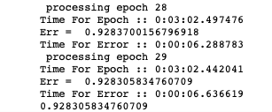

Results
RMSE Error (Integrated Model)
Neighborhood Model | SVD++ | Integrated Model
1.7757 | 0.941 | 0.9283
Error in RMSE (root mean square error)
Notes:
Use the background points to post details that are not common knowledge, or that the audience will need to understand the context of the speech.
-Do not read these main points from the PowerPoint, instead elaborate on these points during the speech.

Slide 25
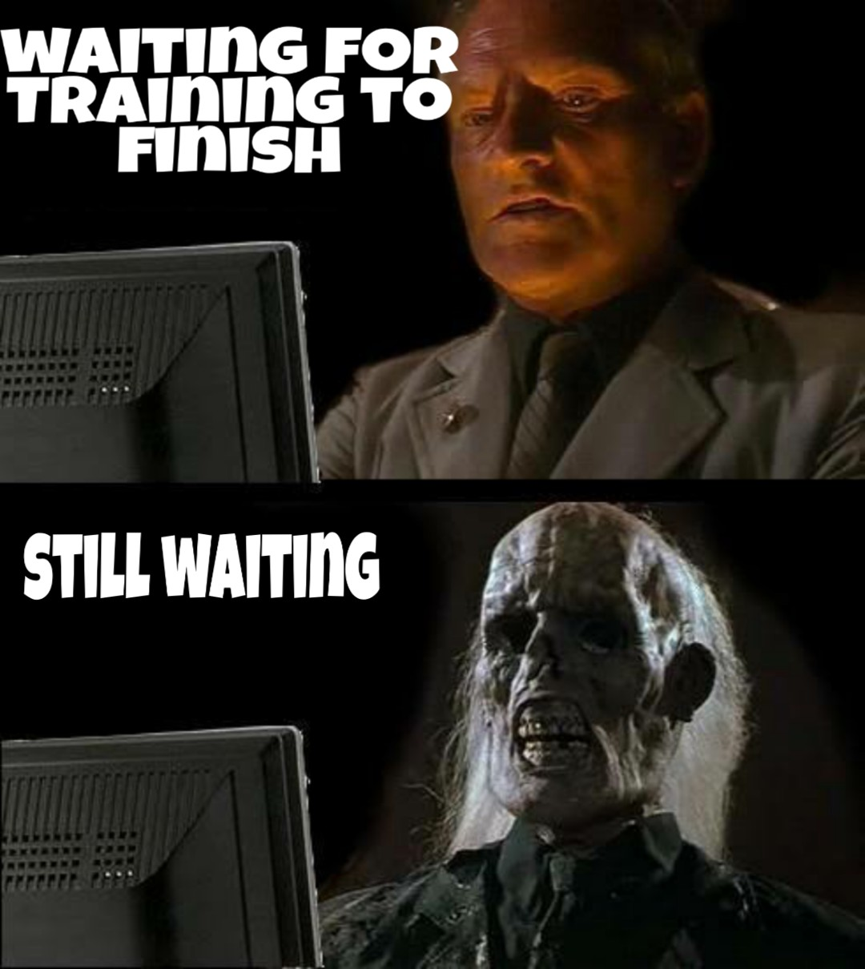
Limitations
Insufficient hardware support to run large dataset (Netflix dataset), even in CSR format.
Better sources needed for implicit feedback.
Data sparsity
Scalability
Cold Start is genuine problem for Recommender Models. It's relevant for both new users and new movies which the model encounters.
For our model :
If the { User , Movie } pair is new to the model, we predict the global mean of all the movies.
Notes:
Use the background points to post details that are not common knowledge, or that the audience will need to understand the context of the speech.
-Do not read these main points from the PowerPoint, instead elaborate on these points during the speech.

Slide 26
Thank you.
Thank You.
Notes:
The action step is what the audience is supposed to do or think about the topic. It should be one sentence that is written clearly and with much thought. It may also be the thesis statement restated as an action. The goal of this slide is to leave the audience with a clear message as to what they are to do or think at the end of the speech. It may be a good idea to end with a powerful quote or image.

