Slide 1
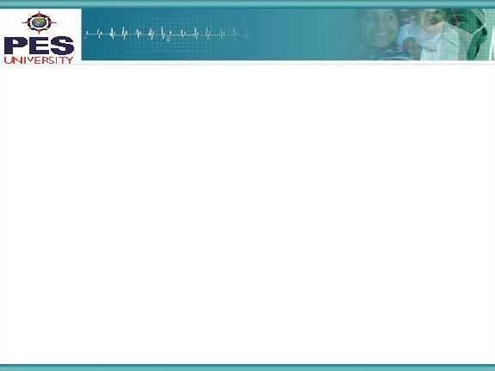



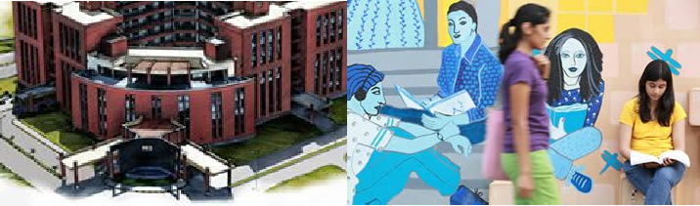

Project Presentation (Final - ESA)
Project Title :
MultiModal Sentiment Classification using Audio Video Feed
Project Team : Adithya Kiran PES1201700231
Chirag P Tubakad PES201700896
<number>

Slide 2
Project Abstract and Scope
Overview :
Sentiment analysis aims to automatically uncover the underlying attitude that we hold towards an entity.
The aggregation of these sentiments over a population represents opinion polling and has numerous applications.
Sentiment analysis from text is currently widely used for customer satisfaction assessment and brand perception analysis, among others.
With the proliferation of social media, multimodal sentiment analysis is set to bring new opportunities with the arrival of complementary data streams for improving and going beyond text-based sentiment analysis.
Since sentiment can be detected through affective traces it leaves, such as facial and vocal displays, multimodal sentiment analysis offers promising avenues for analysing facial and vocal expressions in addition to the transcript or textual content.
<number>

Slide 3
Project Scope -2
Multimodal Sentiment classification plays an important role in the advancement of virtual assistants through the application of natural language processing (NLP) and machine learning techniques.
By combining vocal modulations and facial expressions, it is possible to enrich the feature learning process to better understand affective states of opinion holders.
To predict the sentiments of customers, and subsequently create product or service recommendations.
In the healthcare domain, multimodal sentiment analysis can be utilized to detect certain medical conditions such as stress, anxiety, or depression
Can be applied in the development of different forms of recommendation systems such as in the analysis of user-generated videos of online movie reviews and general product reviews
3

Slide 4
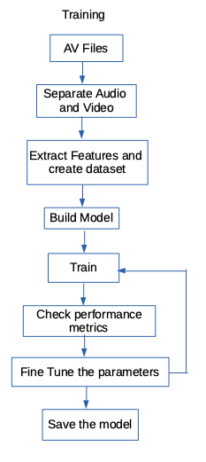
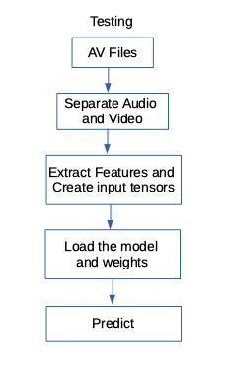
Solution Architecture
The general solution architecture is outlined in the flowchart depicted alongside
<number>

Slide 5
Solution-1
The solution we propose is to train a Deep Neural Network, that takes the frame by frame facial features, along with the audio features of the video, as input and classifies each frame into one of the eight emotions it has been trained on. Then we poll the results for all the frames, and declare the predicted emotion.
Feature Extraction :
The facial features are extracted from each from of the video using the HoG based facial landmarks detector, provided by the python dlib library.
Then we extraced Mel Frequency Cepstral Coefficients (MFCC) from the audio feed using librosa.
This was combined with the frame by frame facial landmarks, to create a massive dataset for the entire collection of videos.

Slide 6
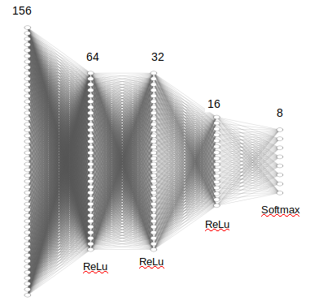

Solution-2
The Neural Network we use is a deep network with three hidden layers. The hidden layers have 64, 32 and 16 neurons each. For the hidden layers we use a ReLu activation.
For the final output layer we use the softmax activation for classification.
Activation functions:
ReLu : f(x) = max(0,x)
f’(x) = 0 or 1
Softmax :
Loss function: Cross Entropy

Slide 7

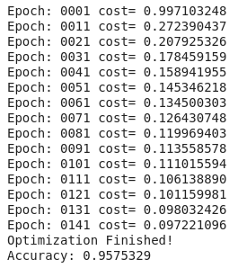
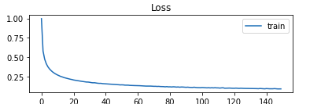
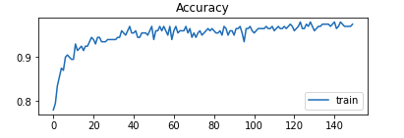
Solution-3
Initially we built binary classification(happy-sad) keras models, to test our method.
On obtaining successful results, we built a tensorflow binary classification model.
Once we were able to obtain successful results, we expanded it to predict all 8 emotions.
8 emotion classification tensorflow model :
The data was split as 70%-30% train-test split.
The training was done with a keep probability of 80%. (= 20% dropout) over 150 epochs.
The average accuracy over 10 training runs, on different randomized 70-30 train-test splits of the dataset, of the validation dataset was 92% for our final model. This seemed as promising results for sentiment classification.
Training snippet

Slide 8
Constraints, Assumptions & Dependencies
Constraints :
The lighting in the input/recorded videos should be good.
Video and audio quality is good.
The subject is situated at an appropriate distance from the camera so that all the facial landmarks are perceivable.
These are the camera parameters of the dataset :
Distance between camera and actor = 1.4 meters
Camera field of view = 0.5 meters
The dataset has only 2 statements : "Kids are talking by the door","Dogs are sitting by the door". So this model won’t work very well with other real world instances, where the vocabulary is much more vast. However, it serves as a proof of concept, that this method can be used, given that we train it on a sufficiently large and diverse dataset, as we see quite favorable and convincing results on the currently available data.
<number>

Slide 9
Future work plan
Future work on the project would be optimize the model in such a way that it would be relatively less intensive on the hardware.
As we know , processing videos is very computationally expensive and such models when deployed in real world scenarios will have to bare the brunt of huge workload and might not scale up well and another bottleneck would be the fact that not every machine the model being run on would have a GPU support for faster calculations.
We could also widen our vocabulary and, increase the dataset and train our model, to be able to handle all sorts of real world scenarios.
<number>

Slide 10
References
Ameya Rajendra Bhamare , Srinivas Katharguppe , Silviya Nancy J , “Deep Neural Networks for Lie Detection with Attention on Bio-signals”
Mohammad Soleymania , David Garciab , Brendan Jou , Björn Schuller , Shih-Fu Chang , Maja Pantic , “A survey of multimodal sentiment analysis”
Livingstone SR, Russo FA (2018) The Ryerson Audio-Visual Database of Emotional Speech and Song (RAVDESS): A dynamic, multimodal set of facial and vocal expressions in North American English. PLoS ONE 13(5): e0196391.
<number>

Slide 11
Thank You
<number>

