Slide 1
Introduction
OPI@LT-EDI-ACL2022: Detecting Signs of Depression from Social MediaText using RoBERTa Pre-trained Language Models.
By team: Detecting Signs of Depression from Social Media Text using Transformer-Based Language Models: A Solution to the LT-EDI-ACL2022 Shared Task
Millions of people all over the globe suffer from depression, a mental health disorder. Better results for patients can result from early diagnosis and treatment of depression. Examining social media text for indications of depression is one possible method for early detection. This study investigates the use of natural language processing methods to identify depressive symptoms in social media writing.
Aditya Milind Limbekar (G01384408)
Stephen Simon Dias (G01387625)

Slide 2
There Are Three Steps
Dataset preprocessing: The authors stemmed, lemmatized, and removed stop words from the dataset. To expand the dataset, they also utilized a method known as data augmentation.
Fine-tuning pre-trained language models: The authors used their updated dataset to fine-tune multiple pre-trained language models, including BERT, RoBERTa, and XLNet.They identified that RoBERTa provided the best outcomes.
Ensemble averaging: To enhance the performance of numerous models, the authors combined their predictions using an ensemble averaging approach. They used this method to obtain a macro averaged F1-score of 0.583.

Slide 3
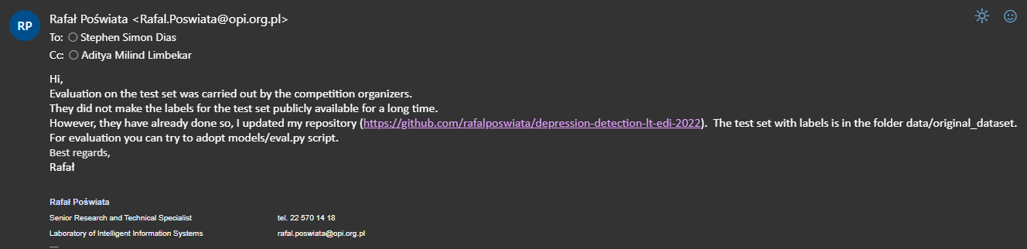
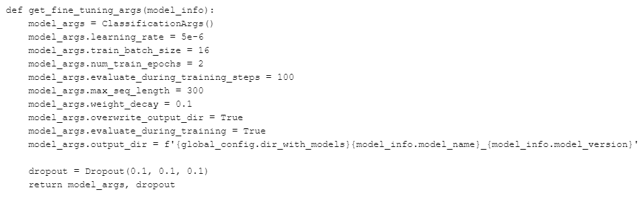
Approach
How Robustness
Data augmentation: Data augmentation is the process of creating new training data from existing data by using various transformations. One typical method, for instance, is to replicate real-world changes by adding noise to the incoming data.
Regularization: Regularization entails in- cluding a penalty term in the training loss function to prevent the model from becoming overfit to the training data. This can increase the resilience of the model and its capacity to generalize to new data.
Transfer learning: In transfer learning, a model is first learned for one task, and then a new task is subsequently trained using the previously trained model as a starting point.The robustness and generalizability of the model can both be enhanced by doing this.
Ensemble methods: To increase performance and robustness, ensemble techniques com- bine various models. One popular method, for instance, is to train several models using various topologies or hyperparameters, then integrate the results to generate predictions.
The use of transformers in neural network design enables efficient processing of sequential data such as text. This is achieved through self-attention processes that recognize long-range relationships and contextual information. Pre-training involves training a language model on a huge corpus of text data to teach it general linguistic traits.
This enables the model to be fine-tuned on a specific task using less data. Masked Language Modeling (MLM) is a pre-training task used in BERT and RoBERTa models. It involves randomly masking certain tokens in a phrase and teaching the model to predict the missing words, improving its understanding of how words relate to each other in different situations.
The RoBERTa model's pre-processing stage uses the SentencePiece subword tokenization library to better handle terms that are not part of the model's lexicon. Byte Pair Encoding (BPE) is used to encode text data into a fixed-length form, dividing words into subwords. Multi-task Learning (MTL) is a training method that teaches a single model to carry out several tasks simultaneously. RoBERTa uses various pre-training tasks, including MLM and Next Sentence Prediction (NSP), to recognize broad language characteristics.
The experiment was carried out using a transformer-based language model technique developed by the authors. They adjusted three models—BERT, RoBERTa, and XLNet—and discovered that RoBERTa big produced the best outcomes. Then, using the provided corpus, they trained DepRoBERTa (RoBERTa for Depression Detection), their own language model. The outcomes of this model were enhanced through fine-tuning. The third option was ensemble av- eraging, which utilized averaging to integrate the predictions of the DepRoBERTa and RoBERTa big models. The dataset was also duplicate-free and the classes were balanced as part of the authors’ preprocessing. To divide the dataset into training, validation, and test sets, they employed stratified sampling.

Slide 4
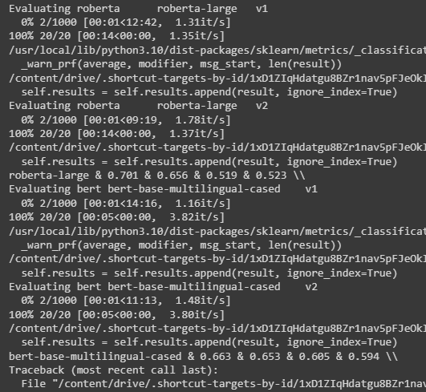
Experiments
Sample size: The study's sample size must be sufficient to guarantee that the results are both statistically significant and representative of the target population. The sample size will be considered in a robust analysis, and estimates will be provided with confidence intervals.
Data quality: The reliability of the conclusions depends heavily on the caliber of the data used in the analysis. The data should be gathered using trustworthy and legitimate tools and techniques, and any incorrect or missing data should be dealt with appropriately.
Statistical methods: The research topic and the data should be suitable for the statistical techniques employed in the study. The methodologies must be thoroughly tested and resistant to outliers and other bias-causing factors.
Model assumptions: The underlying assumptions for the statistical models that were employed in the study should be thoroughly examined and met. These presumptions can be broken, resulting in inaccurate estimations and conclusions.
Sensitivity analysis: A thorough study should incorporate sensitivity testing to determine how well the results hold up to various modeling options, premises, and specifications. This will make it possible to guarantee that the outcomes are independent of any specific modeling choice.
Replication: A reliable study should be able to be repeated by others, which calls for the methods and data to be well-documented and accessible. This will make sure that the results are not the result of data tampering or chance.
There are four ways to create multilingual checklists:
Automated strategy: This involves using translated examples of a source language checklist to automatically extract templates in a target language using the Template Extraction Algorithm (TEA).
Semi-automatic approach: In this method, the templates generated by TEA are reviewed and corrected by human annotators.
Manual method - Translation (t9n): In this method, annotators translate English checklists into the target language to create the checklists.
Manual technique - Scratch (SCR): Using this method, annotators build checklists from scratch by describing the job and available resources. This method is similar to how the first English checklist was created as described in Ribeiro et al., 2020.

Slide 5
Related work
Wolohan et al.’s (2018) paper, ”Detecting Linguistic Traces of Depression in Topic-Restricted Text: Attending to Self Stigmatized Depression with NLP”: The research presented here suggests a strategy for identifying depressive symptoms in topic restricted material using natural language processing methods. To categorize text as depressed or not depressed, the authors utilize a combination of linguistic variables and machine learning methods.
William and Suhartono’s article, ”Text-Based Depression Detection on Social Media Posts: A Systematic Literature Review,” published in 2021: This research presents a thorough evaluation of the literature on the identification of depressive symptoms in social media material. The authors examine numerous methodologies employed in earlier research, such as sentiment analysis, linguistic characteristics, and machine learning models.
Depression Detection from Social Media Text Using Long Short-Term Memory Networks, published in 2018 by Coppersmith et al: In this study, long short-term memory(LSTM) networks are suggested as a technique for identifying depressive symptoms in social media material. To train their algorithm, these researchers utilize a collection of tweets that have been assigned ratings for the degree of depression.
Detecting Depression with Audio-Visual Features and Deep Learning by Kaya et al.(2020): This work suggests a way for identifying depression symptoms using deep learning methods using audio-visual information. To train their algorithm, the scientists use a collection of recordings taken during clinical interviews.
Analysis of depression in social media texts through the Patient Health Questionnaire-9 and natural language processing(2022): In order to correlate textual data with the nine symptoms of depression included in the Patient Health Questionnaire-9 (PHQ-9) by using natural language processing (NLP) techniques, is the methodology employed in this work. According to these symptoms, the study categorized the phrases that social media users posted, and using the data, it determined how depressed the individuals were. The Hanyang University Institutional Review Board granted its ethical approval before the study’s five authors could begin working together on it.

Slide 6
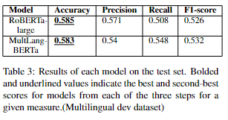
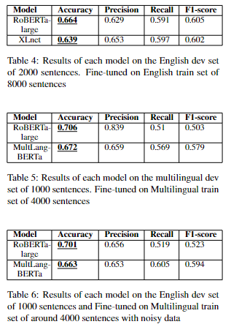
Conclusions
In this study, we aimed to improve the accuracy of sentiment classification on a multilingual dataset by fine-tuning pre-trained language models. The original paper had used an English-only dataset consisting of 8000 training sentences, which resulted in an accuracy of 0.664 for the Roberta Large model. We extended this dataset by filtering 4000 English sentences and translating them into three other languages: Hindi, Spanish, and German.
We used the Multilingual Bert and Roberta Large models for fine-tuning and created two dev datasets - English dev (1000 sentences) and Multilingual dev (1000 sentences). We also added some noisy data, negating some sentences and adding some more short sentences. We cleaned every dataset by removing duplicates and out-of-format data. Although adding noisy data slightly reduced the accuracy, it did not impact the results by more than 1%. We obtained an accuracy of 0.701 for the Roberta Large model and 0.663 for Multilingual Bert on the English dev dataset.
Furthermore, on the Multilingual dev 8 dataset, we achieved accuracies of 0.585 and 0.583 for Roberta Large and Multilingual Bert, respectively. Initially, we tried fine-tuning the XLNet and Roberta Large models, which resulted in accuracies of around 0.639 and 0.664, respectively, consistent with the original paper’s values. Our implementation of Multilingual Bert and creating a Multilingual train dataset resulted in a 4% improvement in accuracy compared to the original paper. We experimented with different values for batch size and learning rate, but the values mentioned in this paper gave us the best results.
Overall, our study suggests that fine-tuning multilingual language models on a diverse dataset could significantly improve the accuracy of sentiment classification for multilingual text.

Slide 7
Future work
Developing NLP-based tools to detect early signs of depression: Early detection of depression is crucial for effective treatment. Future research could focus on developing NLP-based tools that can detect early signs of depression by analyzing written or spoken language patterns.
Exploring the role of NLP in suicide prevention: Suicide is a serious concern among individuals with depression. Future research could focus on exploring the potential of NLP in suicide prevention by analyzing language patterns associated with suicidal ideation and behavior.
Studying the impact of cultural and linguistic differences on NLP-based depression analysis: Language use and expressions of emotions vary across cultures and languages. Future research could focus on studying the impact of cultural and linguistic differences on NLP-based depression analysis and developing tools that are sensitive to such differences.
Developing personalized NLP-based therapies for depression: Depression is a complex and heterogeneous disorder that requires personalized treatment. Future research could focus on developing personalized NLP-based therapies that are tailored to the unique needs and characteristics of each patient.
Integrating NLP with other modalities for depression analysis and treatment: NLP can be integrated with other modalities such as neuroimaging, physiological measures, and behavioral observations to provide a comprehensive analysis of depression. Future research could focus on developing integrated approaches that combine NLP with other modalities for depression analysis and treatment.

