Slide 1

D Y PATIL
TECHNICAL CAMPUS
FACULTY Of ENGINEERNG
TALSANDE
PROJECT TITLE :
TYPING TUTORIAL
Presentation by :
Guidance :
Ms. J. M. Shaikh
Aditya Madur
Tejas Patil
Shweta Kate

Slide 2
ABSTRACT
This mini-project is typing tutorial which uses a game type mechanism.
The keywords falls from above and our objective is to hit that keyword before it
touches the bottom.
The main reason of the project is to test the speed of our typing and it’s accuracy.
It helps develop meticulous hand-eye coordination, where your eyes are focused
on the screen and fingers are in fixed position.

Slide 3
KEYWORDS
User Interaction.
User Interface.
Difficulty Levels.
Typing Skills.
Speed Control.
Charact Animation.
Letters (alphabet).
Result.
Fun.

Slide 4
RESEARCH GAP
“Typing” was the word people came up with over a century ago, to describe a new phenomenon, the activity of pressing keys on the newly-invented typewriter.
The first machine to print letters on a page was something called the scrittura tattle invented by an Italian typographer and publisher, Francesco Rampazetto in 1575.
As the world is entering into Digital Zone, typing became an essential thing in modern society.
This Project is made for the purpose of increasing it’s overall performance.

Slide 5
METHODOLOGY
At First the Window Size is declared.
We used a method where the letters (Alphabets)
randomly fall from top of the window going towards
bottom.
The Objective is to tap the respective letter before it touches the bottom.
The Speed of the letter falling is constant.
|--------------------------------------|
|A U H |
| |
| Y R I |
| |
|Q M V|
| |
| |
| |
| |
|_________________________ |

Slide 6
OBJECTIVES
1. To increase typing speed.
2. To improve accuracy.
3. To enhance productivity.
4. To develop computer skills.
6. To give game experience.

Slide 7
SYSTEM ARCHITECTURE
SHOW INSTRUCTIONS
START
Home screen Interface
PLAY
GAME OVER
SCORE
YES
EXIT

Slide 8
OTHER
IMPLEMENTATIONS
The other things that can be implemented are things like :
Also instead of letters, the falling words can be used, such that unless you enter the entire word, you can’t type the another word.
Can also add the high scores, so that you can improve your efficiency.
A Result Analysis can be added, which shows your accuracy percentage, error reduction tips, Speed of typing (Word/Letter Per Minute).

Slide 9
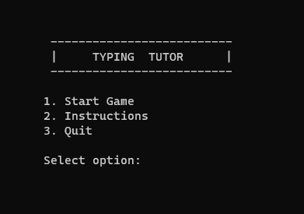
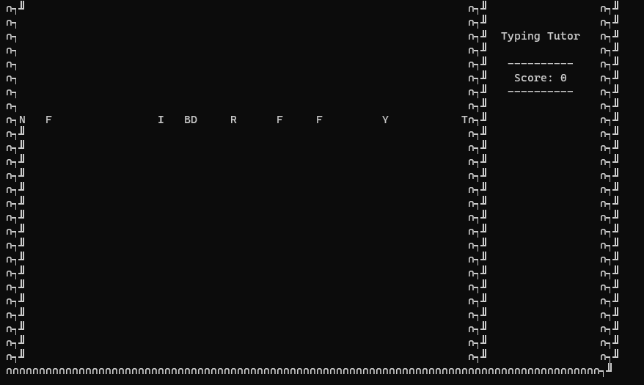
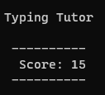
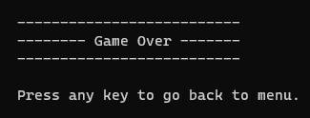
STARTING INTERFACE
IN-GAME INTERFACE
RESULT ANALYSIS
SCORE DISPLAY
END GAME

Slide 10
FUTURE SCOPE
It can be made with graphics in the future.
We can add multiplayer option so that it can be a competition game.
We can add more features like player profiles, score history.
According to player we can set the level.

Slide 11
REFERENCE & BIBLOGRAPHY
1) The Complete Reference C++ by Herbert Schild, 4th Edition.
2) Object Oriented Programming in C++ by Rajesh K. Shukla, Indian Edition.
3) Object Oriented Programming in C++ by E. Balaguru Swamy, 6th Edition.

Slide 12
THANK YOU…

