Slide 1

PRISM - Modular architecture

Slide 2
PRISM Composite Application Guidance
open source http://compositewpf.codeplex.com/
framework for composite applications
targets WPF, Silverlight, WP7
flexible
you can use just what you need
alternatives – Unity, MEF, other IoC
good support
well documented
active community
reference implementation

Slide 3
promotes best practices
layered architecture
design patterns : MVVM, IoC
modularity
application is a set of modules
a module provides services to other modules
a module use services provided by other modules
composite UI
regions – defines the layout
views injected into regions
loosely coupled components
services exposed as interfaces, separated implementation
components communicates using EventAggregator pattern

Slide 4
Benefits
Modules can be developed, tested and maintained independently
easy to involve separate teams/subteams
can focus on a specific area of the application
Prioritization
Features to be done later can be quickly mocked or hardcode
Versioning
Modules can evolve smoothly

Slide 5
Key Concepts
Bootstrapper
Shell
DI container
Modules
Regions
EventAggregator

Slide 6
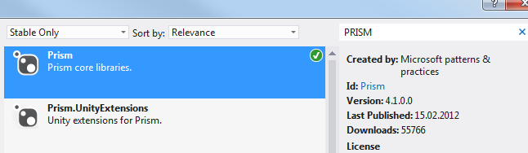
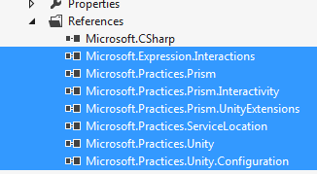
Add PRISM support
nuget – Prism + Prism.UnityExtensions

Slide 7
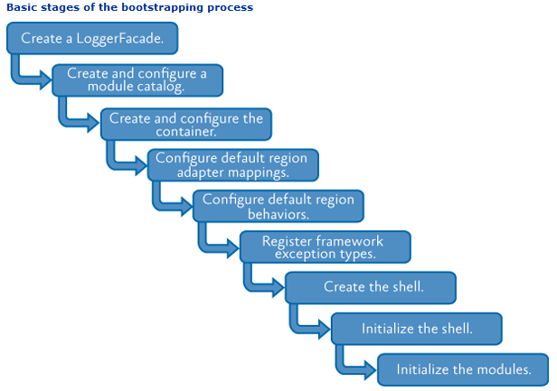
Initialize PRISM application
The Bootstrapper

Slide 8

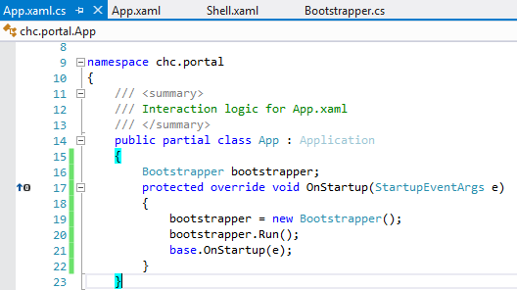
Create the Bootstrapper class
Instantiate and run the Bootstrapper on startup

Slide 9
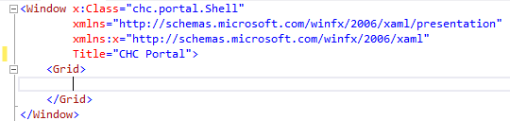
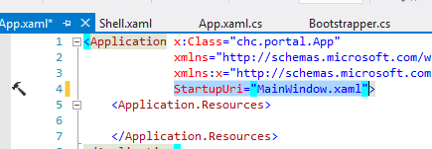
The Shell – main application window
Create the shell
Remove App.StartupUri, remove MainWindow

Slide 10
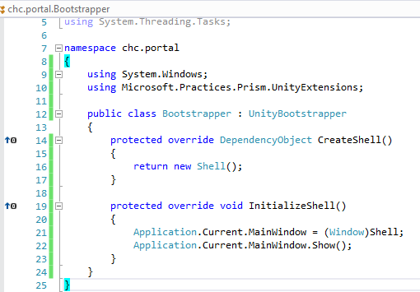
Let the bootstrapper create and initialize the Shell

Slide 11
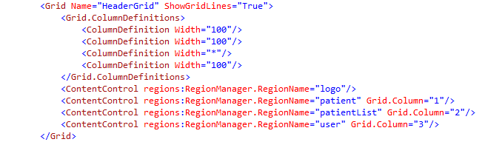
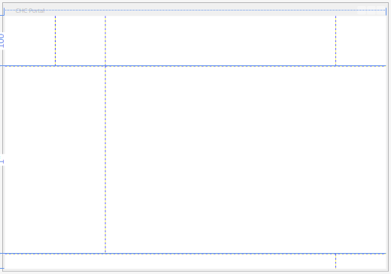
Define the Layout of the Shell using named regions

Slide 12

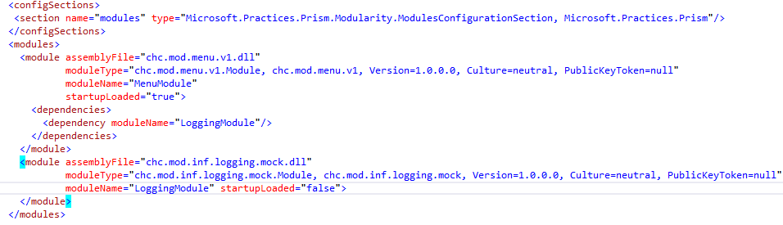
Create a ModuleCatalog in the bootstrapper
using config file
provide the module type , name, loading behavior
describe module dependencies

Slide 13
Register view in region
Consume a service from another module
EventAggregator

