Slide 1
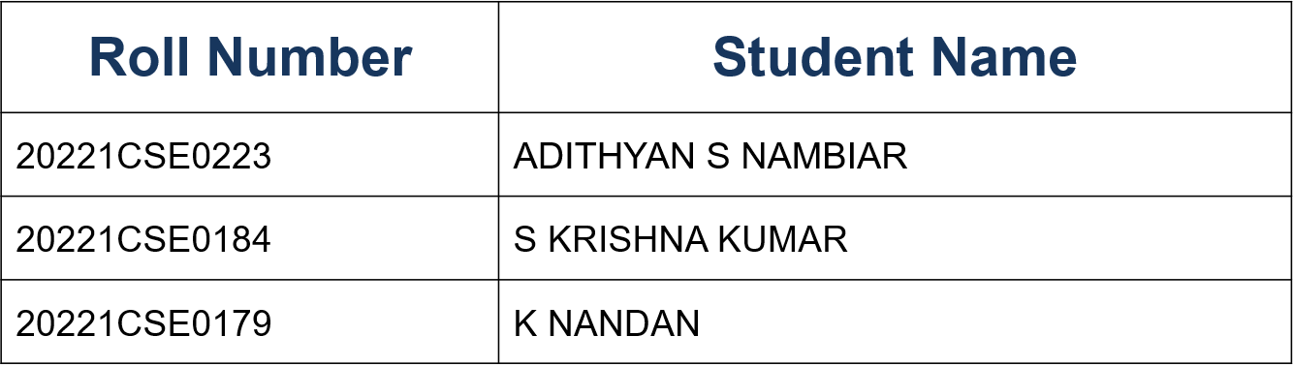
AI-ENHANCED CAREER GUIDANCE SYSTEM FOR PERSONALIZE CAREER PATHWAYS
CSE7101- Capstone Project
Review-2
Batch Number: CSE_188
Under the Supervision of,
Dr. RIYAZULLA RAHMAN J
Senior State Assistant Professor
School of Information Science and Engineering
Presidency University
Name of the Program: B. Tech
Name of the HoD: Dr. Asif Mohammed
Name of the Program Project Coordinator: Dr. Jayavadivel Ravi
Name of the School Project Coordinators: Dr. Sampath A K , Dr. Geetha A

Slide 2
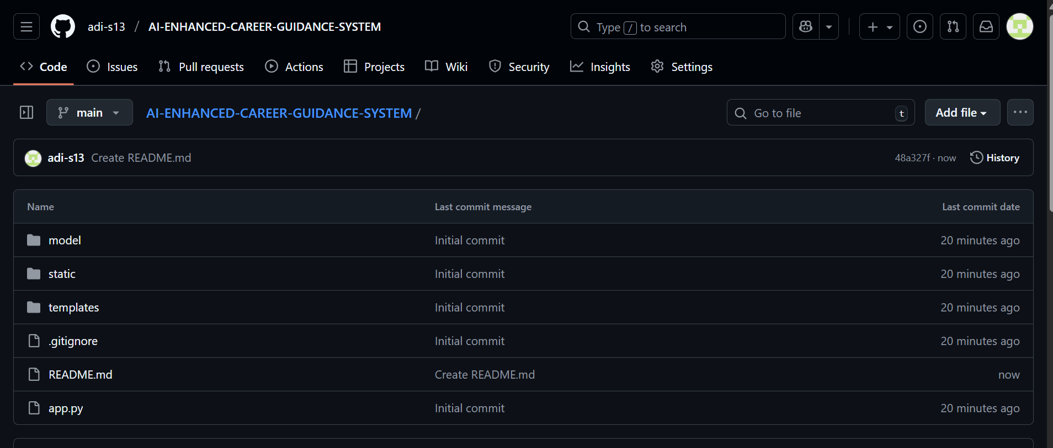
Github Link
Github Link:
https://github.com/adi-s13/AI-ENHANCED-CAREER-GUIDANCE-SYSTEM

Slide 3
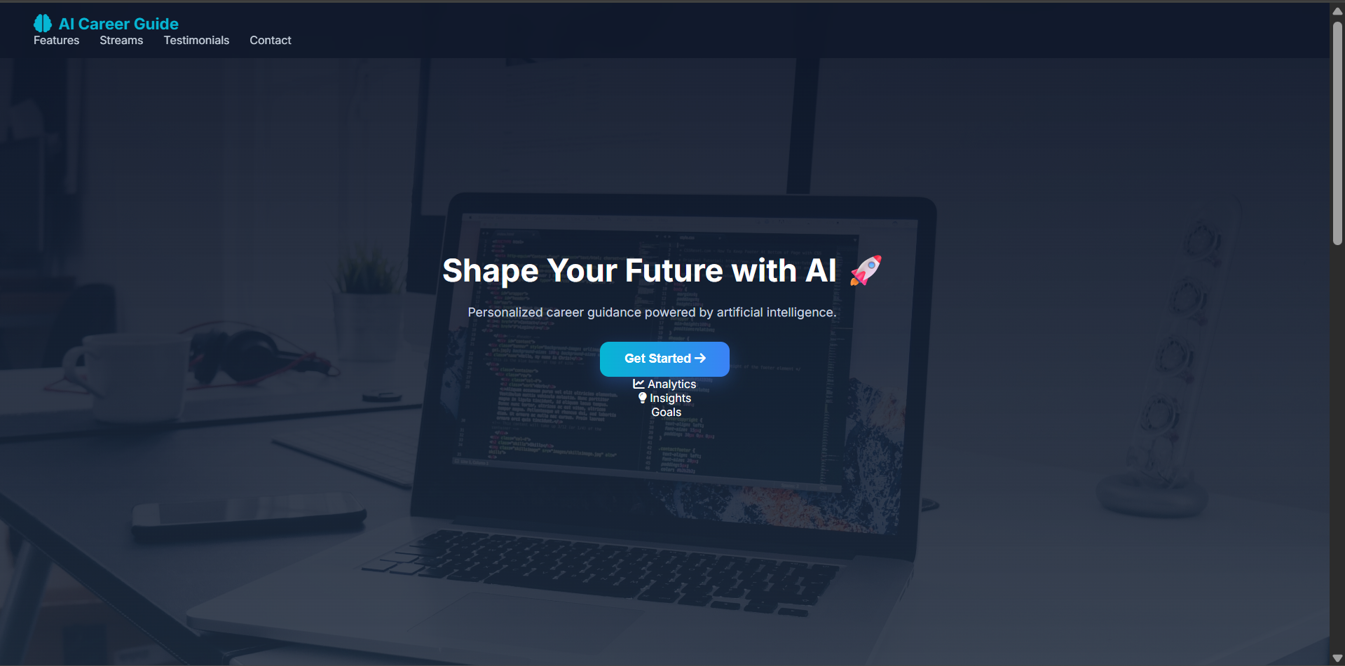

Slide 4
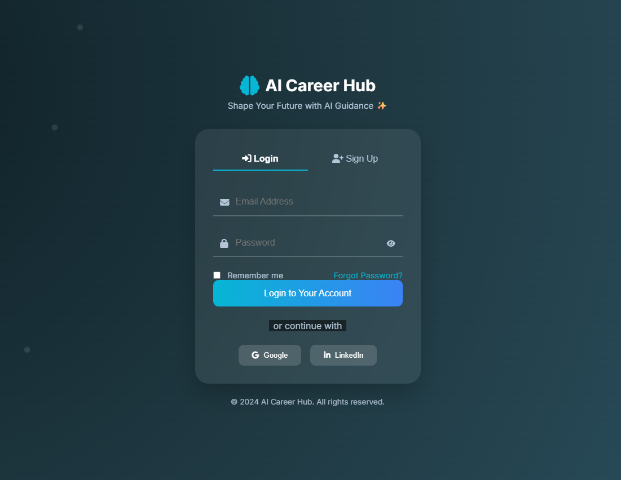
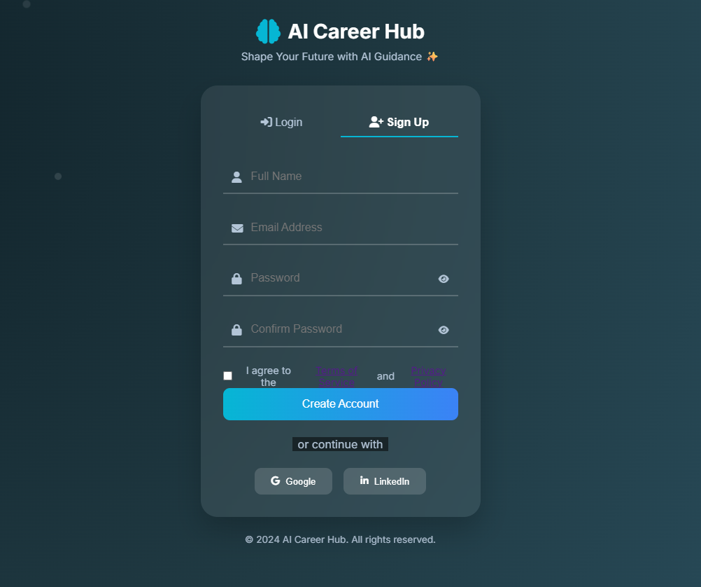

Slide 5
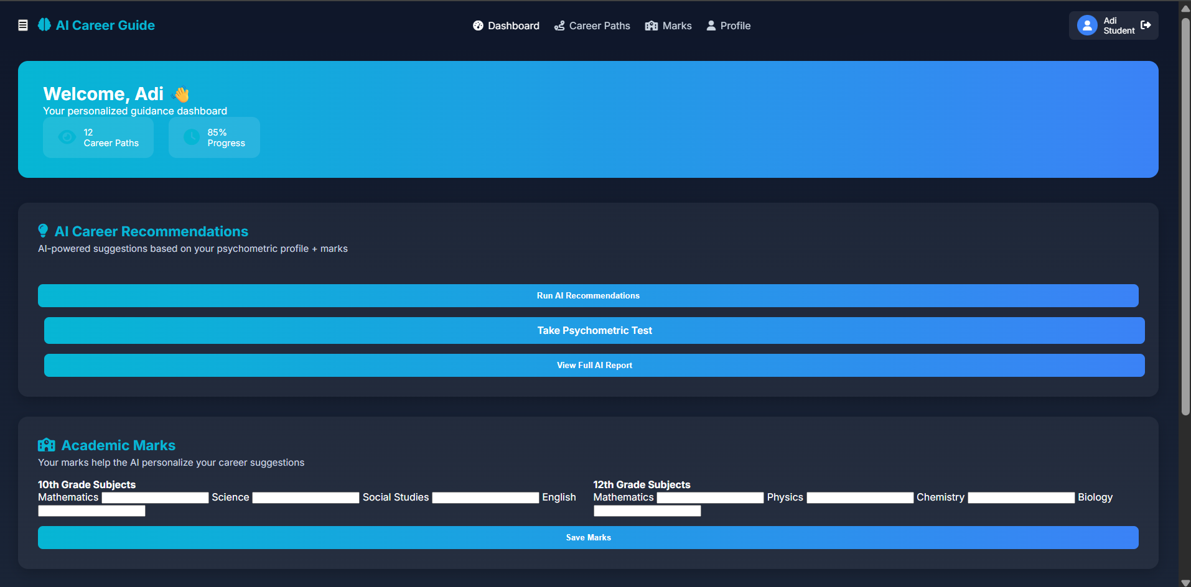
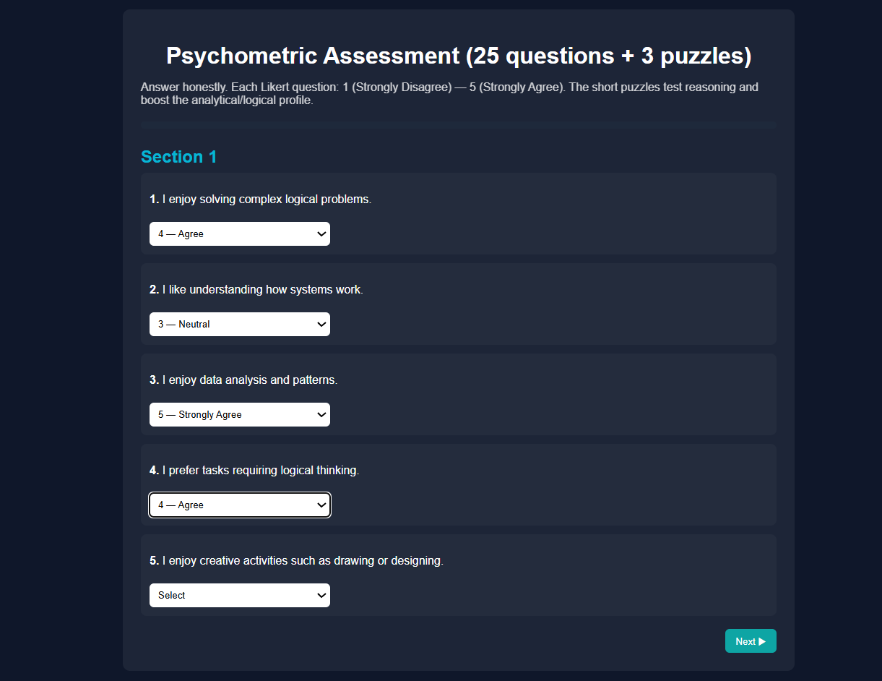

Slide 6
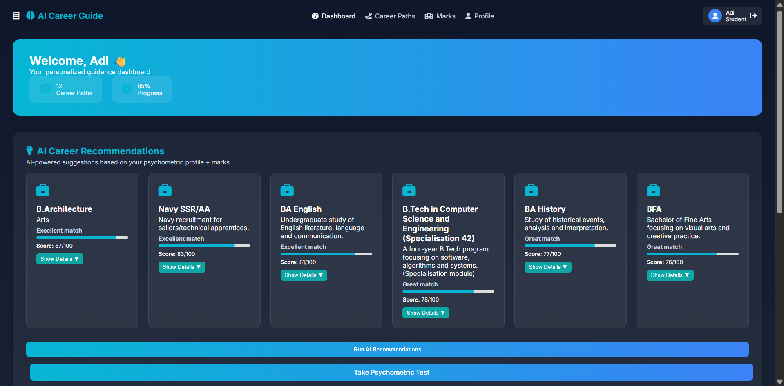

Slide 7
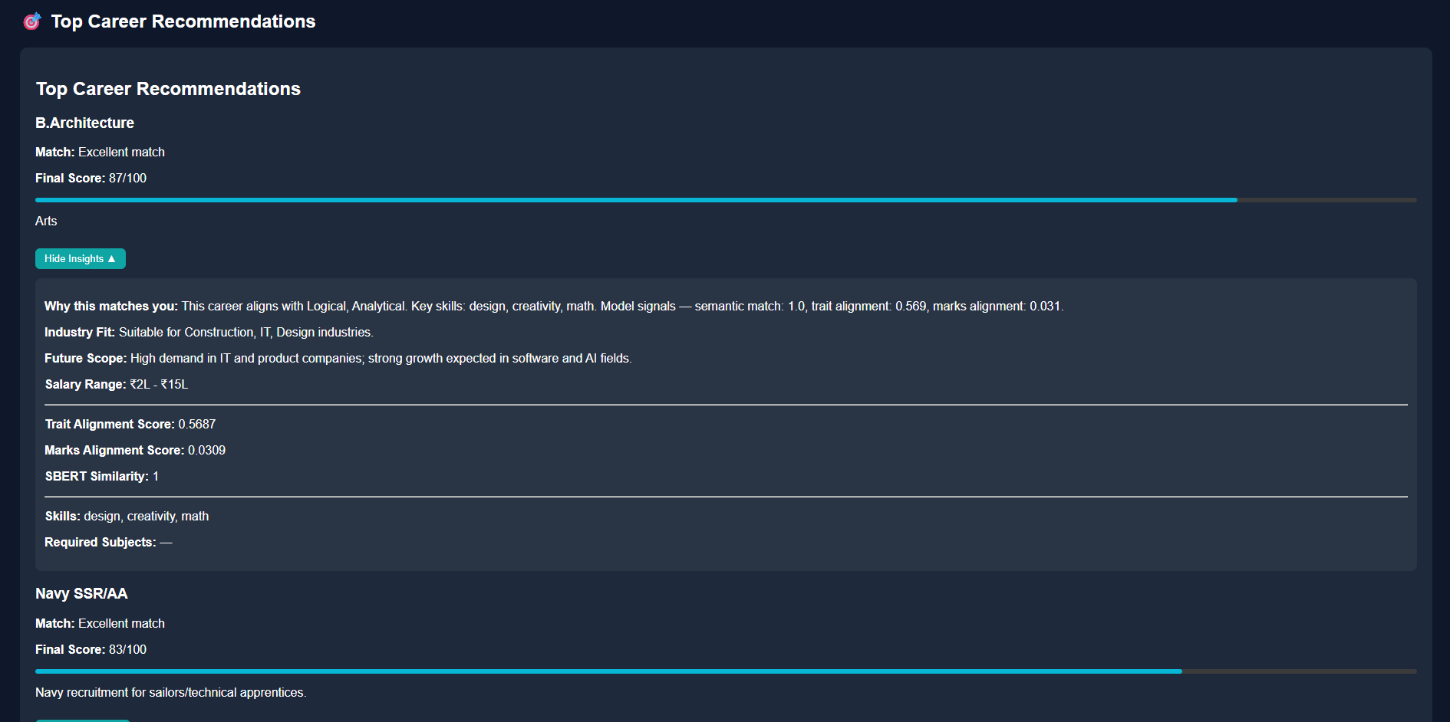

Slide 8
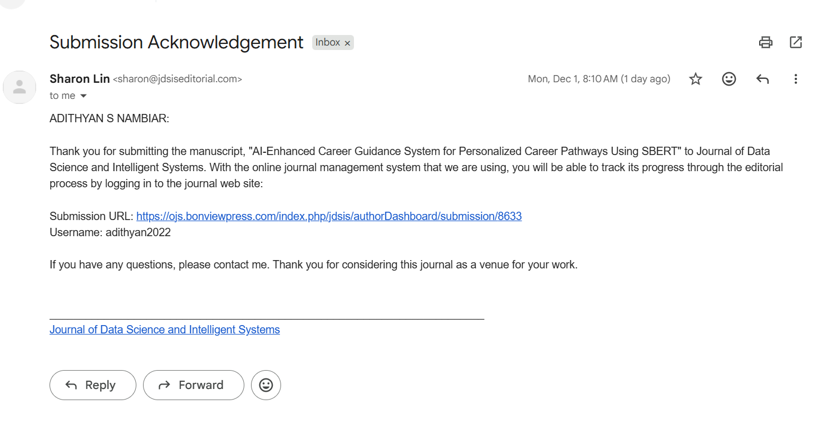

Slide 9
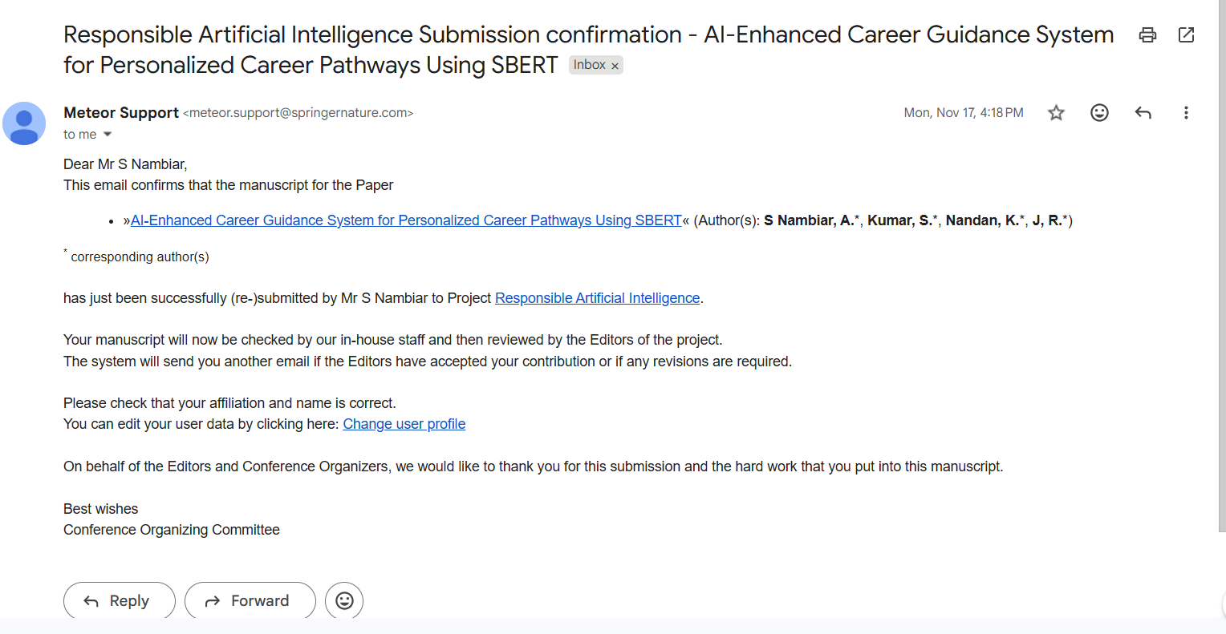

Slide 10
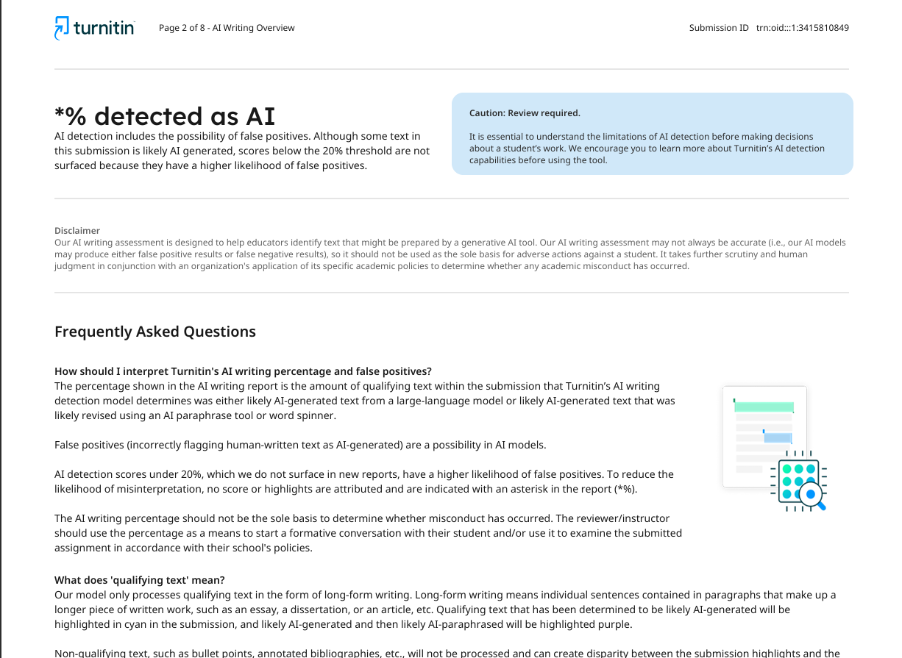

Slide 11
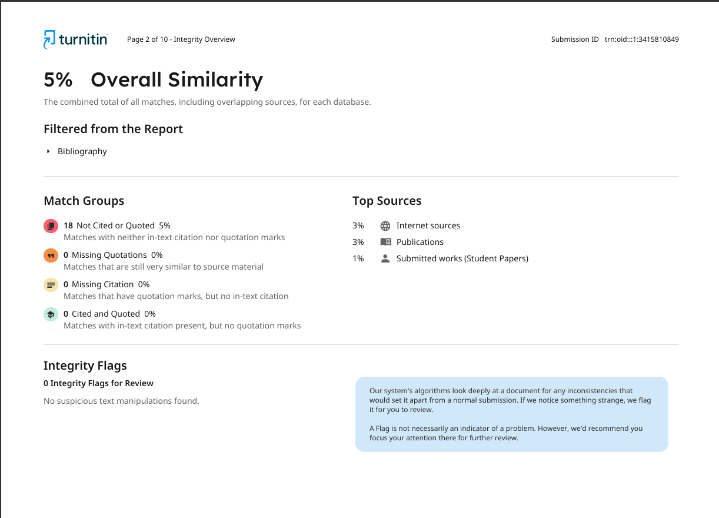

Slide 12
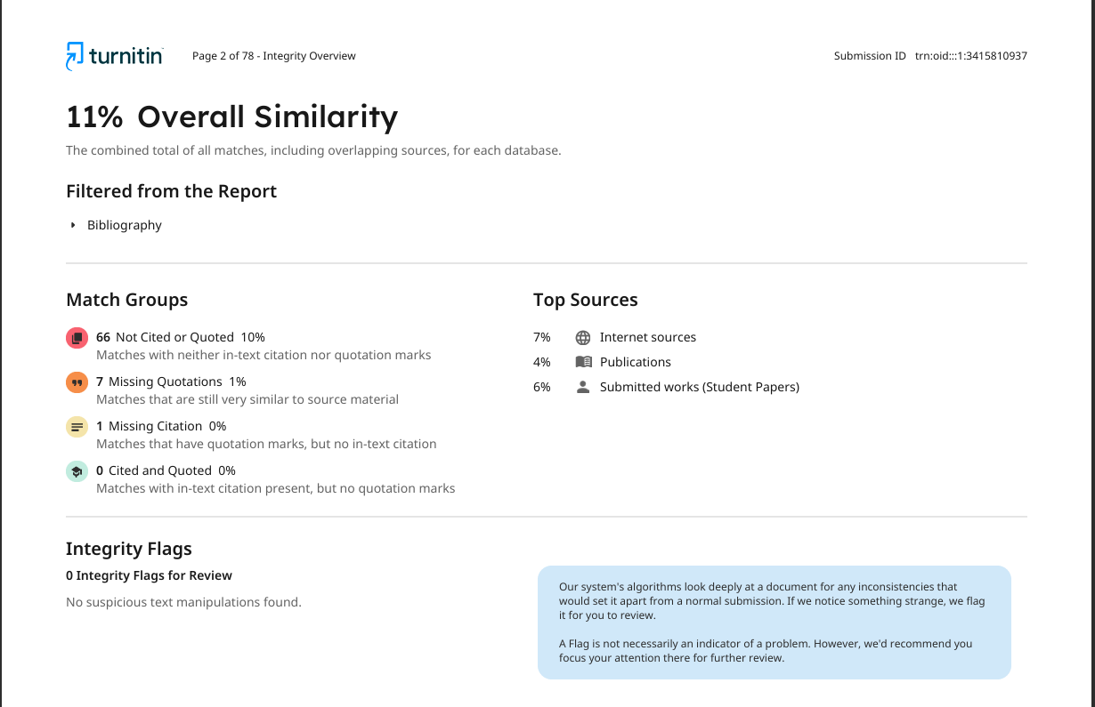

Slide 13


